Slide 1
CIS 110: Introduction to Computer Programming
Lecture 8
Hey (Objects), Listen!
(§ 3.2-3.3)

Slide 2
Outline
Review: what is a library?
The Math class
The String class
The Story Thus Far…

Slide 3
Announcements
Homework 3 due tonight (11:59:59).
Exam 1 on Wednesday.
  See website for locations (based on time + name).
  No homework or lab this week.
Changes to exam protocol:
  ID required to turn in exam.
  Abbreviations for System.out.print(ln):
    S.O.PLN and S.O.P
    All other code must be written out in full!

Slide 4
What is a Library?

Slide 5

Review: Libraries
Libraries are collections of classes that other people have written for us to use.
  Motivation: avoid reinventing the wheel!
  A particular strength of Java.
Example: the DrawingPanel class

Slide 6
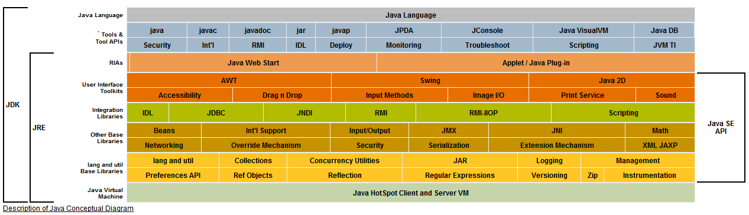
Learning a Programming Language
Need to learn two parts:
  Language: syntax, structure, etc.
  Libraries: commonly-used functionality.
Java's built-in library: the Java Class Libraries.

Slide 7
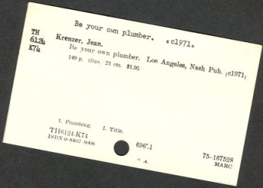
Learning a Programming Language
In reality, few people know the entire library.
  People know where to look stuff up when needed.
  In Java, this is the javadoc API documentation.
For now, we focus on two particular classes:
  The Math class.
  The String class.

Slide 8
The Math Class
Demo (MathExamples.java)

Slide 9
Math Example
Can we write a method that rounds a decimal to an integer?
  MyMath.round(3.75) → 4
  MyMath.round(3.25) → 3
public class MyMath {
public static int round(double d) {
return (int) (d + 0.5);
}
}

Slide 10
Calling Methods from Other Classes
Can't simply call sqrt from another class!
public class MathTest {
public static void main(String[] args) {
System.out.println(sqrt(3.75)); // Bad!
}
}
sqrt is out of scope in MathTest.

Slide 11
Dot Notation for Static Methods and Constants
Solution: clarify where sqrt comes from with dot notation.
  Syntax: <class name>.<method name>().
public class MathTest {
public static void main(String[] args) {
System.out.println(MyMath.sqrt(3.75));
}
}
Only works for static methods and constants.
  Not for local variables!

Slide 12
The Math class
Java already provides round in the Math class.
  Best to not reinvent the wheel!
public class MathTest {
public static void main(String[] args) {
System.out.println(Math.sqrt(3.75));
}
}

Slide 13
Math Methods and Constants Sampler
(See p. 150 for details)
Math.E
Math.PI
Math.abs(num)
Math.ceil(num)
Math.exp(num)
Math.floor(num)
Math.log(num)
Math.log10(num)
Math.max(num1, num2)
Math.min(num1, num2)
Math.pow(num1, num2)
Math.random()
Math.round(num)
Math.sin(num)
Math.sqrt(num)
Math.toDegrees(num)
Math.toRadians(num)

Slide 14
The String Class
Demo (StringExamples.java)

Slide 15
Recall: Objects Are Different From Primitives
DrawingPanel is an object!
  Different syntax for creation and method calls:
DrawingPanel p = new DrawingPanel(500, 500);
Graphics g = p.getGraphics();
Remember objects contain data and methods.
  e.g., DrawingPanel provides the getGraphics method.

Slide 16
Startling Fact: Strings Are Objects!
Strings try to act like primitives…
String msg = "hello world!"
…but they're really objects!
System.out.println(msg.length());
// Prints out 12 --- the length of msg!
What other methods does String provide?

Slide 17
Strings as sequence of characters
Each element of the string is a single char.
msg
'H'
'e'
'l'
'l'
'o'
' '
'W'
'o'
'r'
'l'
'd'
'!'
0
1
2
3
4
5
6
7
8
9
10
11
We refer to individual characters of a string by index.
The first index is 0.

Slide 18
Example: charAt(index)
System.out.println(msg.charAt(4));
// Prints out 'o' --- the char at index 4
msg
'H'
'e'
'l'
'l'
'o'
' '
'W'
'o'
'r'
'l'
'd'
'!'
0
1
2
3
4
5
6
7
8
9
10
11
msg.charAt(4) → 'o'

Slide 19
Example: substring(start, end)
System.out.println(msg.substring(3, 8));
// Prints out "lo Wo": the substring starting
// at index 3 and ending at index (8-1) = 7.
msg
'H'
'e'
'l'
'l'
'o'
' '
'W'
'o'
'r'
'l'
'd'
'!'
0
1
2
3
4
5
6
7
8
9
10
11
msg.substring(3, 8) →
"lo Wo"

Slide 20
Runtime Errors From Bad Arguments
System.out.println(msg.charAt(12));
// Raises an exception since 12 is not valid!
msg
'H'
'e'
'l'
'l'
'o'
' '
'W'
'o'
'r'
'l'
'd'
'!'
0
1
2
3
4
5
6
7
8
9
10
11

Slide 21
Strings Are Immutable
String msg = "Hello World!";
msg.toUpperCase();
System.out.println(msg); // Prints Hello World!
String are immutable!
  Methods calls on a String do not change that String.
  Instead, methods return new Strings that are the result of the operation.
String msg = "Hello World!";
msg = msg.toUpperCase();
System.out.println(msg); // Prints HELLO WORLD!

Slide 22
String Methods Sampler
(See p. 162 for details)
charAt(index)
endsWith(text)
indexOf(text)
length()
startsWith(text)
substring(start, stop)
toLowerCase()
toUpperCase()

Slide 23
And The Story Thus Far…

Slide 24
Why Are We Here?
Learning about algorithmic thinking via computer programming!
  Precision
  Decomposition
  Abstraction
Mental Model of Computation
Static methods
For loops
Class Constants
Parameters
Return values

Slide 25
Syntax: Declarations
// Class declarations
public class <name> {
<methods>
}
// Method declaration
public static <type> <name>(<params>) {
<statements>
}

Slide 26
Syntax: Statements
// Static method call
<name>(<params>);
// Static method call (another class)
<class>.<name>(<params>);
// Method call on an object // For loop
<object>.<name>(<params>); for (<init>; <test>; <update>) {
<statements>
// Variable declaration }
<type> <name> = <expr>
// Variable assignment
<name> = <expr>
<name> += <expr>
<name++>

Slide 27
Syntax: Expressions
// All method calls if they return values (from previous slide)
// Variable use
<name>
// Literals
0 0.0 'c' "hello!"
// Operators (+, -, *, /, %)
<expr> + <expr>

Slide 28
Decomposition: Break A Problem Into Sub-problems
“Draw 5 rows each containing 5 stars”
for (int i = 0; i < 5; i++) {
printStars();
Draw a new line
}
for (int i = 0; i < 5; i++) {
printStars();
System.out.println();
}
public static void printStars() {
for (int i = 0; i < 5; i++) {
System.out.print("*");
}
}
// …
for (int i = 0; i < 5; i++) {
printStars();
System.out.println();
}
for (Each of 5 rows) {
Draw 5 stars.
}

Slide 29
Generalization: Make a Piece of Code Handle More Cases
public static void printStars(int n) {
for (int i = 0; i < 5; i++) {
System.out.print("*");
}
}
public static void printGrid(int n) {
for (int i = 0; i < n; i++) {
printStars(n);
System.out.println();
}
}
public static void printStars() {
for (int i = 0; i < 5; i++) {
System.out.print("*");
}
}
// …
for (int i = 0; i < 5; i++) {
printStars();
System.out.println();
}

