Slide 1
CIS 110: Introduction to Computer Programming
Lecture 7
Actual Graphics, Wow!
(§ 3G)

Slide 2
Outline
Introduction to using objects
Our first object: the DrawingPanel
Drawing with the Graphics class
Applying what we know to 2D graphics

Slide 3
Announcements
Homework 3 is out, due on Monday.
Exam 1 review session.
TUESDAY 6-8 PM … somewhere on campus
Homework 1 grade breakdowns should be given out in section or via email soon.

Slide 4
Using Objects

Slide 5
What Is An Object?
A user-defined programming entity that contains state (data) and behavior (methods).
Classes are blueprints for objects.
A Java program is a "collection of interacting objects" (similar to our static method calls).
Blue, what's 2 + 2?
Nope, I'm helping Aqua first!
4!
Purple, can you print this for me?
Yup!

Slide 6
Using Objects
Creating classes/objects influences how we organize our code.
Unimportant in terms of fundamentals.
However, using objects is fundamental to programming in Java.
Our focus for this lecture (and the next).

Slide 7
Primitive Data versus Objects
Primitive Types
Class Types (objects)
int, char, double, float, boolean, …
(String), DrawingPanel, Graphics, …
Java has different rules with how we handle data of primitive type versus class type.
Worthwhile fact to keep in the back of your mind.

Slide 8
The DrawingPanel
Demo (see Drawings.java)

Slide 9
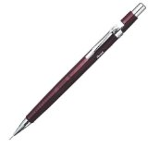
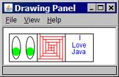
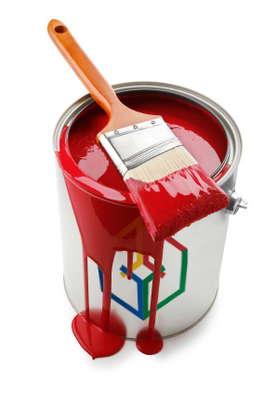
How Do All These Objects Relate?
DrawingPanel
Graphics
Color

