Slide 1
CIS 110: Introduction to Computer Programming
Lecture 1
An introduction of an introduction
(§ 1.1 – 1.3)*
*(no, you shouldn’t have read those yet =P)

Slide 2
Outline
What is computer science and computer programming?
Introductions and logistics
The anatomy of a Java program

Slide 3
What is computer programming?
What is computer science?
(By demonstration!)

Slide 4
What is Computer Science?
“Computer programming is not computer science”
  Programming languages
  Software engineering
  Artificial intelligence/machine learning
  Graphics
  Computer architecture
  Compilers
  Embedded and real-time systems
  Formal methods
  Theory of computation
  Computer security and privacy
  Databases and data management
  Operating systems and networking
  Mobile, distributed, and ubiquitous systems
  Computational biology
  Algorithms and complexity analysis
  Human-computer interaction
What unifies all these crazy, different things?

Slide 5
Algorithmic Thinking
Algorithm: a step-by-step procedure to solve a problem
Algorithmic thinking: a structured approach to problem solving
It represents a universally applicable attitude and skill set everyone, not just computer scientists, would be eager to learn and use.
- Jeannette M. Wing (CMU professor)

Slide 6
The Three Skills of Algorithmic Thinking
Precision
  “Accurately and completely describe how to solve a problem”
Decomposition
  “Break up a big problem into smaller ones.”
Abstraction
  “Recognize that several problems are the same.”

Slide 7
How are CS and Programming Related?
It has often been said that a person does not really understand something until after teaching it to someone else. Actually a person does not really understand something until after teaching it to a computer, i.e., expressing it as an algorithm.
- Donald Knuth

Slide 8
What is Computer Programming?
Two things for our purposes:
  A way to practice algorithmic thinking skills in a concrete way
  A practical skill you can use in your own job
While computer programming is not computer science, programming allows us to exercise the core skills that all computer scientists possess. Also, sharpening our algorithmic thinking makes us better programmers!

Slide 9
Logistics

Slide 10

About me
My name: Peter-Michael Osera.
  Call me whatever you want, e.g.,
Peter
Pete
Michael
Mike
Mikey
PM
Pete-Moss
(Lots more, many inappropriate)
I am a
  4th year Ph.D. student (not a professor).
  Programming languages researcher.
  Former program manager @ Microsoft (VC++ compiler).
  Die-hard supporter of e-sports and pro-gaming.

Slide 11
CIS 110: the Highlights
2 lecture offerings (11-12 and 1-2)
Required lab section (10% of your grade)
Required textbook: Building Java Programs: A Back to Basics Approach, Reges and Stepp
Piazza message board system
No curve, slide if necessary
Late day policy (4 late days)
2 exams, 1 final
See the syllabus for more details

Slide 12
CIS 110 vs. CIS 120
CIS 110 and 120 = the CS intro sequence.
  Both emphasize algorithmic thinking via programming.
CIS 110:
  Assumes no prior programming experience.
  Focuses on control issues in programming.
  Uses the Java programming language.
CIS 120:
  Assumes prior programming experience.
  Focuses on data representation issues in programming.
  Initially uses OCaml then goes back to Java.
To swap classes, please speak to your instructor.

Slide 13
Computer Programming

Slide 14


What is a Computer Program?
Imagine that we need to tell our best friend to do something, but he doesn’t speak our language.
????
PUT THE JELLY ON THE BREAD THEN PUT IT ALL IN YOUR MOUTH

Slide 15
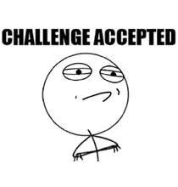
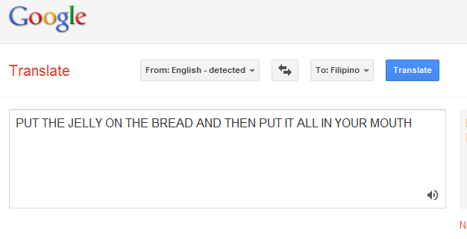
Translation
We can translate our instructions so that our best friend understands them.
PUT THE JELLY ON THE BREAD AND THEN PUT IT ALL IN YOUR MOUTH
Ilagay ang halaya SA tinapay AT pagkatapos ay ilagay ito LAHAT SA INYONG bibig

Slide 16
The analogy revealed
You (the programmer)
The compiler
The computer
(your new best friend)
PUT THE JELLY ON THE BREAD AND THEN PUT IT ALL IN YOUR MOUTH
Ilagay ang halaya SA tinapay AT pagkatapos ay ilagay ito LAHAT SA INYONG bibig
The computer program
Machine code

Slide 17
Programming Languages
Natural languages (e.g., English) are
  Ambiguous.
  Overly general.
  Difficult to translate (in fact, a big research field!).
Solution: create specialized programming languages that are good at specifying instructions to computers.
Examples: Ada, Algol, BASIC, C, C++, C#, CLOS, D, Eiffel, Fortran, F#, Haskell, and so many more!

Slide 18

The Java Programming Language
Created in 1990 by Sun Microsystems
  Alternative to C/C++
Object-oriented language
  “(Almost) Everything is an object”
Platform independent
  Java programs run on Windows, Mac, or Linux
Most popular language out there
  See the TIOBE programming index

Slide 19
Our first computer program.
(jGRASP demonstration)

Slide 20
Our First Computer Program
public class HelloWorld {
public static void main(String[] args) {
System.out.println(“Hello World”!);
}
}

Slide 21

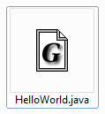

The Compilation Pipeline
(In jGRASP)
[Step 2: compile the source code]
[Step 1: write source code]
(Output: Java bytecodes)

Slide 22

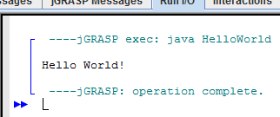

Running your compiled program
Step 3: tell the computer to run your program
(In jGRASP)

Slide 23
The structure of a Java Program
A class named HelloWorld.
For now, classes are containers for our programs.
public class HelloWorld {
public static void main(String[] args) {
System.out.println(“Hello World”!);
}
}
A method named main.
main is a special method because this is where the program begins execution.
A statement that prints “Hello World” to the console.
Statements are commands to be executed by your program.

Slide 24
Syntax, syntax, syntax
Syntax: the rules to form legal programs
Class template
public class <name> {
<method>
<method>
…
<method>
}
Method template
public static void <name>(…) {
<statement> ;
…
<statement> ;
}

Slide 25
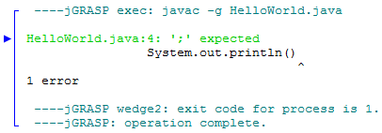
Syntax errors
Syntax errors occur when you violate a syntax rule.
1 public class HelloWorld {
2 public static void main(String[] args) {
3 System.out.println("Hello World!");
4 System.out.println()
5 System.out.println("I like pie");
6 System.out.println("I like pie a lot");
7 }
8 }
Line numbers. Not part of the program.
Need to fix syntax errors before your program can be compiled!

Slide 26
Naming and Identifiers
In Java, names have several restrictions.
  Must not be a reserved keyword (e.g., public, class).
    Many others, see page 20 of the text for the complete list.
  Must start with a letter, _ (underscore), or $.
  Otherwise can contain, letters, numbers, _, or $.
  E.g., HelloWorld42 is valid, 12HelloWorld is not.
Java is a case-sensitive language.
  E.g., main and Main are different names.
The name of a class must match its containing Java file
  E.g., the HelloWorld class is found in HelloWorld.java

Slide 27
System.out.println
Prints to the screen or console.
  How to pronounce it: print-lin
Two uses:
  System.out.println(“msg”) prints msg to the screen along with a newline.
  System.out.println() prints a newline.

Slide 28
Strings
A string is a piece of data that represents text.
  E.g., to be println’ed to the console.
Syntax: “text goes here”
  Text surrounded by quotes.
Restrictions:
  Cannot span over multiple lines
    “this is a
    syntax error!”
  Cannot contain a quotation mark
    “when does this string begin” and end?”

Slide 29
Escape sequences
Escape sequences allow us to write special characters in strings.
  Quotation mark: \”
  Tab character: \t
  Newline character: \n
  Backslash: \\
Ex: System.out.println(“\\\\\”\”\”\”\\”);
  prints \\””””\ to the console!

