Slide 1
CIT 590
Intro to Programming
Last lecture on Python

Slide 2
Logistics
Please figure out which room your midterm will be in.
TAs will administer the midterm
Midterm will be 1hr 25 mins long.
No cheat sheets etc

Slide 3
How code is written (agile paradigm)
PM comes with specs
Make me a solitaire game
Dev team sits and writes ‘user stories’
A user should be able to get a card from the deck
A user should be able to move cards around
Each move should be checked for ‘legality’
User story split up into tasks
Now we start talking data structures/representation etc
Maybe the tableau is a list of lists? Maybe the tableau is a dictionary
top-down design
Each dev looks at the list of functions they have to write
Make a decision about which functionalities go together = class

Slide 4
How code is written (agile paradigm)
Start writing stubs with something like raise NotImplementedError, return “TODO”
Write unit tests for the simplest of those methods
Watch unit test fail
Write code to make unit test pass
Repeat unit testing process
Talk to other devs about the classes they are writing
Stand up meeting every morning
Hook the classes up together
Write tests that test the integration - sometimes these tests are no longer in our unit test form. Front end tests, regression test suite, manual tests

Slide 5
The power of Python libraries
Most anything in Python has already been implemented in some manner
import …..
import antigravity
On a more serious note we will talk a bit about 3 packages – numPy, sciPy, beautifulSoup

Slide 6
How to install packages
Supposedly easier on mac/linux machine
http://www.lfd.uci.edu/~gohlke/pythonlibs/ - only windows
http://sourceforge.net/projects/scipy/?source=dlp
Install pip
http://en.wikipedia.org/wiki/Pip_(package_manager)
http://stackoverflow.com/questions/4750806/how-to-install-pip-on-windows
Once you have pip installed a lot of packages can be installed by just simply typing
pip install some-package-name

Slide 7
Numpy and Scipy
Matlab/R?
Once you import numpy and scipy, Python can be used to math computations just as easily as matlab/R
You now get access to a bunch of numerical methods
numpydemo.py has some really basic stuff
http://wiki.scipy.org/Numpy_Example_List
>>> import numpy as np
>>> a = np.array([[3,1], [1,2]])
>>> b = np.array([9,8])
>>> solution = np.linalg.solve(a, b)

Slide 8
Beautiful soup
Real cool module for scraping data from the web
It basically does parsing of the html and also allows for CSS selectors to be used

Slide 9
What do I do next with Python?
If you are interesting in understanding linguistics from a CS perspective
http://www.cis.upenn.edu/~cis530/ (computational linguistics)
Data science
http://www.meetup.com/DataPhilly/
Use it in a hackathon!
Get good at it and work at Youtube (umm Google)

Slide 10
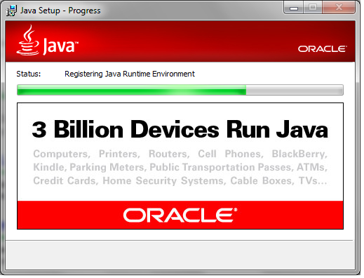
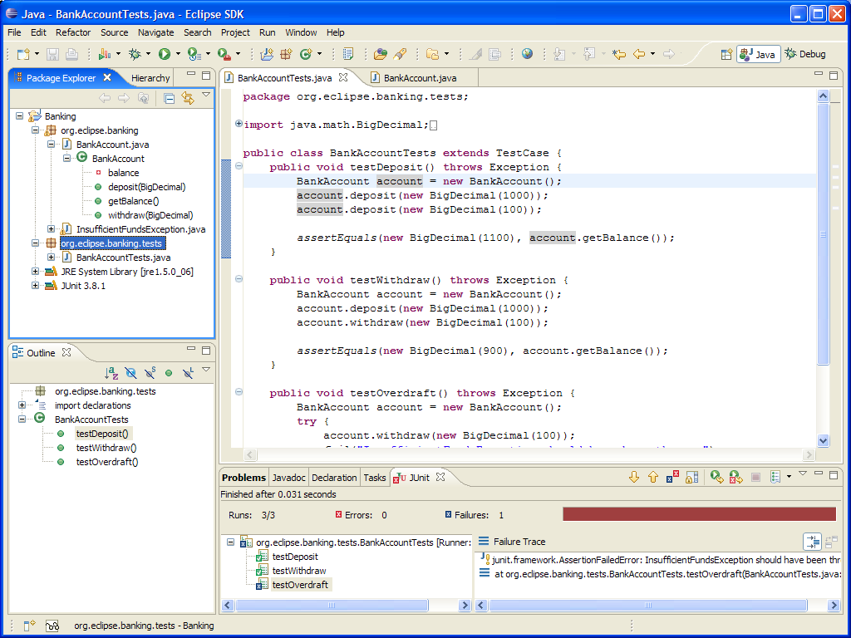
Post midterm

