Slide 1
CIT 590
Debugging

Slide 2
Find a laptop
Please take a moment to open up your laptop and open up Eclipse.
If you do not have a laptop, please find a friend.
If you do not have a friend please make one today.
else … nap time!!

Slide 3
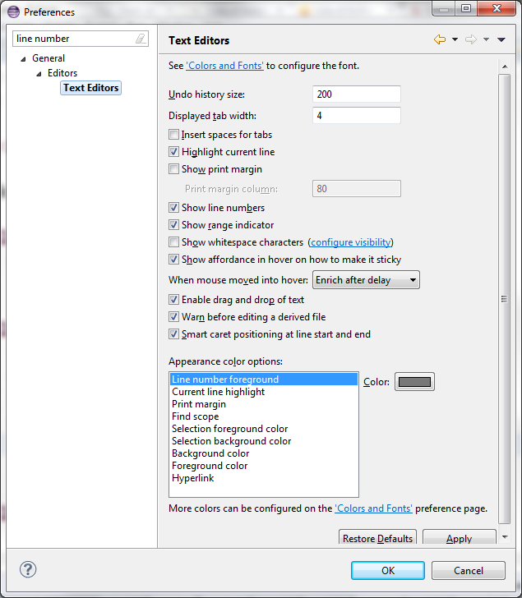

Slide 4
Debugging
Debugging is a skill that you will use regardless of which programming language you come across
Almost all IDEs(Integrated Developer Environment) will have a debugger
The concepts of Step over, Step into, Continue stay exactly the same.

Slide 5
Step into, Step over, Resume
Breakpoint – Add a breakpoint by double clicking the margin until a blue dot appears
When the debugger hits the breakpoint you can
Step over – execute this line and go to the next line of code
Step into – go into the methods that are being called in this line
Step return – if you go into a function and you want to get out of it and go back to where you came from.
Resume – resume execution of the program. It will run until completion or run until it hits the next breakpoint.

Slide 6
Reading that stack trace
The error message that java throws at you is called a stack trace
Stack??
Function calls are being stored on a stack
Last in, first out
So the error was hit at the first location.
But who called that function?
Go read the next line
In Eclipse, just click on the ‘link’ and it will take you to the line number

Slide 7
Example
Download the Polynomial project from Dropbox.
Try not to read the code outside of Polynomial.java right now
Run Polynomial.java and watch it crash!!!!
Imagine you are a new employee in a software firm and you are trying to understand their codebase.
Step 1
You should hit an actual error
Java gives you a stack trace.
Read stack trace
Click right link
Get to the line number
Fix

Slide 8
Example
Step 2
Put a breakpoint
Run in debug mode. F11 on most systems
It will stop at a break point
You can do so many things from that point.
Mouse over a variable. You will get the value
You also have a Variables display
In the variables section (the icon is x=)
Window->Show View -> Display
The Display window is one of the coolest features for debugging
You can write code there and execute it
If you liked IDLE’s ability to run short pieces of code, this is similar
Fix the error

