Slide 1
CIT 590
Intro to Programming
Last lecture on Python

Slide 2
Logistics
Review session this Friday in both lab sessions
  Come with questions
Midterm on Monday
I am out of town for a conference Tues eve - Friday
Midterms handed out and midterm discussion on Wednesday
  Session led by TA(s)
Setting up Eclipse.
  Have to make sure you can run HelloWorld.java before you leave for spring break ☺

Slide 3
Agenda
Wrap up Python
A really brief insight into development of software
Copy versus deepcopy
Show you the power of Python modules (NOT PART OF MIDTERM)

Slide 4
More unit testing
How do I write a test without having written any code?
Best practice in industry is to write the method signature and say
  raise NotImplementedError
modular programming = testable code
Writing unit tests is actually almost like writing code.
  Write comments
  Write helper functions
Sometimes the unit test file is bigger than the code file
Do not hesitate to have a bunch of test cases
If a test fails, it should be fairly obvious which function I need to go fix

Slide 5
How code is written (agile paradigm)
PM comes with specs
  Make me a solitaire game
Dev team sits and writes ‘user stories’
  A user should be able to get a card from the deck
  A user should be able to move cards around
  Each move should be checked for ‘legality’
User story split up into tasks
  Now we start talking data structures/representation etc
  Maybe the tableau is a list of lists? Maybe the tableau is a dictionary
  top-down design
Each dev looks at the list of functions they have to write
Make a decision about which functionalities go together = class

Slide 6
How code is written (agile paradigm)
  Start writing stubs with something like raise NotImplementedError, return “TODO”
  Write unit tests for the simplest of those methods
  Watch unit test fail
  Write code to make unit test pass
  Repeat unit testing process
  Talk to other devs about the classes they are writing
    Stand up meeting every morning
  Hook the classes up together
  Write tests that test the integration - sometimes these tests are no longer in our unit test form. Front end tests, regression test suite, manual tests

Slide 7
Clarifications for Solitaire
Make one Solitaire class
That class should not inherit from Card or Deck
Solitaire is not a Deck. Also Solitaire is not a Card
This assignment is not an example of inheritance. More an example of what is called composition
You should feel free to add more methods to Deck or Card if it makes sense
Example of a bad method to put into Card
  def checkLegalMove(self, other)
Example of a good method to put into Card (if you want)
  def has_same_suit(self, other)

Slide 8
Copy versus deepCopy
import copy
lst = [[1,2,3], [4,5,6], [7,8,9]]
lst1 = copy.copy(lst)
lst2 = copy.deepcopy(lst)
lst.append([5])
lst[0].append(6)
Copy only makes a ‘copy’ at the outermost level.
Basically whenever you have list of lists or dictionaries that have lists inside them, you probably want deepCopy.

Slide 9
LoudCrowd time

Slide 10
lst = [1, 2, 3 , 4]
dct = {‘a’ : 1, ‘b’ : 2, ‘c’ : 3, ‘d’ : 4}
What is the end result of the following lines of code?
vals = dct.values()
vals.sort()
S = lst + vals
X = sum(S)
What is the value of X?

Slide 11
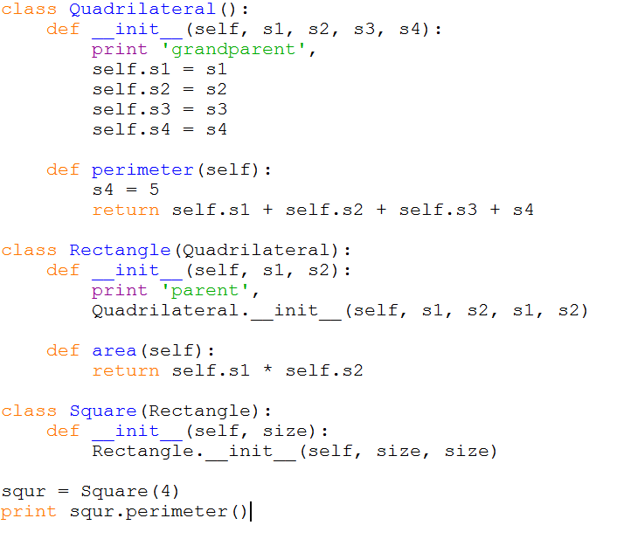
a) grandparent parent 16 b) parent grandparent 16
c) parent grandparent 17 d) error e) grandparent parent 17

Slide 12
reduce(lambda x,y: x%2 + y%2,map(lambda x: x + 3 , 5/2 * [1,2,3]))

Slide 13
The power of Python libraries
Most anything in Python has already been implemented in some manner
import …..
import antigravity
On a more serious note we will talk a bit about 3 packages – numPy, sciPy, beautifulSoup

Slide 14
How to install packages
Supposedly easier on mac/linux machine
http://www.lfd.uci.edu/~gohlke/pythonlibs/ - only windows
http://sourceforge.net/projects/scipy/?source=dlp
Install pip
  http://en.wikipedia.org/wiki/Pip_(package_manager)
  http://stackoverflow.com/questions/4750806/how-to-install-pip-on-windows
  Once you have pip installed a lot of packages can be installed by just simply typing
    pip install some-package-name

Slide 15
Numpy and Scipy
Matlab/R?
Once you import numpy and scipy, Python can be used to math computations just as easily as matlab/R
You now get access to a bunch of numerical methods
numpydemo.py has some really basic stuff
http://wiki.scipy.org/Numpy_Example_List
>>> import numpy as np
>>> a = np.array([[3,1], [1,2]])
>>> b = np.array([9,8])
>>> solution = np.linalg.solve(a, b)

Slide 16
Beautiful soup
Real cool module for scraping data from the web
It basically does parsing of the html and also allows for CSS selectors to be used

Slide 17
What do I do next with Python?
If you are interesting in understanding linguistics from a CS perspective
  http://www.cis.upenn.edu/~cis530/ (computational linguistics)
Data science
  http://www.meetup.com/DataPhilly/
Use it in a hackathon!
Get good at it and work at Youtube (umm Google)

Slide 18
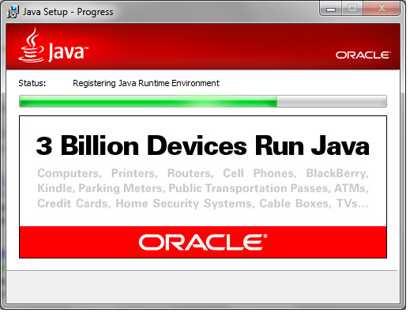
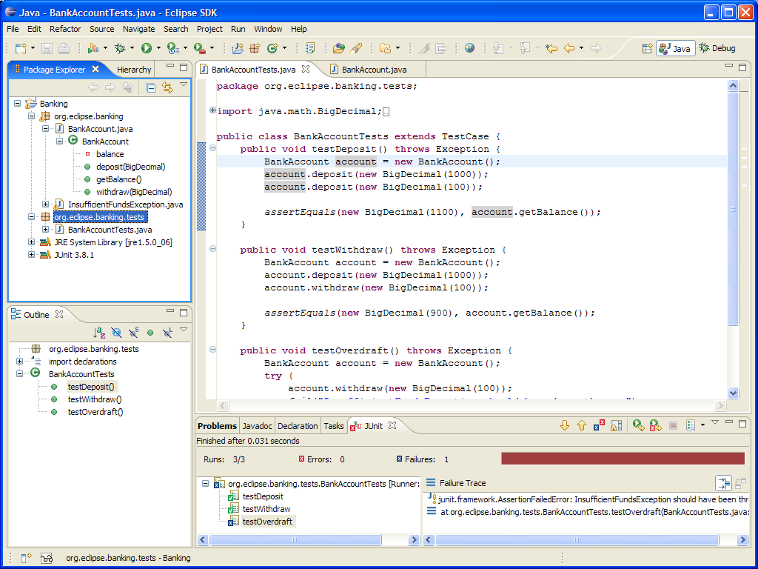
Post midterm

