Slide 1
CIT 590
Swing/GUI in Java

Slide 2
Examples in the repository
https://github.com/abhusnurmath/rando/tree/master/cit590Examples/Java/GUI
Will make a commit at the end of the class
UI is more an art than a science …

Slide 3
How to create a GUI
Create a window in which to display things—usually a JFrame (for an application),
Use the setLayout(LayoutManager manager) method to specify a layout manager
Throw some components in.
Create some listeners and attach them to your components.
When you do something to a component, an event is generated which is ‘listened’ to. When the listener ‘hears’ the event, it executes code to deal with it
Display your window.

Slide 4
OMG so many packages to import …
CTRL + SHIFT + O = magic!
That keyboard shortcut will import all that is needed.
If you are curious….
Javax.swing.*
Java.awt.*
Java.awt.event.*
Javax.swing.event.*
And others ….
I always use CTRL + SHIFT +O
If it doesn’t work (rare but can happen), I google and find out what I need to import.

Slide 5
Eclipse nugget
Eclipse can autosuggest a whole bunch of things.
Type main and hit CTRL + Space
Type for and hit CTRL + Space
Sometimes the suggestions will need to be appropriately modified but at least you will never get silly syntax errors.
Summary – when in doubt, hit CTRL + Space

Slide 6
Reading assignment
Some of the notes in this lecture on GUI will use anonymous classes (specific example of inner classes)
Please read the ‘inner classes’ slides yourself
I am a slower teacher than Dr Dave …

Slide 7
Layouts for your container
The most important layout managers are:
BorderLayout
Provides five areas into which you can put components
This is the default layout manager for both JFrame and JApplet
FlowLayout
Components are added left to right, top to bottom
GridLayout
Components are put in a rectangular grid
All areas are the same size and shape
BoxLayout
Creates a horizontal row or a vertical stack
This can be a little weird to use
GridBagLayout
Too complex and a danger to your sanity--avoid

Slide 8
Add components
container.add(component);
What is a component?
Buttons, textboxes, checkboxes, textareas etc etc
For FlowLayout, GridLayout, and BoxLayout, this adds the component to the next available location
For BorderLayout, this puts the component in the CENTER by default
For BorderLayout, it’s usually better to use container.add(component, BorderLayout.position);
position is one of NORTH, SOUTH, EAST, WEST, or CENTER

Slide 9
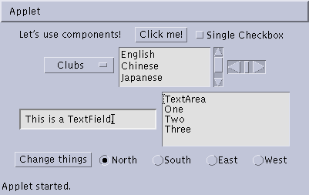
Some types of components
JButton
JCheckbox
JLabel
JChoice
JScrollbar
JTextField
JList
JTextArea
JButton
JCheckbox
JCheckboxGroup

Slide 10
Create components
JButton button = new JButton("Click me!");
JLabel label = new JLabel("This is a JLabel");
JTextField textField1 = new JTextField("This is the initial text");
JTextField textField2 = new JTextField("Initial text", columns);
JTextArea textArea1 = new JTextArea("Initial text");
JTextArea textArea2 = new JTextArea(rows, columns);
JTextArea textArea3 = new JTextArea("Initial text", rows, columns);
JCheckBox checkbox = new JCheckBox("Label for checkbox");
JRadioButton radioButton1 = new JRadioButton("Label for button");
ButtonGroup group = new ButtonGroup(); group.add(radioButton1); group.add(radioButton2); etc.
This is just a sampling of the available constructors; see the javax.swing API for all the rest

Slide 11
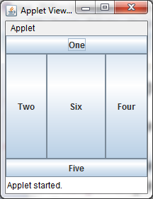
public class BorderLayoutExample extends JApplet { public void init () { setLayout(new BorderLayout ()); add(new JButton("One"), BorderLayout.NORTH); add(new JButton("Two"), BorderLayout.WEST); add(new JButton("Three"), BorderLayout.CENTER); add(new JButton("Four"), BorderLayout.EAST); add(new JButton("Five"), BorderLayout.SOUTH); add(new JButton("Six")); } }

Slide 12
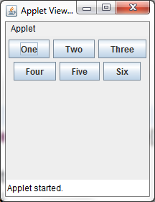
FlowLayout

Slide 13
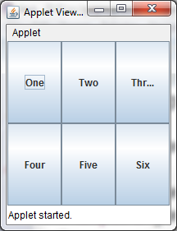
GridLayout

Slide 14
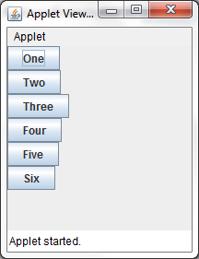
BoxLayout example
As mentioned, this can be a little weird to use but useful if you want to stack things vertically or horizontally

Slide 15
Nested layouts
A JPanel is both a JContainer and a Component
Because it’s a container, you can put other components into it
Because it’s a component, you can put it into other containers
All but the very simplest GUIs are built by creating several JPanels, arranging them, and putting components (possibly other JPanels) into them
A good approach is to draw (on paper) the arrangement you want, then finding an arrangement of JPanels and their layout managers that accomplishes this

Slide 16
Container container = new JFrame() or JApplet(); JPanel p1 = new JPanel(); p1.setLayout(new BorderLayout()); p1.add(new JButton("A"), BorderLayout.NORTH); // also add buttons B, C, D, E JPanel p2 = new JPanel(); p2.setLayout(new GridLayout(3, 2)); p2.add(new JButton("F")); // also add buttons G, H, I, J, K JPanel p3 = new JPanel(); p3.setLayout(new BoxLayout(p3, BoxLayout.Y_AXIS)); p3.add(new JButton("L")); // also add buttons M, N, O, P container.setLayout(new BorderLayout()); container.add(p1, BorderLayout.CENTER); container.add(p2, BorderLayout.SOUTH); container.add(p3, BorderLayout.EAST);

Slide 17
Create and attach listeners
JButton okButton = new JButton("OK");
okButton.addActionListener(new MyOkListener());
class MyOkListener implements ActionListener { public void actionPerformed(ActionEvent event) { // code to handle okButton click } }
A small class like this is often best implemented as an anonymous inner class

Slide 18
What is a listener
Components like button, textbox etc have events that can be ‘listened’ to
When the event is triggered, the next lines of code executed will be the ones corresponding to the listener code.

Slide 19
Suggested program arrangement 1
class SomeClass {
// Declare components as instance variables JFrame frame; // Can also define them here if you prefer JButton button;
public static void main(String[] args) { new SomeClass().createGui(); }
// Define components and attach listeners in a method void createGui() { frame = new JFrame(); button = new JButton("OK"); frame.add(button); // (uses default BorderLayout) button.addActionListener(new MyOkListener()); }
// Use an inner class as your listener class MyOkButtonListener implements ActionListener { public void actionPerformed(ActionEvent event) { // Code to handle button click goes here } } }

Slide 20
Suggested program arrangement 2
class SomeClass extends JFrame {
// Declare components as instance variables // JFrame frame; // Don't need this JButton button;
public static void main(String[] args) { new SomeClass().createGui(); }
// Define components and attach listeners in a method void createGui() { // frame = new JFrame(); // Don't need this button = new JButton("OK"); add(button); // Was: frame.add(button); button.addActionListener(new MyOkListener()); }
// Use an inner class as your listener class MyOkButtonListener implements ActionListener { public void actionPerformed(ActionEvent event) { // Code to handle button click goes here } } }

Slide 21
Components use various listeners
JButton, JMenuItem, JComboBox, JTextField:
addActionListener(ActionListener)
public void actionPerformed(ActionEvent event)
JCheckBox, JRadioButton:
addItemListener(ItemListener)
public void itemStateChanged(ItemEvent event)
JSlider
addChangeListener(ChangeListener)
public void stateChanged(ChangeEvent event)
JTextArea
getDocument().addDocumentListener(DocumentListener)
public void insertUpdate(DocumentEvent event)
public void removeUpdate(DocumentEvent event)
public void changedUpdate(DocumentEvent event)

Slide 22
Getting values
Some user actions normally cause the program to do something: clicking a button, or selecting from a menu
Some user actions set values to be used later: entering text, setting a checkbox or a radio button
You can listen for events from these, but it’s not usually a good idea
Instead, read their values when you need them
String myText = myJTextField.getText();
String myText = myJTextArea.getText();
boolean checked = myJCheckBox.isSelected();
boolean selected1 = myJRadioButton1.isSelected();

Slide 23
Enabling and disabling components
It is poor style to remove components you don’t want the user to be able to use
“Where did it go? It was here a minute ago!”
It’s better to enable and disable controls
Disabled controls appear “grayed out”
The user may still wonder why?, but that’s still less confusing
anyComponent.setEnabled(enabled);
Parameter should be true to enable, false to disable

Slide 24
Dialogs
A dialog (small accessory window) can be modal or nonmodal
When your code opens a modal dialog, it waits for a result from the dialog before continuing
When your code opens a nonmodal dialog, it does so in a separate thread, and your code just keeps going
Sun supplies a few simple (but useful) modal dialogs for your use
You can create your own dialogs (with JDialog), but they are nonmodal by default

Slide 25
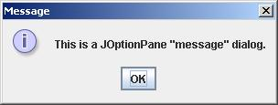
Message dialogs
JOptionPane.showMessageDialog(parentJFrame, "This is a JOptionPane \"message\" dialog.");
Notice that showMessageDialog is a static method of JOptionPane
The “parentJFrame” is typically your main GUI window (but it’s OK to use null if you don’t have a main GUI window)

Slide 26
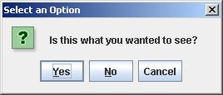
Confirm dialogs
int yesNo = JOptionPane.showConfirmDialog(parentJFrame, "Is this what you wanted to see?");
if (yesNo == JOptionPane.YES_OPTION) { ... }

Slide 27
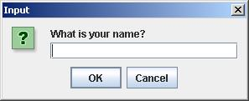
Input dialogs
String userName = JOptionPane.showInputDialog(parentJFrame, "What is your name?")

Slide 28
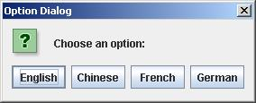
Option dialogs
Object[] options = new String[] {"English", "Chinese", "French", "German" }; int option = JOptionPane.showOptionDialog(parentJFrame, "Choose an option:", "Option Dialog", JOptionPane.YES_NO_OPTION, JOptionPane.QUESTION_MESSAGE, null, options, options[0]); // use as default
Fourth argument could be JOptionPane.YES_NO_CANCEL_OPTION
Fifth argument specifies which icon to use in the dialog; it could be one of ERROR_MESSAGE, INFORMATION_MESSAGE, WARNING_MESSAGE, or PLAIN_MESSAGE
Sixth argument (null above) can specify a custom icon

Slide 29
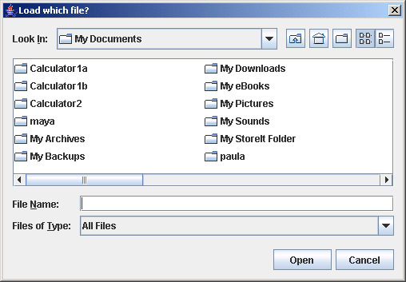
Load file dialogs
JFileChooser chooser = new JFileChooser(); chooser.setDialogTitle("Load which file?");
int result = chooser.showOpenDialog(enclosingJFrame); if (result == JFileChooser.APPROVE_OPTION) { File file = chooser.getSelectedFile(); // use file }
You could also test for CANCEL_OPTION or ERROR_OPTION
You will get back a File object; to use it, you must know how to do file I/O

Slide 30
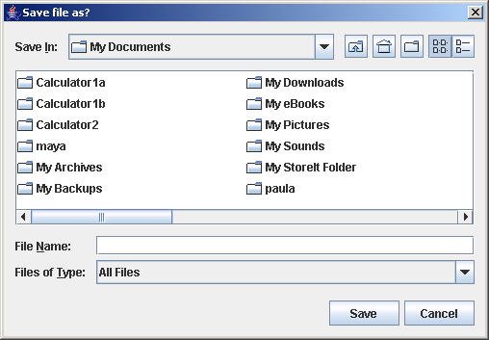
Save file dialogs
JFileChooser chooser = new JFileChooser(); chooser.setDialogTitle(“Save file as?");
int result = chooser.showSaveDialog(enclosingJFrame); if (result == JFileChooser.APPROVE_OPTION) { File file = chooser.getSelectedFile(); // use file }
You could also test for CANCEL_OPTION or ERROR_OPTION
You will get back a File object; to use it, you must know how to do file I/O

Slide 31
Quitting the program
gui.setDefaultCloseOperation(JFrame.EXIT_ON_CLOSE);
Other options are DO_NOTHING_ON_CLOSE, HIDE_ON_CLOSE, and DISPOSE_ON_CLOSE

Slide 32
Summary I: Building a GUI
Create a container, such as JFrame or JApplet
Choose a layout manager
Create more complex layouts by adding JPanels; each JPanel can have its own layout manager
Create other components and add them to whichever JPanels you like

Slide 33
Summary II: Building a GUI
For each active component, look up what kind of Listeners it can have
Create (implement) the Listeners
often there is one Listener for each active component
Active components can share the same Listener
For each Listener you implement, supply the methods that it requires
For Applets, write the necessary HTML
I’ve stuck to Jframe simply because Applets would mean I have to tweak settings for my browser

Slide 34
Making executables
Warning – do not download an executable off the internet!
Unless you trust the source
This makes a lot more sense when you have a GUI!
In fact System.out.println is quirky (basically does not quite work)
http://stackoverflow.com/questions/3013506/creating-exe-for-my-java-application-in-eclipse
Demo in class.

