Slide 1
CIT 590
Unit testing

Slide 2
Agenda
Debugging attempt 2 (because I am stubborn)
What is unit testing
Why?
Unit testing framework in Python

Slide 3
What is unit testing
Test individual units of a program.
Simplest way to think of it – test every function
This does not guarantee that the different functions work together harmoniously. That is the job of integration testing

Slide 4
Why unit test
test driven development (TDD) can save you lots of time
Tracking a bug down is often the most time consuming part of development
When something breaks you want to know exactly which sub sub component has broken down.
In an ideal world, if you implement incorrect code, one of your tests breaks
http://c2.com/cgi/wiki?TestDrivenDevelopment

Slide 5
Common excuses for not doing TDD
Resistance
A lot of this is practice
You will need to start doing this from the next assignment.

Slide 6
Test, Code, Refactor loop
Also described as
  Make it fail (tests)
  Make it work (code)
  Make it better (refactor)
Pure test driven development says that you write your tests first!
This can be annoying unless you commit to your method signatures up front.
Given method signatures write some tests

Slide 7
Refactor?
def isperfect(number):
if number==sum(i for i in range(1,number) if number%i==0):
return True
def isabundant(number):
if number<sum(i for i in range(1,number) if number%i==0): return True
If code is repeating itself, make a function out of it.

Slide 8
def decFloat2Bin(string):
""" Converts a Float to a Binary Number"""
### EXTRACT THE INT AND FRACTION PART
integer = extractIntegerPart(string)
frac = extractFractionalPart(string)
### convert integer part #####
inputCount = int(integer)
decimalCount = ""
while (inputCount > 0):
binary = (int(inputCount) % 2)
decimalCount += str(binary)
inputCount = int(inputCount) /2
intOutput =str(decimalCount)
## convert fractional part to binary ###
decCount = ""
dec = "0."+frac
## only 23 bits allowed
while (len(str(decCount))<23):
#do repeated multiplication by 2
#### ADD THE TWO PIECES TOGETHER
output = intOutput[::-1] + "." + decCount
return output
Break up functions into smaller functions.
Even if the specs say 1 function – you are always allowed to do helper functions

Slide 9

Code reviews
Code review is the process of making pieces of source code available for other developers to review, with the intention of catching bugs and design errors before the code becomes part of the product.
If you are part of a software company that is not doing code reviews …

Slide 10
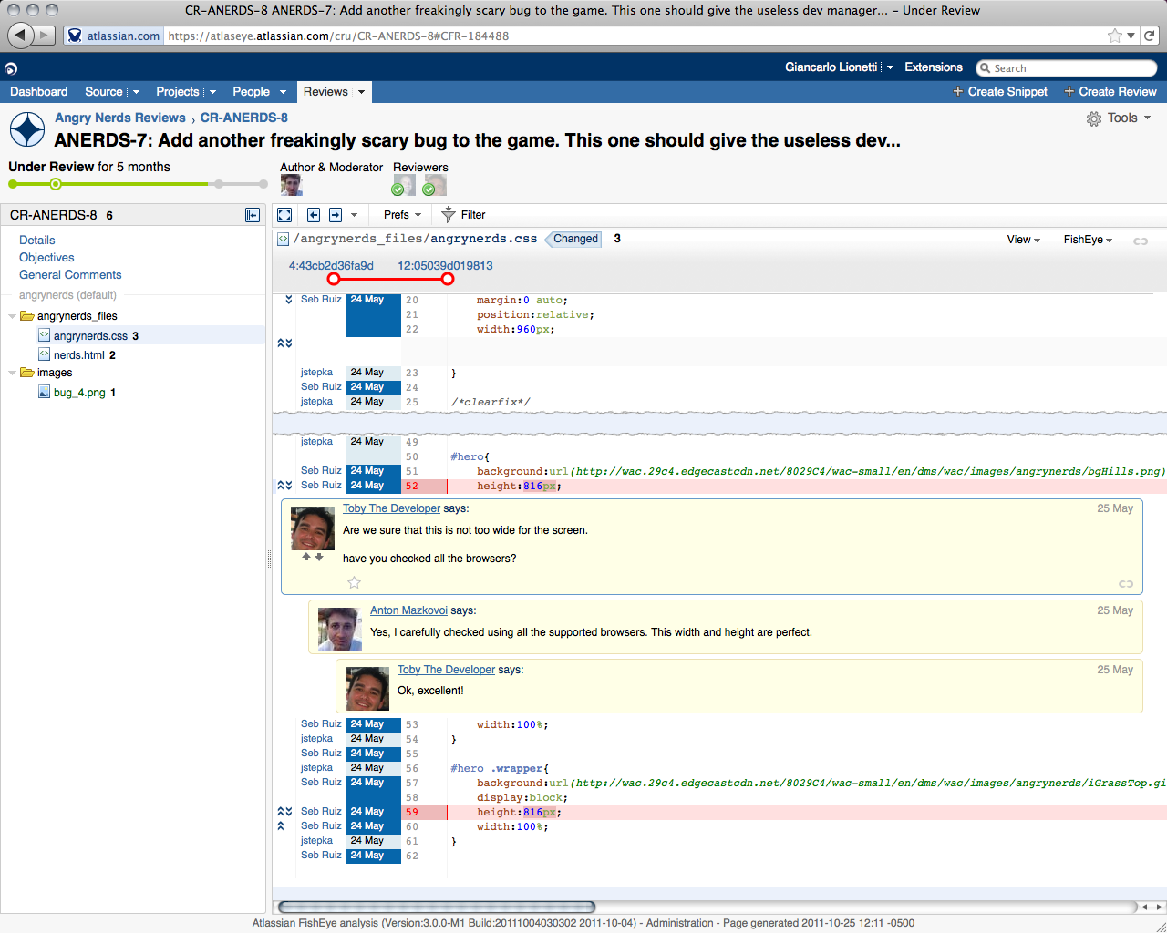
Code reviews
Crucible.
One of the many tools used for online code reviews

Slide 11
How many tests?
Test out a typical example – some call this the smoke test. You really expect this one to pass.
Test out examples at the extreme ends of the input spectrum – empty list, large numbers etc
But there will/might still be bugs
  If you hit a bug – begin the fix by adding a unit test case for it
  Code until unit test passes
  Now run the whole program and ensure things pass

Slide 12
Hands on example of TDD
Quadratic equation solver
mathOps.py and testMath.py (in case I mess up ☺)

Slide 13
Rules for writing tests
The name of a test method must start with the letters 'test', otherwise it will be ignored. This is so that you can write "helper" methods you can call from your tests, but are not directly called by the test framework.
Every test method must have exactly one parameter, self.
You must put 'self.' in front of every built-in assertion method you call.
The tests must be independent of one another, because they may be run in any order. Do not assume they will be executed in the order they occur in the program

Slide 14
What do I test for within a test
self.assertEqual(expectedResult, actualResult, [message])
Test that the two values are exactly equal.
self.assertNotEqual(firstValue secondValue,[message])
Test that the two values are different, and fail if they are equal.
self.assertAlmostEqual(expected, actual, [places,[message]]) Test that the two numeric values are equal, after rounding to places decimal places (default is 7).
self.assertAlmostNotEqual(expected, actual,[places,[message]]) Test that the two numeric values are equal, after rounding to places decimal places (default is 7).
self.assertTrue(booleanCondition,[message]) Test that the booleanCondition is true.
self.assertFalse(booleanCondition,[message])
Test that the booleanCondition is false.
self.assertRaises(exception, functionName, parameter, ...,)
Test that the function functionName, when called with the given (zero or more) parameters, raises the given exception. Note that, for this assertion method, there is no option for a message parameter.
.

Slide 15
TDD as an algorithm
pick a method that doesn't depend on other, untested methods
while the method isn't complete:
write a test for the desired feature
run all tests and make sure the new one fails
while any test fails:
add/fix just enough code to try to pass the tests
refactor the code to make it cleaner

Slide 16
Caution
Who tests the tests??
One of the more annoying things if you get sloppy about writing your tests is that a failed test could indicate an error in the test file more than an error in the actual code
BE VERY CAREFUL WHEN YOU WRITE YOUR TESTS
Sometimes a code refactor will result in the tests having to be refactored themselves
  DO NOT HESITATE TO DO SO

