Slide 1
CIT 590
Intro to Programming
Lecture 12

Slide 2
Agenda
More stuff with classes
Few more thoughts on unit testing/coding in general
Summarizing Python

Slide 3
Administrivia
Midterm on Oct 21
In class
Write answers in space provided style question paper
Closed book
Syntax is implicitly going to be tested, but we will only use syntax that you have probably had to use in your HWs
Questions like
  What does this program do
  Debug the program
  What does this list comprehension give me
Short answers and usually only 1 correct answer

Slide 4
HW grading
HW1 is all done
HW2 mostly done. Should be done by tonight
HW3 will be done over the fall break
HW4 – we just changed the grading scheme to the more lenient one so all TAs should be using that
HW5 – expect it to be done by the Friday of next week.

Slide 5
Continuation of the stacks / RPN calculator
>>> calc = CalculatorEngine()
>>> calc.pushOperand(5)
>>> calc.pushOperand(3)
>>> calc.performBinary(math.pow)
>>> calc.currentOperand()
125.0
But no non insanely geeky user is going to use my calculator

Slide 6
Wrapping an interface around the calculator engine
RPNCalculator.py
But even this requires the user to remember to write everything in the postfix/reverse polish notation

Slide 7
Can we write an infix calculator?
If we can convert an infix expression into the equivalent reverse polish notation expression we are done
RPN was nice in that we did not have to worry about order of precedence. Now we do.
How do we convert an infix expression to a postfix expression?
  Stacks!!
  Consider 3 + 4 * 7 versus 3*4 + 7

Slide 8
More unit testing
How do I write a test without having written any code?
Write some minimal code?
Best practice in industry is to write the method signature and say
  def get_blackjackrank(self):
  raise NotImplementedError
The more you use modular programming, the more testable your code will be
Writing unit tests is actually almost like writing code.
Sometimes the unit test file is bigger than the code file
Do not hesitate to have a bunch of test cases.

Slide 9
How code is written (agile paradigm)
PM comes with specs
  Make me a blackjack game
Dev team sits and writes ‘user stories’
  A user should be able to place a card on the table
  A user should be able to discard a card
  A user should be able to get his/her score
User story split up into tasks
  Now we start talking data structures/representation etc
  Maybe the table is a list of lists? Maybe the table is a dictionary?
  Maybe the table is some fancy matrix?
  top-down
Each dev looks at the list of functions they have to write
Make a decision about which functionalities go together = class

Slide 10
How code is written (agile paradigm)
  Start writing stubs with raise NotImplementedError
  Write unit tests for the simplest of those methods
  Watch unit test fail
  Write code to make unit test pass
  Repeat unit testing process
  Talk to other devs about the classes they are writing
  Hook the classes up together
  Write tests that test the integration - sometimes these tests are no longer in our unit test form. Front end tests, regression test suite, manual tests

Slide 11
What do I do next with Python?
http://www.lfd.uci.edu/~gohlke/pythonlibs/
Python has tons of libraries
If you use a lot of numerical methods
  Consider numpy/scipy
  http://showmedo.com/videotutorials/series?name=i9KuJuNcG
  Numpydemo.py
  sillyLittleGraph.py
If you thought the Harry Potter assignment was interesting or if you are interesting in understanding linguistics from a CS perspective
  http://www.cis.upenn.edu/~cis530/
Data science
http://www.meetup.com/DataPhilly/
Use it in a hackathon!
Get good at it and work at Youtube (well ok it is Google now…)

Slide 12
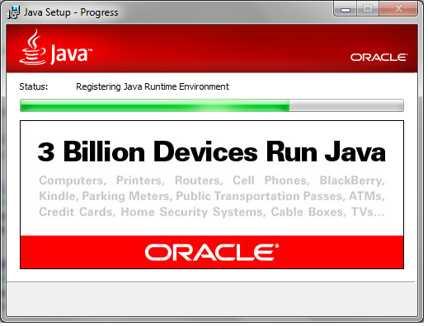
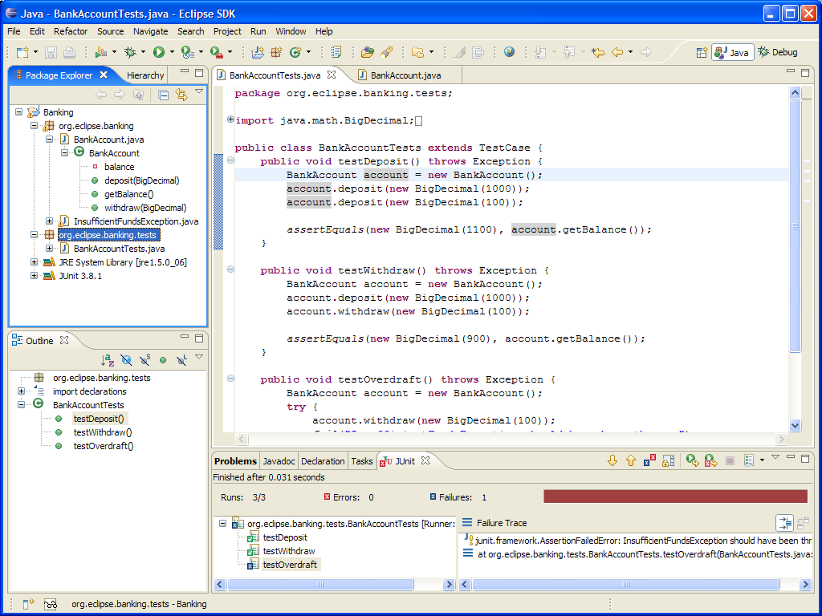
After fall break …

