Slide 1


Model Checking for Safe Autonomy
Rajeev Alur
University of Pennsylvania
VMCAI, January 2020

Slide 2








Formal Verification in Practice
Emerging Research Challenge:
Software includes components trained using machine learning

Slide 3
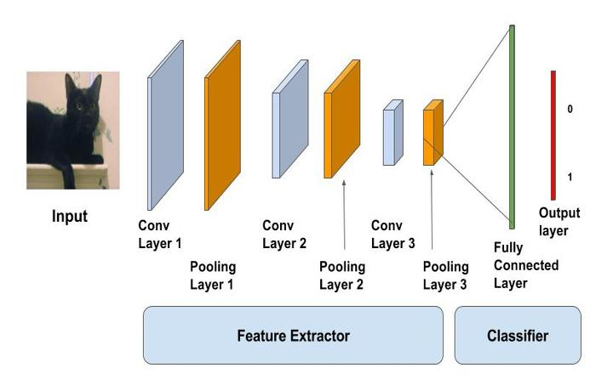
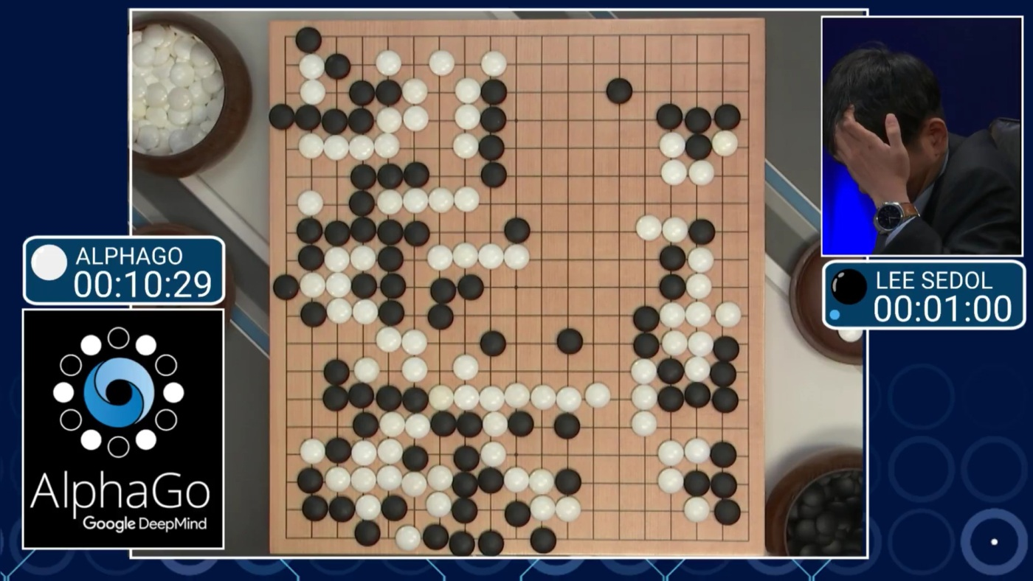
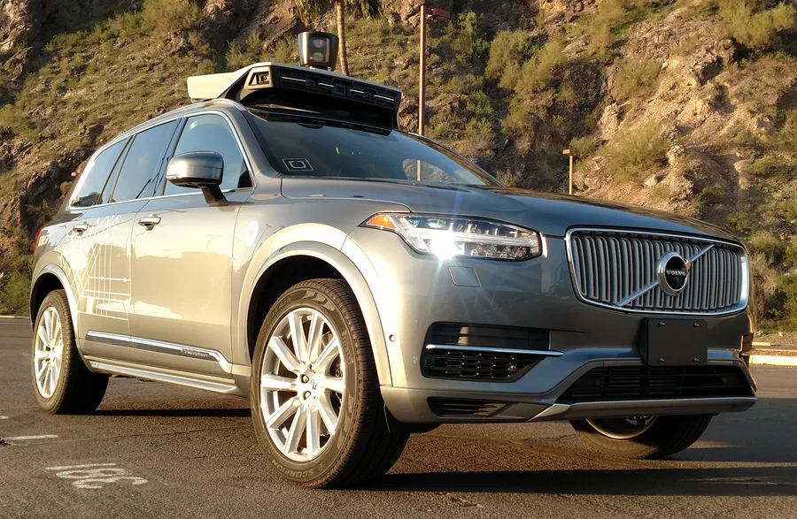
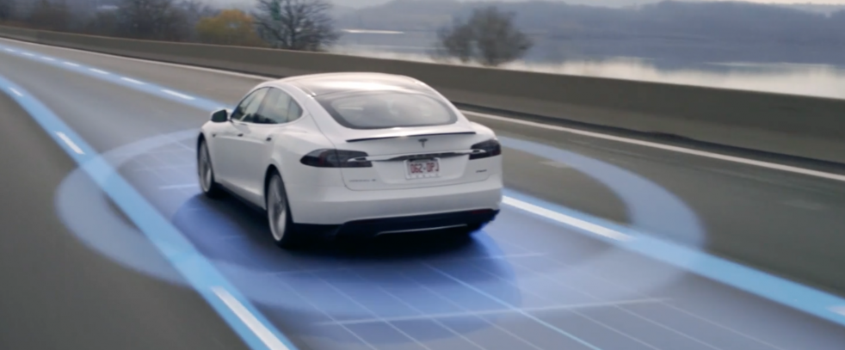
Deep Neural Networks: Enabling Technology for Modern AI
Great success in image processing, language translation, games …
Hence the temptation to use them in challenging control applications

Slide 4
Closed-loop Control Systems
Controller
Measurements
Control inputs
Plant
When controller is implemented as a neural network, how to assure that the system is correct with respect to high-level requirements ?

Slide 5
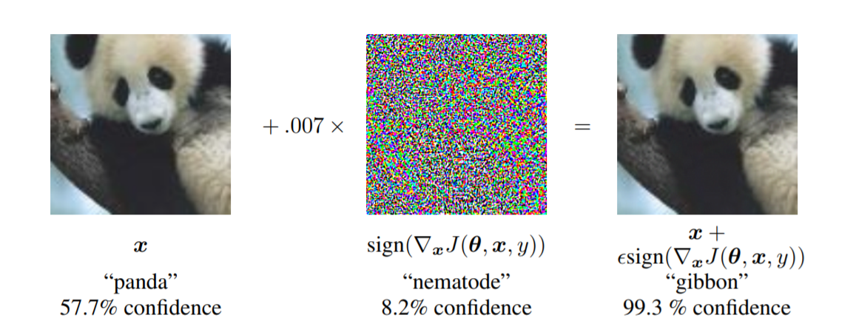
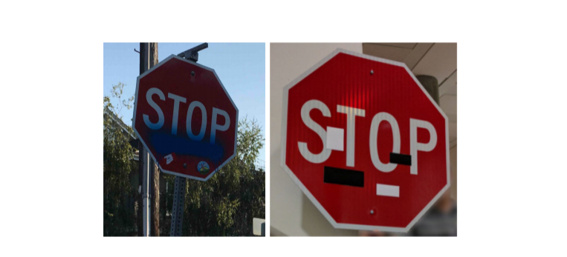
Neural Network Classification Famously Not Robust !
Prediction:
Panda (58%)
Noise
Prediction:
Gibbon (99%)
Prediction:
Stop sign
Prediction:
Speed Limit 45

Slide 6
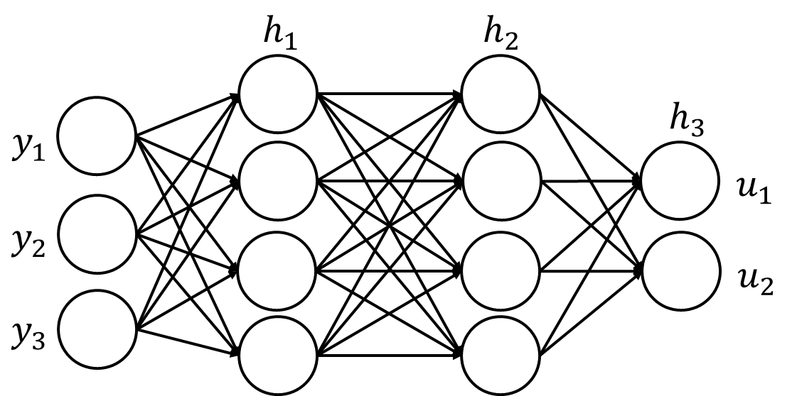
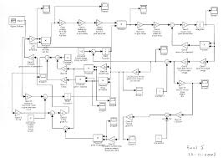
Model Checking for Safe Autonomy
Controller
Model Checker
yes
Plant / Environment
counterexample
Logical Requirement
Set ϕ of safe states

Slide 7

Talk Outline
F1/10 Autonomous Racing Car
Neural-network-based controller: why and how
Setting up the verification problem
Reduction to verification of hybrid systems
Verisig: A model checker for hybrid systems with NN controllers
Conclusions
In collaboration with:
Taylor Carpenter, Radoslav Ivanov, Insup Lee, George Pappas, Jim Weimer
https://github.com/verisig/
Assured Autonomy

Slide 8
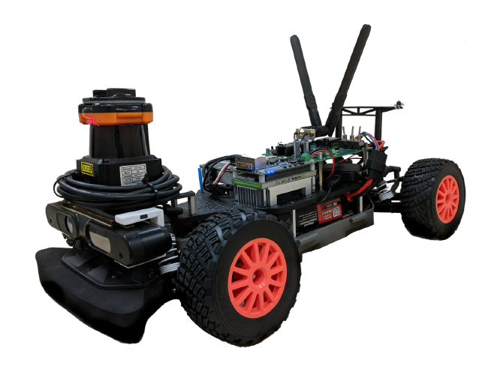
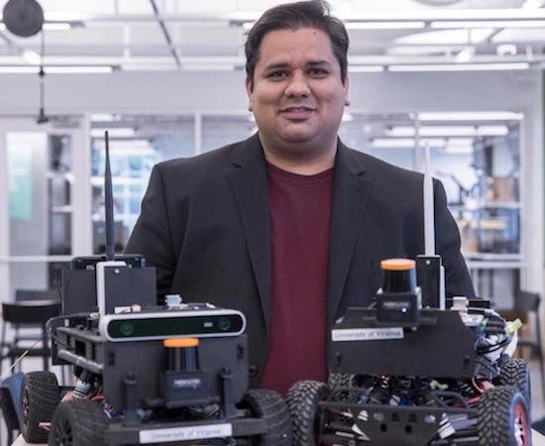

F1/10 Autonomous Racing Car
Platform for autonomous system design
See f1tenth.org
Competitions at CPSWeek and ESWeek
Initiated by
Madhur Behl (University of Virginia)
Rahul Mangharam (University of Pennsylvania)

Slide 9
F1/10 Car in Action

Slide 10

Model-based Control Design
State variables for car:
  Position (x₁, x₂)
  Linear velocity v
  Angular velocity ω
  Orientation θ
Control inputs:
  Throttle input u_{t}
  to change speed
  Steering input u_{h}
to change direction
State dynamics (non-linear ODEs):
  dx₁ /dt = v . cos (θ)
  dx₂ /dt = v . sin (θ)
  …
Standard bicycle model for planning trajectories in autonomous vehicles

Slide 11
Control Design Problem
Determine throttle input u_{t} and steering input u_{h} as a function of
  Current state x₁, x₂, v, ω, θ
  LiDAR sensor measurements y
LiDAR used to map the environment:
1080 rays spanning -135⁰ to + 135⁰
Returns distance to first obstacle (upto 10m)
High-level Requirements:
  Avoid Collisions (Safety)
  Follow racing path in hallways
  Minimize finish time

Slide 12
Learning for Control
Goal: Design control function
(u_{t}, u_{h}) = f(x₁, x₂, v, ω, θ, vector y of LiDAR readings)
Learning-based approach:
Learn the control function
Benefits over classical model-based techniques
Don’t need the model
Evaluation of f is fast
Challenges
Need training data (simulation environment to evaluate quality)
No well developed theory for safety/robustness guarantees

Slide 13
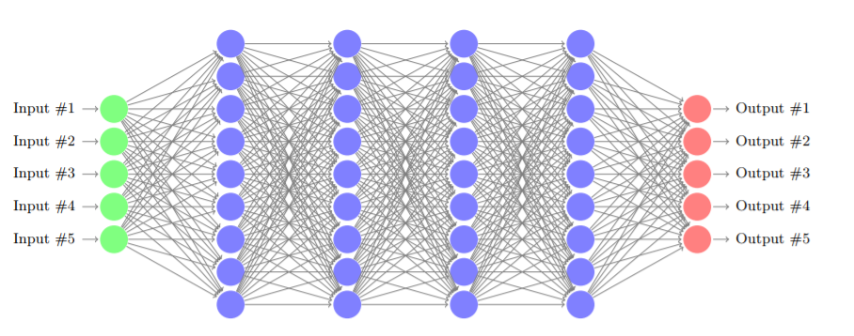
What is a Neural Network ?
Inputs
Hidden Layers
Outputs
Neuron output =
Non-linear-function(Linear function of inputs)
Example: ReLU
Output = max (0, W . Inp )
Weights W determined during training

Slide 14
Neural Network Based Controller for F1/10 Car

Slide 15
Training Neural Network
Goal: Train a neural network based control function
u_{h} = NN(LiDAR readings y, weights W);
u_{t} kept fixed; Number of LiDAR rays reduced from 1080 to 21
Determine “optimal” weights W using reinforcement learning
Fix a hallway geometry and use simulation to generate a trajectory
Reward function based on
  Proportional to amount of time before a collision
  Penalized for changes in control inputs to ensure smoothness
Result: NN with 21 inputs, 64 neurons with sigmoidal activation, 1 output

Slide 16
Why Verification ?
“Safe AI” is a vibrant research area
Focus: design of novel ML algorithms that integrate symbolic/logical reasoning
Independent of progress in “safe AI” algorithms, we need technology that can verify/certify controllers:
Traditional separation between design and validation teams has been key to higher software reliability

Slide 17
Verifying Safety
Formal verification to ensure safety (absence of collisions)
  Gradient-descent-based training of weights of neural network does not ensure logical relationship between inputs and outputs
  Environment (hallway geometry) used in simulation-based training not the same while racing
  Want to verify safety for a range of initial conditions
  LiDAR readings have noise, can model errors during verification

Slide 18
Model Checking for Safe Autonomy
Controller
Model Checker
yes
Plant / Environment
counterexample
Logical Requirement
Set ϕ of safe states
Hybrid dynamical system H

Slide 19
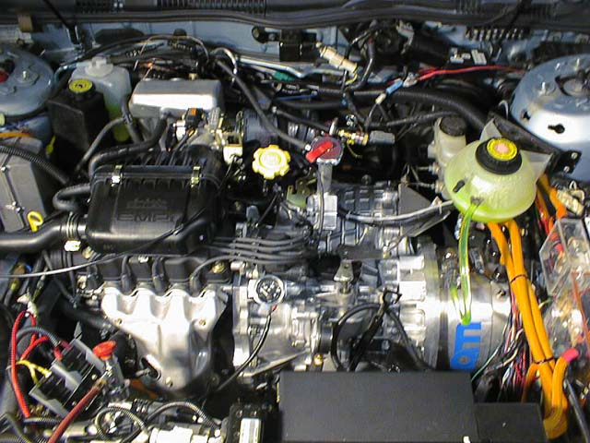
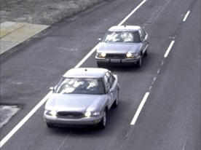
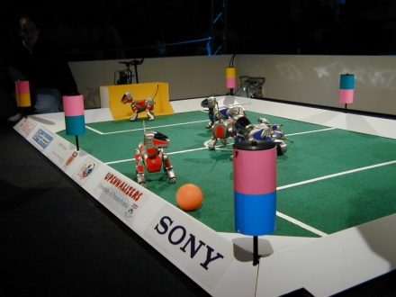
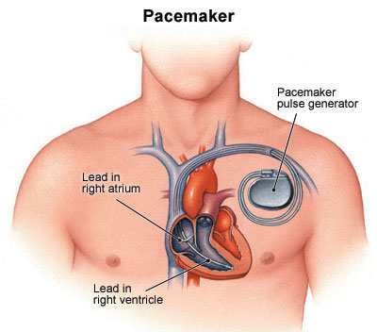
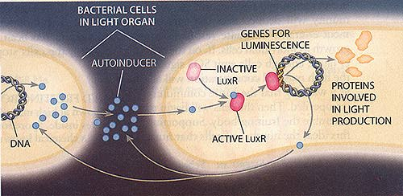
Hybrid Systems
Computer Science
Automata/Logic
Concurrency
Formal verification
+ Control Theory
Optimal control
Stability analysis
Discrete-event system
Software + Environment
State machines
+ Dynamical systems
x>68
on
off
dx/dt = kx
x<70
dx/dt = -k’x
x>60
x<63
Coordination
Protocols
Medical
Devices
Systems
Biology
Automotive
Robotics

Slide 20
Safety Verification
Problem: Given
  Neural network N for the controller
  Hybrid systems model H for the plant
  Safety property ϕ as a predicate over plant state variables
verify that all reachable state of N ||H satisfy ϕ
Challenge: N is a complex non-linear function !!
Solution strategy 1: Synthesize a simpler representation of N
maybe as a decision tree
or an instantiation of a template in a domain-specific language
Illustrative work:
Programmatically interpretable reinforcement learning
Verma, Murali, Singh, Kohli, and Chaudhuri, ICML 2018

Slide 21
Proving Safety via Compositional Reasoning
Problem: Given a neural network N, hybrid systems model H for the plant, and a safety property ϕ, verify that all reachable state of N ||H satisfy ϕ
Solution strategy 2 (not yet explored): Find linear input-output relationship Ψ(y,u) for the neural network such that
  Neural network N satisfies Ψ (y,u)
  Ψ(y,u) || H satisfies ϕ
For 1, a potential tool is:
Reluplex: An Efficient SMT Solver for Verifying Deep Neural Networks
Katz, Barrett, Dill, Julian, Kochenderfer, CAV 2017
(Specialized SMT solver for ReLU constraints)
For 2, one can use tools for safety verification of hybrid systems (e.g. Flow*)

Slide 22
Proving Safety via Reach Set Computation
Problem: Given a neural network N, hybrid systems model H for the plant, and a safety property ϕ, verify that all reachable state of N ||H satisfy ϕ
Solution strategy 3: Adapt existing symbolic state-space exploration techniques for dynamical/hybrid systems
Illustrative works:
Verisig: verifying safety properties of hybrid systems with neural network controllers; Ivanov, Weimer, Alur, Pappas, Lee, HSCC 2019
Verifying the safety of an autonomous racing car with a neural network controller; Ivanov, Carpenter, Weimer, Alur, Pappas, Lee; HSCC 2020
Reachability Analysis for Neural Feedback Systems using Regressive Polynomial Rule Inference
Datta, Chen, Sankaranarayan; HSCC 2019
(Taylor-model-based over-approximation of reachable state sets)

Slide 23
Reach Set Computation
To check if unsafe state is reachable from an initial state, repeatedly apply Post, where Post applies single transition to set of states
When system is a dynamical or hybrid system (state machine + differential equations for evolution), well studied techniques and tools
Techniques:
Flow-pipes, Zonotopes, Taylor models, …
Tools:
C2E2, SpaceEx, dReach, Flow* …
Unsafe
Init
Post(R)
R
t₄
t₅
t₆
t₇
t₃
t₈
t₂
t₁
t₉
X₀

Slide 24
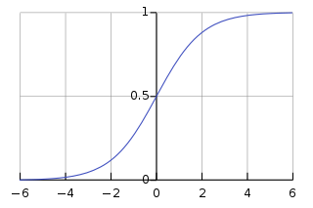
Verisig Verification Methodology
Let’s focus on neurons with sigmoidal activation function
For one input x, output of sigmoidal neuron is the smooth function
σ(x) = 1 / (1 + e^{-x} )
Key challenge for symbolic reach set computation:
given a set I, compute an over-approximation for the set σ(I)

Slide 25
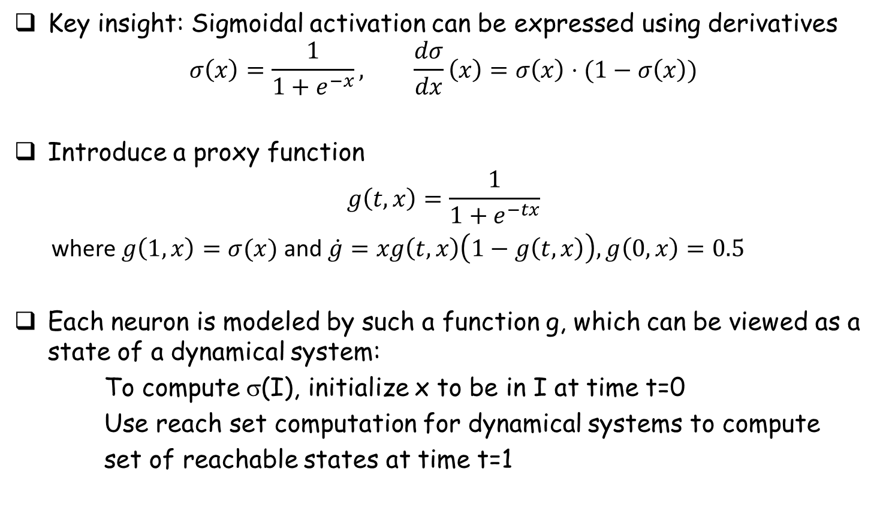
Verisig Verification Methodology
Key insight: Sigmoidal activation can be expressed using derivatives
$$σ\left(x\right)=\frac{1}{1+e^{−x}}, \frac{dσ}{dx}\left(x\right)=σ\left(x\right)⋅(1−σ\left(x\right))$$
Introduce a proxy function
$$g\left(t,x\right)=\frac{1}{1+e^{−tx}}$$
where $g\left(1,x\right)=σ(x)$ and $\dot{g}=xg\left(t,x\right)\left(1−g\left(t,x\right)\right), g\left(0, x\right)=0.5$
Each neuron is modeled by such a function g, which can be viewed as a state of a dynamical system:
To compute σ(I), initialize x to be in I at time t=0
Use reach set computation for dynamical systems to compute
set of reachable states at time t=1

Slide 26
Verisig Verification Tool
Given a neural network N, hybrid systems model H for the plant, and a safety property ϕ, verify that all reachable state of N ||H satisfy ϕ
  Translate controller N to a hybrid automaton H’
  Compose hybrid automata H and H’
  Apply existing verification tool for hybrid systems
  Flow*: An analyzer for non-linear hybrid systems
  Chen, Abraham, Sankaranarayanan; CAV 2013

Slide 27
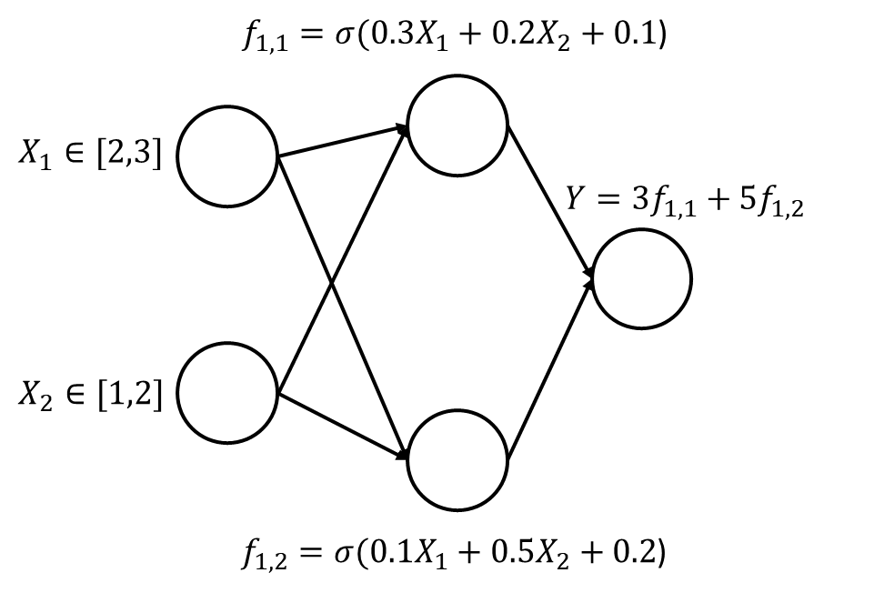
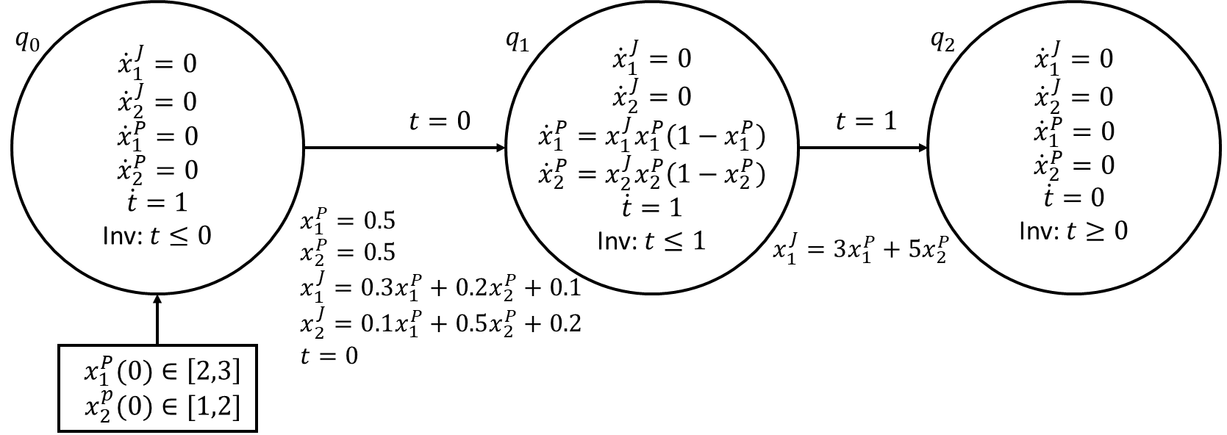
Illustrative Transformation

Slide 28
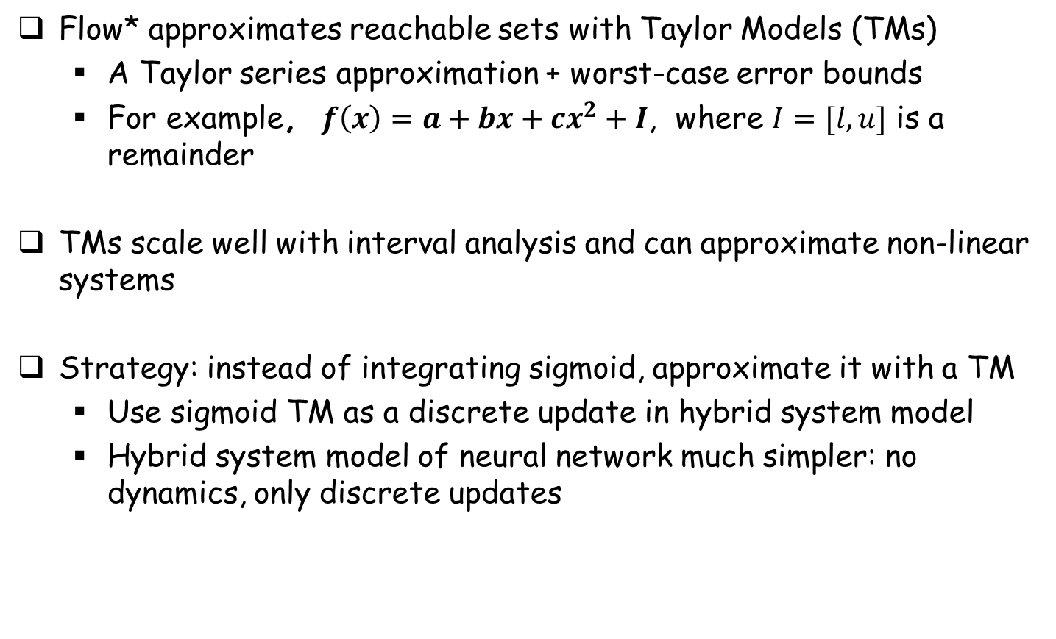
Taylor Models for Approximations
Flow* approximates reachable sets with Taylor Models (TMs)
  A Taylor series approximation + worst-case error bounds
  For example, $f\left(x\right)=a+bx+cx^{2}+I$, where $I=[l,u]$ is a remainder
TMs scale well with interval analysis and can approximate non-linear systems
Strategy: instead of integrating sigmoid, approximate it with a TM
  Use sigmoid TM as a discrete update in hybrid system model
  Hybrid system model of neural network much simpler: no dynamics, only discrete updates

Slide 29
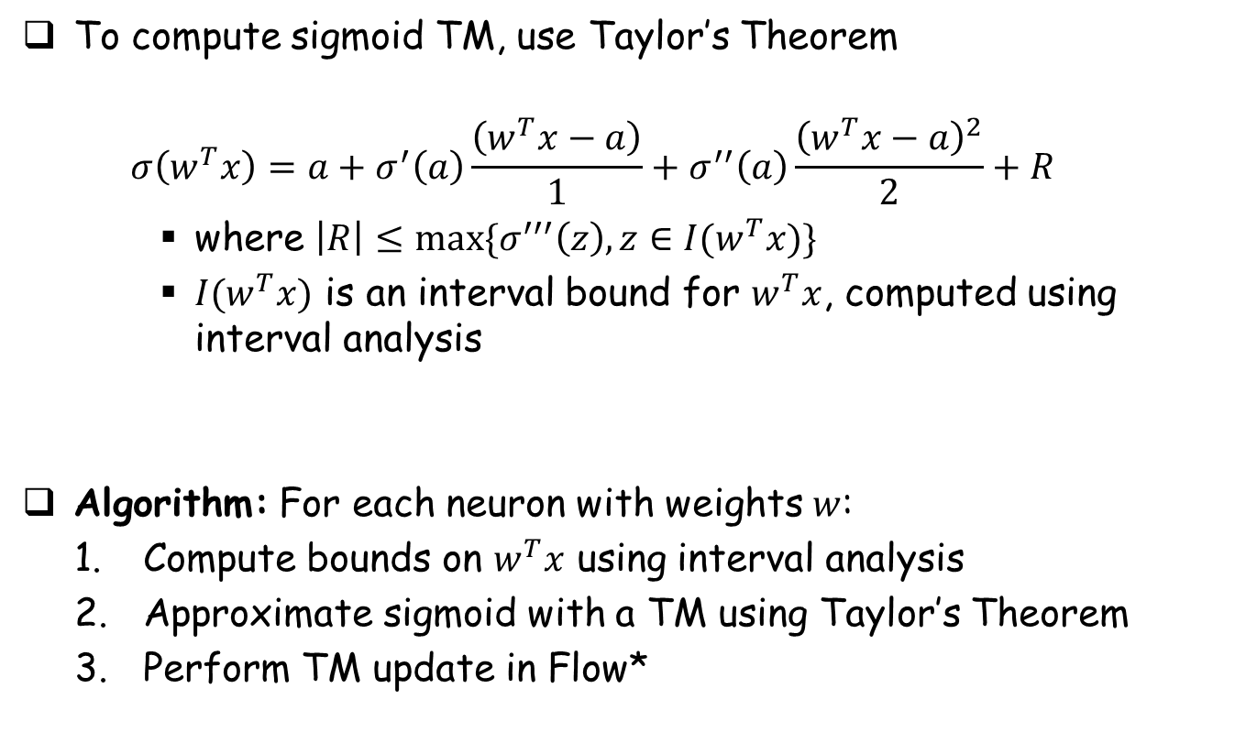
Approximating Sigmoid
To compute sigmoid TM, use Taylor’s Theorem
  $$σ\left(w^{T}x\right)=a+σ^{′}\left(a\right)\frac{\left(w^{T}x−a\right)}{1}+σ^{′′}\left(a\right)\frac{{\left(w^{T}x−a\right)}^{2}}{2}+R$$
    where $\left|R\right|≤max⁡\{σ^{′′′}\left(z\right), z∈I(w^{T}x)\}$
    $I(w^{T}x)$ is an interval bound for $w^{T}x$, computed using interval analysis
Algorithm: For each neuron with weights $w$:
  Compute bounds on $w^{T}x$ using interval analysis
  Approximate sigmoid with a TM using Taylor’s Theorem
  Perform TM update in Flow*

Slide 30
Summary of Analysis Results
Both strategies are implemented in the tool Verisig
Case studies for experimental evaluation
  Mountain car (standard benchmark in reinforcement learning)
  Quadrotor with NN-based controller
  F1/10 autonomous racing car controller
Scales to about 10 layers and 100 neurons per layer

Slide 31
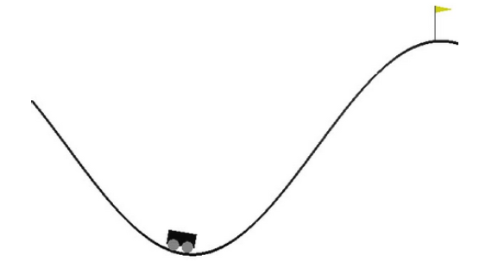
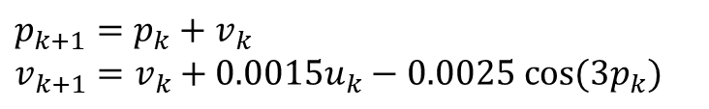
Mountain Car: Benchmark for Reinforcement Learning
Learn a controller to get an underpowered car up a hill
  Need to go up left hill first
  During training, try various actions and observe reward
Learning problem considered “solved” if average reward over 100 random trials is over 90
$p_{k+1}=p_{k}+v_{k}$
$$v_{k+1}=v_{k}+0.0015u_{k}−0.0025 cos⁡(3p_{k})$$
Initial condition chosen randomly from this range
-0.6
-0.4
Can we verify this property for all initial states?

Slide 32
Mountain Car Verification Results
Trained 2-hidden-layer DNN with 16 neurons per layer
  Inputs: position and velocity
  Output: thrust
Verified car goes up the hill with reward >= 90
  Divided the initial set into subsets and verified each one
  Found a counterexample for left-most set, [-0.6, -0.59]
Direct encoding using Taylor models reduces verification time significantly

Slide 33

Scalability
Trained DNNs of increasing size on the Mountain Car problem
  Varied layers from 2 to 10 and neurons per layer from 16 to 128
  Compare verification times
  TM approach an order of magnitude faster!

Slide 34
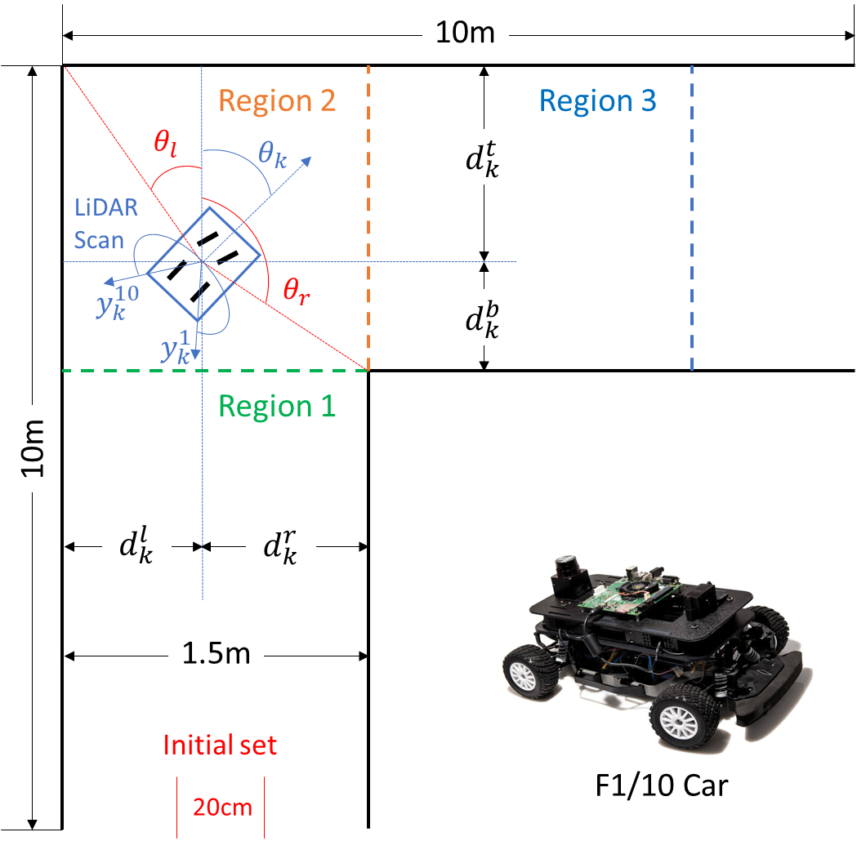
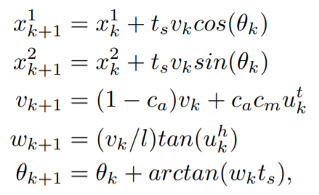
Verification of F1/10 Racing Car Controller
NN controller maps LiDAR measurements to steering direction
Trained 2-hidden-layer DNN with 64 neurons per layer
Verified car does not hit walls
Verified controller deployed on car

Slide 35
Concluding Remarks
We are in the very early stages of developing tools for verifying safety of closed-loop control systems with NN controllers
All verification tools are not scalable, but some can find bugs in practice
Neural networks pose an intriguing challenge for verification:
  A neural network does not have a modular structure!
  Develop abstraction-based / compositional reasoning tools!
Try out Verisig : https://github.com/verisig/

