Slide 1

Quantitative Policies over Streaming Data
Rajeev Alur
University of Pennsylvania

Slide 2





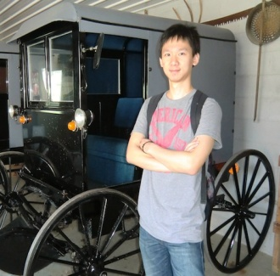
Thanks to Collaborators
Dana Fisman
Sanjeev Khanna
Boon Thau Loo
Kostas Mamouras
Mukund Raghothaman
Yifei Yuan
Notes:
Implemenations are plenty... choose one that has typical features

Slide 3

Notes:
Implemenations are plenty... choose one that has typical features

Slide 4
Real-time Decision Making in IoT Applications
data
decisions
Controller
Notes:
Implemenations are plenty... choose one that has typical features

Slide 5
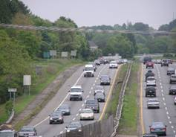
Variable Tolling
(car ID, position, time)
toll
Controller
Adjust toll rate at each tool booth dynamically based on time of day and congestion conditions in road segments
Reference: Linear road benchmark for stream management systems
Notes:
Implemenations are plenty... choose one that has typical features

Slide 6
Network Traffic Engineering
(source IP, dest IP, payload)
drop / forward to port X /
alert controller
Switch
Dynamic network management for traffic engineering
Real-time response to emerging attacks / security threats
Software Defined Networking (SDN)
Opportunity for increased programmability/functionality
Notes:
Implemenations are plenty... choose one that has typical features

Slide 7
Quantitative Policy
data
decisions
Policy
Example network policy:
if number of packets in current VoIP session exceeds
the average over past VoIP sessions by a threshold T,
then drop the packet
Stateful: Need to maintain state and update it with each item
Quantitative: Based on numerical aggregate metrics of past history
Notes:
Implemenations are plenty... choose one that has typical features

Slide 8
Design and Implementation of Policies
data
decisions
Policy
Which policies are effective ?
Based on traffic models and domain specific insights
How to specify and implement policies ?
Focus of this talk !
Notes:
Implemenations are plenty... choose one that has typical features

Slide 9
Streaming Algorithm
state s = initialize;
for each packet p {
s = update (s, p);
output d = decide (s)
}
data
decisions
Notes:
Implemenations are plenty... choose one that has typical features

Slide 10
High-level Abstractions over Data Streams ??
(source IP, dest IP, payload)
drop / forward /
alert controller
Switch
Example network policy:
if number of packets in current VoIP session exceeds the average
over past VoIP sessions by a threshold T then drop the packet
Low-level programming:
What state to maintain? How to update it?
Desired high-level abstraction: Beyond packet sequence
Notes:
Implemenations are plenty... choose one that has typical features

Slide 11
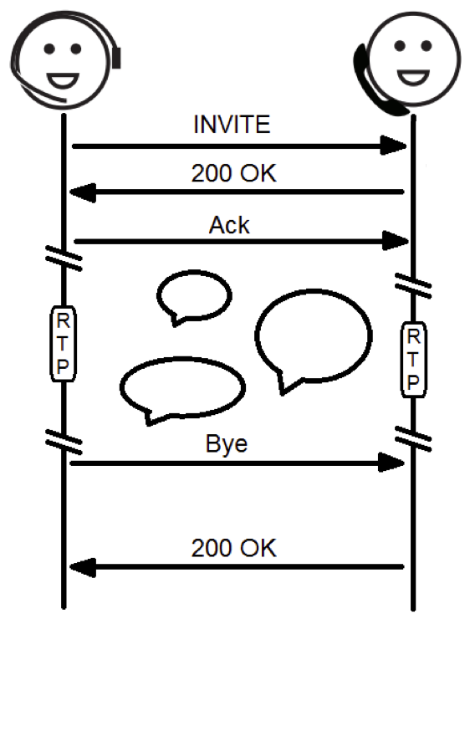
Modular Monitoring of VoIP Sessions
Focus on traffic between a specific source and destination
View data stream as a sequence of VoIP session
View a VoIP session as split in three phases
Aggregate cost over call phase during a session, and aggregate cost across sessions
Init
Call
End
Session Initiation Protocol
Notes:
Implemenations are plenty... choose one that has typical features

Slide 12

Design Goals for Policy Language
Programming abstractions for processing data stream ??
Policy spec
Theoretical foundations
Expressiveness
Optimization
Policy compiler
data
Policy code
decisions
Efficiency critical: Key parameters
1. Time to process each packet
2. State that needs to maintained
Ideally both should be constant or logarithmic in length of data stream
Notes:
Implemenations are plenty... choose one that has typical features

Slide 13
Talk Outline
Motivation
Quantitative Regular Expressions (QRE)
QRE Compilation
Implementation and Evaluation in SDN Platform
Research Opportunities
Notes:
Follow the wall and obstacle avoidance can be sequentially implemented

Slide 14
Illustrative Example: Bank Transactions
Data stream: Sequence of bank transactions of a single customer
Data items:
Transaction T with a positive/negative numerical amount
End-of-day marker D
End-of-month marker M
12
-5
D
200
D
-25
D
M
20
Compute maximum over months,
average net-deposit per day during a month
Notes:
Implemenations are plenty... choose one that has typical features

Slide 15
Daily Transactions
What pattern specifies substream of transactions during a single day?
12
-5
D
200
D
-25
D
M
20
T*
T* . D
T* . D
Regular expressions:
Excellent match for specifying patterns of substreams of data
Notes:
Implemenations are plenty... choose one that has typical features

Slide 16
Net Deposit During a Day
Regular Expressions + Aggregation operators
12
-5
D
200
D
-25
D
M
20
f = iter(T, +)
g = split ( f, D, + )
Base function T maps an item, if it’s a transaction, to its amount
Expression f maps a sequence of transactions to its sum
Base function D maps an item, if it’s end-of-day marker, to 0
Expression g maps daily transactions to net deposit during that day
Notes:
Implemenations are plenty... choose one that has typical features

Slide 17
Average Daily Net-deposit In a Month
12
-5
D
200
D
-25
D
M
20
g : T* . D → Net-deposit
g
h = iter ( g, average )
k = split ( h, M, + )
Expression k matches streams with the pattern (T* . D)* . M and
maps it to average daily net-deposit
Notes:
Implemenations are plenty... choose one that has typical features

Slide 18
Completing the Query
12
-5
D
D
M
g : T* . D → Net-deposit
k : (T*.D)*. M → Average daily net-deposit
iter (k, max)
Compute maximum over months,
average daily net-deposit per day during a month
Notes:
Implemenations are plenty... choose one that has typical features

Slide 19
Quantitative Regular Expressions
Each QRE maps a sequence of data items to a cost value
Definition parameterized by operations over costs
Example: Set of integers with min, max, sum, average
Domain of QRE = Sequences for which it is defined
Characterized by a regular expression
Base QRE : Maps individual data items to costs
QREs combined using a few operators such as split, iter, else …
Notes:
Follow the wall and obstacle avoidance can be sequentially implemented

Slide 20
Split Combinator: split(f, g, op)
f and g are QREs and op is a cost operation such as +, max, …
Divide input data stream s into two parts s₁ and s₂ such that
f is defined on s₁ and g is defined on s₂ and return op(f(s₁), g(s₂))
Key requirement: split must be unique (unambiguous)
Domain of f : Streams ending with a high-risk transaction (amount > 500)
Domain of g : Stream without high-risk transactions
12
-5
600
-80
525
24
-100
450
67
f
g
Combine results using op
Notes:
Follow the wall and obstacle avoidance can be sequentially implemented

Slide 21
Iterated Composition: iter(f, op)
f is a QRE and op is an aggregation operation such as +, max, average…
Divide input data stream s into multiple parts s₁, s₂, … s_{k} such that
f is defined on each s_{i} and return op( f(s₁), f(s₂), … f(s_{k}))
Splitting must be unique!
In full generality, QRE takes arguments and iteration is chained
E.g. f(x) computes balance at end of a day using x as initial balance
iter(f)(x) splits transaction stream into chunks corresponding to days
f is applied to first day using initial balance x
Result of this is used as initial balance to apply f to next day and so on
Notes:
Follow the wall and obstacle avoidance can be sequentially implemented

Slide 22
Conditional: f else g
Given a stream s, if f(s) is defined, return it, else return g(s)
Example: f makes decisions for a stream that does not contain high-risk transactions (e.g. with amount > threshold), and g makes decisions for streams that do contain such transactions
Benefit: Test based on a global property of stream
data
decisions
Controller
Notes:
Follow the wall and obstacle avoidance can be sequentially implemented

Slide 23
Parameterized QREs
Suppose stream contains transactions of Alice and Bob
Suppose we want to compute average net deposit during a day for each customer
f(ID) maps a stream to average net deposit during a day by customer ID
Specified using QRE with ID as the parameter
f ( Alice ) looks at only her transactions
f ( Bob ) looks at only his transactions
Notes:
Follow the wall and obstacle avoidance can be sequentially implemented

Slide 24
Composing QREs
Suppose stream contains transactions of Alice and Bob
Compute the maximum over all customers,
average net deposit during a day by that customer
f(ID) maps a stream to average net deposit during a day by customer ID
Desired query : max ( f ( Alice ), f ( Bob ) )
Composition: op(f, g) where op is cost operation and f and g are QREs
This is the analog of “intersection” operation in regular expressions
Notes:
Follow the wall and obstacle avoidance can be sequentially implemented

Slide 25
Expressiveness
Do we have enough operators?
Is expressiveness of QREs robust?
Regular functions
parameterized by cost operations
Quantitative regular expressions
Cost register automata (CRA)
MSO-definable string to term transformations
Emerging theory (open problems…)
Regular languages
Regular expressions
Deterministic finite automata
Monadic second-order logic MSO
Beautiful well-understood theory
Notes:
Follow the wall and obstacle avoidance can be sequentially implemented

Slide 26
Talk Outline
Motivation
Quantitative Regular Expressions (QRE)
QRE Compilation
Implementation and Evaluation in SDN Platform
Research Opportunities
Notes:
Follow the wall and obstacle avoidance can be sequentially implemented

Slide 27
Goals for Compiler
QRE
QRE compiler
state s = initialize;
for each packet p {
s = update (s, p);
output d = decide (s)
}
data
decisions
Optimize bits needed to store state and time for update
Ideally independent of length of data stream
Notes:
Implemenations are plenty... choose one that has typical features

Slide 28
QRE Evaluation ➔ Expression Evaluation
Average net-deposit per day: iter (split (iter ( T, +) , D, +) , average)
average
+
+
+
+
+
0
+
0
+
0
+
0
12
-5
10
-8
-9
24
89
-5
12
400
12
-5
D
10
-8
-9
D
24
89
-5
12
D
400
D
Computing f(s), where f is a QRE and s is input stream, amounts to evaluating an expression tree of size linear in length of s
Notes:
Implemenations are plenty... choose one that has typical features

Slide 29
Incremental Construction of Expressions
Having seen a substream, desired result is an expression with variables
min
+
+
y
12
-5
10
-8
x
12
-5
10
-8
Variables x and y are placeholders to be expanded as more items arrive
Need a way to rewrite expressions to get a compressed representation
Notes:
Implemenations are plenty... choose one that has typical features

Slide 30
Expression Compression
Consider expressions with variable x, constants, and operators min and +
Rule 1: Fully evaluate each variable-free subexpression to a constant
min
min
+
+
7
+
12
-5
10
-8
x
2
x
Notes:
Follow the wall and obstacle avoidance can be sequentially implemented

Slide 31
Expression Compression
Consider expressions with variable x, constants, and operators min and +
Rule 2: Distribute + over min
+
min
min
5
+
15
+
10
x
11
x
6
Notes:
Follow the wall and obstacle avoidance can be sequentially implemented

Slide 32
Expression Compression
Consider expressions with variable x, constants, and operators min and +
Rule 1: Fully evaluate each variable-free subexpression to a constant
Rule 2: Distribute + over min
Every expression with a single variable x, constants, and operators min and + can be reduced to a canonical compressed form: min ( x + c, d )
Generalizes to terms with multiple variables and operators of +, min, max, and average
Notes:
Follow the wall and obstacle avoidance can be sequentially implemented

Slide 33
Approximation
Suppose we want to compute average of numbers in a streaming fashion
Need to remember total sum (73) and count of items (5) so far
Suppose we want to compute median of numbers
To ensure exact answer, must remember all numbers seen so far
Approximation algorithm:
Map each number n to bucket k such that (1+ε)^{k} <= n < (1+ε)^{k+1}
Maintain for each bucket, count of numbers mapped to that bucket
Space needed : log U, where U is the range of numerical values
Approximation error: Multiplicative factor of ε
42
4
12
10
5
Notes:
Follow the wall and obstacle avoidance can be sequentially implemented

Slide 34
Online Computation of Split Points
To process split(f,g,+), find the position where f ends and g starts
Domain of f : Streams ending with high-risk transaction (amount > 500)
Need to maintain multiple parallel computations of same subexpression initialized at different positions in input stream
Insight: number of parallel copies is bounded (bound depends on query)
f
Start evaluating g
and keep computing f
12
-5
600
450
-80
525
24
-100
f
Start evaluating g
and keep computing f
Notes:
Follow the wall and obstacle avoidance can be sequentially implemented

Slide 35
QRE Compiler Summary
Given a QRE, compiler first checks all typing rules are met
(e.g. when split is applied, the splitting must be unambiguous)
Then it compiles it into an executable streaming algorithm
General case: Memory used is linear in length of stream
If numerical operators are min, max, sum, average,
then constant memory and constant per item processing time
If, in addition, median is also used, then
  log U memory, where U is (dynamically updated) range of values
  constant time to process each item
  user specified multiplicative factor of approximation error
Notes:
Follow the wall and obstacle avoidance can be sequentially implemented

Slide 36
Talk Outline
Motivation
Quantitative Regular Expressions (QRE)
QRE Compilation
Implementation and Evaluation in SDN Platform
Research Opportunities
Notes:
Follow the wall and obstacle avoidance can be sequentially implemented

Slide 37

Software Defined Networking
App
App
Programmability
APIs
Distributed
Protocols
e.g. POX, NOX, Floodlight
Controller
Openflow
Dst | NextHop
A | 2
… | …
Control plane
Data plane
Match | Action
Src=A | drop
… | …
Notes:
Follow the wall and obstacle avoidance can be sequentially implemented

Slide 38
NetQRE Language
(source IP, dest IP, payload)
drop / forward to port X /
alert controller
Switch
Domain-specific extension/adaptation of core QRE
Basic types: ports, IP addresses, tests of packet fields
Actions on packets: drop, flood, forward, augmentation with fields…
Reference to time windows (e.g. stream of packets in last 5 sec)
Basic functions on packets (written in C) +
QRE combinators (else, split, iter, max, min, sum, average) +
Parameterization (by IP addresses, current time, threshold values …)
Notes:
Implemenations are plenty... choose one that has typical features

Slide 39
Implementation and Evaluation
NetQRE Compiler
+ NetQRE Runtime system (to process packets and update state)
Can network policies be expressed in concise and intuitive manner ?
Is compiled code efficient for throughput and memory footprint ?
Can our system be used for real-time monitoring and alerting ?
Flow-level traffic measurements
e.g. detection of heavy hitters, super spreaders
TCP state monitoring
e.g. aggregate statistics of TCP connections, detect SYN flood attack
Application level monitoring
e.g. collect statistics about VoIP sessions
Notes:
Implemenations are plenty... choose one that has typical features

Slide 40
Monitoring of VoIP Sessions
Detect if current VoIP session is using excessive bandwidth compared of past average
Modular specification using
Parameterized expressions
Split and Iter constructs
Aggregation across users
Aggregation across sessions
18 lines of NetQRE code
(vs 100s of lines C++ code)
Init
Call
End
Session Initiation Protocol
Notes:
Implemenations are plenty... choose one that has typical features

Slide 41
Throughput and Memory Footprint
How does NetQRE generated code compare with hand-crafted code?
Example: Detection of heavy hitters
(a source IP address has consumed > K bandwidth in past T sec)
Workload: CAIDA traffic trace of ~ 50 million packets
Throughput (million packets per second)
Manual: 10.50 vs NetQRE: 10.45
Memory: Manual: 14 MB vs NetQRE: 15.1 MB
Summary for other queries (measured for 20 queries)
Throughput within 4% overhead
SYN flood attack: NetQRE uses twice as much memory
Notes:
Implemenations are plenty... choose one that has typical features

Slide 42
Real-Time Response
Experimental setup:
Network of two clients and one SDN switch
SDN Controller based on POX
Network emulated by Mininet with link bandwidth 100 Mbps
How long does it take to detect an attack and block traffic ?
Note: correction requires SDN controller to update rules on switch
Incomplete TCP handshake:
SYN packet, followed by matching SYNACK, but no subsequent ACK
SYN flood attack: Too many incomplete TCP handshakes
Notes:
Implemenations are plenty... choose one that has typical features

Slide 43
SYN Flood Attack
Attack starts
Attack detected
and corrected by
updating rules in switch
Notes:
Implemenations are plenty... choose one that has typical features

Slide 44
Talk Outline
Motivation
Quantitative Regular Expressions (QRE)
QRE Compilation
Implementation and Evaluation in SDN Platform
Research Opportunities
Notes:
Follow the wall and obstacle avoidance can be sequentially implemented

Slide 45

Real-time Decision Making
data
decisions
Data driven
Control
One research question:
How to specify quantitative policies over data streams ?
One solution: Quantitative Regular Expressions (QRE)
Modular high-level specifications
Theoretically robust expressiveness
Guaranteed space/time requirements of generated code
Evaluation for network traffic engineering
Notes:
Implemenations are plenty... choose one that has typical features

Slide 46
Privacy ??
(car ID, position, time)
Controller
Query: Max over CarID { Average speed of CarID in past month }
How much information about a specific car does answer to this query leak ?
Research opportunity:
Anonymity / privacy guarantees for queries over streaming data
Notes:
Implemenations are plenty... choose one that has typical features

Slide 47
Learning ??
(source IP, dest IP, payload)
drop / forward to port X /
alert controller
Switch
What traffic constitutes an attack ?
Known patterns can be captured by, say, QREs, but can the switch dynamically learn the attack pattern?
Research opportunity:
Learning high-level declarative patterns, say QREs, more
plausible than learning low-level code
Notes:
Implemenations are plenty... choose one that has typical features

Slide 48
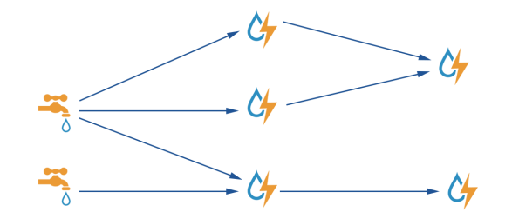
Distributed Processing ??
Logical query on a single stream of data
Physical implementation: distributed system
How to ensure consistency ? High performance ? Resilience to errors ?
Emerging architectures: Apache STORM
Notes:
Implemenations are plenty... choose one that has typical features

Slide 49
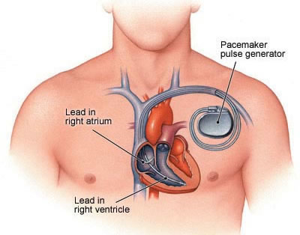
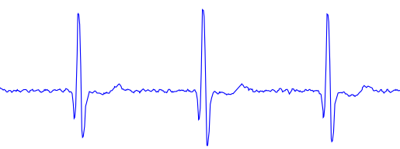
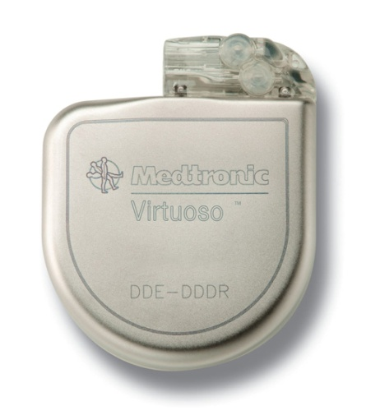
Safety-critical Applications ??
Clinical diagnosis
→ pacing stimulus
Specification: logical query over analog signal
➔ Implementation: discrete control software
Predictable response time critical
Key resource constraint: battery life, so need optimized code
Goal: design more effective diagnosis strategies
Notes:
Implemenations are plenty... choose one that has typical features

Slide 50
Principles of Real-time Decision Making
Programming
Languages
Streaming
Algorithms
Formal
Methods
Optimal
Control Theory
Data driven
Smart Control
Distributed
Computing
Real-Time
Systems
Security &
Privacy
Database
Theory
Notes:
Implemenations are plenty... choose one that has typical features

