Slide 1
Interfaces for Control Components
Rajeev Alur
University of Pennsylvania
Joint work with Gera Weiss (and many others)

Slide 2
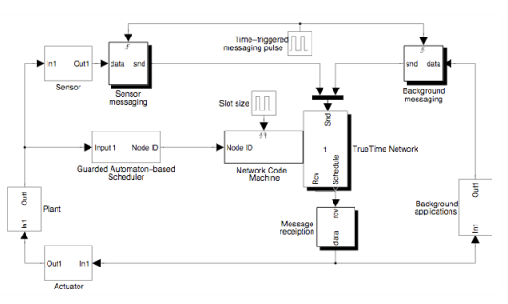
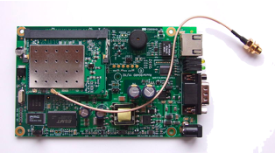
Interface-based Control Design
Interface: Simplified description useful for system integration
Control Designs
Implementation Platforms

Slide 3
Interface Specs: Desirable Properties
Compositional:
Design each component in isolation
Dependable:
If interface spec is satisfied, performance goals are met
Separation of concerns:
Between control and software engineers
Analyzability:
Tool support to check if all interface specs can be met

Slide 4
Execution Period as Interface Spec
Control Designer:
Does sampling frequency ensure performance spec?
Discrete-time control theory
5 ms
Interface: Period at which sense-compute-actuate cycle to be executed
3 ms
System Integrator:
Can resource requirements of all the components be met?
Platform-specific WCET analysis
Real-time scheduling theory

Slide 5
Execution Period as an Interface Spec
Challenges:
Composition, adaptation to changes in resource availability, online admission control, performance optimization
Composing two periodic specs does not give periodic spec
Should component be executed more frequently, if possible?
How does period relate to control performance?

Slide 6
Time-triggered Resource Scheduling
Plant 1
Controller 1
Controller 2
Plant 2
Resource
Controller 1
Controller 2
Time

Slide 7
Automata Based Interfaces
Generalization of the periodic interface:
Automaton (regular language) for each component
specifying allowed patterns of resource allocations
1
0
1
Spec: Component must get at least one slot in a window of 4 slots
1
1
0
0
0: Slot not allocated to the component
1: Slot allocated to the component

Slide 8
Automata Based Interfaces
Infinite schedules specified using Buchi automata
1
0
Spec: Component must get infinitely many slots
0
1
Example specs:
Component must get at least 2 slots in a window of 5
Eventually component must get every alternate slot
Periodic: (k 0’s . 1) *

Slide 9
Composing Specs
Composition : Rename followed by intersection (product)
1
1
1
0
0
0
0
1
1
1
1
1
1
Component A
Component B
0
1
Rename
Rename
A
0
A
B
0/A
Product
A
0/B
0/A
A
B
A
A
0
B
B
Schedulability Test: Check if composition of all specs is nonempty

Slide 10
Analyzing stability with resource scheduling
Transitions happen at the beginning of Δ intervals
Different dynamics based on controller has the resource or not
t models elapsed time
Next discrete mode is determined by the schedule σ
Challenge: Compute set of schedules σ for which system is stable

Slide 11
Stable modes ⇏ Stability
stable
stable
unstable
Switching may introduce instability !

Slide 12
Can we express stability with a Finite Automaton?
Answer: No! (Language of stable schedules is not regular)
Proof: Transform a stable word to an unstable one by pumping

Slide 13
Exponential Stability
Regular
Stability
Exp. Stability
Quantified version of stability

Slide 14
Automata-based Interfaces
Control Designer:
Specify all acceptable allocation sequences as a regular language
E.g. Periodicity, Exponential stability, Fairness
Interface: Regular language for desired allocation on time-triggered platform
System Integrator:
Can resource requirements of all the components be met?
Find a schedule acceptable to all using automata constructions

Slide 15
Talk Overview
Embedded Control Software
Networked Control Systems
Wireless Control Networks
Motivation

Slide 16
Embedded Control Software
Java ???
Discrete Control
(Software)
Sensors
Actuators
Physical Plant
(Continuous Dynamics)

Slide 17
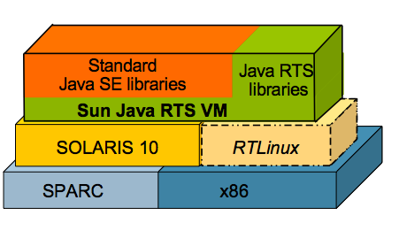
Java for Real-Time
Java
Bytecode portability
Component based
Java RTS
Real-time guarantees
No timing portability!
Can I run the same code on a faster machine and expect better performance?

Slide 18
RTComposer
A tool for building modular Real-Time Java applications
RTComposer
Interrupts
Non Real-Time
Real-Time Java
Real-Time Operating System
Component:
Java Class + Automaton specifying patterns of method calls

Slide 19
Logical Execution Time
Macro Schedule: Assignment of methods to time slots
Micro Schedule: CPU scheduling within each slot
I/O
I/O
I/O
I/O
I/O
Macro
Micro
Short method
Heavy method
Component 1
Component 2
Interrupts
Tasks finish in allotted slots ⇒ Dynamics determined by macro schedule
We use automata interfaces for specifying macro schedules

Slide 20
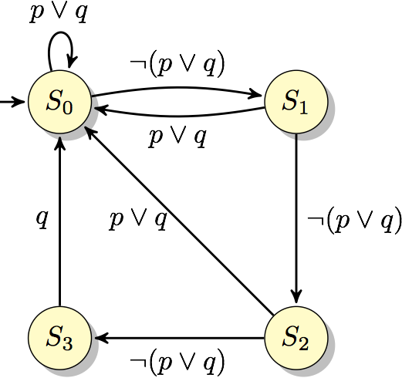
Example component
Class signature:
public class Example {
void p() {...};
void q() {...};
void r() {...};
}
Requirement:
Methods p and q not invoked for 3 consecutive slots
⇒ q must run in the next slot
Temporal logic:
Automaton:

Slide 21
Proposed Methodology
Component
Component
Which methods can be executed together within a slot?
Automaton
Automaton
Platform
empty?
Product Automaton
Automaton
Macro Scheduler
inter-slot schedule
Interrupts
Micro Scheduler
Background tasks
intra-slot schedule
CPU

Slide 22
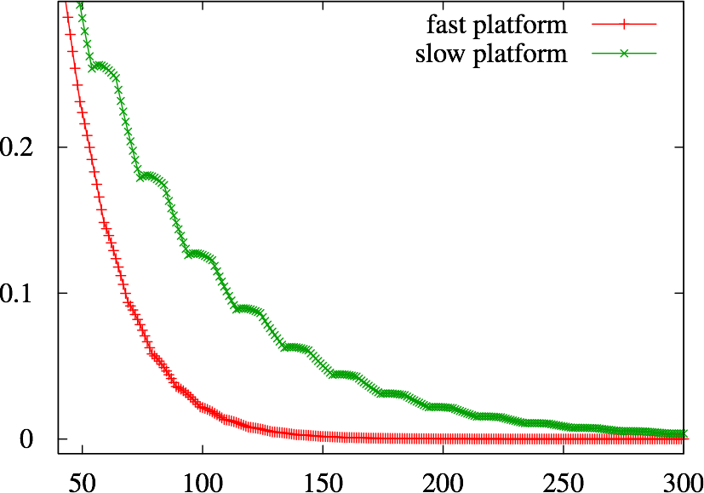
Timing Portability
Bytecode portability is not enough for real-time systems
Previous approaches:
Same timing on fast and slow machines [Giotto, Metronome, Exotasks]
RTComposer:
Faster machines allow better performance (faster convergence)
Displacement (millimeters)
Time (milliseconds)

Slide 23
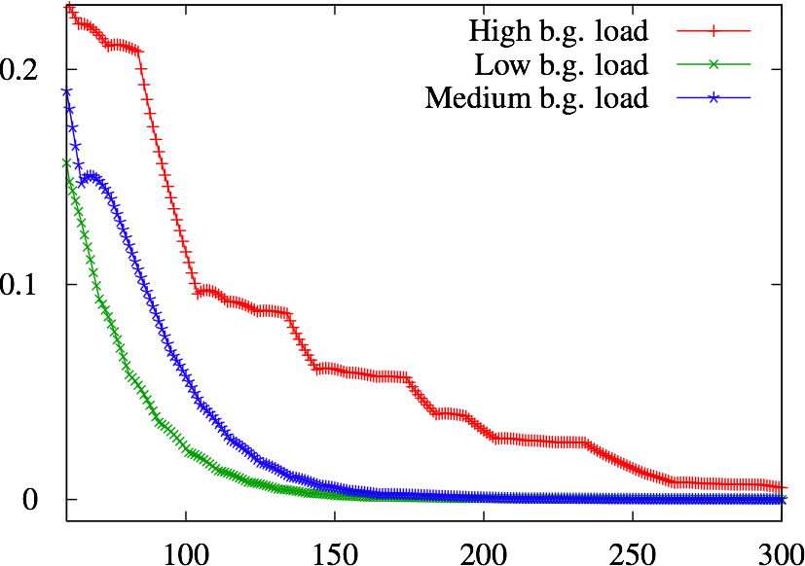
Dynamic Scheduling
Static schedules [Giotto, Exotasks]:
Same set of methods in all execution slots.
RTComposer:
Dynamic assignment of methods to execution slots allows to adjust to changing conditions
Displacement (millimeters)
Time (milliseconds)

Slide 24
Talk Overview
Motivation
Embedded Control Software
Networked Control Systems
Wireless Control Networks

Slide 25
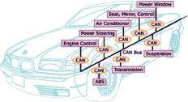
Networked Control Systems
Systems where control loops are closed through a real-time network
State of the art:
Static time-triggered scheduling mechanisms
Our focus:
Dynamic network scheduling based on sensor reading

Slide 26
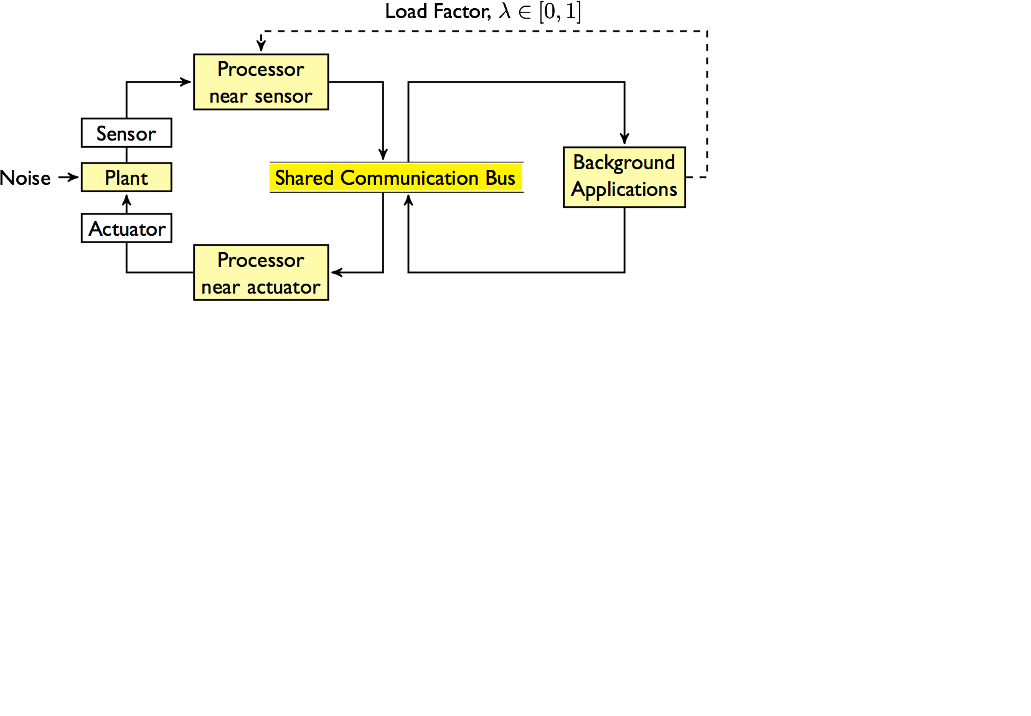
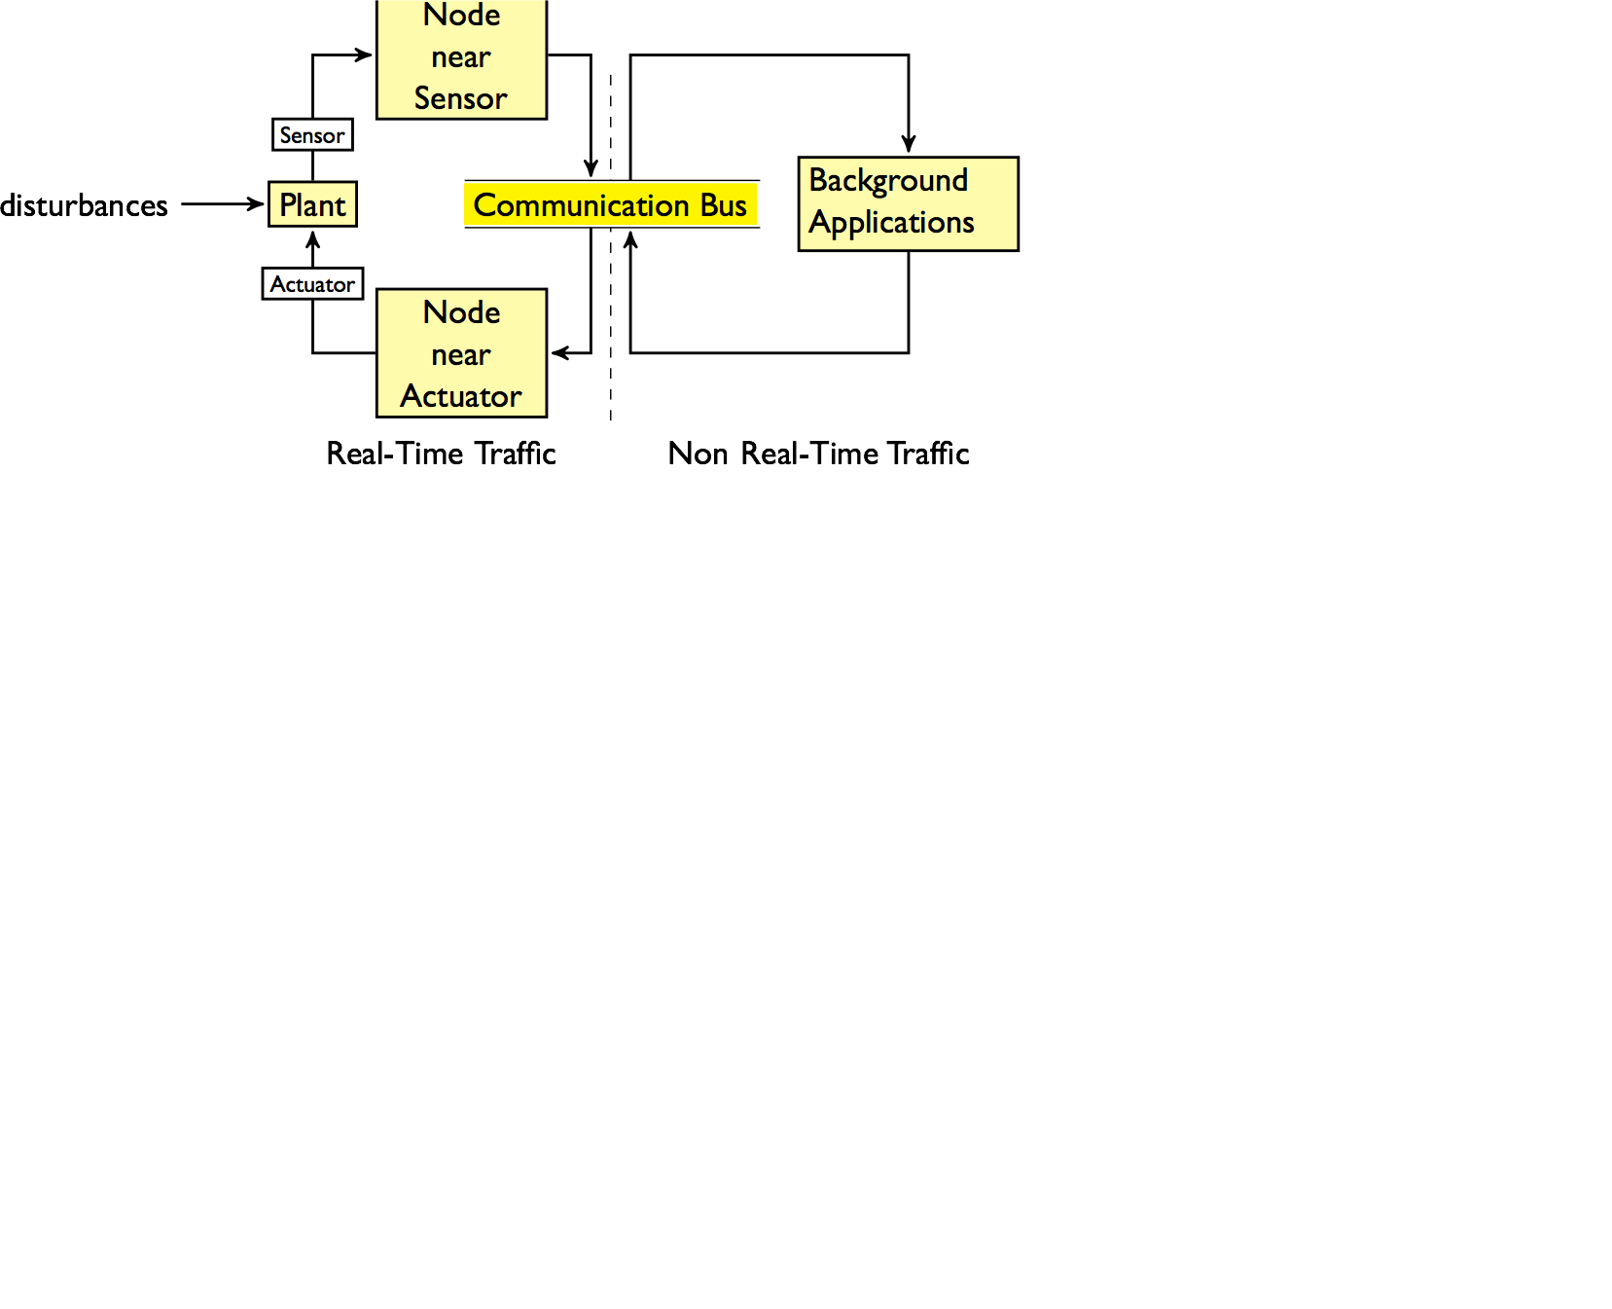
Resource Allocation for Communication
High Priority
Low Priority
When should the node near the sensor send messages?

Slide 27
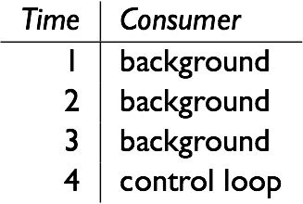
Static Schedules
Advantages: Lightweight implementation, analyzable
Limitation: Cannot adjust to changing conditions
Challenge: Use sensor reading to generate schedules?
Constraint: Light-weight and analyzable computation

Slide 28
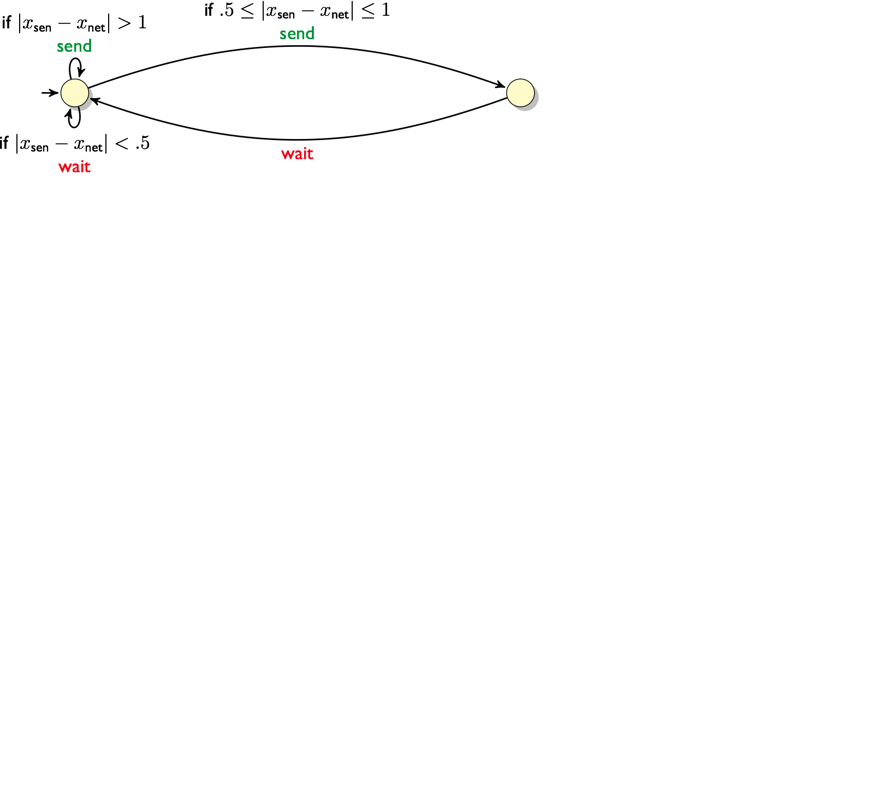
Automata Based Dynamic Scheduling
Challenge: Design such automata in a systematic way

Slide 29
Problem Formulation
Switched System
Transducer
rand

Slide 30
First Step: Alarm Automaton

Slide 31
Computing the Guards

Slide 32
From Automaton to Transducer
Switched System
Transducer
???
rand
This scheme ensures stable words, unless the initial state is bad

Slide 33
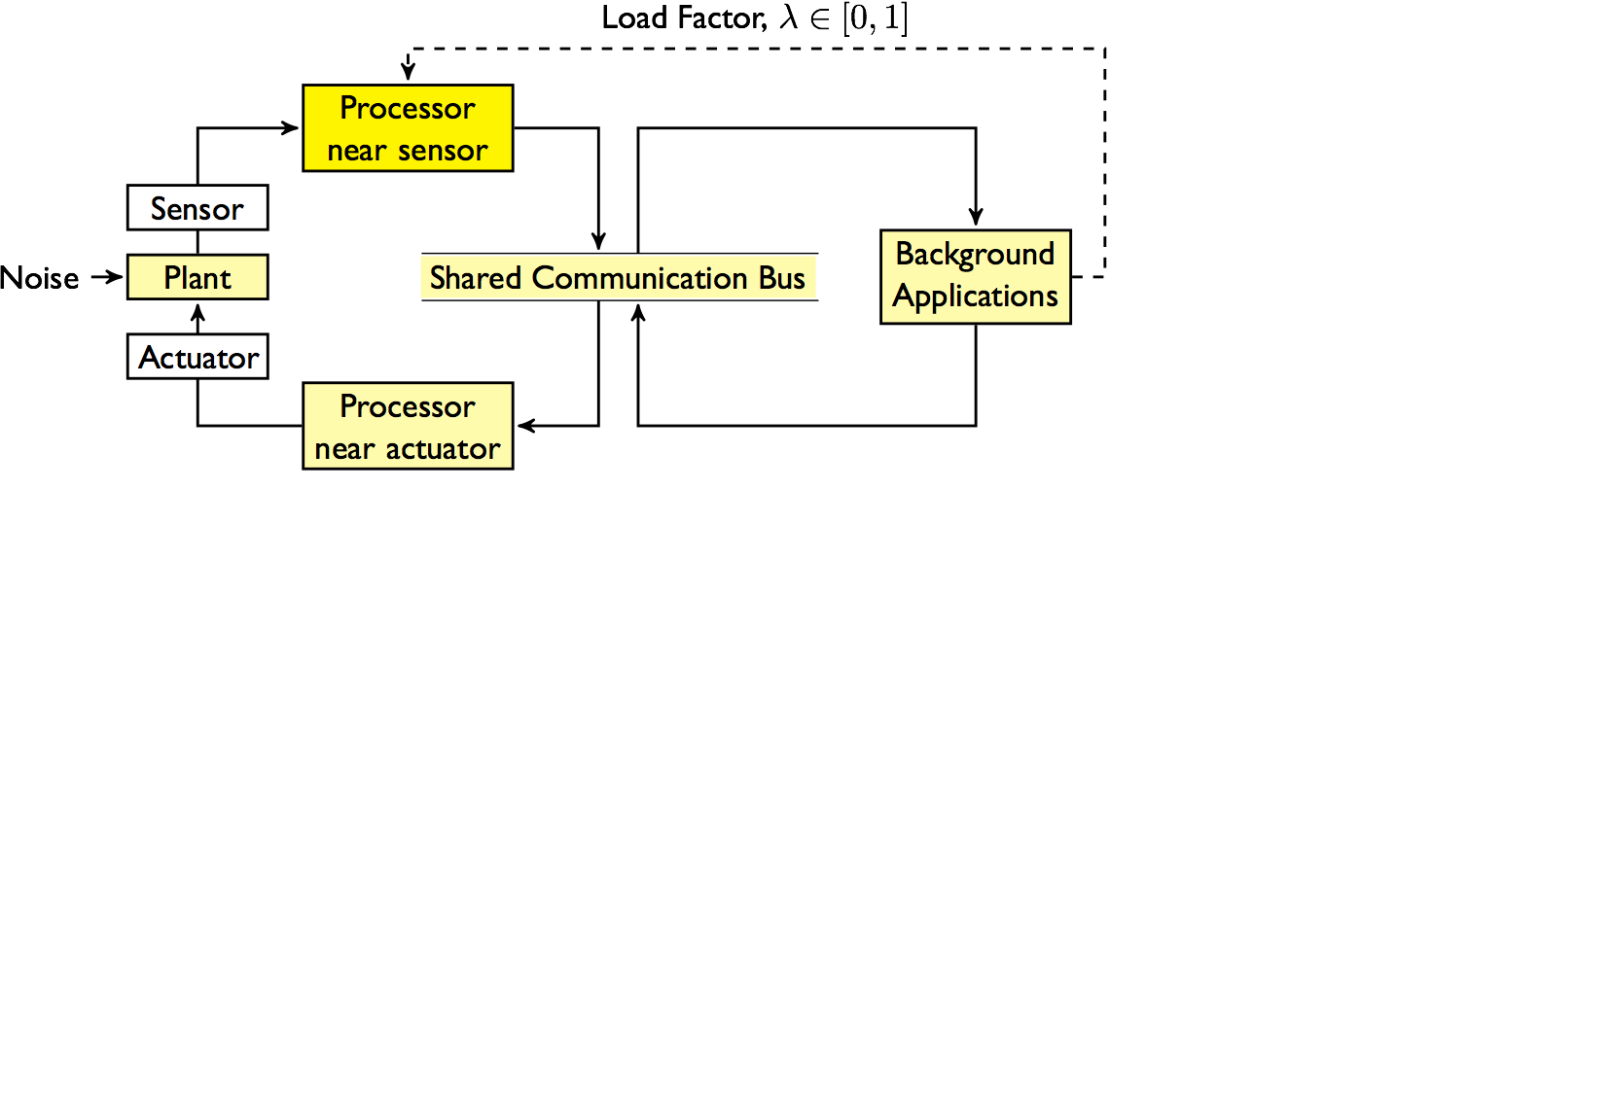
Scheduling Scheme

Slide 34
Simulation Results Varying Load
Static schedules will give worst case response all the time

Slide 35
Simulation Results
Sporadic Disturbances
A static schedule must keep a constant (high) network load
With our approach: High load comes only after disturbances

Slide 36
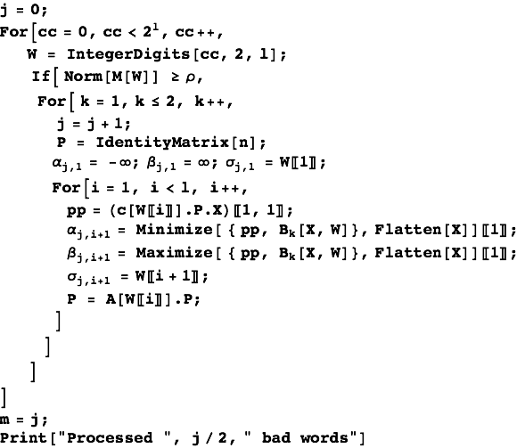
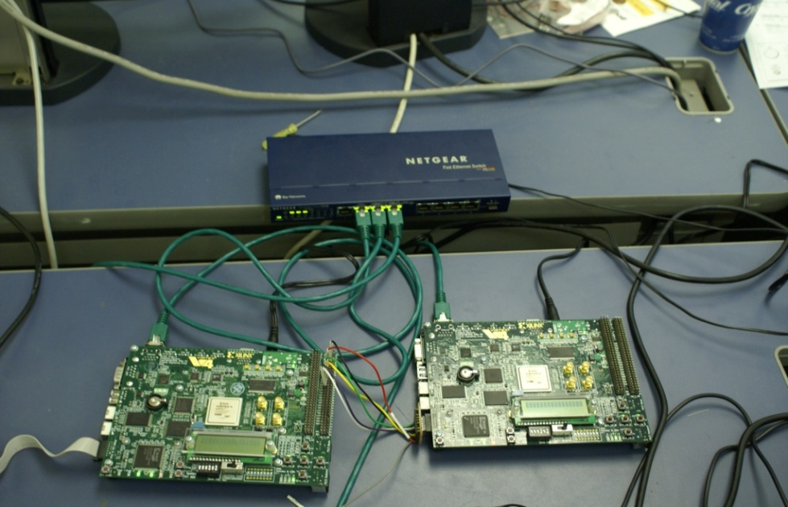
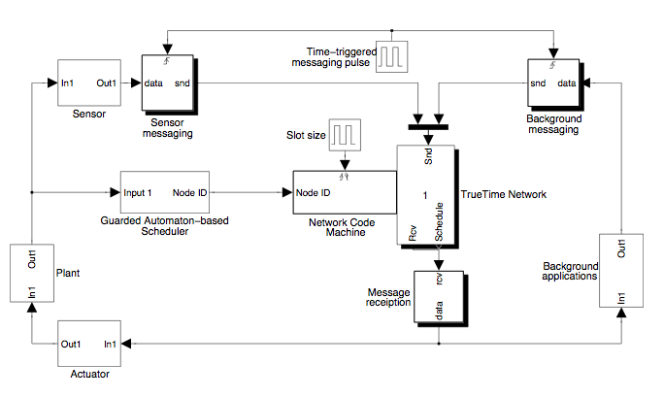
State of the Work
Automaton generation in Mathematica
Simulation in TrueTime based on Network Code Machine
Software prototype on CAN, Ethernet+RTLinux
FPGA IP core working at line speed on 100Mb Ethernet
Courtesy of Robert Trausmuth et al.

Slide 37
Talk Overview
Motivation
Embedded Control Software
Network Control Systems
Wireless Control Networks

Slide 38
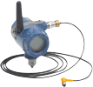
Motivation
Growing use of wireless technologies for control
Sensors, controllers, and actuators communicate using multi-hop network
Aspects: Control design, network topology, routing, scheduling
Compositional analysis for co-design of network and control

Slide 39
Multi-Hop Control Networks
A distributed system of sensor and actuator nodes interconnected by communication links:
Plant 2
Plant 1
Controller
measurement
feedback
Plant 3

Slide 40
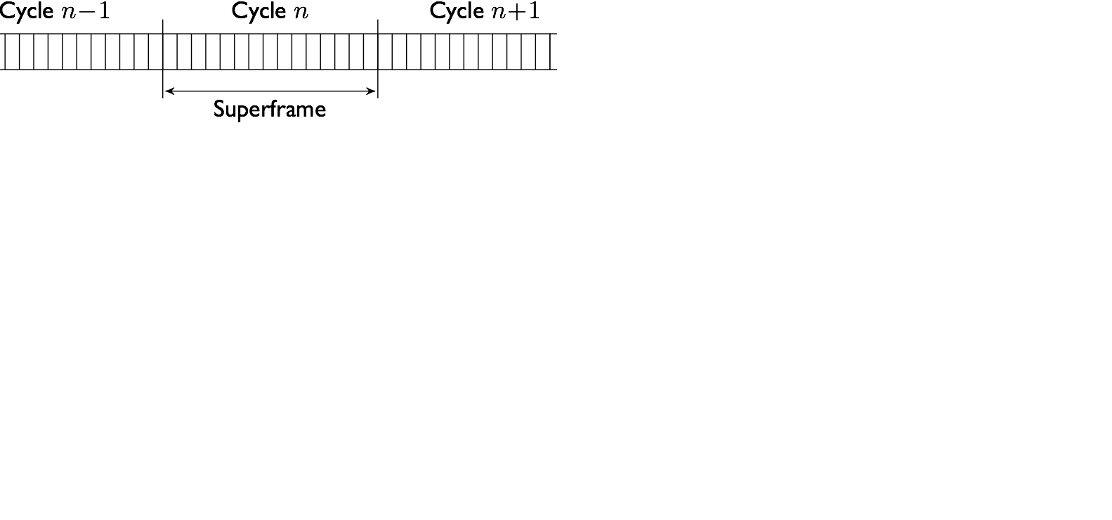
WirelessHART™
Time Division Multiple Access (TDMA)
Each device maintains a precise sense of time
Communication is done in pre-scheduled time frames
A periodic schedule, called Superframe, is distributed
Challenge: Systematic design and evaluation of schedules?

Slide 41
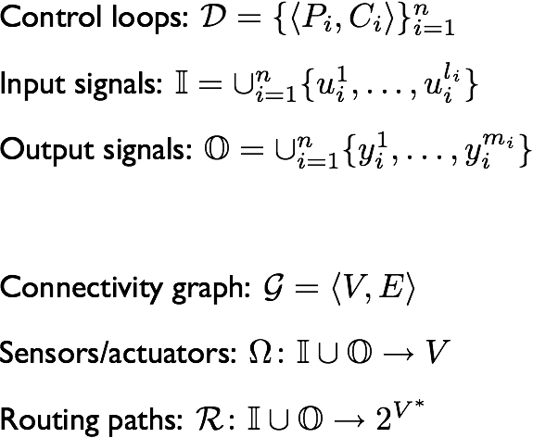
Formal Model
Dynamics of plants and controllers, names of input and output signals
Communication channels, assignment of signals to nodes, and routing

Slide 42
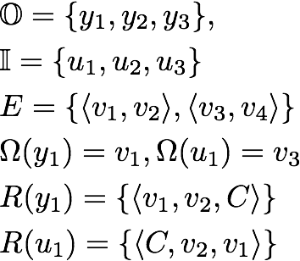
Example
Plant 2
1
2
Plant 1
Controller
3
4
Plant 3

Slide 43
Resource Allocation Schedules
Example
Plant 2
1
2
Plant 1
Controller
3
4
Plant 3

Slide 44
Switched System Semantics

Slide 45
Mathematica Based Tool
Multi-Hop Control Network
Switched Systems
Schedules &
Controller Design
Input syntax: the mathematical model presented earlier
Automatic translation to switched systems
Experimental implementation of some design methodologies
Supports compositional analysis (separate model for each control loop)

Slide 46
Example 1: Controller Design
We demonstrate an application of the following recipe:
Model the Multi-Hop Control Network, including schedules
Design a parametric controller for each control loop
Resolve parameters, using the Mathematica based tool, by requiring stability of the switched system

Slide 47
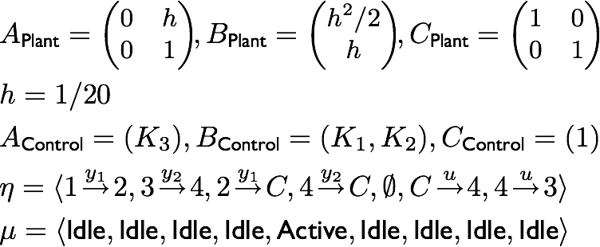
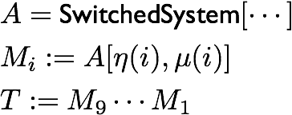
Example 1: Controller Design
1
2
Plant
Controller
3
4
Multi Hop Control Network
Obtain a switched system dynamics
Choose parameters by solving a
pole assignment equation

Slide 48
Example 2: Stability Verification
1
2
Plant
Controller
3
4

Slide 49
Example 3: Compositional Analysis
Plant 1
Controller
Plant 2

Slide 50
Case Study
Separation of minerals using floatation cells
Boliden mine, Garpenberg, Sweden
17 Control loops communicating using WirelessHART
Computed set of acceptable schedules/routes for each loop
Schedule generated by interesecting 17 automata using NuSMV
Shortest path generated by SMV as a counter-example to the
claim that no schedule exists that is acceptable to all

Slide 51
References
Automata based interfaces for control and scheduling
Weiss, Alur. HSCC 2007
RTComposer: A framework for real-time components with
scheduling interfaces
Alur, Weiss. EMSOFT 2008
Specification and analysis of network resource requirements of
control systems
Weiss, Fischmeister, Anand, Alur. HSCC 2008
Modeling and analysis of multi-hop control networks
Alur, D’Innocenzo, Johansson, Pappas, Weiss. RTAS 2008
Scalable scheduling algorithms for wireless networked control
D’Innocenzo, Weiss, Alur, Isaksson, Johansson, Pappas. CASE 2009

Slide 52
Recap: Automata-based Interfaces
Control Designer:
Specify all acceptable allocation sequences as a regular language
E.g. Periodicity, Exponential stability, Fairness
Interface: Regular language for desired allocation on time-triggered platform
System Integrator:
Can resource requirements of all the components be met?
Find a schedule acceptable to all using automata constructions
Applications: Real-time Java components, Networked sensors/actuators
Wireless control network (WirelessHART)

