Slide 1


Syntax-Guided Program Synthesis
Rajeev Alur
University of Pennsylvania

Slide 2
Part I
(Syntax-guided) Synthesis: Why and What ?

Slide 3







Formal Verification in Practice
Next Challenge: Beyond Verification and Testing ??

Slide 4
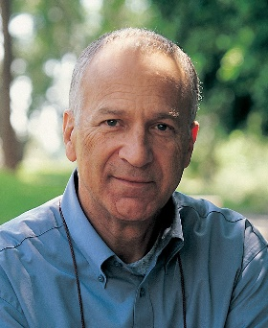
Vision of Program Synthesis
Can programming be liberated, period.
David Harel, IEEE Computer, 2008
Enabling Technologies
  More computing power
  Mature software analysis/verification tools
  Better human-computer interfaces
  Data mining tools for code repositories

Slide 5
Applications in the near term …
Programming by examples (PBE)
Superoptimizing compilers
Program repair
Proof objects for verification

Slide 6
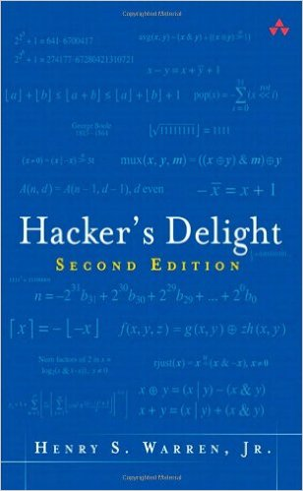
1. Programming By Examples (PBE)
Desired program P: bit-vector transformation that resets rightmost substring of contiguous 1’s to 0’s
1. P should be constructed from standard bit-vector operations
|, &, ~, +, -, <<, >>, 0, 1, …
2. P specified using input-output examples
00101 → 00100
01010 → 01000
10110 → 10000
Desired solution:
x & ( 1 + (x | (x-1) )

Slide 7

FlashFill: PBE in Practice
Ref: Gulwani (POPL 2011)
Input | Output
(425)-706-7709 | 425-706-7709
510.220.5586 | 510-220-5586
1 425 235 7654 | 425-235-7654
425 745-8139 | 425-745-8139
  Wired: Excel is now a lot easier for people who aren’t spreadsheet- and chart-making pros. The application’s new Flash Fill feature recognizes patterns, and will offer auto-complete options for your data. For example, if you have a column of first names and a column of last names, and want to create a new column of initials, you’ll only need to type in the first few boxes before Excel recognizes what you’re doing and lets you press Enter to complete the rest of the column.
Notes:
7

Slide 8
Scythe: SQL queries from input-output examples
Wang, Cheung, Bodik; scythe.cs.washington.edu

Slide 9
2. Program Optimization
Can regular programmers match experts in code performance?
Improved energy performance in resource constrained settings
Adoption to new computing platforms such as GPUs
Opportunity: Semantics-preserving code transformation
Possible Solution: Superoptimizing Compiler
Structure of transformed code may be dissimilar to original

Slide 10
Superoptimization Illustration
Given a program P, find a “better” equivalent program P’
average (bitvec[32] x, y) {
bitvec[64] x1 = x;
bitvec[64] y1 = y;
bitvec[64] z1 = (x1+y1)/2;
bitvec[32] z = z1;
return z
}
Find equivalent code without extension to 64 bit vectors
average (x, y) =
(x and y) + [(x xor y) shift-right 1 ]

Slide 11
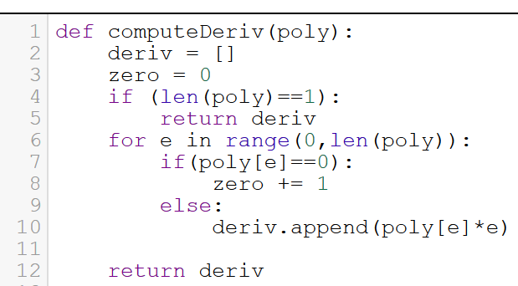
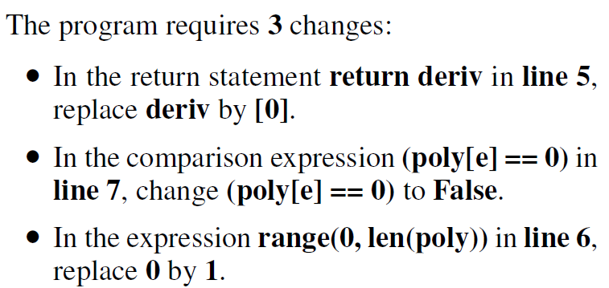
3. Repair/Feedback for Programming Homeworks
Singh et al (PLDI 2013)
Student Solution P
+ Reference Solution R
+ Error Model
Find min no of edits to P so as to make it equivalent to R

Slide 12
4. Automatic Invariant Generation
SelectionSort(int A[],n) {
i := 0;
while(i < n−1) {
v := i;
j := i + 1;
while (j < n) {
if (A[j]<A[v])
v := j ;
j++;
}
swap(A[i], A[v]);
i++;
}
return A;
}
Invariant: ?
Invariant: ?
post: ∀k : 0 ≤k<n ⇒ A[k]≤A[k + 1]
Notes:
The next several slides visualize a verification problem for a given program, in this case one that implements selection sort. The precondition, not shown, gives that n is length of A; the postcondition is given at the bottom of the slide: that each element of the array is in ascending order (and also that it is a permutation of the initial array, but this part is not shown). The goal of verification is to prove that, given input that satisfies the precondition, running the program will always produce output that satisfies the postcondition.
Then we show how this same approach can be slightly generalized to synthesize most of the program, rather than verify it. This is the PTS approach developed by Gulwani, Srivastava, and Foster.

Slide 13
Template-based Automatic Invariant Generation
SelectionSort(int A[],n) {
i :=0;
while(i < n−1) {
v := i;
j := i + 1;
while (j < n) {
if (A[j]<A[v])
v := j ;
j++;
}
swap(A[i], A[v]);
i++;
}
return A;
}
Invariant:
∀k1,k2. ? ∧ ?
Invariant:
? ∧ ? ∧
(∀k1,k2. ? ∧ ?) ∧ (∀k. ? ∧ ?)
Constraint solver
post: ∀k : 0 ≤k<n ⇒ A[k]≤A[k + 1]
Notes:
The next several slides visualize a verification problem for a given program, in this case one that implements selection sort. The precondition, not shown, gives that n is length of A; the postcondition is given at the bottom of the slide: that each element of the array is in ascending order (and also that it is a permutation of the initial array, but this part is not shown). The goal of verification is to prove that, given input that satisfies the precondition, running the program will always produce output that satisfies the postcondition.
Then we show how this same approach can be slightly generalized to synthesize most of the program, rather than verify it. This is the PTS approach developed by Gulwani, Srivastava, and Foster.

Slide 14
Template-based Automatic Invariant Generation
SelectionSort(int A[],n) {
i :=0;
while(i < n−1) {
v := i;
j := i + 1;
while (j < n) {
if (A[j]<A[v])
v := j ;
j++;
}
swap(A[i], A[v]);
i++;
}
return A;
}
Invariant:
∀k1,k2. 0≤k1<k2<n ∧
k1<i ⇒ A[k1]≤A[k2]
Invariant:
i<j ∧
i≤v<n ∧
(∀k1,k2. 0≤k1<k2<n ∧
k1<i ⇒ A[k1]≤A[k2]) ∧
(∀k. i1≤k<j ∧
k≥0 ⇒ A[v]≤A[k])
post: ∀k : 0 ≤k<n ⇒ A[k]≤A[k + 1]
Notes:
The next several slides visualize a verification problem for a given program, in this case one that implements selection sort. The precondition, not shown, gives that n is length of A; the postcondition is given at the bottom of the slide: that each element of the array is in ascending order (and also that it is a permutation of the initial array, but this part is not shown). The goal of verification is to prove that, given input that satisfies the precondition, running the program will always produce output that satisfies the postcondition.
Then we show how this same approach can be slightly generalized to synthesize most of the program, rather than verify it. This is the PTS approach developed by Gulwani, Srivastava, and Foster.

Slide 15
Syntax-Guided Program Synthesis
Rich variety of projects in programming systems and software engineering
  Programming by examples
  Program superoptimization
  Automatic program repair
  Template-guided invariant generation
Computational problem at the core of all these synthesis projects:
Find a program that meets given syntactic and semantic constraints

Slide 16
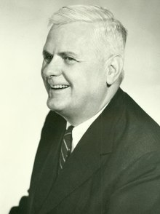
Classical Program Synthesis
Church (1957)
Logical relation ϕ(x,y)
among input x and output y
Specification
“What”
Constructive proof of
Exists f. For all x. ϕ(x,f(x))
Synthesizer
Function f(x) such that
ϕ(x,f(x))
Implementation
“How”

Slide 17
Syntax-Guided Program Synthesis
www.sygus.org
Logical formula
ϕ(x,y)
Semantic
Specification
Syntactic
Specification
Set E of
expressions
Search for e in E
s.t. ϕ(x,e(x))
Synthesizer
Implementation

Slide 18
Part II
Syntax-guided Synthesis: Formalization

Slide 19
Syntax-Guided Program Synthesis
www.sygus.org
Find a program snippet e such that
1. e is in a set E of programs (syntactic constraint)
2. e satisfies logical specification ϕ (semantic constraint)
Core computational problem in many synthesis tools/applications
Can we formalize and standardize this computational problem?
Inspiration: Success of SMT solvers in formal verification

Slide 20
SMT: Satisfiability Modulo Theories
Computational problem: Find a satisfying assignment to a formula
  Boolean + Int types, logical connectives, arithmetic operators
  Bit-vectors + bit-manipulation operations in C
  Boolean + Int types, logical/arithmetic ops + Uninterpreted functs
“Modulo Theory”: Interpretation for symbols is fixed
  Can use specialized algorithms (e.g. for arithmetic constraints)
Little Engines of Proof
SAT; Linear arithmetic; Congruence closure

Slide 21
Syntax-Guided Synthesis (SyGuS) Problem
Fix a background theory T: fixes types and operations
Function to be synthesized: name f along with its type
  General case: multiple functions to be synthesized
Inputs to SyGuS problem:
  Specification ϕ(x, f(x))
  Typed formula using symbols in T + symbol f
  Set E of expressions given by a context-free grammar
  Set of candidate expressions that use symbols in T
Computational problem:
Output e in E such that ϕ[f/e] is valid (in theory T)
Syntax-guided synthesis; FMCAD’13
with Bodik, Juniwal, Martin, Raghothaman, Seshia, Singh, Solar-Lezama, Torlak, Udupa

Slide 22
SyGuS Example 1
Theory QF-LIA (Quantifier-free linear integer arithmetic)
Types: Integers and Booleans
Logical connectives, Conditionals, and Linear arithmetic
Quantifier-free formulas
Function to be synthesized f (int x₁, x₂) : int
Specification: (x₁ ≤ f(x₁, x₂)) & (x₂ ≤ f(x₁, x₂))
Candidate Implementations: Linear expressions
LinExp := x₁ | x₂ | Const | LinExp + LinExp | LinExp - LinExp
No solution exists

Slide 23
SyGuS Example 2
Theory QF-LIA
Function to be synthesized: f (int x₁ , x₂) : int
Specification: (x₁ ≤ f(x₁, x₂)) & (x₂ ≤ f(x₁, x₂))
Candidate Implementations: Conditional expressions without +
Term := x₁ | x₂ | Const | If-Then-Else (Cond, Term, Term)
Cond := Term ≤ Term | Cond & Cond | ~ Cond | (Cond)
Possible solution:
If-Then-Else (x₁ ≤ x₂, x₂, x₁)

Slide 24
From SMT-LIB to SYNTH-LIB
  (set-logic LIA)
  (synth-fun max2 ((x Int) (y Int)) Int
  ((Start Int (x y 0 1
  (+ Start Start)
  (- Start Start)
  (ite StartBool Start Start)))
  (StartBool Bool ((and StartBool StartBool)
  (or StartBool StartBool)
  (not StartBool)
  (<= Start Start))))
  (declare-var x Int)
  (declare-var y Int)
  (constraint (≤ x (max2 x y)))
  (constraint (≤ y (max2 x y)))
  (constraint (or (= x (max2 x y)) (= y (max2 x y))))
  (check-synth)
www.sygus.org

Slide 25
Invariant Generation as SyGuS
bool x, y, z
int a, b, c
while( Test ) {
loop-body
….
}
Goal: Find inductive loop invariant automatically
Function to be synthesized
Inv (bool x, bool z, int a, int b) : bool
Compile loop-body into a logical predicate
Update(x,y,z,a,b,c, x’,y’,z’,a’,b’,c’)
Specification:
( Inv & Update & Test’) ⇒ Inv’
& Pre ⇒ Inv & (Inv & ~Test ⇒ Post)
Template for set of candidate invariants
Term := a | b | Const | Term + Term | If-Then-Else (Cond, Term, Term)
Cond := x | z | Cond & Cond | ~ Cond | (Cond)

Slide 26
Part III
Solving SyGuS

Slide 27
Solving SyGuS
Is SyGuS same as solving SMT formulas with quantifier alternation?
SyGuS can sometimes be reduced to Quantified-SMT, but not always
  Set E is all linear expressions over input vars x, y
  SyGuS reduces to Exists a,b,c. Forall X. ϕ [ f/ ax+by+c]
  Set E is all conditional expressions
  SyGuS cannot be reduced to deciding a formula in LIA
Syntactic structure of the set E of candidate implementations can be used effectively by a solver
Existing work on solving Quantified-SMT formulas suggests solution strategies for SyGuS

Slide 28
SyGuS as Active Learning
Initial examples I
Candidate
Expression
Search
Algorithm
Verification
Oracle
Counterexample
Fail
Success
Concept class: Set E of expressions
Examples: Concrete input values

Slide 29

Counterexample-Guided Inductive Synthesis
Solar-Lezama et al (ASPLOS’06)
Specification: (x₁ ≤ f(x₁, x₂)) & (x₂ ≤ f(x₁, x₂))
Set E: All expressions built from x₁, x₂,0,1, Comparison, If-Then-Else
I = { }
Candidate
f(x₁, x₂) = x₁
Search
Algorithm
Verification
Oracle
Counterexample
(x₁=0, x₂=1)

Slide 30
CEGIS Example
Specification: (x₁ ≤ f(x₁, x₂)) & (x₂ ≤ f(x₁, x₂))
Set E: All expressions built from x₁, x₂,0,1, Comparison, If-Then-Else
I = {(x₁ =0, x₂ =1) }
Candidate
f(x₁, x₂) = x₂
Search
Algorithm
Verification
Oracle
Counterexample
(x₁ =1, x₂ =0)

Slide 31
CEGIS Example
Specification: (x₁ ≤ f(x₁, x₂)) & (x₂ ≤ f(x₁, x₂))
Set E: All expressions built from x₁, x₂,0,1, Comparison, If-Then-Else
{(x₁ =0, x₂ =1)
(x₁ =1, x₂ =0)
(x₁ =0, x₂ =0)
(x₁ =1, x₂ =1)}
Candidate
ITE(x₁ ≤ x₂,x₂,x₁)
Search
Algorithm
Verification
Oracle
Success

Slide 32
Counterexample-guided Inductive Synthesis (CEGIS)
Goal: Find f in E such that for all x in D, ϕ(x, f) holds
I = { }; /* Interesting set of inputs */
Repeat
Learn: Find f in E such that for all x in I, ϕ(f, x) holds
Verify: Find x in D such that ϕ(f, x) does not hol
If so, add x to I
Else, return f

Slide 33
SyGuS Solutions
CEGIS approach (Solar-Lezama et al, ASPLOS’08)
Similar strategies for solving quantified formulas and invariant generation
Initial learning strategies based on:
  Enumerative (search with pruning): Udupa et al (PLDI’13)
  Symbolic (solving constraints): Gulwani et al (PLDI’11)
  Stochastic (probabilistic walk): Schkufza et al (ASPLOS’13)

Slide 34
1. Enumerative Search
Given:
Specification ϕ(x, f(x))
Grammar for set E of candidate implementations
Finite set I of inputs
Find an expression e(x) in E s.t. ϕ(x,e(x)) holds for all x in I
Attempt 0: Enumerate expressions in E in increasing size till you find one that satisfies ϕ for all inputs in I
Attempt 1: Pruning of search space based on:
Expressions e₁ and e₂ are equivalent
if e₁(x)=e₂(x) on all x in I
Only one representative among equivalent subexpressions needs
to be considered for building larger expressions

Slide 35
Illustrating Pruning
Spec: (x₁ < f(x₁, x₂)) & (x₂ < f(x₁, x₂))
Grammar: E := x₁ | x₂ | 0 | 1 | E + E
I = { (x₁=0, x₂=1) }
Find an expression f such that (f(0,1) > 0) & (f(0,1) > 1)
x₁ x₂
0 1
x₁ + x₁ x₁ + x₂ x₂ + x₂
x₂ + x₁

Slide 36
2. Symbolic Search
Use a constraint solver for both synthesis and verification steps
Each production in the grammar is thought of as a component.
  Input and Output ports of every component are typed.
Term
Term
Cond
+
ITE
>=
Cond
Term
Term
Term
Term
Term
Term
Term
Term
Term
Term
x
y
0
1
A well-typed loop-free program comprising these component corresponds to an expression DAG from the grammar.

Slide 37
Symbolic Encoding
Start with a library consisting of some number of occurrences of each component.
n1
n2
n3
n4
n5
n6
n7
n8
n9
n10
x
x
y
y
0
1
+
+
>=
ITE
  Synthesis Constraints:
Shape is a DAG, Types are consistent
Spec ϕ[f/e] is satisfied on every concrete input in I
Use an SMT solver (Z3) to find a satisfying solution.
If synthesis fails, try increasing the number of occurrences of components in the library in an outer loop

Slide 38
3. Stochastic Search
Idea: Find desired expression e by probabilistic walk on graph where nodes are expressions and edges capture single-edits
Metropolis-Hastings Algorithm: Given a probability distribution P over domain X, and an ergodic Markov chain over X, samples from X
Fix expression size n. X is the set of expressions E_{n} of size n. P(e) ∝Score(e) (“Extent to which e meets the spec φ”)
For a given set Examples, Score(e) = exp( - 0.5 Wrong(e)), where Wrong(e) = No of inputs in Examples for which ~ ϕ [f/e]
Score(e) is large when Wrong(e) is small. Expressions e with Wrong(e) = 0 more likely to be chosen in the limit than any other expression

Slide 39
Stochastic Search
Initial candidate expression e sampled uniformly from E_{n}
When Score(e) = 1, return e
Pick node v in parse tree of e uniformly at random. Replace subtree rooted at e with subtree of same size, sampled uniformly
e
e’
+
+
+
z
z
-
x
y
1
z
With probability min{ 1, Score(e’)/Score(e) }, replace e with e’
Outer loop responsible for updating expression size n

Slide 40
Part IV
SyGuS Competition and Evolution

Slide 41
SMT Success Story
CBMC
SAGE
VCC
Spec#
…
SMT-LIB Standardized Interchange Format (smt-lib.org)
Problem classification + Benchmark repositories
LIA, LIA_UF, LRA, QF_LIA, …
+ Annual Competition (smt-competition.org)
Z3
Yices
CVC4
MathSAT5
…

Slide 42
SyGuS Competition
Program
optimization
Programming
by examples
Program
repair
Invariant
generation
SYNTH-LIB Standardized Interchange Format
Problem classification + Benchmark repository
+ SyGuS-COMP (Competition for solvers) held since FLoC 2014
Techniques for Solvers:
Learning, Constraint solvers, Enumerative/stochastic search
Collaborators: D. Fisman, S. Padhi, A. Reynolds, R. Singh, A. Solar-Lezama, A. Udupa

Slide 43
SyGuS Progress
www.sygus.org
Over 2000 benchmarks
  Hacker’s delight
  Invariant generation (based on verification competition SV-Comp)
  FlashFill (programming by examples system from Microsoft)
  Synthesis of attack-resilient crypto circuits
  Program repair
  Motion planning
  ICFP programming competition
Special tracks for competition
  Invariant generation
  Programming by examples
  Conditional linear arithmetic
New solution strategies and applications

Slide 44
Scaling Enumerative Search by Divide & Conquer
For the spec (x₁ ≤ f(x₁, x₂)) & (x₂ ≤ f(x₁, x₂)) the answer is
If-Then-Else (x₁ ≤ x₂, x₂, x₁)
Size of expressions in conditionals and terms can be much smaller than the size of the entire expression!
f(x₁, x₂)= x₂ is correct when x₁ ≤ x₂ and f(x₁, x₂)= x₁ is correct otherwise
Key idea:
  Generate partial solutions that are correct on subsets of inputs and combine them using conditionals
  Enumerate terms and tests for conditionals separately
  Terms and tests are put together using decision tree learning
  With A. Radhakrishna and A. Udupa (TACAS 2017)

Slide 45
Enumerative Search with Decision Tree Learning
Expressions / Labels
Inputs / Data points
Predicates / Attributes
x₁
x₂
x₂+x₂
…
(x₁=0, x₂=1)
(x₁=1, x₂=0)
…
…
x₁ ≤ x₂
x₂+x₂ ≤ x₁
…
…
Input x labeled with expression e
if ϕ(x, e(x)) holds
Input x has attribute p
if p(x) holds
Desired decision tree:
Internal nodes: predicates + Leaves : expressions

Slide 46
Acceleration Using Learned Probabilistic Models
Can we bias the search towards likely programs?
Step 1: Mine existing solutions to convert given grammar into a probabilistic higher-order grammar
  Weighted production rules
  Conditioned on parent and sibling context
  Transfer learning used to avoid overfitting
Step 2: Enumerative search to generate expressions in decreasing likelihood
  Use A* with cost estimation heuristic
  Integrated with previous optimizations (equivalence-based pruning…)
  With W. Lee, K. Heo, and M. Naik (PLDI 2018)

Slide 47
Experimental Evaluation
2017 SyGuS Competition
Over 1500 benchmarks in different categories
Solution size:
about 20 AST nodes in string manipulation programs
upto 1000 AST nodes in bitvector manipulation programs
Number of participating solvers: 8
State of the art solver: Euphony
Enumerative + Decision trees + Learned probabilistic models
Evaluation of Euphony
70% of all benchmarks solved with a time limit of 1 hour
Average time ~ 10 min
Median time ~ 2 min
2019 Winner : CVC4 (Reynolds et al):
Integration of enumerative search with constraint solving !!

Slide 48
Emerging Applications of SyGuS
Synthesis of crypto-circuits resilient to timing attack
(Wang et al, CAV 2016)
Solving of quantified formulas in SMT solvers
(Biere et al, TACAS 2017)
To solve For all x. Exists y. ϕ(x,y)
synthesize Skolem function f(x) such that For all x. ϕ(x,f(x))
Improved solver for bit-vector arithmetic in CVC4
(Barrett et al, CAV 2018)
Automatic generation of side conditions for bit-vector rewriting
Automatic inversion of list manipulating programs
(Hu and D’Antoni, PLDI 2018)
Modeled as symbolic transducers and applied to string encoders

Slide 49
Side Channel Attacks on Cryptographic Circuits
PPRM1 AES S-Box implementation [Morioka and Satoh, 2002]
Vulnerability: Timing-based attack can reveal secret input In2

Slide 50
Countermeasure to Attack
FSA attack resilient ckt: All input-to-output paths have same delays
Manually hand-crafted solution [Schaumont et al, DATE 2014]

Slide 51
Synthesis of Attack Countermeasures
Given a circuit C, automatically synthesize a circuit C’ such that
1. C’ is functionally equivalent to C [sematic constraint]
2. All input-to-output paths in C’ have same length [syntactic constraint]
Existing EDA tools cannot handle this synthesis problem

Slide 52
SyGuS Result
Original ckt prone to attack
SyGuS-generated Attack resilient ckt
Fully automatic
Smaller size
Shorter delays
Hand-crafted attack resilient ckt

Slide 53
Part V
Application: Network Traffic Classification
Sharingan: Network traffic classification by program synthesis;
Collaborators: Shi, Loo; TACAS 2021

Slide 54
Network Traffic Engineering
(source IP, dest IP, payload)
drop / forward to port X /
alert controller
Switch
Dynamic network management for traffic engineering requires writing classification rules to identify anomalous traffic
Example attack: DDoS (flood attack to exhaust available resources)
Too many open connections within a short time interval from SourceIPs in a close range
Notes:
Implemenations are plenty... choose one that has typical features

Slide 55
Synthesis of Network Traffic Classifiers
Can we learn a traffic classifier from positive/negative examples?
Challenges:
Example: (very large) sequences of raw network packets
Very few examples, particularly of anomalous traffic
Operators need to manually examine potential false reports
Synthesized classifier should be interpretable (easy to decipher / edit)
Synthesized classifier should be efficiently implementable
Should be expressive to capture application-layer protocols …
Active research area:
automatic generation of classifiers using machine learning and data mining
Kitsune: An ensemble of Autoencoders for online network intrusion detection; Mirsky et al; NSDI 2018

Slide 56
Syntax-Guided Synthesis Based Solution
Choose a suitable DSL for traffic classifiers
  Expressive enough to capture a variety of attacks
  Built-in abstractions for succinct descriptions
Design a synthesis tool that, given positive and negative examples, finds a succinct expression in DSL consistent with examples
  Scalable enough to generate interesting classifiers
  Capable of handling traffic traces of thousands of packets
  Program synthesis based approach, in principle, can meet challenges of network traffic classification better than ML-based solutions
  Our solution: Sharingan

Slide 57
Choosing a DSL for Classifiers
(source IP, dest IP, payload)
drop / forward /
alert controller
Switch
Example classifier:
if number of packets in current VoIP session exceeds the average
over past VoIP sessions by a standard deviation then drop the packet
Low-level programming:
What state to maintain? How to update it?
Desired high-level abstraction: Beyond packet sequence
Notes:
Implemenations are plenty... choose one that has typical features

Slide 58
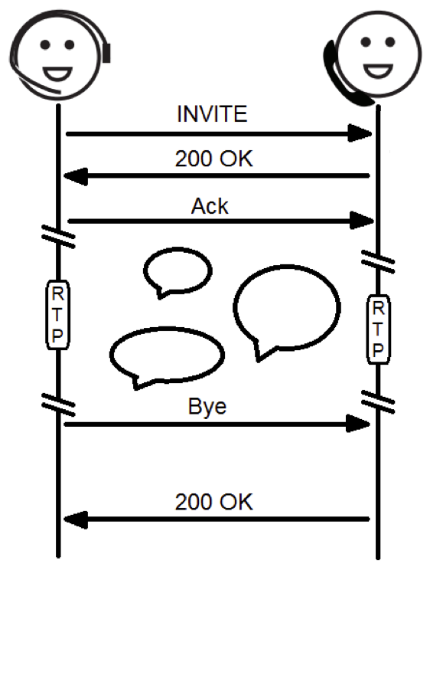
High-level Specification of VoIP Session Monitor
Focus on traffic between a specific source and destination
View data stream as a sequence of VoIP sessions
View a VoIP session as a sequence of three phases
Aggregate cost over call phase during a session, and aggregate cost across sessions
Init
Call
End
Session Initiation Protocol
Notes:
Implemenations are plenty... choose one that has typical features

Slide 59
NetQRE Language for Network Traffic Classifiers
SIGCOMM 2017 (with Y. Yuan and B.-T. Loo)
Core language: QRE (Quantitative Regular Expressions)
  Regular expressions
  Aggregate operators such as max, min, sum, average, …
Domain-specific features
  Ports, IP addresses, Range types
  Group-by construct on IP-address keys
  Tests on packet fields
  References to time windows (e.g. packets in last 5 sec)
Semantics of an expression: maps packet stream to a numerical value
Efficient compiler and runtime system: each expression can be compiled into optimized code (with theoretical guarantees of how much state is stored)

Slide 60
NetQRE Examples
Flow-level traffic measurements
e.g. detection of heavy hitters, super spreaders
TCP state monitoring
e.g. aggregate statistics of TCP connections
detect SYN flood attack
Application level monitoring
e.g. collect statistics about VoIP sessions
18 lines of NetQRE code (vs 100s lines of C++)
DDoS attack classifier (synthesized by Sharingan)
( ( /_* A _* B _*/ )*sum /_* C _*/ )sum > 4
where A = [ip.src_ip ->[0%,50%]]
B = [tcp.rst == 1]
C = [time_since_last_pkt <= 50%]
Notes:
Implemenations are plenty... choose one that has typical features

Slide 61
Synthesis of NetQRE Expressions from Examples
Given sets P and N of positive and negative packet traces, find a NetQRE expression that separates them
  Recall: An expression maps a packet trace to a numerical value
Key challenges for synthesis
  Search space is large due to a rich set of constructs
  Expressions involve numerical constants
  Packet traces are long (thousands of packets)
Ideas for optimized search from SyGuS solvers are relevant, yet can’t use an off-the-shelf solver
  No SMT theory of quantitative regular expressions
Search in Sharingan
  Optimized enumerative search (as in former SyGuS solvers)
  Merge search: Divide-and-conquer solution to handle long traces
  Partial evaluation for early pruning

Slide 62
Partial Evaluation
Partial NetQRE expression e
  The expression e still contains some non-terminals
  Generated by the NetQRE grammar
Partial evaluation of e on a packet trace t: interval [l, u]
  Requirement: for every completion f of e, f(t) should belong to [l,u]
Partial evaluation of e on all positive and negative examples may allow us to conclude that no completion of e can separate them
  This early pruning critical for performance of synthesis tool
Key technical challenge: how to do partial evaluation efficiently

Slide 63
Experimental Evaluation
Benchmarks from CICIDS2017 database
  8 types of attacks: Slowloris, Slowhttps, DoS Hulk, SSH Patator, HTP Patator, DDoS, Botnet ARES, Portscan
Accuracy of Sharingan:
  In 6 out of 8 attacks, 100% true positive rate at 1% false positive rate
  In 7 out of 8 attacks, above 0.994 of AUC-ROC
  Comparable to existing approaches such as Kitsune
Synthesizes short NetQRE programs
  Can be interpreted
  Editing possible: threshold can be adjusted manually
Synthesized program can be deployed directly (or translated to rules)
Synthesis time
  For 7 out of 8: within 50 minutes; BotNET ARES: 300 minutes
  Size of synthesized expressions: 20 – 30 terms
  Optimizations (merge search and partial evaluation) critical for performance

Slide 64
Part VI
Conclusions and Research Directions

Slide 65
SyGuS Conclusions
Problem definition
Syntactic constraint on space of allowed programs
Semantic constraint given by logical formula
Solution strategies
Counterexample-guided inductive synthesis
Search in program space + Verification of candidate solutions
Applications
Programming by examples
Program repair/optimization with respect to syntactic constraints
Annual competition (SyGuS-comp)
Standardized interchange format + benchmarks repository
www.sygus.org

Slide 66
What next: Infrastructure
Synthesis is a hot topic as measured by number of publications in CAV/POPL/PLDI and even database / machine learning / software engineering conferences.
  Many use SyGuS benchmarks for evaluation
  Some of these papers do use SyGuS or Sketch (Solar-Lezama et al) or Rosette (Torlak et al), yet many are stand-alone efforts
Future direction: integrate constraint solving and synthesis in mainstream compilers such as LLVM
Future direction: SyGuS-like back-end focused on efficient search, but decoupled from SMT solvers so as to allow interface with alternative testing / verification tools

Slide 67
What next: Applications
PBE-based tools for automating repetitive code transformations
  Sustained effort at Microsoft (see Bluepencil)
  Key challenge: programmer interaction
Low-level code optimizations for heterogeneous platforms
  New effort on Machine Programming at Intel
From data to logic (interpretable machine learning)
  Synthesis of logic programs from data

Slide 68
What next: Solution Techniques
How to make synthesis scalable? No magic bullet here, but slow and steady progress will continue…
Exciting opportunity: Machine learning for program synthesis
  Challenges in ML research: how to learn structured objects, how to integrate symbolic constraints in training of neural networks
  Challenges for program synthesis: what’s a suitable representation of a program
  Lots of papers in ML conferences in last 2-3 years (e.g. Hoppity: Learning graph transformations to detect and fix bugs in programs; Dinella et al; ICLR 2020)

Slide 69
IDEs of Future
Program
Synthesis
Machine
Learning
Human-Computer
Interaction

