Slide 1
Specification-Guided Reinforcement Learning
Rajeev Alur, Suguman Bansal, Osbert Bastani, Kishor Jothimurugan
AAAI Tutorial
Notes:
TODO:
Expand motivation based on proposal write-up
List of papers
Future work and timeline
Shorten technical stuff for time and unify theme

Slide 2
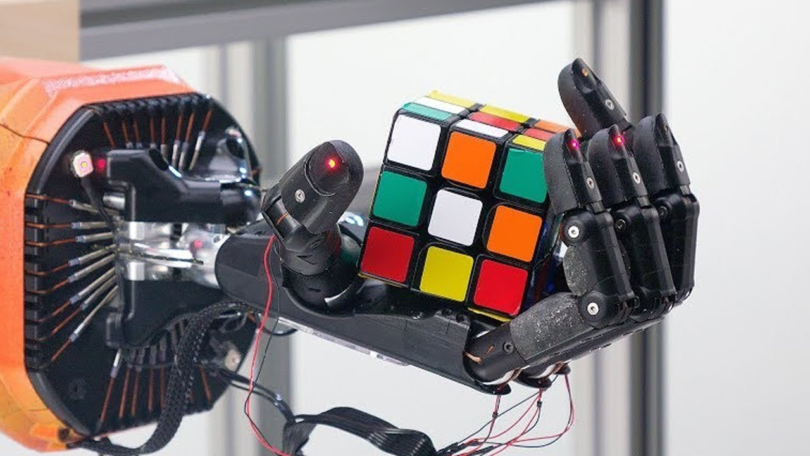
Reinforcement Learning

Slide 3
Reinforcement Learning
Action $a∈A$
$$s^{′}$$
Reward $r$
$$s$$
New state is $s′∈S$
Current state is $s∈S$
SETTING: Probabilistic transitions and unknown model of environment
GOAL: Learn to act in the environment to achieve maximum aggregate reward

Slide 4
Reward Function
$$s_{t}$$
$$s_{t}$$
Reward function $r(s,a)∈ℝ$ tells which actions are better.

Slide 5
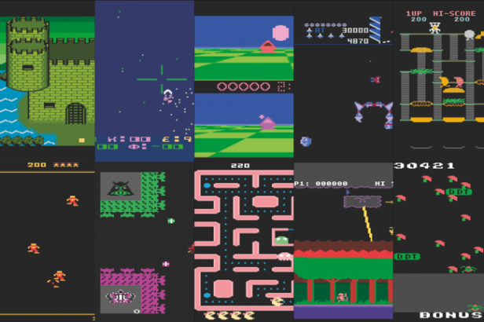
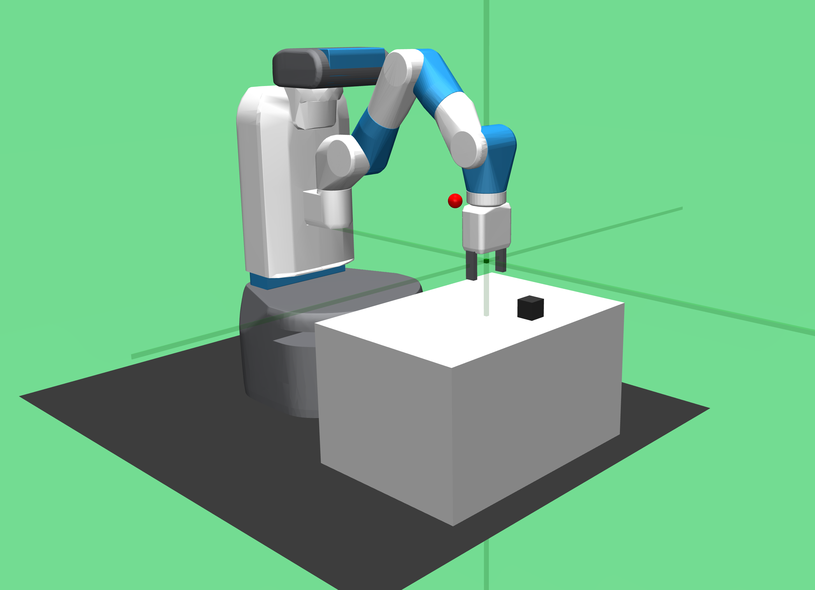
How to assign rewards?
Score from games
Hand engineered rewards
Ideally we want to say: Go close to block; Pick block; Move to target; Place block
Notes:
A key challenge facing RL is that encoding the task as rewards can become very hard, especially for long-horizon tasks.
For example, consider this continuous space environment consisting of 9 rooms separated by walls and connected through doorways. Suppose the RL agent is initially in bottom left corner S0 and the desired task is to navigate to the topright corner to S3 via either corners S1 or S2, while avoiding the obstacle 0. The reward function for this task is shown on the right. Even for this simple task, the reward is fairly sophisticated – with many conditions and has to maintain global variables . As tasks become more complex, engineering reward function becomes harder too.

Slide 6
Reward hacking
Reward misspecification is common and can lead to agent not achieving the goal
Negative rewards for crashing are compensated by positive reward for hitting targets
Notes:
A key challenge facing RL is that encoding the task as rewards can become very hard, especially for long-horizon tasks.
For example, consider this continuous space environment consisting of 9 rooms separated by walls and connected through doorways. Suppose the RL agent is initially in bottom left corner S0 and the desired task is to navigate to the topright corner to S3 via either corners S1 or S2, while avoiding the obstacle 0. The reward function for this task is shown on the right. Even for this simple task, the reward is fairly sophisticated – with many conditions and has to maintain global variables . As tasks become more complex, engineering reward function becomes harder too.

Slide 7
Reward engineering is hard!
Can we use logical specifications to specify tasks in RL?
Notes:
A key challenge facing RL is that encoding the task as rewards can become very hard, especially for long-horizon tasks.
For example, consider this continuous space environment consisting of 9 rooms separated by walls and connected through doorways. Suppose the RL agent is initially in bottom left corner S0 and the desired task is to navigate to the topright corner to S3 via either corners S1 or S2, while avoiding the obstacle 0. The reward function for this task is shown on the right. Even for this simple task, the reward is fairly sophisticated – with many conditions and has to maintain global variables . As tasks become more complex, engineering reward function becomes harder too.

Slide 8
Challenge 1: Sparse rewards
count = 0 # global variable
def get_rewards(s):
if state.at(O) :
return -10
if count == 0 and state.at($S_{1}$) :
count = 1
if count == 0 and state.at($S_{2}$) :
count = 1
if count == 1 and state.at($S_{3}$) :
count = 0
return 1
return 0
Existing approaches for learning from formal specifications generate sparse rewards
No reward is received until some subtasks are completed
This requires a lot of samples to “stumble into” a good policy
Can we systematically generate continuous shaped rewards from
formal specifications?

Slide 9
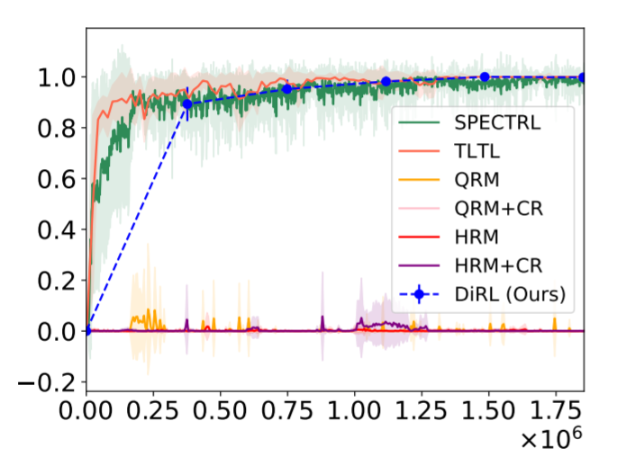
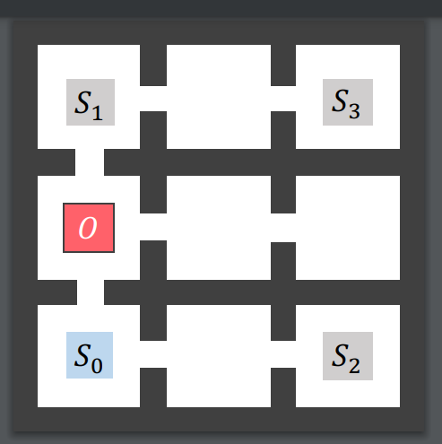
Challenge 2: Myopia in RL
RL is good at short-horizon tasks but poor at long-horizon tasks
Visit $(S_{1}$ or $S_{2})$
while avoiding $O$
Probability
Number of samples
Learns to visit $S_{2}$ via obstacle-free path

Slide 10
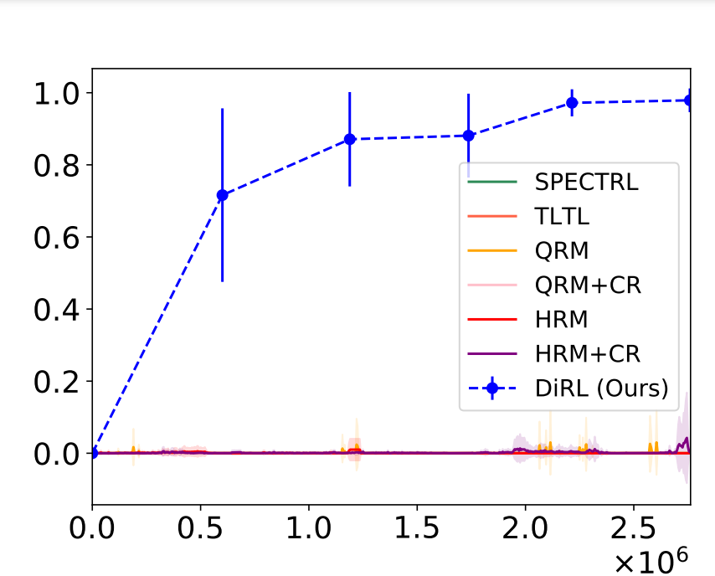
Challenge 2: Myopia in RL
RL is good at short-horizon tasks but poor at long-horizon tasks
Probability
Can we design RL algorithms that can handle complex tasks requiring
high-level decision making?
Visit $(S_{1}$ or $S_{2})$ then Visit $S_{3}$ while avoiding $O$
Futile to learn to visit $S_{2}$
Better to learn to visit $S_{1}$
Number of samples

Slide 11
Outline
Introduction to Reinforcement Learning
MDPs, Q-learning
RL from Specs: Practical Algorithms
Reward Machines – structured rewards
Q-learning for reward machines
2. SpectRL – simple specification language
Compositional learning for SpectrRL
RL from Specs: Theory
LTL and Buchi Automata
Generating rewards with guarantees
2. Impossibility results
Hardness of PAC learning

Slide 12
Reinforcement Learning
Data
$${D=\left\{\left(s_{i}, a_{i},r_{i}, s_{i}′\right)\right\}}_{i = 1…T}$$
Environment
Compute update
Update parameters
$$θ←θ −α⋅Δθ$$
Policy Or
Environment Model
$$π_{θ}$$

Slide 13
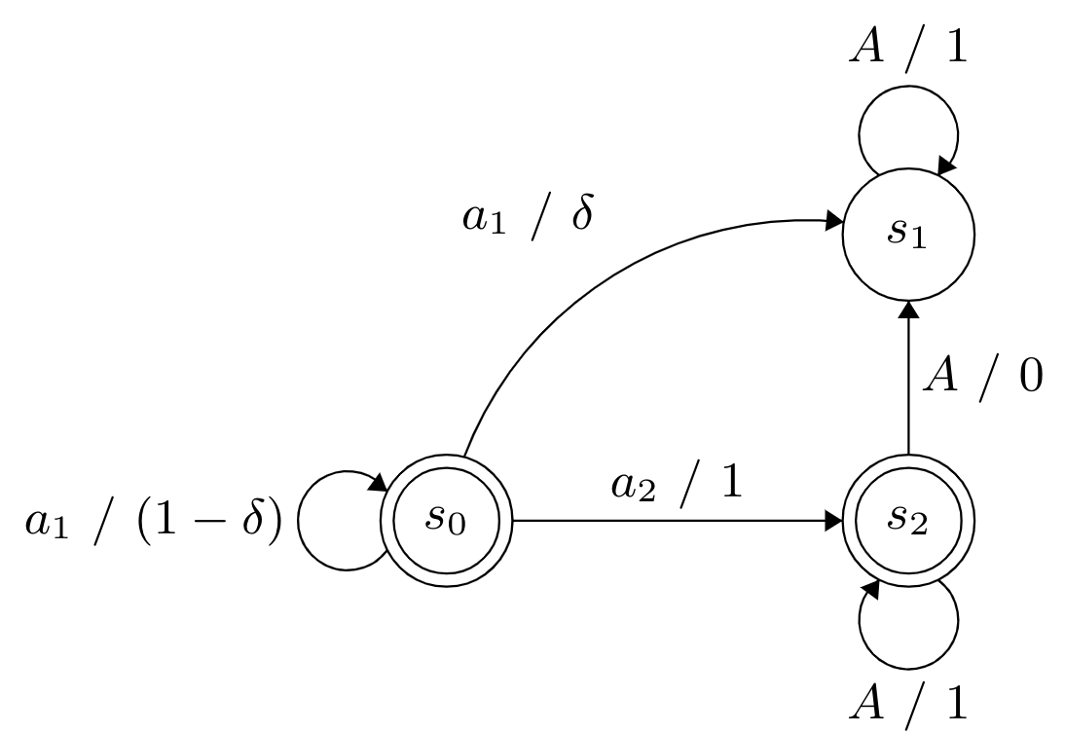
Markov Decision Processes
Actions
States
Initial state
MDPs are controlled using policies
Policy $π$ maps runs to distribution over actions
E.g., $π\left(s_{0}a_{1}s_{0}a_{2}s_{2}\right)=a_{1}$
Transition probability
$$P\left(s_{0},a_{1},s_{0}\right)=1−δ$$
In RL transition probabilities are unknown
Notes:
Environment modelled as MDP make clear

Slide 14
Simulator of an MDP
Simulator $𝕊$ is an object with a state field
Provides two methods
Dreset():
self.state = $s_{0}$
return self.state
Dstep($a$):
self.state ~ $P$($⋅ ∣$self.state, $a$)
return self.state

Slide 15
Discounted-Sum Reward
Value of a state $s$ given a policy $π$:
$V^{π}\left(s\right)= 𝔼\left[r\left(s_{0},a_{0}\right)+γr\left(s_{1},a_{1}\right)+⋯+γ^{t}r\left(s_{t},a_{t}\right)+⋯\right| s_{0}=s, π]$
Given initial state distribution $η$ we want to solve for
$$π^{∗}=argmax_{π} 𝔼_{s∼η}[V^{π}\left(s\right)]$$
As opposed to supervised learning, the distribution of data depends on the model being learned

Slide 16
Value Iteration
Assume P and R are given.
Then the value of the optimum policy $V^{∗}$ is the unique value function satisfying,
$V^{∗}\left(s^{′}\right)=\max_{a^{′}} Q^{∗}(s^{′},a′)$
where
$Q^{∗}\left(s,a\right)=r\left(s,a\right)+ {γ⋅𝔼}_{s^{′}∼P(⋅|s,a)}\left[V^{∗}\left(s^{′}\right)\right]$
Assuming finite state MDP, this can be computed.
The best policy is then given by,
$π^{∗}\left(s\right)= {argmax}_{a} Q^{∗}(s,a)$

Slide 17
Value Iteration

Slide 18
Q-learning
Best action based on current Q:
$$a={argmax}_{a′} Q(s,a)$$
Also need to explore:
Choose $a$ with probability $ε$ and a uniformly random action with probability $1−ε$
Apply value iteration idea to the unknown MDP setting.
Initialize the $Q$ values randomly.
Repeat until convergence:
Choose some action $a$ to perform in current state $s.$
Observe next state $s^{′}$ and reward $r$.
Update the $Q$ value for state $s$ and action $a,$
$$Q\left(s,a\right)←\left(1−α\right)Q\left(s,a\right)+α [r+γ⋅\max_{a^{′}} Q\left(s^{′},a^{′}\right)]$$

Slide 19
Reinforcement Learning
From
High-Level Specifications

Slide 20
Task Specification as Rewards
Challenging to express complex tasks
Cumbersome to write reward functions
$$q$$
# reach $p$
def reward_function(s):
if state.at($p$) :
return 1
else :
return 0
# reach $p$ then reach $q$
### reach $p$
### reach $q$
Initial
$$p$$
Desired policy
Learnt policy
Notes:
Now this could be a bottleneck, because expressing sequential tasks in the form of rewards could be quite challenging.
For exampe
Suppose the specification is to reach p. The corresponding reward function is easy – it simply assigns positive reward upon reaching p and none otherwise.
Next, suppose the specification is to reach p then reach q. Now the reward function cant simply compose the functions of reach p and reach q because that won’t prevent behaviors which reaches q without even visiting p.
To warrant against such behaviors, the reward function would have to do more book keeping. You can now imagine --- as the task becomes longer or contains logical constraints --- designing a correct reward function is challenging in itself.

Slide 21
High-level Specifications
State-Machine Based
Logic Based
Makes internal states explicit
Reward Machines
Syntax is natural-language like
SpectRL
“reach p”
Eventually (p)
$$S_{0}$$
$$S_{1}$$
$p∧¬q$,0
$q$, 1
“reach p then reach q”
Eventually (p) ;
Eventually (q)
$$S_{2}$$

Slide 22
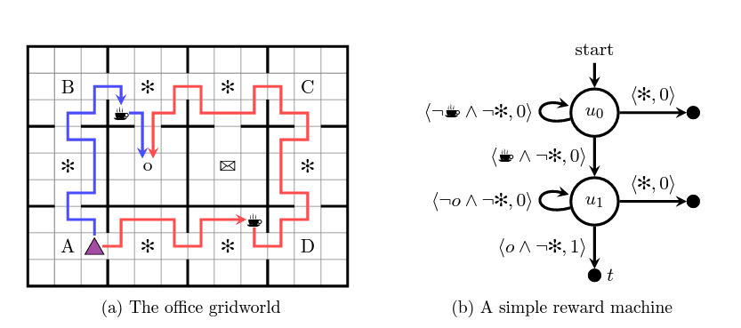
Reward Machines
Labelling function $L:S×A×S→2^{\left\{Prop\right\}}$
States $U$
Initial state
Terminal States $F$
Get Coffee. Go to O
Always avoid obstacle *
State-reward function
$$δ_{r}: U→[S×A×S→R]$$
State-transition function
$$δ_{u}:U×2^{\left\{Prop\right\}}→U∪F$$
Notes:
TODOs:
Check definition of \delta_u
Add labelling function

Slide 23
Algorithmic approaches: Q-Learning from Reward Machines (QRM)
Q-learning on product of MDP and Reward Machine
States are of the form $\left(s, u\right)$
Actions are MDP actions
Let, Current state be $(s,u)$
Choose action $a$
Next state is $(s^{′},u^{′})$ where $u^{′}=δ_{u}(u, L(s,a,s^{′}))$ [It’s prob. is $P(s,a,s^{′})$]
Reward is $δ_{r}\left(u\right)\left(s,a,s^{′}\right)$
Update Q-value of state $(s,u)$
$$Q\left((s,u), a\right)←\left(1−α\right)Q\left((s,u,) a\right)+α [r+γ⋅\max_{a^{′}} Q\left((s^{′},u^{′}) a^{′}\right)]$$
Notes:
TODO: Have to figure the product construction

Slide 24
Algorithmic approaches: QRM with Counterfactuals (QRM+CR)
While running QRM, generate more experiences
Let, Current state be$\left(s,u\right)$
Choose action be $a$
Next state is $(s^{′},u^{′})$ where $u^{′}=δ_{u}(u, L(s,a,s^{′}))$ [It’s prob. is $P(s,a,s^{′})$]
Reward is $δ_{r}\left(u\right)\left(s,a,s^{′}\right)$
Generate counterfactual experiences
Sample $a$from $(s, \hat{u})$ for all $\hat{u}∈U$
Update Q-values for $(s, \hat{u})$ for all $\hat{u}∈U$

Slide 25
More algorithmic variants
Hierarchical RL + RM
Learn separate function for Q-value for each RM state
Automated reward shaping (simple rewards only)
“Reward Machines: Exploiting Reward Function Structure in Reinforcement Learning” by Icarte, Klassen, Valenzano, and McIlraith. JAIR 2022.
Notes:
Add interpretation

Slide 26
REWARD MACHINES
Clean and versatile representation
Algorithms: Hierarchical RL with RM, separate training, etc
Reward machine can be generated from logical specifications
Still a reward-based specification
Not as scalable on complex, long-horizon tasks
Notes:
-Reward based specification (less interpretable) – discounting in rewards
- Adapts current Rl algorithms to RM setting, suffers from the drawbacks of RL --- In particular, scales poorly to long-horizon tasks (Need new algorithmic approach)

Slide 27
SPECTRL
and
COMPOSITIONAL APPROACH

Slide 28
SpectRL
Logical specification language
Temporal logic over predicates on the environment states
Predicates map environment states to {True, False}
Interpreted over a finite and fixed horizon
Syntax: $φ :=$eventually b | $φ$ensuring b | $φ_{1}$ ; $φ_{2}$ | $φ_{1}$ or $φ_{2}$
Example: “Visit $S_{1}$ while avoiding $O$”
((eventually $\text{Visit} S_{1}$) ensuring (Avoid $O$))

Slide 29
RL from Logical Specifications
Given, a MDP and
a Logical Specification
Assuming transition probabilities $P$ are unknown
Generate,
policy $Π :{\left(S×A\right)}^{∗}S→D(A)$
s.t. it optimizes
(expected) probability of satisfaction
9-rooms Environment
Spec: Eventually $S_{1}$
Optimal Policy
As shown in illustration
Notes:
The first difference is in the formulation of the learning problem. In this work, the RL problem is formulated to optimize on the logical specification directly.
In particular, given an unknown MDP and a temporal logic specification, the goal is to generate a policy that optimizes probability of satisfaction of the spec.
In prior work, logic is converted to a reward function in a way that may not preserve optimal solutions. Hence, learning from rewards could lead to inefficiencies.

Slide 30
Plenty in RL from Logical Specifications
Convert specification to rewards. Use a traditional RL algorithm
Boolean rewards [Camacho et. al. SOCS 17] [De Giacomo et. al. ICAPS 19]
Reward shaping [Ng, Harada, Russel. ICML 99] [Camacho et. al. IJCAI 19]
Faithful reward conversion [Bozkurt et. al. 2019] [Hahn et. al. TACAS 19, ATVA 20]
Signal Temporal Logic [Balakrishnan and Deshmukh. IROS 19] [Kalagarla, Jain, and Nuzzo. CDC 2021]
Truncated LTL [Li, Vasile, Belta IROS 17]
SpectRL [Jothimurugan, Bastani, Alur. NeurIPS 2019]
Notes:
Consequenty, RL from tempral logics, instead of rewards, has quickly emerged as an active area of research.
From 10000-feet away, algorithms for RL from temporal logic, first convert the logic to rewards. This conversion is automatic. Then, use favorite RL algorithms.
Initially, logic were converted to boolean rewards – 1 if execution satisfied the spec and 0 otherwise. Obviously these rewards were too sparse. In follow up work, several schemes to generate non-sparse rewards have been proposed.
Yet, none of these algorithms scale with increasing complexity of specification or environment.
The current sota is tha temporal logics siply task specification but learning algorithms do not scale.

Slide 31
Algorithmic Performance
Visit $S_{1}$ or $S_{2}$ then visit $S_{3}$
while avoiding $O$
Poor Scalability
1
Probability
Probability
Ideal performance
Number of samples
9-rooms Environment
Number of samples
Notes:
A challenge facing existing algoirthms for learning from logics is that RL is inherently myopic. Which means ---- good at --- poor at ---
For example, take here the same 9-rooms environment.
Suppoes we consider the short horizon task – which says to visit either s1 or s2 all the while avoiding the red obstacle region 0.
Here we plot the performance of several sotas. The x-asix denotes … y-axix denote probability of speciifcaiton satisfaction after x-samples. We see that after few samples most algorithms learn policy with probability close to 1.
Next, let us make the specification one step longer. So, after reaching either s1 or s2 the task is to reach s3. Now suddenly the performance of all algorithms has dropped.
Reason is in the first case, between learning to reach s1 and s2, all algorithms successfully learnt the obstacle free path to s2.
In the second case, this is futile since there is no direct path from s2 to s3. In other words, learning a locally optimal short-horizon subtasks costs learning of the original specification.
What these algorithms are missing is a high-level reasoning which informs it that even though some subtasks may be harder to learn, they are the better one to learn in the long horizon.

Slide 32
Myopia in RL
RL is good at short-horizon task but poor at long-horizon tasks
Visit $S_{1}$ or $S_{2}$
while avoiding $O$
Visit $S_{1}$ or $S_{2}$ then visit $S_{3}$
while avoiding $O$
Probability
Probability
Number of samples
Number of samples
Learns to visit $S_{2}$ via obstacle-free path
Futile to learn to visit $S_{2}$
Better to learn to visit $S_{1}$
Notes:
A challenge facing existing algoirthms for learning from logics is that RL is inherently myopic. Which means ---- good at --- poor at ---
For example, take here the same 9-rooms environment.
Suppoes we consider the short horizon task – which says to visit either s1 or s2 all the while avoiding the red obstacle region 0.
Here we plot the performance of several sotas. The x-asix denotes … y-axix denote probability of speciifcaiton satisfaction after x-samples. We see that after few samples most algorithms learn policy with probability close to 1.
Next, let us make the specification one step longer. So, after reaching either s1 or s2 the task is to reach s3. Now suddenly the performance of all algorithms has dropped.
Reason is in the first case, between learning to reach s1 and s2, all algorithms successfully learnt the obstacle free path to s2.
In the second case, this is futile since there is no direct path from s2 to s3. In other words, learning a locally optimal short-horizon subtasks costs learning of the original specification.
What these algorithms are missing is a high-level reasoning which informs it that even though some subtasks may be harder to learn, they are the better one to learn in the long horizon.

Slide 33
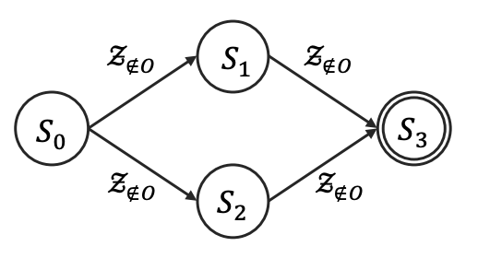
DiRL = Compositional RL from specifications
Theorem: SpectRL specifications generate DAG abstractions of environment s.t.
Every edge is a subtask
Every path from initial to final satisfies the specification
“Visit $S_{1}$ or $S_{2}$ then $S_{3}$while avoiding $O$”
$φ :=$eventually b
$$S_{0}$$
$$S_{1}$$
Notes:
We resolve, by incorporating high-level

Slide 34
DiRL = Compositional RL from specifications
“Visit $S_{1}$ or $S_{2}$ then $S_{3}$while avoiding $O$”
Decomposition phase
“Every edge is a subtask”
Learn a policy for every edge
Composition phase
“Every path to final satisfies the specification”
Compute best policy to final state
Best policy = Path with maximum probability
Edge probability = Estimated success of sub-task policy
$$π_{1}$$
$$π_{2}$$
$$π_{3}$$
$$π_{4}$$
Policy $S_{0}→S_{1}→S_{3}$
$π_{1}$ until $S_{1}$ reached;
$π_{2}$ until $S_{3}$ reached
Notes:
We resolve, by incorporating high-level

Slide 35
DiRL = Compositional RL from specifications
“Visit $S_{1}$ or $S_{2}$ then $S_{3}$while avoiding $O$”
Decomposition phase
“Every edge is a subtask”
Learn a policy for every edge
State distribution on DAG state?
Composition phase
“Every path to final satisfies the specification”
Compute best policy to final state
Best policy = Path with maximum probability
Edge probability = Estimated success of sub-task policy
$$π_{1}$$
$$π_{2}$$
$$π_{3}$$
$$π_{4}$$
Policy $S_{0}→S_{1}→S_{3}$
$π_{1}$ until $S_{1}$ reached;
$π_{2}$ until $S_{3}$ reached
Notes:
We resolve, by incorporating high-level

Slide 36
Learning State Distributions
Learnt
Policies
$$S_{0}$$
$$S_{i}$$
Learnt
Policies
Known
State Distribution
Induced
State Distribution
Choose order of learning states and edges
Notes:
Add image

Slide 37
Dijkstra’s Algorithm with Learning OTF
Learn policy for edge when edge cost is required
$p_{i}=$Probability that $π_{i}$ successfully reaches $S_{i}$while staying safe w.r.t. edge
$$π_{1}$$
$$S_{1}$$
$$S_{0}$$
$$π_{2}$$
$$S_{2}$$

Slide 38
Dijkstra’s Algorithm with Learning OTF
$$π_{1}$$
$$S_{1}$$
Learn policy for edge when edge prob. is required
$p_{i}=$Probability that $π_{i}$ successfully reaches $S_{i}$while staying safe w.r.t. edge
1
$$S_{0}$$
0.5
$$π_{2}$$
$$S_{2}$$

Slide 39
Initial Distribution for Edge Policies
$$S_{4}$$
Distribution over $S_{1}$ used to train $π_{3}$ and $π_{4}$ - induced by $π_{1}$; can sample from this distribution:
Start at initial state $s_{0}$ and execute $π_{1}$ until a state in $S_{1}$ is reached
$$π_{3}$$
$$π_{1}$$
$$S_{1}$$
1
$$π_{4}$$
$$S_{3}$$
$$S_{0}$$
0.5
$$π_{2}$$
$$S_{2}$$

Slide 40
Initial Distribution for Edge Policies
$$S_{4}$$
Distribution over $S_{1}$ used to train $π_{3}$ and $π_{4}$ - induced by $π_{1}$; can sample from this distribution:
Start at initial state $s_{0}$ and execute $π_{1}$ until a state in $S_{1}$ is reached
$$π_{3}$$
0.25
$$π_{1}$$
$$S_{1}$$
1
1
$$π_{4}$$
$$S_{3}$$
$$S_{0}$$
0.5
$$π_{5}$$
1
$$π_{2}$$
$$S_{2}$$

Slide 41
DiRL: Compositional RL from specification
Specification $φ$
Theorem
DiRL is $O(\left|E\right|⋅log⁡(|V|))$
+
Number of RL calls is $O(|E|)$
Decompose
Learn subtask
Theorem
Size of DAG
$\left|V\right|=O(|φ|)$ and $|E|= O(|φ^{2}|)$
Compose
Policy
Notes:
Add image

Slide 42
Algorithmic performance
Visit $S_{1}$ or $S_{2}$
while avoiding $O$
1
Probability
Probability
Ideal performance
Number of samples
Number of samples
Notes:
A challenge facing existing algoirthms for learning from logics is that RL is inherently myopic. Which means ---- good at --- poor at ---
For example, take here the same 9-rooms environment.
Suppoes we consider the short horizon task – which says to visit either s1 or s2 all the while avoiding the red obstacle region 0.
Here we plot the performance of several sotas. The x-asix denotes … y-axix denote probability of speciifcaiton satisfaction after x-samples. We see that after few samples most algorithms learn policy with probability close to 1.
Next, let us make the specification one step longer. So, after reaching either s1 or s2 the task is to reach s3. Now suddenly the performance of all algorithms has dropped.
Reason is in the first case, between learning to reach s1 and s2, all algorithms successfully learnt the obstacle free path to s2.
In the second case, this is futile since there is no direct path from s2 to s3. In other words, learning a locally optimal short-horizon subtasks costs learning of the original specification.
What these algorithms are missing is a high-level reasoning which informs it that even though some subtasks may be harder to learn, they are the better one to learn in the long horizon.

Slide 43
Algorithmic performance
Visit $S_{1}$ or $S_{2}$ then visit $S_{3}$
while avoiding $O$
1
Probability
Ideal performance
Probability
Number of samples
Number of samples
Notes:
A challenge facing existing algoirthms for learning from logics is that RL is inherently myopic. Which means ---- good at --- poor at ---
For example, take here the same 9-rooms environment.
Suppoes we consider the short horizon task – which says to visit either s1 or s2 all the while avoiding the red obstacle region 0.
Here we plot the performance of several sotas. The x-asix denotes … y-axix denote probability of speciifcaiton satisfaction after x-samples. We see that after few samples most algorithms learn policy with probability close to 1.
Next, let us make the specification one step longer. So, after reaching either s1 or s2 the task is to reach s3. Now suddenly the performance of all algorithms has dropped.
Reason is in the first case, between learning to reach s1 and s2, all algorithms successfully learnt the obstacle free path to s2.
In the second case, this is futile since there is no direct path from s2 to s3. In other words, learning a locally optimal short-horizon subtasks costs learning of the original specification.
What these algorithms are missing is a high-level reasoning which informs it that even though some subtasks may be harder to learn, they are the better one to learn in the long horizon.

Slide 44
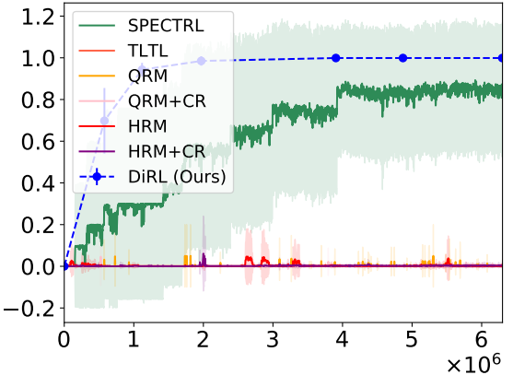
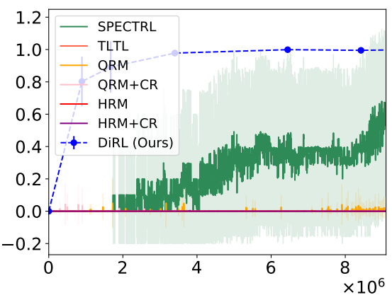
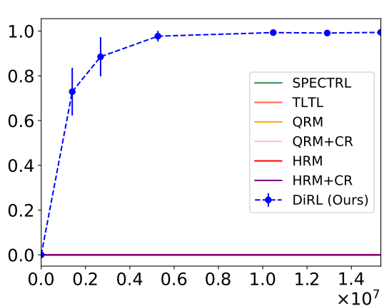
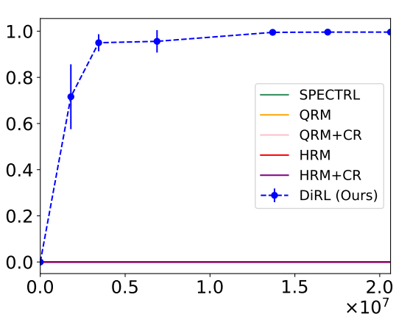
Scalability
In Specification
A to B
A to B
B to C
C
C-1
Y
B
A to B
B to C
C to D
A to B
B to C
C to D
D to E
X
D
C-2
A
E
From X,
Visit Corner-1 or Corner-2, then Visit Y,
while avoiding Obstacles
X to Y
$x$-axis: Number of samples $y$-axis: Probability of satisfaction of spec.

Slide 45
Scalability
In (dimensionality of) Environment
Simulation of Baxter Robotic Arm
$x$-axis: Number of samples $y$-axis: Probability of satisfaction of spec.
Notes:
TODO: Insert OpenGym AI + Mujoco

Slide 46
COMPOSITIONAL RL APPROACH
Approach leverages structure of specification to really decompose tasks
“A composable specification language for reinforcement learning tasks” by Kishor Jothimurugan, Rajeev Alur, Osbert Bastani. NeurIPS 2019.
“Compositional RL from logical specifications” by Kishor Jothimurugan, Suguman Bansal, Osbert Bastani, Rajeev Alur. NeurIPS 2021.
“Specification-guided learning of nash equilibria with high social welfare” by Kishor Jothimurugan, Suguman Bansal, Osbert Bastani, Rajeev Alur. CAV 2022.

Slide 47
SUMMARY
RL
RL from specifications
Scalable RL from specifications
Using specifications for verifiability, generalizability, multi-agent, etc

Slide 48
THEORY OF RL FROM LTL

Slide 49
Outline
Linear Temporal Logic (LTL)
Syntax
Semantics
Learning for LTL
Reduction to Rewards
Buchi Automata
Rewards for Buchi
condition
Hardness of reduction
PAC-MDP Learning
Definition
Robustness of LTL
Hardness of PAC learning

Slide 50
Linear Temporal Logic (LTL)
Logic for specifying properties of infinite sequences
$$p_{1}$$
True
False
True
False
True
...
$$p_{2}$$
False
False
True
True
False
...
Time
EXAMPLES
$p_{1}$ should be true eventually at some point in the future
$p_{2}$ should be always true
$p_{1}$ should be true at infinitely many time steps
$p_{1}$ should be true eventually and then $p_{2}$ should be true some time later

Slide 51
Linear Temporal Logic (LTL)
Logic for specifying properties of infinite sequences
SYNTAX
$$φ :=p \left| ¬φ \right| φ∨φ \left| Xφ \right| φ Uφ$$
Propositional Logic
Temporal Operators
SEMANTICS
Formula $p$ is true if and only if $p$ is true at the current step
Boolean logic is interpreted as usual
Can derive “logical and” $∧$ and “implies” $→$ operators

Slide 52
Temporal Operators: Next
$$p_{1}$$
True
False
True
False
True
...
$$p_{2}$$
False
True
True
True
False
...
Time
1
2
3
4
5
...
$Xφ$is true for the above sequence if $φ$ is true starting at next position (2)
Example: The sequence does not satisfy $p_{1}∧Xp_{1}$ but satisfies $p_{1}∧Xp_{2}$

Slide 53
Temporal Operators: Until
$$p_{1}$$
True
True
False
False
True
...
$$p_{2}$$
False
False
True
True
False
...
Time
1
2
3
4
5
...
$φ_{1}Uφ_{2}$is true for the above sequence if
$φ_{2}$ is true at some future position $i$ and,
At ever position $j$ before $i$, $φ_{1}$ is true
Example: $p_{1}Up_{2}$ is true because
$p_{2}$ is true at position 3 and,
$p_{1}$ is true at positions 1 and 2

Slide 54
LTL Examples
$p_{1}$ should be true eventually at some point in the future
true $U p_{1}=Fp_{1}$
$Fφ$ is an abbreviation for true $Uφ$referred to as Finally
$p_{2}$ should be always true
$$¬F\left(¬p_{2}\right)=Gp_{2}$$
$Gφ$ is an abbreviation for $¬F\left(¬φ\right)$ referred to as Globally

Slide 55
LTL Examples
$p_{1}$ should be true at infinitely many time steps
At every step, there is a future time where $p_{1}$ is true
$$φ=G(Fp_{1})$$
$p_{1}$ should be true eventually and then $p_{2}$ should be true some time later
$$φ=F(p_{1}∧X(Fp_{2}))$$

Slide 56
LTL and MDPs
An MDP (along with a policy) generates sequences of states
$$s_{0}$$
$$s_{1}$$
$$s_{2}$$
$$s_{3}$$
$$s_{4}$$
Time
Labelling function $L:S→2^{P}$ maps states to set of propositions
$${L(s}_{0})$$
$${L(s}_{1})$$
$${L(s}_{2})$$
$${L(s}_{3})$$
$${L(s}_{4})$$
Time
Now we know which propositions are true at which time step for any sequence
Want to compute policy $π$ that maximizes probability that generated sequence satisfies a given LTL formula

Slide 57
Core Questions
What guarantees can be obtained from
reduction of RL from LTL to RL from rewards?
What guarantees about RL algorithms from LTL specs
can we obtain?

Slide 58
Core Questions
What guarantees can be obtained from
reduction of RL from LTL to RL from rewards?
What guarantees about RL algorithms from LTL specs
can we obtain?

Slide 59
Reduction I: Specification Translation
Optimality Preservation: For all $M$ maximizing expected reward implies maximizing probability of satisfying $φ$
$$φ$$
Reduce
rewards
THEOREM
No optimality preserving specification translation exists for reducing reachability specifications to discounted-sum reward specifications

Slide 60
Reduction II: Sampling-Based Reduction
It should be possible to simulate $M′$ using a simulator of $M$ without knowledge of transition probabilities $P$
$$M,φ$$
Reduce
${ M}^{′}$ + rewards
THEOREM
Optimality preserving sampling-based reduction exists [1] for translating LTL to discounted-sum rewards (there are some subtleties)

Slide 61
Reduction from LTL to Discounted Rewards
$$M$$
Original MDP
Simulator
$$¬p$$
true
$$Fp$$
$$M^{′},R$$
$$q_{0}$$
$$p$$
$$q_{1}$$
LTL Formula
New MDP (Simulator)
with Rewards
Buchi Automaton

Slide 62
Buchi Automata
Infinite sequence accepted iff some final state is visited infinitely many times
Transitions labelled with conditions on propositions
$$¬p$$
true
$$q_{0}$$
$$p$$
$$q_{1}$$
Initial state
Accepting state
$$p$$
False
False
True
True
False
...
Time
$$q_{0}$$
$$q_{0}$$
$$q_{0}$$
$$q_{1}$$
$$q_{1}$$
$$q_{1}$$
...

Slide 63
Buchi Automata: Examples
$$p$$
true
$$¬p$$
$$p$$
$$q_{0}$$
$$¬p$$
$$q_{1}$$
$$q_{0}$$
$$p$$
$$q_{1}$$
$$¬p$$
$$Gp$$
$$G(Fp)$$
$p$should be always true
$p$should be true at infinitely many steps

Slide 64
Buchi Automata: Examples
$$¬p_{1}$$
$$¬p_{2}$$
true
$$q_{0}$$
$$p_{1}$$
$$q_{1}$$
$$p_{2}$$
$$q_{2}$$
$$φ=F(p_{1}∧X(Fp_{2}))$$
$p_{1}$ should be true eventually and then $p_{2}$ should be true some time later

Slide 65
Nondeterministic Buchi Automata
Two choices for where to go on seeing $p$
Infinite sequence accepted iff some final state is visited infinitely many times in at least one valid run
true
$$p$$
true
$$q_{0}$$
$$p$$
$$q_{2}$$
$$¬p$$
$$q_{2}$$
$$φ=F(Gp)$$
There is a time after which $p$ is always true

Slide 66
Reduction from LTL to Discounted Rewards
$$M$$
Existing algorithms can do this!
Original MDP
Simulator
$$¬p$$
true
$$Fp$$
$$M^{′},R$$
$$q_{0}$$
$$p$$
$$q_{1}$$
LTL Formula
New MDP (Simulator)
with Rewards
Buchi Automaton

Slide 67
Constructing Product MDP
$$s$$
$$s′$$
MDP State
$$L(s)$$
Full State
$$q$$
$$q′$$
Automaton State
MDP Action $a$
Buchi Action $a′$
Chooses next automaton state among possible ones
Full Action

Slide 68
Buchi Learning Problem
New MDP
(Simulator)
Learning Algorithm
Policy $π$
Accepting States $S_{a}$
OBJECTIVE: Maximize the probability that accepting states are visited infinitely often

Slide 69
Good-for-MDP Automaton
true
true
$$A/0.5$$
$$A/0.5$$
$$q_{1}$$
$$q_{0}$$
$$q_{2}$$
$$p$$
$$A/0.5$$
$$¬p$$
$$p$$
$$¬p$$
$$A/0.5$$
MDP in which $p$ holds with probability half at every step
Buchi automaton accepting all sequences
$$p$$
MDP Action
$$¬p$$
No way to satisfy reach accepting states after this!
$$q_{0}$$
Choose $q_{1}$
$$q_{1}$$
This happens with probability 0.5

Slide 70
Good-for-MDP Automaton
true
true
$$A/0.5$$
$$A/0.5$$
$$q_{1}$$
$$q_{0}$$
$$q_{2}$$
$$p$$
$$A/0.5$$
$$¬p$$
$$p$$
$$¬p$$
$$A/0.5$$
MDP in which $p$ holds with probability half at every step
Buchi automaton accepting all sequences
SOLUTION: Construct Buchi automaton that does not have this issue, i.e., is good-for-MDP [1]
[1] Hahn, Ernst Moritz, et al. "Good-for-MDPs automata for probabilistic analysis and reinforcement learning.”

Slide 71
Rewards for Buchi Condition
Reward = $0$
Discount factor = $γ$
Accepting States
Discounted-sum rewards with two discount factors
Reward = $1−γ_{a}$
Discount factor = $γ_{a}$
States of New MDP
THEOREM: For any MDP and LTL property, there exist $γ_{a},γ<1$ such that maximizing discounted sum rewards in product MDP yields optimal policy for LTL property [1]
[1] Bozkurt, Alper Kamil, et al. "Control synthesis from linear temporal logic specifications using model-free reinforcement learning."

Slide 72
Reduction II: Sampling-Based Reduction
It should be possible to simulate $M′$ using a simulator of $M$ without knowledge of transition probabilities $P$
$$M,φ$$
Reduce
${ M}^{′}$ + rewards
Requires parameters (eg. $γ_{a},γ$) that depend on transition probabilities of $M$
THEOREM
Optimality preserving sampling-based reduction exists [1] for translating LTL to discounted-sum rewards (there are some subtleties)

Slide 73
Reduction II: Sampling-Based Reduction
Expected reward is $ε$-close to optimal value
STRONGER REQUIREMENT
Near-Optimality Preservation: For all $M$ any policy that achieves a near-optimal expected discounted-sum reward $J^{M^{′}}\left(π\right)$ for $M^{′}$ also achieves near-optimal probability of satisfying $φ$ in $M$
Probability of satisfying specification is $ε′$-close to optimal value
THEOREM
No near-optimality preserving sampling-based reduction exists for reducing safety/reachability specifications to discounted reward specifications
Notes:
What is reachability?

Slide 74
Core Questions
What guarantees can be obtained from
reduction of RL from LTL to RL from rewards?
What guarantees about RL algorithms from LTL specs
can we obtain?

Slide 75
Core Questions
What guarantees can be obtained from
reduction of RL from LTL to RL from rewards?
What guarantees about RL algorithms from LTL specs
can we obtain?

Slide 76
Simulator of an MDP
Simulator $𝕊$ is an object with a state field
Provides two methods
Dreset():
self.state = $s_{0}$
return self.state
Dstep($a$):
self.state ~ $P$($⋅ ∣$self.state, $a$)
return self.state

Slide 77
Probably Approximately Correct Learning
A learning algorithm is an iterative process where for each iteration $n=1, 2,…$
Calls step(a) and optionally calls reset()
Outputs current best policy $π_{n}$
A learning algorithm is PAC-MDP if with high probability, after some number of steps it always outputs near-optimal policies

Slide 78
PAC Learning Objective
A learning algorithm is an iterative process where for each iteration $n=1, 2,…$
Calls step(a) and optionally calls reset()
Outputs current best policy $π_{n}$
Output of Learning Algorithm on MDP - Distribution over sequences of policies
$N$ can depend on $ε,δ, S, A, φ$
Independent of transition probabilities
$${ π}_{N}$$
$${ π}_{N+1}$$
$${ π}_{1}$$
$${ π}_{2}$$
$${ π}_{N+1}$$
PAC if with probability $>1−δ$, all policies after $N$ steps are $ε$-optimal

Slide 79
No PAC-MDP for safety
THEOREM
There does not exist a PAC-MDP algorithm for the class of safety/reachability specifications
This is primarily because safety specifications are not robust [1].
[1] Environment-independent task specifications via GLTL. Littman, Michael L., et al.
Notes:
explain high level idea of proof

Slide 80
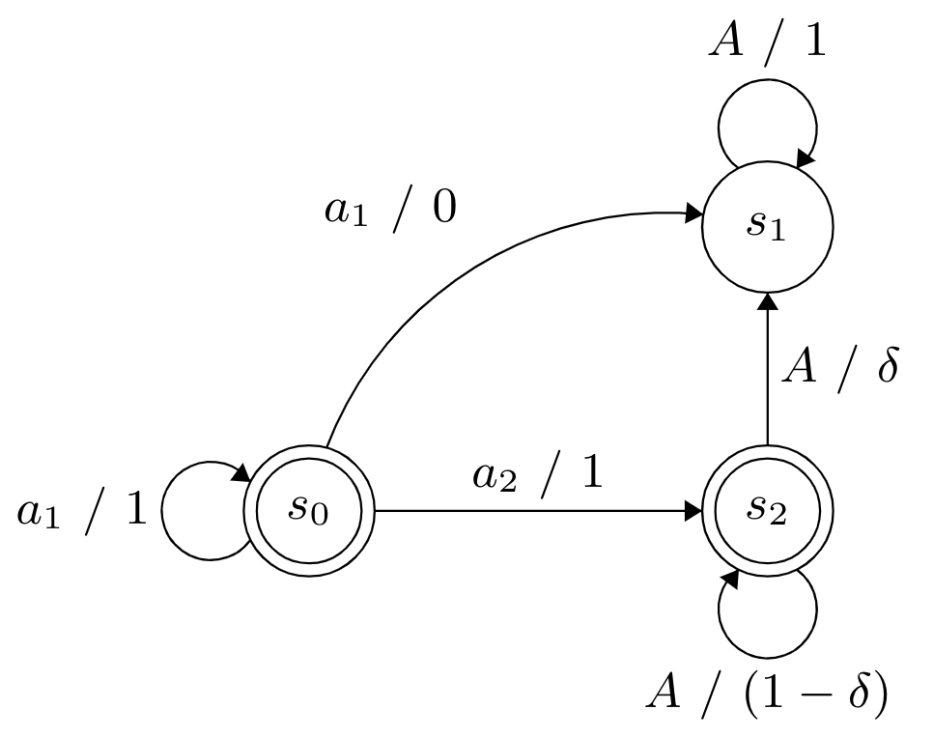
Proof Sketch
Unsafe
Safe
$$φ=always safe$$
$$M_{δ}^{1}$$
$$M_{δ}^{2}$$
$$Let ε<0.5, then,$$

Slide 81
Proof Sketch
Let $𝒜$ be a PAC-MDP algorithm for safety specifications.
When run on $M_{δ}^{1}$, fixing $δ=0.1,$with probability at least 0.9, $𝒜$ outputs a policy in $Π_{opt}^{ε}(M_{δ}^{1}, φ)$ in all but $N=h(\left|S\right|, \left|A\right|, \left|φ\right|,\frac{1}{δ},\frac{1}{ε})$ iterations.
$${ π}_{1}$$
$${ π}_{2}$$
$${ π}_{K}$$
$$K=2N+1$$
With probability atleast 0.9, $\left|{\{π}_{i} \right|π_{i}∈Π_{opt}^{ε}\left(M_{δ}^{1}, φ\right)|≥N+1,$
With probability atleast 0.9, $\left|{\{π}_{i} \right|π_{i}∉Π_{opt}^{ε}\left(M_{δ}^{2}, φ\right)|≥N+1$.
For sufficiently small $δ,$ even when run on $M_{δ}^{2}$, with probability at least 0.8,
$\left|{\{π}_{i} \right|π_{i}∉Π_{opt}^{ε}\left(M_{δ}^{2}, φ\right)|≥N+1$.
Contradiction!

Slide 82
Stronger Result
THEOREM [1]
PAC-MDP algorithm exists for the for an LTL specification if and only if it is finitary
FINITARY LTL SPECIFICATION
There is a time limit $H$ such that events after time step $H$ are irrelevant to satisfaction of the specification
[1] Yang, C., Littman, M. and Carbin, M., 2021. Reinforcement learning for general LTL objectives is intractable.

Slide 83
THEORY TAKEAWAYS
Provided a general definition of a simulation-based reduction in the RL setting
Showed optimality preserving reductions from LTL to rewards are possible
Showed that certain reductions from LTL to discounted rewards are not possible
Impossibility result regarding existence of PAC algorithm for safety
Notes:
Make visual

Slide 84
Recap
Introduction to Reinforcement Learning
MDPs, Q-learning
RL from Specs: Practical Algorithms
Reward Machines – structured rewards
Q-learning for reward machines
2. SpectRL – simple specification language
Compositional learning for SpectrRL
RL from Specs: Theory
LTL and Buchi Automata
Generating rewards with guarantees
2. Impossibility results
Hardness of PAC learning

Slide 85
Conclusions
Formal temporal specifications are useful in specifying intent in RL
Many specification languages have been proposed
Reward machines, SpectRL, LTL etc.
Recent work has led to many algorithms for learning from specifications
Can often leverage structure of specification to learn better
Can learn more interpretable policies
Theoretical study regarding convergence, correctness etc.
Can guide designing new algorithms for learning or reward generation
Insight into why existing specification languages lead to hard learning problems

Slide 86
Future Work
Time-discounting in specification languages to enable PAC learning
Discounted rewards make PAC learning possible
Conditions on the MDP that make PAC learning possible for existing languages
Ex. PAC learning possible when smallest non-zero probability is known
Learning from offline data
Offline RL from specifications
Learning specifications from expert demonstrations (inverse RL)
Beyond reinforcement learning
Specifications to guide supervised learning – ex. require model to be robust
Code generation models – incorporate formal specifications for code

Slide 87
Links
Our Websites
Rajeev Alur - https://www.cis.upenn.edu/~alur/
Suguman Bansal - https://suguman.github.io/
Osbert Bastani - https://obastani.github.io/
Kishor Jothimurugan - https://keyshor.github.io/
Tutorial website with
reading material

