Slide 1

Computer-Aided Verification
Rajeev Alur
University of Pennsylvania
CIS 673 Spring 2020

Slide 2

Systems Software
do{
KeAcquireSpinLock();
nPacketsOld = nPackets;
if(request){
request = request->Next;
KeReleaseSpinLock();
nPackets++;
}
}while(nPackets!= nPacketsOld);
KeReleaseSpinLock();
Can Microsoft Windows version X be bug-free?
  Millions of lines of code
  Types of bugs that cause crashes well-known
  Enormous effort spent on debugging/testing code
  Certifying third-party code (e.g. device drivers)
Do lock operations, acquire and
release strictly alternate on every
program execution?

Slide 3
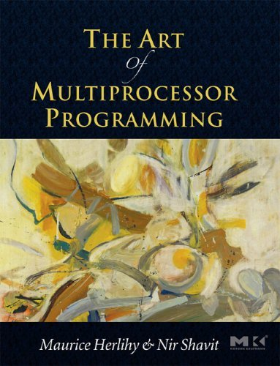
Concurrency Libraries
Exploiting concurrency efficiently and correctly
dequeue(queue_t *queue, value_t *pvalue)
{
node_t *head;
node_t *tail;
node_t *next;
while (true) {
head = queue->head;
tail = queue->tail;
next = head->next;
if (head == queue->head) {
if (head == tail) {
if (next == 0)
return false;
cas(&queue->tail, tail, next);
} else {
*pvalue = next->value;
if (cas(&queue->head, head, next))
break;
}
}
}
delete_node(head);
return true;
}
Concurrent Queue (MS’92)
Can the code deadlock?
Is sequential semantics of a queue
preserved? (Sequential consistency)
Notes:
- linked list. concurrent access. ex (multiple prod, multiple cons)
- compare-and-swap instead of locks.

Slide 4

Security Checks for Java Applets
https://java.sun.com/javame/
public Vector<String> phoneBook;
public String number;
public int Selected;
public void sendEvent() {
phoneBook = getPhoneBook();
selected = chhoseReceiver();
number=phoneBook.elementAt(selected);
if ((number==null)|(number=“”)){
//output error
} else{
String message = inputMessage();
sendMessage(number, message);
}
}
EventSharingMidlet from J2ME
How to certify applications for
data integrity / confidentiality ?
By listening to messages, can
one infer whether a particular
entry is in the addressbook?
Notes:
- linked list. concurrent access. ex (multiple prod, multiple cons)
- compare-and-swap instead of locks.

Slide 5
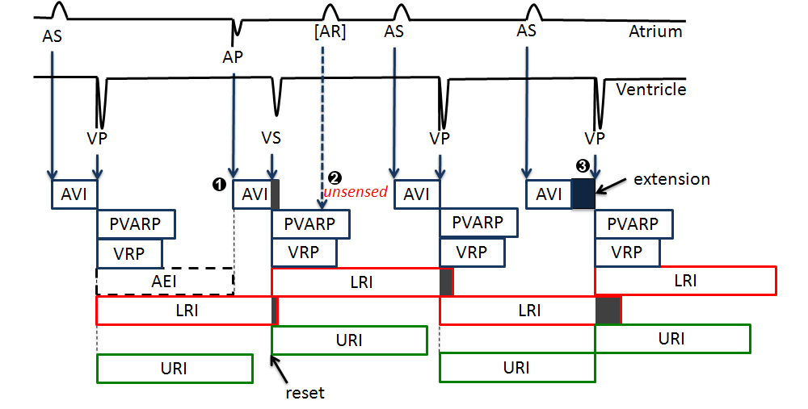
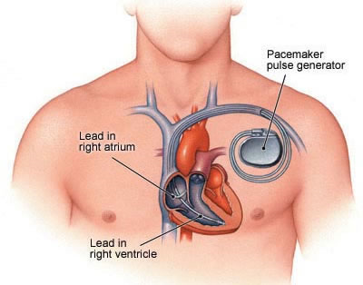
Certification of Safety-Critical Software
How to verify that a pacemaker meets all the correctness
requirements published by the FDA ?
Notes:
- linked list. concurrent access. ex (multiple prod, multiple cons)
- compare-and-swap instead of locks.

Slide 6
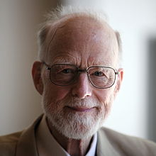
Verified Programming
An axiomatic basis for computer programming
Tony Hoare; CACM 1969
In this paper an attempt is made to explore the logical foundations of computer programming by use of techniques which were first applied in the study of geometry and have later been extended to other branches of mathematics. This involves the elucidation of sets of axioms and rules of inference which can be used in proofs of the properties of computer programs. Examples are given of such axioms and rules, and a formal proof of a simple theorem is displayed. Finally, it is argued that important advantage, both theoretical and practical, may follow from a pursuance of these topics.

Slide 7
Verifier
In Search of the Holy Grail…
software/model
yes/proof
correctness
specification
no/bug
Correctness is formalized as a mathematical claim to be proved or falsified rigorously
  Always with respect to the given specification
Challenge: Impossibility results for automated verifier
  Verification problem is undecidable
  Even approximate versions are computationally intractable (model checking is Pspace-hard)

Slide 8
Today’s Lecture
A brief history of Computer-Aided Verification
Course Logistics

Slide 9
Research Thread 1: Proofs of Programs (1970s--)
SelectionSort(int A[],n) {
i = 0;
while(i < n−1) {
v = i;
j = i + 1;
while (j < n) {
if (A[j]<A[v])
v = j ;
j++;
}
swap(A[i], A[v]);
i++;
}
return A;
}
Invariant:
∀k1,k2. (0≤k1<k2<n) ∧ (k1<i)
⇒ A[k1] ≤ A[k2]
Invariant:
i<j ∧
i≤v<n ∧
(∀k1,k2. (0≤k1<k2<n) ∧ (k1<i)
⇒ A[k1] ≤ A[k2]) ∧
(∀k. (i≤k<j) ∧ (k≥0)
⇒ A[v] ≤ A[k])
post: ∀k : 0 ≤ k <n ⇒ A[k] ≤ A[k + 1]
Notes:
The next several slides visualize a verification problem for a given program, in this case one that implements selection sort. The precondition, not shown, gives that n is length of A; the postcondition is given at the bottom of the slide: that each element of the array is in ascending order (and also that it is a permutation of the initial array, but this part is not shown). The goal of verification is to prove that, given input that satisfies the precondition, running the program will always produce output that satisfies the postcondition.
Then we show how this same approach can be slightly generalized to synthesize most of the program, rather than verify it. This is the PTS approach developed by Gulwani, Srivastava, and Foster.

Slide 10
Deductive Program Verification
Powerful mathematical logic (e.g. first-order logic, Higher-order logics) needed for formalization
  Great progress in decision procedures for logic fragments
  Finding proof decomposition requires expertise, but modern tools support many built-in proof tactics
  Continued progress in theorem provers: Coq, PVS, ACL2, Isabelle
Much skepticism on practical relevance

Slide 11
Formal Verification Declared Dead…
Social Processes and Proofs of Theorems and Programs
De Millo, Lipton, and Perlis; CACM 1979
It is argued that formal verifications of programs, no matter how obtained, will not play the same key role in the development of computer science and software engineering as proofs do in mathematics. Furthermore the absence of continuity, the inevitability of change, and the complexity of specification of significantly many real programs make the formal verification process difficult to justify and manage. It is felt that ease of formal verification should not dominate program language design.

Slide 12
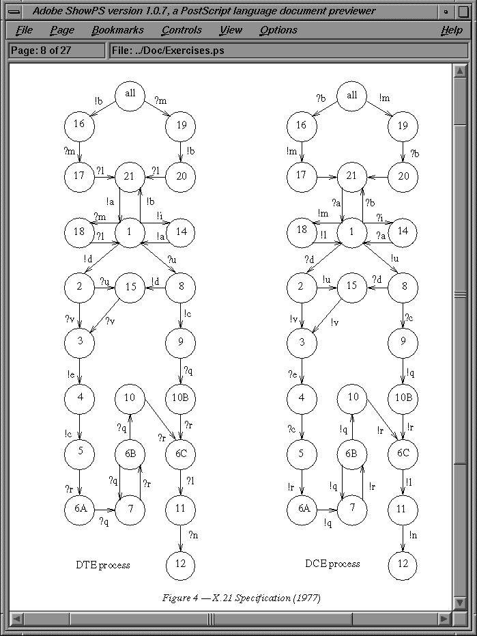
Research Thread 2: Finite-state Protocol Analysis (1980s--)
Automated analysis of finite-state protocols with respect to temporal logic specifications
  Applications: Network protocols, Distributed algorithms
Specifications:
Is there a deadlock?
Does every req get ack?
Does a buffer overflow?
Tools:
SPIN, Murphi, CADP …

Slide 13
Battling State-space Explosion
Analysis is basically a reachability problem in a HUGE graph
  Size of graph grows exponentially as the number of bits required for state encoding
  Graph is constructed only incrementally, on-the-fly
  Many techniques for exploiting structure: symmetry, data independence, hashing, partial order reduction …
  Great flexibility in modeling: Scale down parameters (buffer size, number of network nodes…)
State
Transition
Bad states

Slide 14
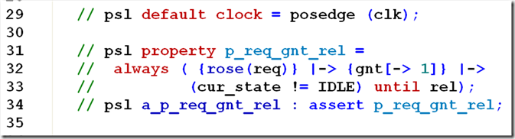
Success Story:
Temporal Logic
Linear temporal logic (LTL) emerged as a widely used and natural notation for expressing requirements of infinite executions
Always ( Request → Eventually Response)
Success similar to notations such as regular expressions and SQL
IEEE 1850-2010 Standard: Property Specification Language (PSL)
LTL, regular expressions, multiple clocks …
Supported by industrial simulation tools for Verilog/VHDL/SystemC

Slide 15
Research Trend 3: Symbolic Model Checking (1990s--)
Constraint-based analysis of Boolean systems
  Symbolic Boolean representations (propositional formulas, OBDDs) used to encode system dynamics
  Success in finding high-quality bugs in hardware applications (VHDL/Verilog code)
Global bus
Deadlock found in
cache coherency
protocol Gigamax by model checker SMV
UIC
UIC
UIC
Cluster bus
M
P
M
P
Read-shared/read-owned/write-invalid/write-shared/…

Slide 16
Symbolic Reachability Problem
Model variables X ={x1, … xn}
  Each var is of finite type, say, boolean
Initialization: I(X): a formula over X e.g. (x1 && ~x2)
Update: T(X,X’)
How new vars X’ are related to old vars X as a result of executing one step of the program: Disjunction of clauses obtained by compiling individual instructions e.g. (x1 && x1’ = x1 && x2’ = ~x2 && x3’ = x3)
Target set: F(X) e.g. (x2 && x3)
Computational problem:
  Can F be satisfied starting with I by repeatedly applying T ?
K-step reachability reduces to propositional satisfiability (SAT): Bounded Model Checking
I(X⁰) && T(X⁰,X¹) && T(X¹,X²) && --- && T(X^{k-1},X^{k}) && F(X^{k})

Slide 17
Success Story: Hardware Verification
Catalysts:
  Intel Pentium FDIV bug (1994): estimated cost of fix/recall: 500Million
  Symbolic model checking technology
Formal verification of critical hardware components
Cache coherence protocols, Pipelined architectures, …
1990s: IBM, Intel, Motorola, Cadence, Synopsis, …
Today: Demand for verification “consultants”: Jasper, OSKI, …

Slide 18
Research Trend 4: Model Checking Code (2000s--)
Phase 1: Given a program P, build an abstract finite-state (Boolean) model A such that set of behaviors of P is a subset of those of A (conservative abstraction)
Phase 2: Model check A wrt specification: this can prove P to be correct, or reveal a bug in P, or suggest inadequacy of A
Counterexample guided abstraction refinement (CEGAR)
do{
KeAcquireSpinLock();
nPacketsOld = nPackets;
if(request){
request = request->Next;
KeReleaseSpinLock();
nPackets++;
}
}while(nPackets!= nPacketsOld);
KeReleaseSpinLock();
Do lock operations, acquire and
release, strictly alternate on every
program execution?

Slide 19
Software Model Checking
Tools for verifying source code combine many techniques
  Program analysis techniques such as slicing, range analysis
  Abstraction
  Model checking
  Refinement from counterexamples (CEGAR)
New challenges for model checking (beyond finite-state reachability analysis)
  Recursion gives pushdown control
  Pointers, dynamic creation of objects, inheritence…
Active research area
  Abstraction-based tools: SLAM, BLAST,…
  Direct state encoding: F-SOFT, CBMC, CheckFence…

Slide 20
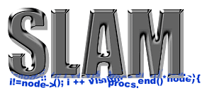
Success Story:
Static Device Verifier
Origin: Microsoft research project SLAM on software model checking
Technology transfer: Windows development project SDV
Catalyst: frequent crashes in Windows because of third-party code
Things like even software verification, this has been the Holy Grail of computer science for many decades but now in some very key areas, for example, driver verification we’re building tools that can do actual proof about the software and how it works in order to guarantee the reliability. -- Bill Gates (2002)

Slide 21
Research Trend 5: Constraint Solvers (1990s--)
Propositional Satisfiability: Given a formula over Boolean variables, is there an assignment of 0/1’s to vars which makes the formula true
  Canonical NP-hard problem (Cook 1973)
  Enormous progress in tools that can solve instances with thousands of variables and millions of clauses
  Extensions to richer classes of constraints (SMT solvers)
1960
DP
≈10 var
1988
SOCRATES
≈ 3k var
1994
Hannibal
≈ 3k var
1996
GRASP
≈1k var
2002
Berkmin
≈10k var
1986
BDDs
≈ 100 var
1992
GSAT
≈ 300 var
1996
Stålmarck
≈ 1000 var
2001
Chaff
≈10k var
1952
Quine
≈ 10 var
1962
DLL
≈ 10 var
1996
SATO
≈1k var

Slide 22
SMT: Satisfiability Modulo Theories
Computational problem: Find a satisfying assignment to a formula
  Boolean + Int types, logical connectives, arithmetic operators
  Bit-vectors + bit-manipulation operations in C
  Boolean + Int types, logical/arithmetic ops + Uninterpreted functions
“Modulo Theory”: Interpretation for symbols is fixed
  Can use specialized algorithms (e.g. for arithmetic constraints)
Progress in improved SMT solvers
Little Engines of Proof
SAT; Linear arithmetic; Congruence closure

Slide 23
Success Story: SMT Solvers
CBMC
SAGE
VCC
Spec#
SMT-LIB Standardized Interchange Format (smt-lib.org)
Problem classification + Benchmark repositories
LIA, LIA_UF, LRA, QF_LIA, …
+ Annual Competition (smt-competition.org)
Z3
Yices
CVC4
MathSAT5
Ever-growing scalability and use in different applications

Slide 24
Research Trend 6: Cyber-Physical Systems (1990s--)
Discrete software interacting with continuously evolving physical system
  Need to model physical world using differential equations and timing delays
  Models: Timed automata, Hybrid automata
  Symbolic reachability analysis over sets of real-valued variables
  Finite-state abstractions
  Beyond correctness: Stability, Timely response
  Collaboration between control theory and formal methods
  Verification tools: Uppaal, Taliro, Keymaera, dReal, SpaceEx …
  Applications: medical devices, collision avoidance protocols

Slide 25
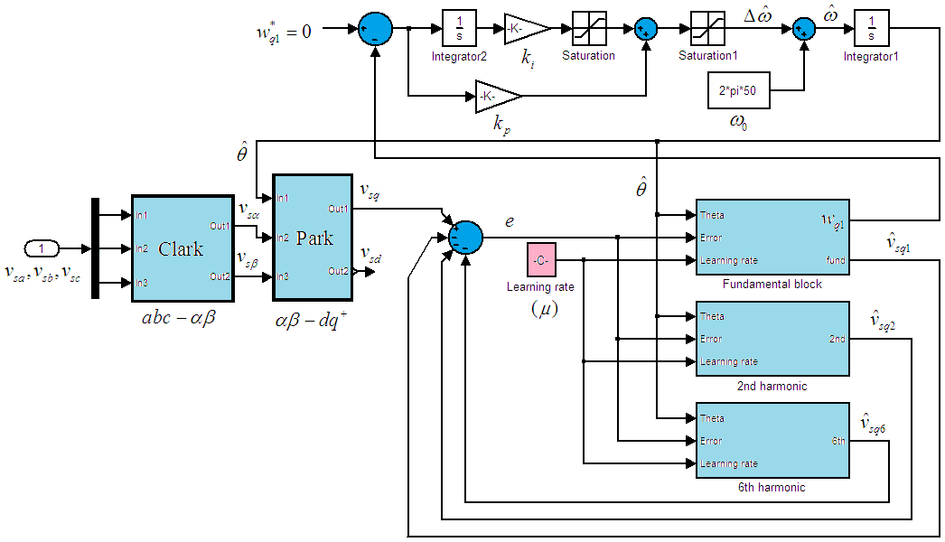
Success Story:
Model-based Design of CPS
Model-based design for safety-critical control software
  Demand from avionics and automobile industry
  Formal verification groups in Airbus, Boeing, GM, Toyota
Popular industrial-strength tools: Mathworks (Stateflow/Simulink)
  Initial reluctance to formal models
  But growing adoption (e.g. Hybrid automata as Simulink domain)
  Simulink Design Verifier (model-based testing, static analysis)

Slide 26
Research Trend 7: Software Testing using CAV (2000s--)
Testing is still the dominant way of debugging software systems
Specification-based testing
  Test cases should reveal violations of formal specifications
How to generate “interesting” inputs for testing
  Combination of techniques based on static analysis, abstraction, symbolic methods, constraint solvers
Symbolic execution
  Execute program on symbolic input values
  Concolic testing (concrete + symbolic) for scalability

Slide 27

Success Story: SAGE
Testing based on whitebox fuzzing for security vulnerabilities
Underlying technology: program analysis, SMT solvers, concolic testing
Deployed on large scale daily for Windows, Office, etc
1/3 of all Windows7 WEX security bugs found by SAGE
Bug fixes shipped routinely to billions of PCs

Slide 28
Research Trend 8: Back to Verified Software (2005 --)
Maturing tools and persistent security vulnerabilities shift focus back to the dream of fully verified systems
Successful efforts
  CompCert (Compilers you can formally trust)
  seL4 (Formally verified operating system microKernel)
  Paxos (practical distributed systems protocol for data replication)
Keys to success
  Formalization and logical foundations
  Automation support with proof tactics and decision procedures
  Sustained effort by experts

Slide 29
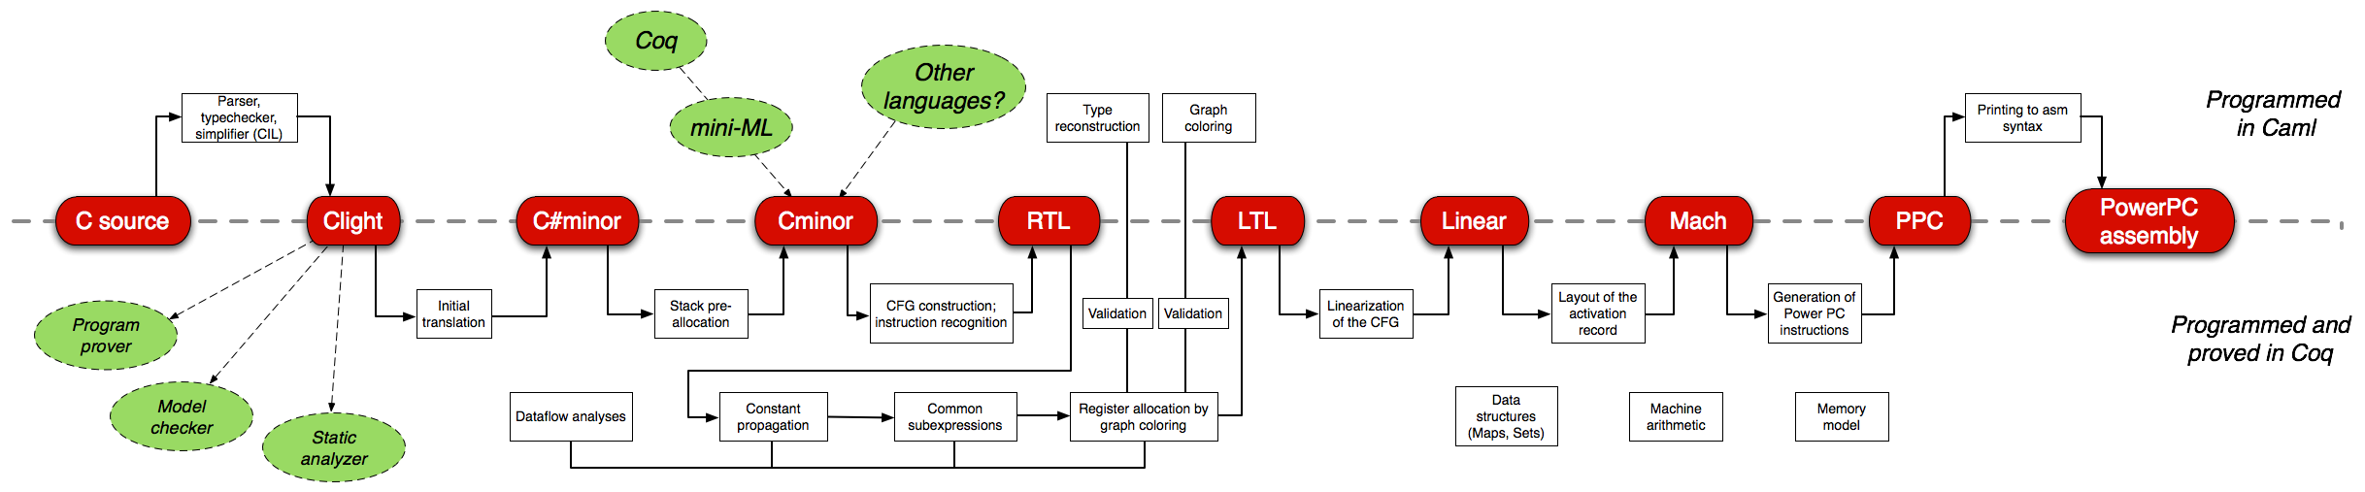
Success Story: CompCert C compiler compcert.inria.fr
Fully verified translator from C to machine code
Accepts most of ISO C 99
Produces machine code for PowerPC, ARM, and IA32 architectures
90% of the performance of GCC (v4, opt. level 1)
Many ongoing projects on “verified” web-browsers, OS-kernels, …
by researchers in programming languages, compilers, OS, …

Slide 30
CIS 673
Focus on “automated” techniques
List of topics subject to change based on student interest

Slide 31
Tentative Topics
Constraint solving:
  Program verification as satisfiability checking of logical formulas
  Boolean satisfiability and efficient SAT solvers
  Decidable logical theories, combination of decision procedures, SMT solvers
Software model checking:
  Predicate abstraction
  Temporal logic specifications
  Symbolic state-space exploration
  Reasoning about procedures
  Counterexample-guided abstraction refinement
Program synthesis:
  Syntax-guided synthesis
  Counterexample-guided inductive synthesis
  Machine learning and synthesis
Analysis of hybrid systems:
  Basics of dynamical systems and control
  Symbolic reachability analysis
  Verification of neural-network-based controllers

Slide 32
Course Logistics
This course is suitable for
  PhD students interested in research in formal methods and programming systems
  Undergraduate/Masters students who want to learn about techniques underlying verification tools
Grade based on
  Active class participation
  Course project (written report + presentation)
Course project
  Verification case study
  Improvement in analysis technique of an existing tool
  Design your own project

Slide 33
Puzzle: Cinderella v. stepmother
There are five buckets arranged in a circle. Each bucket can hold upto B liters of water. Initially all buckets are empty. The wicked stepmother and Cinderella take turns playing the following game:
Stepmother brings 1 liter of additional water and splits it into 5 buckets.
If any of the buckets overflows, stepmother wins the game.
If not, Cinderella gets to empty two adjacent buckets. If the game goes on forever, Cinderella wins.
Find B* such that if B < B* the stepmother has a winning strategy, and if B = B*, Cinderella has a winning strategy.
And give a proof that your strategies work!

