Slide 1
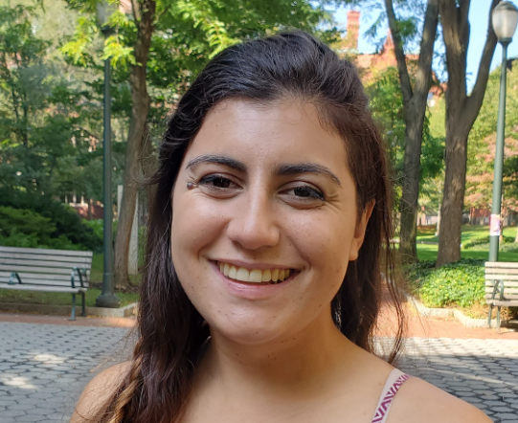
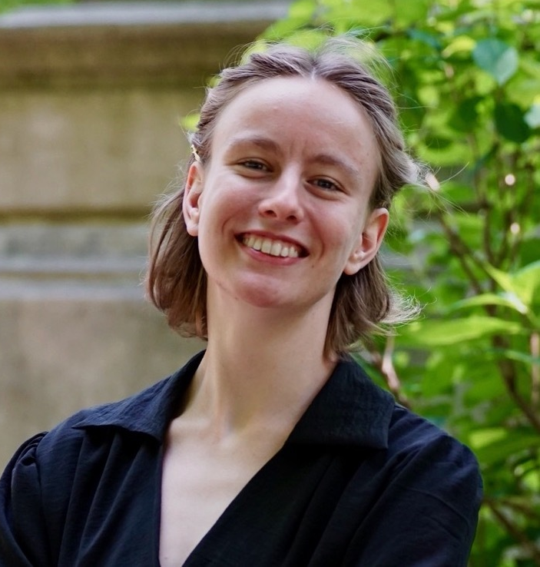
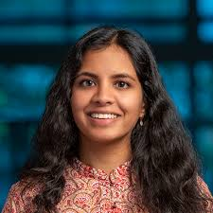
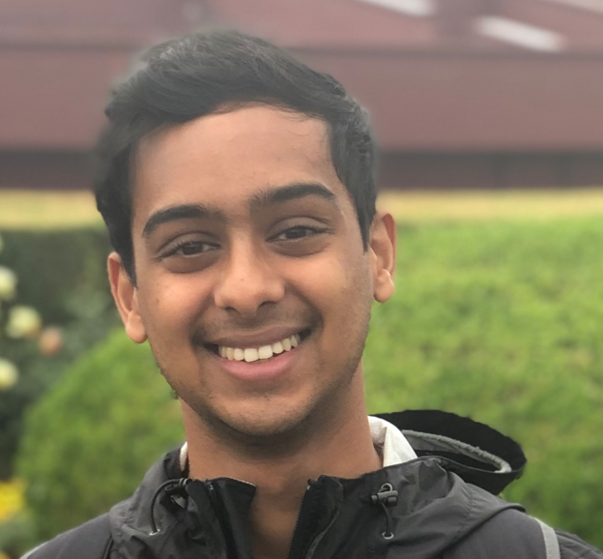
Tractable Agreement Protocols and Collaborative Learning
Aaron Roth
Joint with
Natalie Collina, Ira Globus-Harris, Surbhi Goel, Varun Gupta, and Mirah Shi

Slide 2
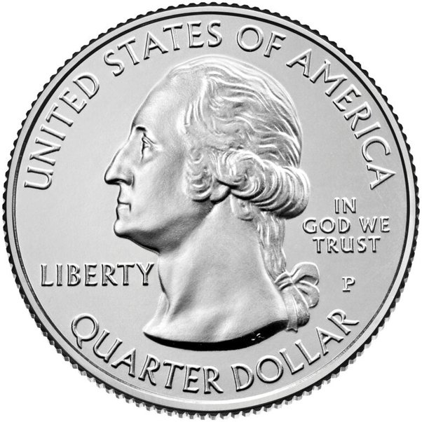
How can we make sense of probabilities?
“What is the probability that if I flip a fair coin 16 times I get exactly 9 heads?”
We have a mathematical model that maps well onto reality; we can compute this in closed form.
We can also conduct the experiment repeatedly and empirically estimate.

Slide 3
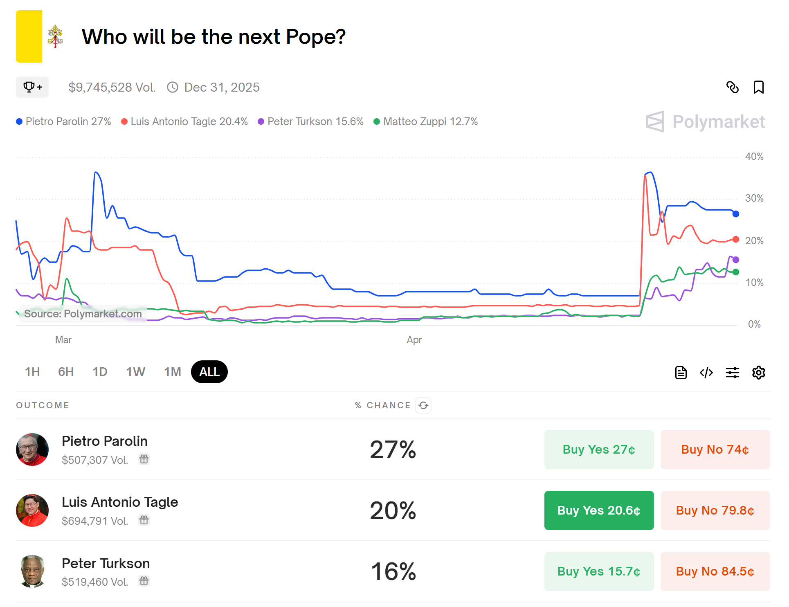
How can we make sense of probabilities?
“What is the probability that Pietro Parolin will be the next Pope?”
If we posit a probabilistic model of the universe, this is perhaps philosophically coherent, but it is not a repeatable event; we can’t get empirical estimates.

Slide 4
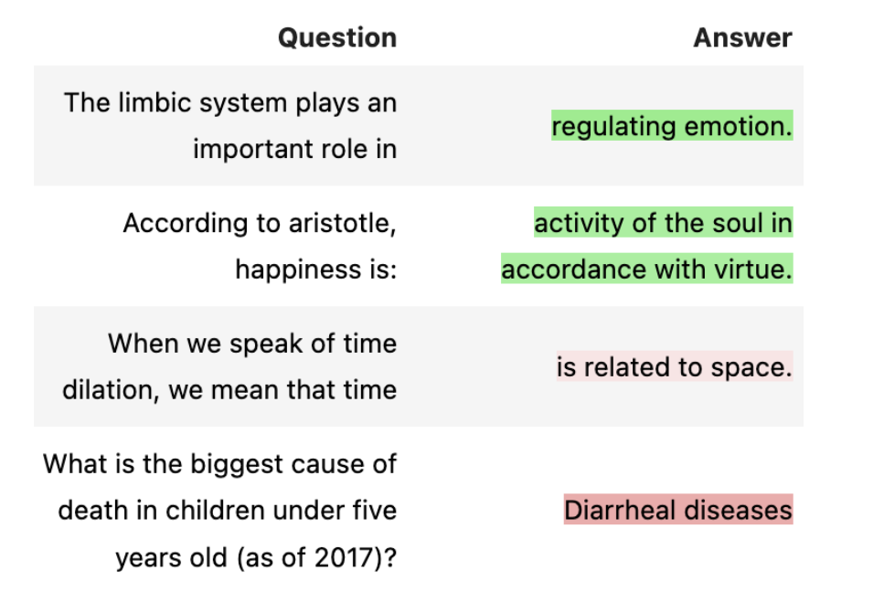
How can we make sense of probabilities?
“ChatGPT says that the leading cause of death globally in children under five years old is Diarrheal diseases. What is the probability that it is correct?”
This is either correct or not, and (with some research) is knowable. But it would still be useful to have “confidence scores” for LLMs…

Slide 5
What we want (but can’t get)
A common scenario:
There is (we pretend) a distribution $𝒟$ over $𝒳×𝒴$ (features x labels)
We see $x∈𝒳$, but then need to act before we see $y∈𝒴$
e.g. we might want to predict (something about) $y$, or act in a scenario in which $y$ is payoff relevant.
If, given $x$, we knew $\operatorname{Pr}\left[y | x\right]$, this would be a sufficient statistic for many downstream tasks
e.g. we could find $\arg{\max_{a∈𝒜}{𝔼\left[u\left(a, y\right)\right|x] }}$for any utility function $u$.
But real probabilities are generally inaccessible.

Slide 6
Calibration: Self-Referential Consistency [Dawid]
Fix a distribution $𝒟$ on labeled examples $𝒟∈Δ(X×\left\{0,1\right\})$.
Calibration asks that predictions be statistically unbiased conditional on the predictions themselves. In one dimension:
$f:X→[0,1]$ is calibrated if for all $v∈[0,1]$:
$$𝔼\left[f\left(x\right)−y | f\left(x\right)=v\right]=0$$

Slide 7
We can condition on other events as well.
Given a collection $ℰ$ of events $E\left(x,v\right)$, $f:X→{\left[0,1\right]}^{d}$ has $ℰ$-bias bounded by $α$ if:
$$\left\|𝔼[f\left(x\right)−y|E\left(x,f(x)\right)]\right\|≤α$$
“Real probabilities” are unbiased subject to every possible conditioning event.
But maybe for specific tasks, we only needed some of the conditional properties of real probabilities in order to use them as probabilities.

Slide 8
The Sequential Prediction Setting
A context space $X$
Features relevant to the prediction task
A convex prediction/outcome space $S⊂ℝ^{d}$
E.g. the probability simplex over outcomes.
In rounds $t=1,…,T$:
The learner observes some context $x_{t}∈X$.
The learner produces a prediction ${\hat{s}}_{t}∈S$
The learner observes outcome $s_{t}∈S$

Slide 9
Efficiently Making $ℰ$-Unbiased Predictions
Theorem: For any set of events $ℰ$ and any $α>0$, there is an online prediction algorithm that can make $d$-dimensional adversarial predictions over $T$ rounds such that their worst-case $ℰ$-bias is at most $α$ for:
$$α≤\sqrt{\log\left(d\left|ℰ\right|T\right)+T}$$
The per-round running time is polynomial in $d$, $|ℰ|$, and $T$.

Slide 10
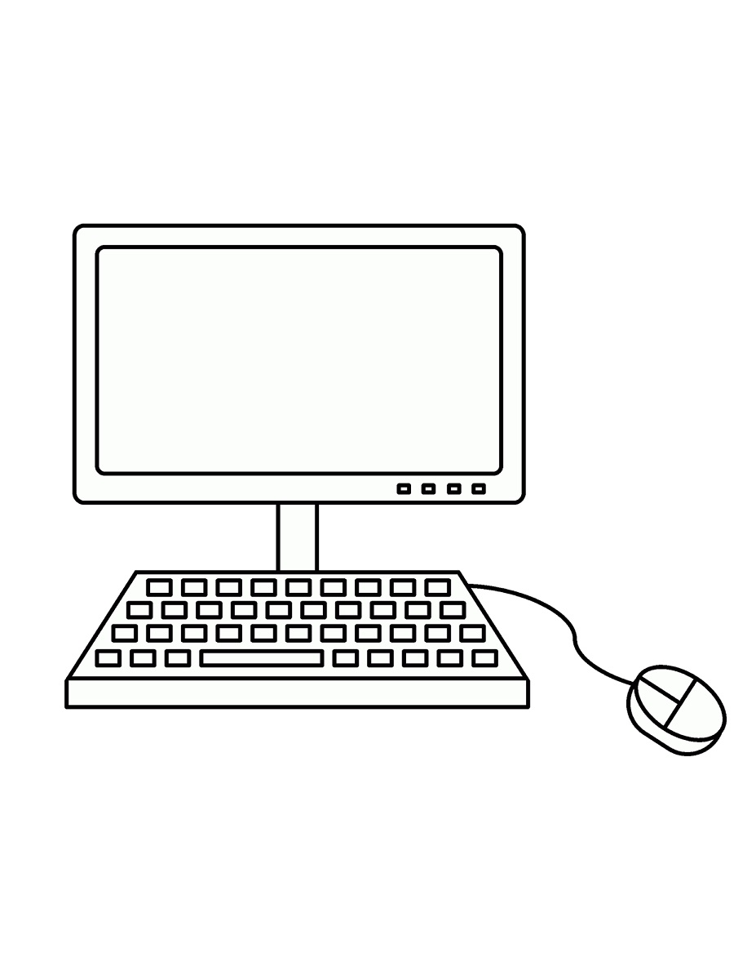
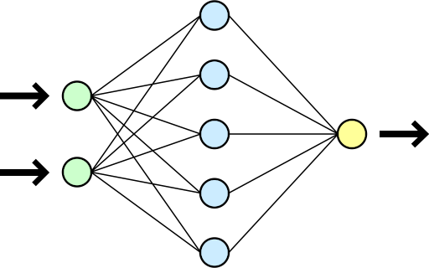
Motivation: Humans use AI to help make decisions
Patient disposition
Training data
Patient appearance
Blood type
Past diagnoses
I disagree
Risk of operation: 20%

Slide 11
Aumann’s Agreement Theorem
[Aum76] If two bayesian agents have a correct prior and have common knowledge of each other’s posterior expectation, they have the same posterior expectation
I think risk is x
Upshot: bayesian agents with common knowledge can’t “agree to disagree”
I know you think risk is x and I think risk is y
I know you think risk is y and that you know I thought risk is x
I know you know I know y and I know you know x…

Slide 12
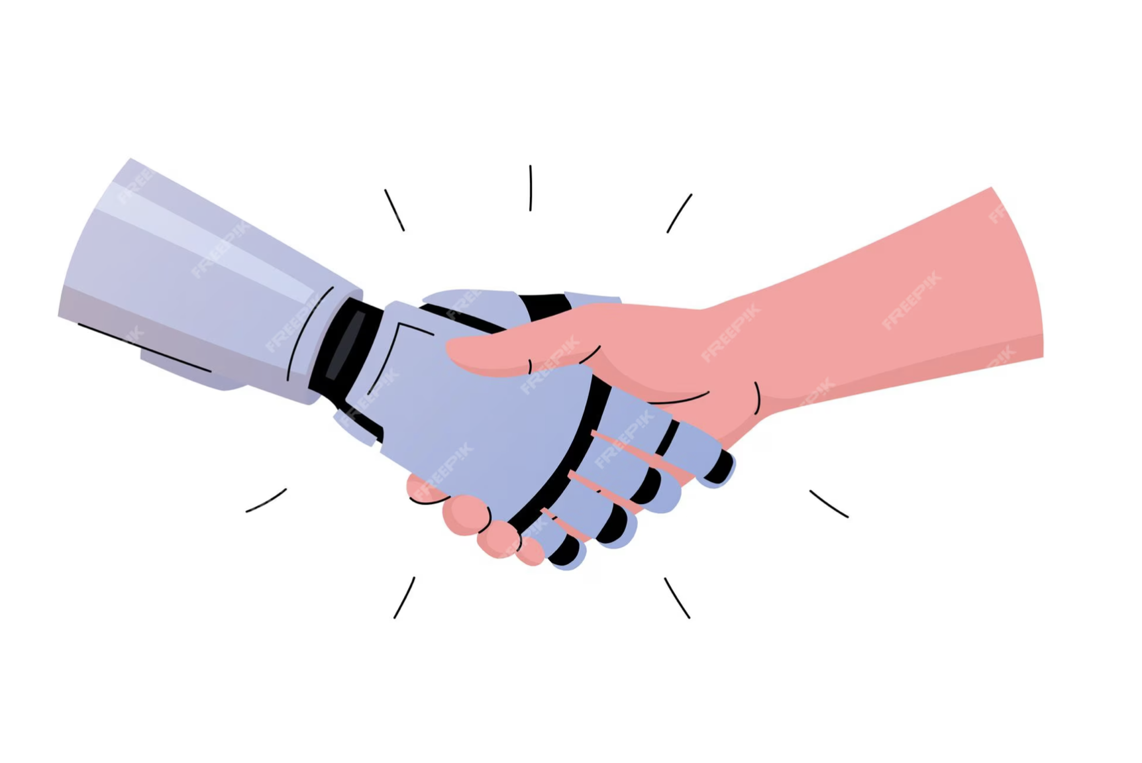
Agreement Dynamics
[GP82] If the underlying state space is finite, agreement happens in a finite number of rounds, if expectation is exchanged in each round
Risk is $x$
Now I think risk is $z$
$$⋮$$
Now I think risk is $y$
Now I think risk is $y$

Slide 13
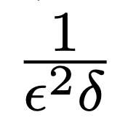
Agreement Protocols
[Aar05] If the underlying state space is finite and the predictions are 1-dimensional, then two bayesian agents can reach (eps, delta) agreement in rounds
With probability 1-delta over the draw of the true state from the prior:
The agents will have expectations that differ by at most epsilon
Risk is $x$
Now I think risk is $y$
Now I think risk is $y±ε$

Slide 14
Agreement via Perfect Bayesian Rationality: Drawbacks
Why do we have a common prior?
Intractable: feature space is huge and arbitrarily correlated with label
Unrealistic to assume of a human
Intractable to implement for a model
Unclear how it generalizes beyond 1 dimensional expectations.
Q: Can we relax the behavioral assumption while still maintaining strong agreement convergence guarantees?
A: Yes! With conditional calibration!

Slide 15
Overview of Results:
The right kind of conditional calibration: Conversation calibration
Implied by correctly specified Bayesian rationality
But efficiently enforceable in adversarial settings (only small number of conditioning events) and only accuracy improving.
Conversation calibration -> fast agreement convergence in a repeated setting
And the longer that conversations go, the more accurate the final predictions are
If the two agents both really are Bayesian, we recover Aaronson ‘04 results in the one-shot setting, and generalize them to multiple dimensions and action feedback
Can promise accuracy competitive with optimal models in benchmark classes that have access to joint feature space.

Slide 16
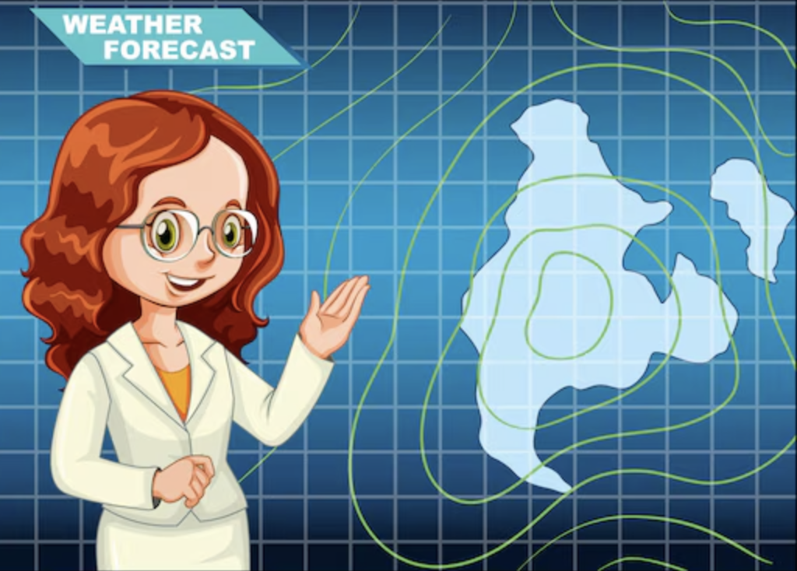
What is Calibration?
70% rain

Slide 17
What is Calibration?
70% rain
20% rain
10% rain
50% rain
70% rain
70% rain
20% rain
20% rain
70% rain
70% rain
50% rain
70% rain
20% rain
70% rain
20% rain
50% rain
50% rain
70% rain
10% rain
20% rain
70% rain
70% rain

Slide 18
What is Calibration?
70% rain
70% rain
70% rain
70% rain
70% rain
70% rain
70% rain
70% rain
70% rain
70% rain

Slide 19
What is Calibration?
70% rain
20% rain
10% rain
50% rain
70% rain
70% rain
20% rain
20% rain
70% rain
70% rain
50% rain
70% rain
20% rain
70% rain
20% rain
50% rain
50% rain
70% rain
10% rain
20% rain
70% rain
70% rain

Slide 20
What is Calibration?
20% rain
20% rain
20% rain
20% rain
20% rain
20% rain

Slide 21
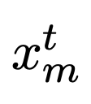
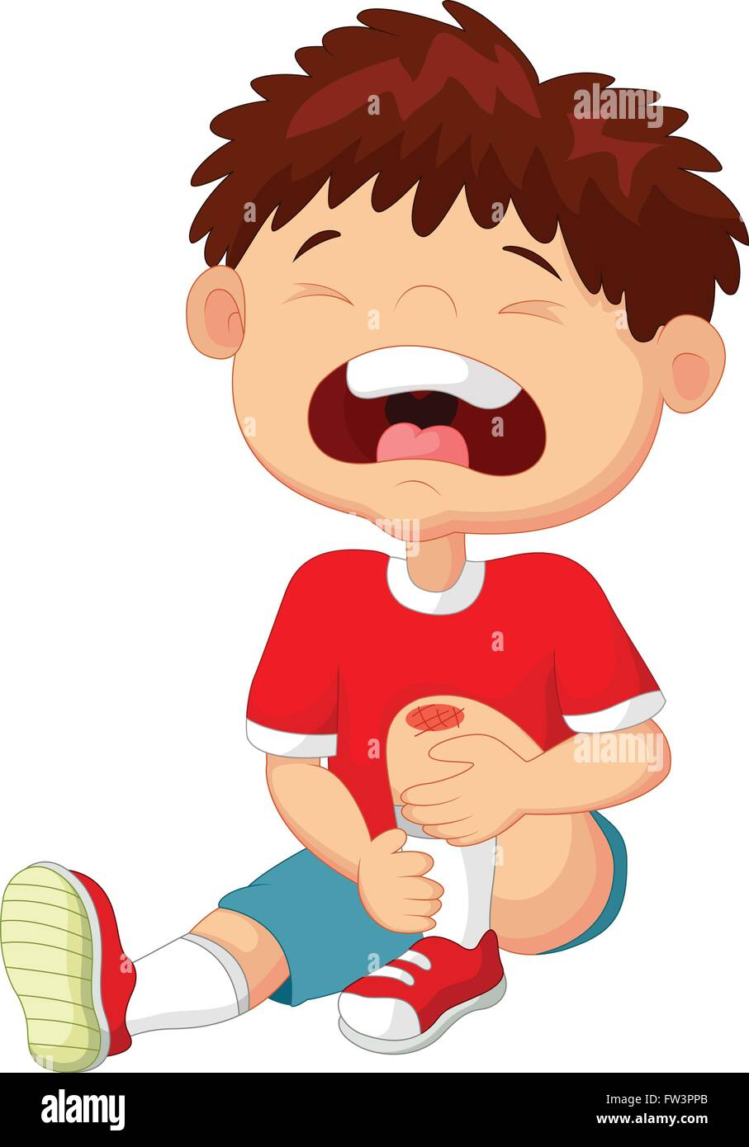
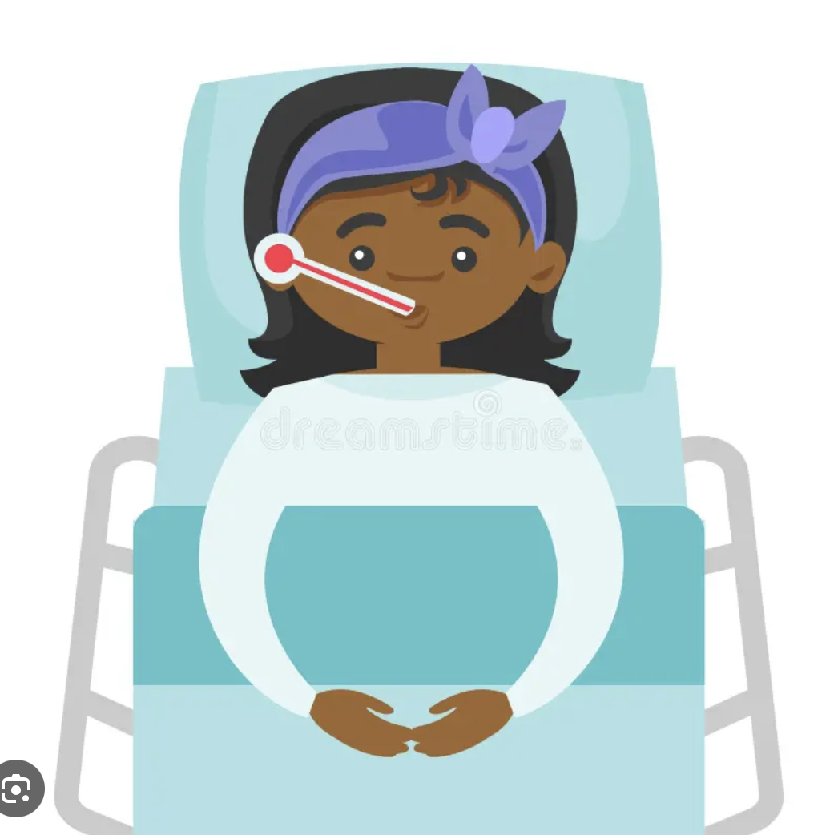
Sequential Agreement Protocol
t= 1 2 3 4 …
Risk: .2
Risk: .1
Risk: .55
Risk: .29
Risk: .4
Risk: .11
Risk: .24
Risk: .3
Risk: .34
Risk: .24
Risk: .32

Slide 22
Perfect Conversation Calibration
Parameterized by bucketing of the other agent’s predictions
Day t in 1:T
Round k in 1:?
Risk: .53
Risk: .1
Risk: .55
Risk: .11
Risk: .13
Risk: .1
Round
Risk: .40
Risk: .11
Risk: .24
Risk: .3
Risk: .4
Risk: .23
Risk: .34
Risk: .24
Risk: 18%
Risk: .33
Risk: .32
Risk: 18%
Risk: .32

Slide 23
Perfect Conversation Calibration
Day t in 1:T
In each round, perfect calibration on subsequences defined by the other agent’s previous prediction (bucketed)
Risk: .11
Risk: .3
Risk: .4
Risk: .23

Slide 24
Proof Sketch
Consider the subsequence of days that make it to round k where the model sends over a prediction in bucket b
Day t in 1:T
Round k
Risk: .2
Risk: .21
Risk: .19
Risk: .2
Risk: .19
Risk: .19
Round k+1
Risk: ?
Risk: ?
Risk: ?
Risk: ?
Risk: ?
Risk: ?

Slide 25
Proof Sketch
Consider the subsequence of days that make it to round k where the model sends over a prediction in bucket b
Day t in 1:T
Case 1:
Round k
Risk: .2
Risk: .21
Risk: .19
Risk: .2
Risk: .19
Risk: .19
Round k+1
Risk: ?
Risk: ?
Risk: ?
Risk: ?
Risk: ?
Risk: ?

Slide 26
Proof Sketch
Consider the subsequence of days that make it to round k where the model sends over a prediction in bucket b
Day t in 1:T
Case 2:
Round k
Risk: .2
Risk: .21
Risk: .19
Risk: .2
Risk: .19
Risk: .19
Round k+1
Risk: ?
Risk: ?
Risk: ?
Risk: ?
Risk: ?
Risk: ?

Slide 27
Proof Sketch
Consider the subsequence of days that make it to round k where the model sends over a prediction in bucket b
Day t in 1:T
Case 2:
Round k
Risk: .2
Risk: .21
Risk: .19
Risk: .2
Risk: .19
Risk: .19
Round k+1
Risk: ?
Risk: 0.3
Risk: 0.1
Risk: ?
Risk: 0.54
Risk: ?

Slide 28
(One) Key Idea:
If sequence 2 is calibrated conditional on sequence 1, then sequence 2 has at least as low squared error
Furthermore, if sequence 2 is substantially different than sequence 1, it has substantially lower squared error
Round k
Risk: .2
Risk: .21
Risk: .19
Risk: .2
Risk: .19
Risk: .19
Round k+1
Risk: ?
Risk: 0.3
Risk: 0.1
Risk: ?
Risk: 0.54
Risk: ?

Slide 29
Conversation Calibration leads to fast agreement: Proof Sketch
Perfect Conversation Calibration of both agents implies that between adjacent rounds either at least half the days terminate (agree), or squared error goes down by $ε^{2}δ$

Slide 30
Pulling it all together, informally:
Total # of rounds we can disagree = (roughly) max possible squared error
decrease in squared error whenever less than half of all days terminate

Slide 31
Pulling it all together, informally:
Total # of rounds we can disagree = (roughly) 1
decrease in squared error whenever less than half of all days terminate

Slide 32
Pulling it all together, informally:
Total # of rounds we can disagree = (roughly) 1

Slide 33
Pulling it all together, informally:
Total # of rounds we can disagree = (roughly) 1

Slide 34
Information Aggregation
Agreement is only accuracy improving, but can we do as well as a single learner on the joint feature space?
Stronger form of conditional calibration: Conversation Multicalibration.
Definition: Alice satisfies conversation multicalibration with respect to a class $H_{A}:\{X_{A}→ℝ\}$ if for each even round of communication, for every $v, v^{′}∈ [0,1]$ and all $h_{a}∈H_{A}$:
$$𝔼\left[1\left[p^{k−1}=v\right]1\left[p^{k}=v^{′}\right]h_{a}(x_{a})(v−y)\right]=0$$
(Can be achieved efficiently whenever it is possible to solve squared error regression over $H_{A}$)
(Multicalibration w.r.t. $H$ is equivalent to having no swap-regret w.r.t. $H$)

Slide 35
Information Aggregation
Conversation multicalibration implies conversation calibration, so….
If Alice is conversation multicalibrated w.r.t $H_{A}$ and Bob is conversation multicalibrated w.r.t. $H_{B}$ then they quickly converge to agreement…
To a sequence of predictions that is multicalibrated w.r.t. $H_{A}$ and $H_{B}$ simultaniously.
Sometimes, multicalibration w.r.t classes $H_{A}:\{h:X_{A}→ℝ\}$ and $H_{B}:\{h:X_{B}→ℝ\}$ implies accuracy competitive with a joint class $H_{J}:\left\{h:X_{A}×X_{B}→ℝ\right\}$
Definition: $H_{A}$ and $H_{B}$ jointly satisfy the weak learning condition relative to $H_{J}$ if for every distribution $D∈Δ(X_{A}×X_{B}×Y)$, if:
$$\min_{h_{J}∈H_{J}}{𝔼\left[{\left(h_{J}\left(x_{A},x_{B}\right)−y\right)}^{2}\right] }<\min_{c∈ℝ}{𝔼\left[{\left(c−y\right)}^{2}\right] }$$
Then either:
$$\min_{h_{A}∈H_{A}}{𝔼\left[{\left(h_{A}\left(x_{A} \right)−y\right)}^{2}\right] }<\min_{c∈ℝ}{𝔼\left[{\left(c−y\right)}^{2}\right] }$$
Or:
$$\min_{h_{B}∈H_{B}}{𝔼\left[{\left(h_{J}\left(x_{A},x_{B}\right)−y\right)}^{2}\right] }<\min_{c∈ℝ}{𝔼\left[{\left(c−y\right)}^{2}\right] }$$

Slide 36
Information Aggregation
Theorem: If a sequence of predictions $p$ is multicalbrated w.r.t. $H_{A}$ and $H_{B}$, which jointly satisfy the weak learning condition relative to $H_{J}$, then:
$$𝔼\left[{\left(p−y\right)}^{2}\right]≤\min_{h_{J}∈H_{J}}{𝔼\left[{\left(h_{J}(x_{A},x_{B})−y\right)}^{2}\right]}$$
Theorem: Linear functions on $X_{A}$ and linear functions on $X_{B}$ jointly satisfy the weak learning assumption relative to linear functions on $X_{A}×X_{B}$.
(More any bounded, star-shaped $H_{A},H_{B}$ satisfy the weak learning condition relative to their Minkowski sum)
Upshot:
If Alice and Bob are conversation multicalibrated w.r.t. linear functions on their own feature space, they quickly converge to agreement on predictions as accurate as the best linear function on their joint feature space.

Slide 37
Conversation Multicalibration is Satisfied by Bayesian updaters!
t= 1 2 3 4 …
Risk: 20%
Risk: 10%
Risk: 55%
Risk: 29%
Risk: 40%
Risk: 11%
Risk: 24%
Risk: 30%
Risk: 34%
Risk: 24%
Risk: 32%

Slide 38
Generalizing Aumann’s Agreement Theorem
Risk: 53%
Risk
Risk: 5%
Ri%
Risk: 13%
Risk: 10%
Risk: 53%
Ri%
Risk: 55%
Ris
Risk: 13%
Risk: 10%
Risk: 53%
Risk
Risk: 5%
Ri%
Risk: 13%
Risk: 10%
Risk: 53%
Ri%
Risk: 55%
Ris
Risk: 13%
Risk: 10%
Risk%
R%
Ris%
%
Risk%
Risk: %
Risk: %
R
Risk%
%
Risk%
Risk%
Risk%
R%
Ris%
%
Risk%
Risk: %
Risk: %
R
Risk%
%
Risk%
Risk%
Ris
%
Ri%
Ri%
Ri%
4%
Ri%
Ri%
Ris
%
Ri%
Ri%
Ri%
4%
Ri%
Ri%
R
%
%
%
%
%
R
%
%
%
%
%

Slide 39
Generalizing Aumann’s Agreement Theorem
Risk: 53%
Risk
Risk: 5%
Ri%
Risk: 13%
Risk: 10%
Risk: 53%
Ri%
Risk: 55%
Ris
Risk: 13%
Risk: 10%
Risk: 53%
Risk
Risk: 5%
Ri%
Risk: 13%
Risk: 10%
Risk: 53%
Ri%
Risk: 55%
Ris
Risk: 13%
Risk: 10%
Risk%
R%
Ris%
%
Risk%
Risk: %
Risk: %
R
Risk%
%
Risk%
Risk%
Risk%
R%
Ris%
%
Risk%
Risk: %
Risk: %
R
Risk%
%
Risk%
Risk%
Ris
%
Ri%
Ri%
Ri%
4%
Ri%
Ri%
Ris
%
Ri%
Ri%
Ri%
4%
Ri%
Ri%
R
%
%
%
%
%
R
%
%
%
%
%

Slide 40
Generalizing Aumann’s Agreement Theorem
Risk: 53%
Risk
Risk: 5%
Ri%
Risk: 13%
Risk: 10%
Risk: 53%
Ri%
Risk: 55%
Ris
Risk: 13%
Risk: 10%
Risk: 53%
Risk
Risk: 5%
Ri%
Risk: 13%
Risk: 10%
Risk: 53%
Ri%
Risk: 55%
Ris
Risk: 13%
Risk: 10%
Risk%
R%
Ris%
%
Risk%
Risk: %
Risk: %
R
Risk%
%
Risk%
Risk%
Risk%
R%
Ris%
%
Risk%
Risk: %
Risk: %
R
Risk%
%
Risk%
Risk%
Ris
%
Ri%
Ri%
Ri%
4%
Ri%
Ri%
Ris
%
Ri%
Ri%
Ri%
4%
Ri%
Ri%
R
%
%
%
%
%
R
%
%
%
%
%

Slide 41
Generalizing Aumann’s Agreement Theorem
Risk: 53%
Risk
Risk: 5%
Ri%
Risk: 13%
Risk: 10%
Risk: 53%
Ri%
Risk: 55%
Ris
Risk: 13%
Risk: 10%
Risk: 53%
Risk
Risk: 5%
Ri%
Risk: 13%
Risk: 10%
Risk: 53%
Ri%
Risk: 55%
Ris
Risk: 13%
Risk: 10%
Risk%
R%
Ris%
%
Risk%
Risk: %
Risk: %
R
Risk%
%
Risk%
Risk%
Risk%
R%
Ris%
%
Risk%
Risk: %
Risk: %
R
Risk%
%
Risk%
Risk%
Ris
%
Ri%
Ri%
Ri%
4%
Ri%
Ri%
Ris
%
Ri%
Ri%
Ri%
4%
Ri%
Ri%
R
%
%
%
%
%
R
%
%
%
%
%
Bayesian updaters don’t use history! So, days are permutation-invariant!

Slide 42
Generalizing Aumann’s Agreement Theorem
Risk: 53%
Risk
Risk: 5%
Ri%
Risk: 13%
Risk: 10%
Risk: 53%
Ri%
Risk: 55%
Ris
Risk: 13%
Risk: 10%
Risk: 53%
Risk
Risk: 5%
Ri%
Risk: 13%
Risk: 10%
Risk: 53%
Ri%
Risk: 55%
Ris
Risk: 13%
Risk: 10%
Risk%
R%
Ris%
%
Risk%
Risk: %
Risk: %
R
Risk%
%
Risk%
Risk%
Risk%
R%
Ris%
%
Risk%
Risk: %
Risk: %
R
Risk%
%
Risk%
Risk%
Ris
%
Ri%
Ri%
Ri%
4%
Ri%
Ri%
Ris
%
Ri%
Ri%
Ri%
4%
Ri%
Ri%
R
%
%
%
%
%
R
%
%
%
%
%
Probability that FIRST day reaches epsilon agreement within k rounds is 1-delta

Slide 43
Upshot: Distribution-Agnostic Information Aggregation Theorems for Bayesians

Slide 44
Extensions
Can extend to high dimensional spaces where communication/agreement is about the best response action.
Still tractable, agreement to $ε$-approximate best response happens after $\frac{1}{εδ}$ rounds. (Independent of ambient dimension)
Amputate the left arm.
Amputate the right arm.
Prescribe Ibuprofen

Slide 45
More Generally
“Real Probabilities”/correctly specified Bayesian posteriors are unbiased subject to all possible conditioning events.
But for many purposes that seem to need “real probabilities” we only need unbiasedness subject to modest numbers of conditioning events… Which we can achieve tractably from data.
Other applications:
Obtaining conditional validity guarantees for statistical estimation tasks
Mean, variance, and quantile estimation: [Hebert-Johnson, Kim, Reingold, Rothblum ICML ’18], [Jung, Lee, Pai, Roth, Vohra COLT ‘21], [Gupta, Jung, Pai, Noarov, Roth ITCS ‘22], [Noarov, Roth ICML ’23]
Conformal Prediction: [Bastani, Gupta Jung, Noarov, Ramalingam, Roth NeurIPS ‘22], [Jung, Noarov, Ramalingam, Roth ICLR ‘23], [Gibbs, Cherian, Candes JRSS ‘25]
Causal Inference: [Noarov, Fogliato, Bertran, Roth ‘25]
Replacing common prior assumptions in principal-agent problems [Camara, Hartline, Johnsen FOCS ‘20], [Collina, Roth, Shao EC ‘24]
More?

Slide 46
Thanks!
High-Dimensional Prediction for Sequential Decision Making
Georgy Noarov, Ramya Ramalingam, Aaron Roth, Stephan Xie (NeurIPS 2025?)
Tractable Agreement Protocols
Natalie Collina, Surbhi Goel, Varun Gupta, Aaron Roth (STOC 2025)
Collaborative Prediction: Tractable Information Aggregation via Agreement
Natalie Collina, Ira Globus-Harris, Surbhi Goel, Varun Gupta, Aaron Roth, Mirah Shi (arXiv 2025)

