Slide 1
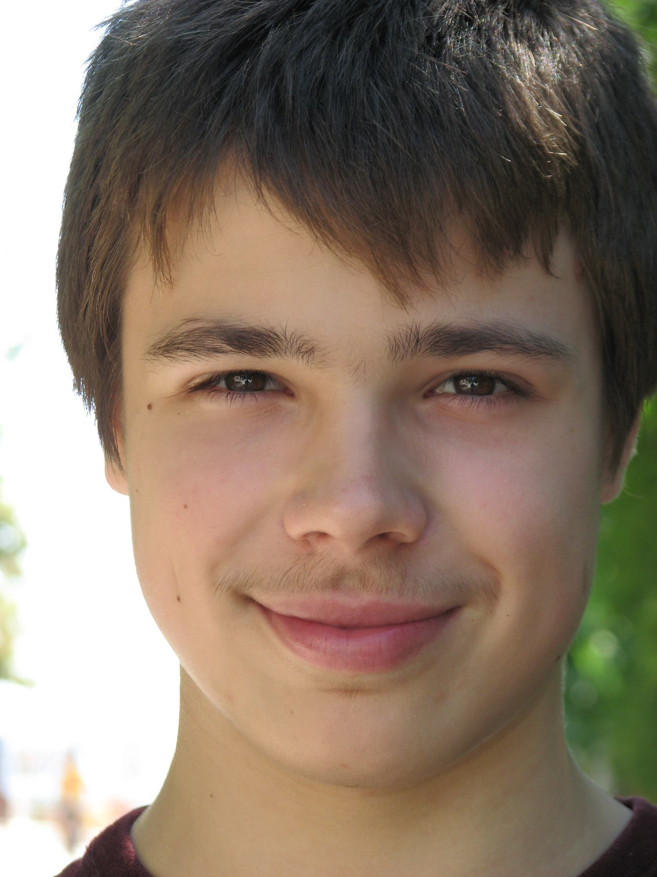
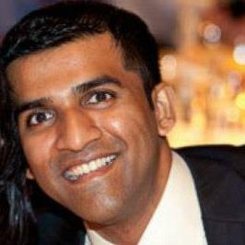
Online Multivalid Learning: Means, Moments, and Prediction Intervals
Aaron Roth
Joint with Varun Gupta, Chris Jung, George Noarov, and Mallesh Pai.

Slide 2
A simple goal
To endow sequential predictions with uncertainty estimates without making assumptions about the data.

Slide 3
What do/should reported uncertainty estimates mean?
Given your features $x$, our model predicts your expected disease severity in two days time is $f\left(x\right).$
How sure are you?
I have a 95% prediction interval that your severity will be in $\left[ℓ\left(x\right),u\left(x\right)\right].$
Hmmm…

Slide 4
What do/should reported probability estimates mean?
Ideally
$$f\left(x\right)=𝔼\left[y \right|x]$$
$$\underset{y}{Pr}\left[y∈\left[ℓ\left(x\right),u\left(x\right)\right]| x\right]=0.95$$
Randomness is entirely over the unrealized/unmeasured randomness of the world, conditional on all of your observable attributes.
More likely
Calibration: $f\left(x\right)=𝔼_{\left(x,y\right)}\left[y \right|f(x)]$
Marginal Coverage:$\underset{(x,y)}{Pr}\left[y∈\left[ℓ\left(x\right),u\left(x\right)\right]\right]=0.95$
Randomness is averaging over people.

Slide 5
What do/should reported probability estimates mean?
True conditional expectations and prediction intervals are too strong in rich feature spaces.
If we have never seen $x$ before we have no information at all about $y|x$.
Standard Solutions:
Parametric assumptions. E.g. assume $𝔼\left[y \right|x]=⟨θ, x⟩$, form confidence regions around $θ$ which translate into prediction intervals
If we believe the model..
From conditional to marginal guarantees.
Calibration, conformal prediction.

Slide 6
Marginal Guarantees.
$\left[ℓ\left(x\right),u\left(x\right)\right]$ is a 95% marginal prediction interval.
But I’m part of a demographic group representing less than 5% of the population…

Slide 7
Marginal Guarantees.
What about for people like me?
For African Americans under the age of 50 the 95% prediction interval is [a,b]
For women with a family history of diabetes the 95% prediction interval is [c,d]
What does this mean for me?
For people with egg allergies and no history of smoking, the 95% prediction interval is [e, f].

Slide 8
Distributional Assumptions
Standard Assumption for Conformal Prediction:
Exchangeability (e.g. iid data): The future must look like the past.
But this is often violated:
Covariate shift: e.g. as a disease moves through a population, the demographics of patients can change suddenly in unanticipated ways.
Label shift: e.g. as treatments improve, the distribution on $y$ conditional on $x$ can change.
Strategic effects: In e.g. lending, hiring, college admissions, people may manipulate their features to optimize for a deployed classifier, which may frequently be retrained.
Time series data: Predictions about correlated data --- e.g. disease severity by time.

Slide 9
This work
We will mitigate both of these problems for sequential prediction:
By making stronger than marginal guarantees, and
Assuming nothing about the data
For prediction intervals… and similar results for predicting means, variances, and higher moments of the label distribution

Slide 10
Mean Multicalibration (Reparametrized) [Hebert-Johnson, Kim, Reingold, Rothblum ’18]
Mean Consistency
Given: a sequence of examples $\left(\left(x_{1},y_{1}\right),…\left(x_{T},y_{T}\right)\right)∈{\left(X×\left[0,1\right]\right)}^{T}$ and a sequence of predictions $\left({\overline{y}}_{1},…{\overline{y}}_{T}\right)∈{\left[0,1\right]}^{T}$
Given a set $S⊆X$ write:
$$μ\left(S\right)=\sum_{t:x_{t}∈S}{y_{t}} \overline{μ}(S)=\sum_{t:x_{t}∈S}{{ \overline{y}}_{t}}$$
A predictor $μ$ is $α$ mean-consistent on a set $S$ if:
$$\left|μ\left(S\right)−\overline{μ}\left(S\right)\right|≤αT$$

Slide 11
Mean Multicalibration (Reparametrized) [Hebert-Johnson, Kim, Reingold, Rothblum ’18]
Calibration
Given a discretization parameter $m$ and a grid $\{0,\frac{1}{m},\frac{2}{m}…,\frac{m−1}{m},1\}.$
Write $\overline{y}∈B(i)$ if $\left|\overline{y}−\frac{i}{m}\right|≤\frac{1}{2m}$
Given $S⊆X: S\left(i\right)= \{x_{t}∈S :{\overline{y}}_{t}∈B(i)\}$
A sequence of predictions $\left({\overline{y}}_{1},…{\overline{y}}_{T}\right)$is $(α,m)$-calibrated if for every $i∈\left[m\right]$ it satisfies $α$-mean consistent on $X(i)$
Multi-calibration
Given: An arbitrary collection of overlapping sets $G⊆2^{X}$
$\left({\overline{y}}_{1},…{\overline{y}}_{T}\right)$is $(α,m)$-multicalibrated w.r.t. $G$ if for every $i∈\left[m\right], S∈G:$
it is $α$-mean consistent on $S(i)$

Slide 12
Prediction Interval Multivalidity
Given: a sequence of examples $\left(\left(x_{1},y_{1}\right),…\left(x_{T},y_{T}\right)\right)∈{\left(X×\left[0,1\right]\right)}^{T}$ and a sequence of prediction intervals $\left(\left[ℓ_{1},u_{1}\right],{[ℓ}_{T},u_{T}]\right)∈{{(\left[0,1\right]}^{2})}^{T}$
Bucketing: Say $\left[ℓ,u\right]∈B(i,j)$ if $ℓ∈B(i)$ and $u∈B(j)$.
The sequence of prediction intervals is $(α,m)$-multivalid for a coverage target $1−δ$ and a collection of groups $G⊂2^{X}$ if for every $\left(i,j\right)∈{\left[m\right]}^{2}$ and for every $S∈G$:
$$|\sum_{t:x_{t}∈S, \left(ℓ_{t},u_{t}\right)∈B(i,j)}{\left(1\left[y_{t}∈\left[ℓ_{t},u_{t}\right]\right]−(1−δ)\right) | ≤αT}$$

Slide 13
The Online Problem
For $t=1,…, T$
An adversary selects $x_{t}∈X$ and $y_{t}∈[0,1]$ and shows $x_{t}$ to the learner.
The learner makes a (possibly randomized) prediction ${\overline{p}}_{t}$
(Of the mean, variance, a prediction interval, etc.)
The learner observes $y_{t}$.
The goal is for the prediction player to guarantee multicalibration/multi-validity in the worst-case over adversaries.

Slide 14
For example, the “conformal prediction” problem
For $t=1,…, T$
An adversary selects a pair $(x_{t},y_{t}^{′})$.
The prediction player predicts $\hat{y}=g_{t}\left(x_{t}\right).$ Define $y_{t}=y_{t}^{′}−{\hat{y}}_{t}$ to be the residual.
The prediction player proposes a 95% prediction $[ℓ_{t},u_{t}]$ for the residual.
The prediction player learns $y_{t}^{′}$.
Goal: for an arbitrary learning procedure for training $g_{t}$, make sure that the prediction intervals have ~95% coverage on the empirical sample.

Slide 15
Mean Multicalibration
For each time step $c$, group $S∈G$ and prediction bucket $i∈\left[m\right]:$
$$V_{C}^{S,i}=\sum_{t=1}^{C}{1[}x_{t}∈S, {\overline{y}}_{t}∈B(i)]⋅(y_{t}−{\overline{y}}_{t})$$
(If $\left|\frac{1}{T}V_{T}^{S,i}\right|≤α$ for all $S∈G,i∈[m]$, we are $(α,m)$-multicalibrated.)

Slide 16
The Basic Idea Taking inspiration from [Fudenberg and Levine 95]
We want to bound $\max_{i,S}\left|V_{T}^{S,i}\right|$.
But this is not a nice function analytically…
Instead, bound a surrogate: $L_{T}= \sum_{i,S}{\exp\left(ηV_{T}^{S,i}\right)+\exp\left(−ηV_{T}^{S,i}\right)}$
($\max_{i,S}\left|V_{T}^{S,i}\right|≤\frac{\log\left(L_{T}\right)}{η}≤\max_{i,S}\left|V_{T}^{S,i}\right|+\frac{\log\left(2\left|G\right|m\right)}{η}$)
This quantity depends on the whole history --- hard to grapple with.
Instead, try to greedily bound its increase after we see $x_{t}$:
$$Δ_{t}({\overline{y}}_{t})=𝔼\left[L_{t}−L_{t−1}|{x_{t},\overline{y}}_{t}\right]$$
(If we can bound this for every history, we can bound $E[L_{T}]$ by telescoping…)

Slide 17
The Basic Idea Taking inspiration from [Fudenberg and Levine 95]
Lemma: For every history and every ${\overline{y}}_{t}∈B(i)$:
$$Δ_{t}\left({\overline{y}}_{t}\right)≤η\left(𝔼\left[y_{t}\right]−{\overline{y}}_{t}\right)⋅C_{t−1}^{i}\left(x_{t}\right)+2η^{2}L_{t−1}$$
where:
$$C_{t−1}^{i}\left(x_{t}\right)= \sum_{S∈G(x_{t})}{\exp\left(ηV_{t−1}^{S,i}\right)−\exp\left(−ηV_{t−1}^{S,i}\right)}$$
Proof: $\exp\left(x\right)≤1+x+2x^{2}$ if $\left|x\right|≤1/2$
$G\left(x_{t}\right)=\{S∈G :x_{t}∈S\}$ --- the groups that $x_{t}$ belongs to.

Slide 18
An Interlude: Zero Sum Games
A Zero Sum Game is defined by:
A minimization player (the learner) with finite strategy space $A_{1}$
A maximization player (the adversary) with finite strategy space $A_{2}$
A utility function $u:A_{1}×A_{2}→ℝ$.
Extended to distributions in the natural way. For $Q_{1}∈ΔA_{1},Q_{2}∈ΔA_{2}$:
$$u\left(Q_{1},Q_{2}\right)=𝔼\left[u\left(a_{1},a_{2}\right)\right]$$
Von Neumann’s Minimax Theorem:
$$\min_{Q_{1}∈ΔA_{1}}{\max_{a_{2}∈A_{2}}{u\left(Q_{1},a_{2}\right)}}=\max_{Q_{2}∈ΔA_{2}}{\min_{a_{1}∈A_{1}}{u\left(a_{1},Q_{2}\right)}}$$
“Order of play doesn’t matter”

Slide 19
The Basic Idea Taking inspiration from [Fudenberg and Levine 95]
Define a game using our upper bound on $Δ_{t}\left({\overline{y}}_{t}\right)$:
$$u\left({\overline{y}}_{t},y_{t}\right)=η\left(y_{t}−{\overline{y}}_{t}\right)⋅C_{t−1}^{B^{−1}({\overline{y}}_{t})}\left(x_{t}\right)+2η^{2}L_{t−1}$$
$u$ is linear in $y_{t}$, so without loss we can take $A_{2}=\{0,1\}$.
We need a finite strategy space for the learner, so we take:
$$A_{1}^{rm}=\left\{0,\frac{1}{rm},\frac{2}{rm},…,1\right\}$$
Here $r$ is a nuisance parameter that will not show up in our running time, so imagine it to be arbitrarily large.

Slide 20
The Basic Idea Taking inspiration from [Fudenberg and Levine 95]
Bound the value of the game by imagining the adversary goes first.
$$v=\max_{Q_{2}∈Δ\{0,1\}}{\min_{\overline{y}∈A_{1}^{r}}\left(η\left(𝔼\left[y_{t}\right]−{\overline{y}}_{t}\right)⋅C_{t−1}^{B^{−1}\left({\overline{y}}_{t}\right)}\left(x_{t}\right)+2η^{2}L_{t−1}\right)}$$
$≤\left(\frac{η}{rm}+2η^{2}\right)L_{t−1}$
(Since we can always choose ${\hat{y}}_{t}$ to be within $±\frac{1}{rm}$ of $𝔼[y_{t}]$)
Apply the minimax theorem to conclude the Learner can do just as well against a worst-case label.
(Non-constructive argument)

Slide 21
So
Lemma: For every adversary, and for every history, at every round $t$, the learner has some distribution $Q_{t}∈{ΔA}_{1}^{rm}$ that guarantees that:
$$𝔼\left[L_{t}\right]=L_{t−1}+𝔼_{\overline{y}∼Q_{t}}\left[Δ_{t}\left({\overline{y}}_{t}\right)\right]≤\left(1+\frac{η}{rm}+2η^{2}\right)L_{t−1}$$
Therefore, by telescoping, since $L_{0}=2|G|m$…
$$𝔼\left[L_{T}\right]≤2\left|G\right|m{\left(1+\frac{η}{rm}+2η^{2}\right)}^{T}$$
And recalling that:
$$\max_{i,S}\left|V_{T}^{S,i}\right|≤\frac{\log\left(L_{T}\right)}{η}$$

Slide 22
We get…
Theorem: There exists an algorithm that for any set of groups $G$, and against any adversary, guarantees $(α,m)$-multicalibration for:
$$𝔼\left[α\right]≤\frac{1}{rm}+2\sqrt{\frac{2\ln\left(2\left|G\right|m\right)}{T}}≤(2+ε)\sqrt{\frac{2\ln\left(2\left|G\right|m\right)}{T}}$$
Also… With probability $1−δ$:
$α≤$ $(4+ε)\sqrt{\frac{2\ln\left(\frac{2\left|G\right|m}{δ}\right)}{T}}$

Slide 23
And the algorithm? Just compute the Minimax Equilibrium.
For $t=1$ to $T$:
Compute $C_{t−1}^{i}\left(x_{t}\right)= \sum_{S∈G(x_{t})}{\exp\left(ηV_{t−1}^{S,i}\right)−\exp\left(−ηV_{t−1}^{S,i}\right)}$ for $i∈[m]$
If $C_{t−1}^{i}\left(x_{t}\right)>0$ for all $i$ then predict ${\overline{y}}_{t}=1$
If $C_{t−1}^{i}\left(x_{t}\right)<0$ for all $i$ then predict ${\overline{y}}_{t}=0$
Otherwise:
find $i^{∗}$ s.t. $C_{t−1}^{i^{∗}}\left(x_{t}\right)⋅C_{t−1}^{i^{∗+1}}\left(x_{t}\right)≤0$
Let $p_{t}∈[0,1]$ be s.t. $p_{t}⋅C_{t−1}^{i^{∗}}\left(x_{t}\right)+\left(1−p_{t}\right)⋅C_{t−1}^{i^{∗+1}}\left(x_{t}\right)=0$
Predict ${\overline{y}}_{t}=\frac{i^{∗}}{m}−\frac{1}{rm}$ with probability $p_{t}$, otherwise predict ${\overline{y}}_{t}=\frac{i^{∗}}{m}$
Running time: Linear in $m$ once the $C$ quantities are computed.
Computing $C$’s: Linear in $|G\left(x_{t}\right)|$ --- at most $|G|$, possibly much smaller.
(Running time polynomial in $|G|$ necessary in worst case [Hebert-Johnson et al]

Slide 24
Prediction Intervals: Applying our General Strategy Once More
Redefine the measure of error on each group/bucket pair:
$$V_{C}^{S,(i,j)}=\sum_{t=1}^{C}{1[}x_{t}∈S, (ℓ_{t},u_{t})∈B(i,j)]⋅(1\left[y_{t}∈\left[ℓ_{t},u_{t}\right]\right]−(1−δ))$$
2) Use the same surrogate:
$$L_{T}= \sum_{(i,j),S}{\exp\left(ηV_{T}^{S,(i,j)}\right)+\exp\left(−ηV_{T}^{S,(i,j)}\right)}$$
3) Prove an analogous bound on $Δ_{t}\left(ℓ_{t},u_{t}\right):$
$$Δ_{t}\left(ℓ_{t},u_{t}\right)≤η\left(𝔼\left[1\left[y_{t}∈\left[ℓ_{t},u_{t}\right]\right]\right]−(1−δ)\right)⋅C_{t−1}^{i,j}\left(x_{t}\right)+2η^{2}L_{t−1}$$

Slide 25
A new game:
A new game:
$$u\left(\left[ℓ_{t},u_{t}\right],y_{t}\right)=η\left(𝔼\left[1\left[y_{t}∈\left[ℓ_{t},u_{t}\right]\right]\right]−(1−δ)\right)⋅C_{t−1}^{i,j}\left(x_{t}\right)$$
$$A_{1}^{rm}=\left\{\left[ℓ_{t},u_{t}\right]∈{\left\{0,\frac{1}{rm},\frac{2}{rm},…,1\right\}}^{2}\right\}$$
$$A_{2}= ?$$
We will need to bound the value of the game:
$$v≤\max_{Q_{2}∈ΔA_{2}}{\min_{\left[ℓ_{t},u_{t}\right]∈A_{1}^{rm}}{η\left(𝔼\left[1\left[y_{t}∈\left[ℓ_{t},u_{t}\right]\right]\right]−(1−δ)\right)⋅C_{t−1}^{i,j}\left(x_{t}\right) }}$$

Slide 26
A new game:
When can we find an interval ${[ℓ}_{t},u_{t}]∈A_{1}^{rm}$ that guarantees that:
$\left(𝔼_{y_{t}∼Q_{2}}\left[1\left[y_{t}∈\left[ℓ_{t},u_{t}\right]\right]\right]−(1−δ)\right)$ is small?
A question about coverage for a known distribution.
Not generally possible --- e.g. if $Q_{2}$ is a point mass.
Definition: A label distribution $Q$ is $(ρ,rm)$-smooth if for every $a,b∈[0,1]$ with $\left|a−b\right|≤\frac{1}{rm}$, then $\underset{y∼Q}{Pr}\left[y∈\left[a,b\right]\right]≤ρ$

Slide 27
A new game:
Suppose* that $A_{2}^{ρ,rm}=\left\{\left(ρ,rm\right)−\text{smooth} \text{label} \text{disributions}\right\}$
We can now bound the value of the game:
$$v≤\max_{Q_{2}∈ΔA_{2}^{ρ,rm}}{\min_{\left[ℓ_{t},u_{t}\right]∈A_{1}^{rm}}{η\left(𝔼\left[1\left[y_{t}∈\left[ℓ_{t},u_{t}\right]\right]\right]−(1−δ)\right)⋅C_{t−1}^{i,j}\left(x_{t}\right) }}$$
$$≤ρ{⋅L}_{t−1}$$
And so applying the min-max theorem…
Lemma: For every $(ρ,rm)$-smooth adversary, for every history, at every round $t$, the learner has some distribution $Q_{t}∈{ΔA}_{1}^{rm}$ that guarantees that:
$$𝔼\left[L_{t}\right]=L_{t−1}+𝔼_{(ℓ_{t},u_{t})∼Q_{t}}\left[Δ_{t}\left([ℓ_{t},u_{t}]\right)\right]≤\left(1+ρ+2η^{2}\right)L_{t−1}$$

Slide 28
We get…
Theorem: There exists an algorithm that for any set of groups $G$, and against any $(ρ,rm)$-smooth adversary, guarantees $(α,m)$-multivalidity for:
$$𝔼\left[α\right]≤ρ+2\sqrt{\frac{4\ln\left(2\left|G\right|m\right)}{T}}$$
Also… With probability $1−δ$:
$α≤$ $ρ+4\sqrt{\frac{4\ln\left(\frac{2\left|G\right|m}{δ}\right)}{T}}$

Slide 29
The Assumption
Is $(ρ,rm)$-smoothness a reasonable assumption?
In an unpredictably changing, but distributional setting, probably.
(Becomes very mild as $r$ grows large)
In an adversarial setting we can enforce it.
Given adversarially chosen $y_{t}$, feed the algorithm $y_{t}^{′}=y_{t}+U(−ε,ε)$
$y^{′}$ is drawn from a $\left(\frac{1}{2rmε},rm\right)$-smooth distribution by construction.
Choosing $r=\frac{\sqrt{T}}{2mε}$ yields $α=O\left(\sqrt{\frac{4\ln\left(2\left|G\right|m\right)}{T}}\right)$
Prediction intervals $[ℓ_{t},u_{t}]$ are $α$-multivalid for $y_{t}^{′}$ --- remain conservative for $y_{t}$ simply by expanding to $[ℓ_{t}−ε,u_{t}+ε]$.
We will get run-time polynomial in $1/ε$, and so we can take $ε$ polynomially small.

Slide 30
The Algorithm
Once again, we need to compute an equilibrium of our game.
This time, we don’t get a closed form solution, but we can solve an LP.
${\left(rm\right)}^{2}$ variables, but exponentially many constraints…
But a separation oracle that runs in time $O(rn^{3})$
Can be cast as solving a fractional knapsack problem
LP$(t)$:
Find $Q_{L}∈ΔA_{1}^{rm}$ to minimize $γ$
Such that for every $(ρ,rm)$-smooth distribution $Q_{A}∈A_{2}^{ρ,rm}$:
$𝔼_{\left(ℓ,u\right)∼Q_{L}}\left[𝔼_{y∼Q_{A}}\left[(1[y∈[ℓ,u]\right]−(1−δ))C_{t−1}^{i,j}\left(x_{t}\right)\right]≤γ$

Slide 31
The Algorithm
For $t=1$ to $T$:
Compute $C_{t−1}^{i,j}\left(x_{t}\right)= \sum_{S∈G(x_{t})}{\exp\left(ηV_{t−1}^{S,(i,j)}\right)−\exp\left(−ηV_{t−1}^{S,(i,j)}\right)}$ for $i,j∈[m]$
Using these values, solve Linear Program $LP(t)$ with Ellipsoid and a separation oracle to obtain $Q_{L}^{t}∈ΔA_{1}^{rm}$
Sample $\left(ℓ,u\right)∼Q_{L}^{t}$ and predict $\left(ℓ_{t},u_{t}\right)=(ℓ,u)$
Given $C_{t−1}^{i,j}$ values, running time is polynomial in $r,m$.
Computing each $C_{t−1}^{i,j}(x_{t})$ takes time linear in $\left|G\left(x_{t}\right)\right|≤|G|$.

Slide 32
Thanks!
Online Multivalid Learning: Means, Moments, and Prediction Intervals
Joint work with Varun Gupta, Chris Jung, George Noarov, Mallesh Pai.
Enjoy the Summer!

