Slide 1





When do Prices Coordinate Markets?
Aaron Roth
Based on joint work with:
Justin Hsu, Jamie Morgenstern, Ryan Rogers, and Rakesh Vohra

Slide 2
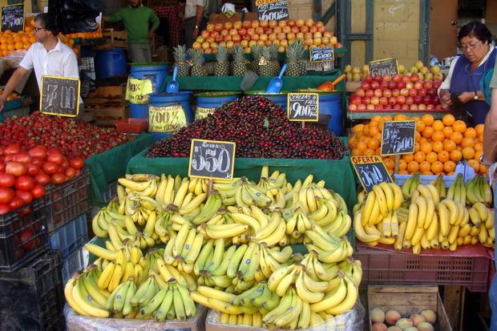
Prices are remarkable
Markets are decentralized.
Individuals observe prices, and buy bundles of goods that optimize their own utility functions. And somehow:
  Markets clear! No substantial shortages or surpluses
  The resulting allocation is pretty good.

Slide 3
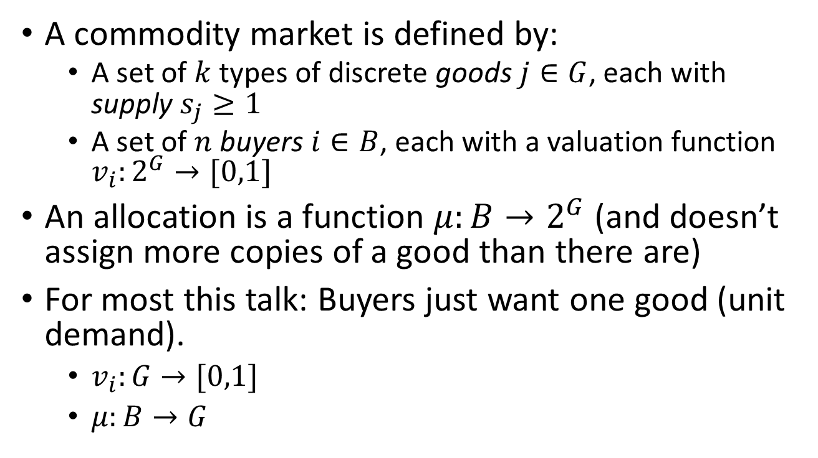
What does the theory tell us?
A commodity market is defined by:
  A set of $k$ types of discrete goods $j∈G$, each with supply $s_{j}≥1$
  A set of $n$ buyers $i∈B$, each with a valuation function $v_{i}:2^{G}→[0,1]$
An allocation is a function $μ:B→2^{G}$ (and doesn’t assign more copies of a good than there are)
For most this talk: Buyers just want one good (unit demand).
  $v_{i}:G→[0,1]$
  $μ:B→G$

Slide 4
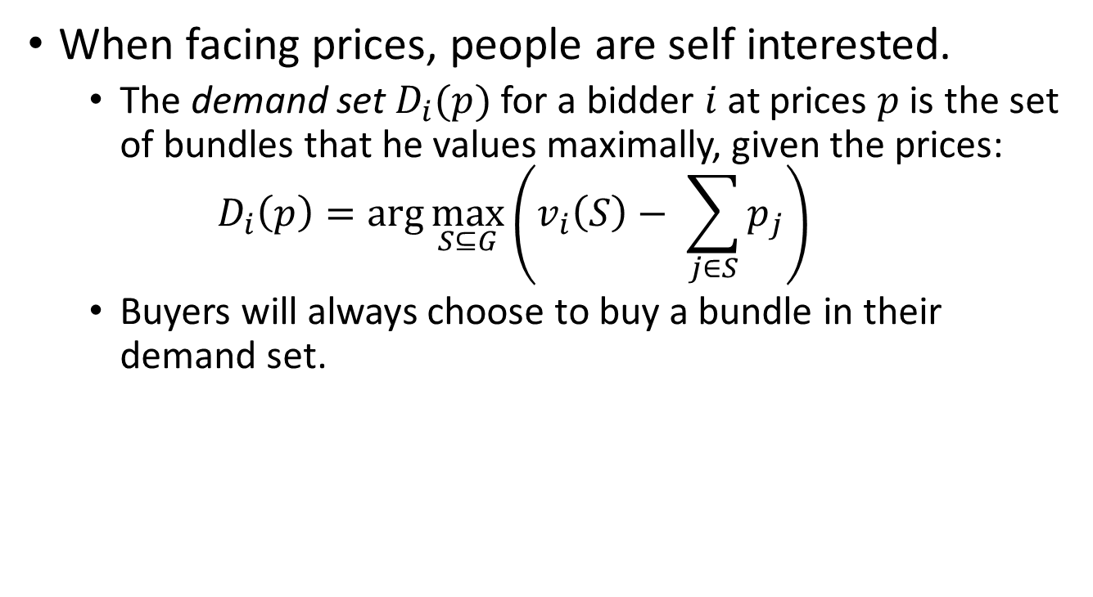
What does the theory tell us?
When facing prices, people are self interested.
  The demand set $D_{i}(p)$ for a bidder $i$ at prices $p$ is the set of bundles that he values maximally, given the prices:
  $$D_{i}\left(p\right)=\arg{\max_{S⊆G}\left(v_{i}\left(S\right)− \sum_{j∈S}{p_{j}}\right)}$$
  Buyers will always choose to buy a bundle in their demand set.

Slide 5
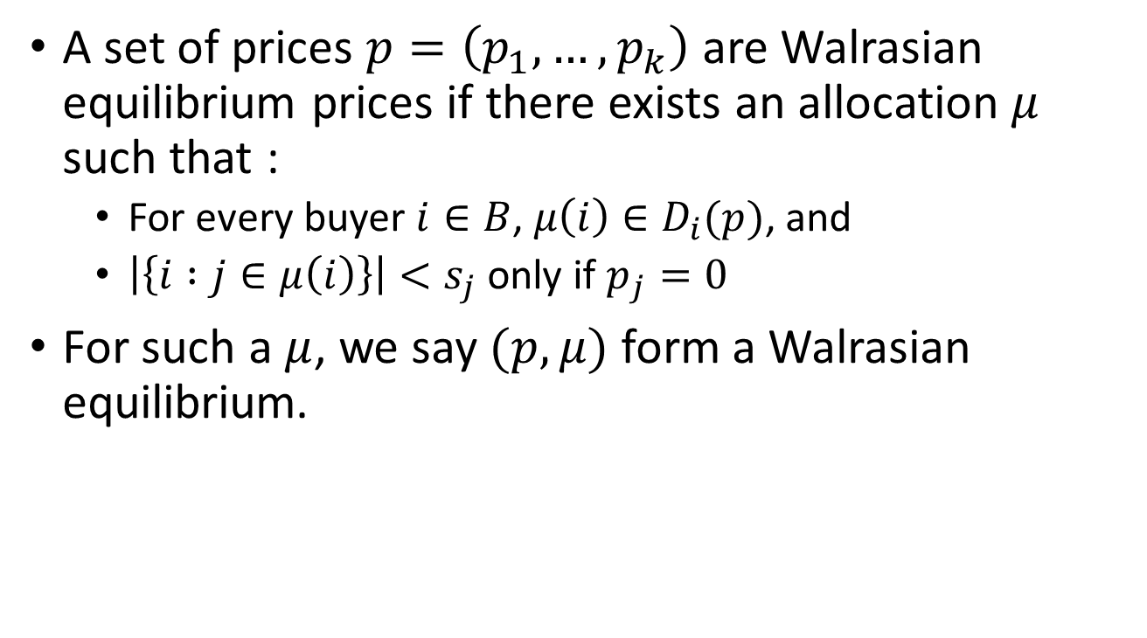
What does the theory tell us?
A set of prices $p=\left(p_{1},…,p_{k}\right)$ are Walrasian equilibrium prices if there exists an allocation $μ$ such that :
  For every buyer $i∈B$, $μ\left(i\right)∈D_{i}(p)$, and
  $\left|\left\{i :j∈μ\left(i\right)\right\}\right|<s_{j}$ only if $p_{j}=0$
For such a $μ$, we say $(p,μ)$ form a Walrasian equilibrium.

Slide 6
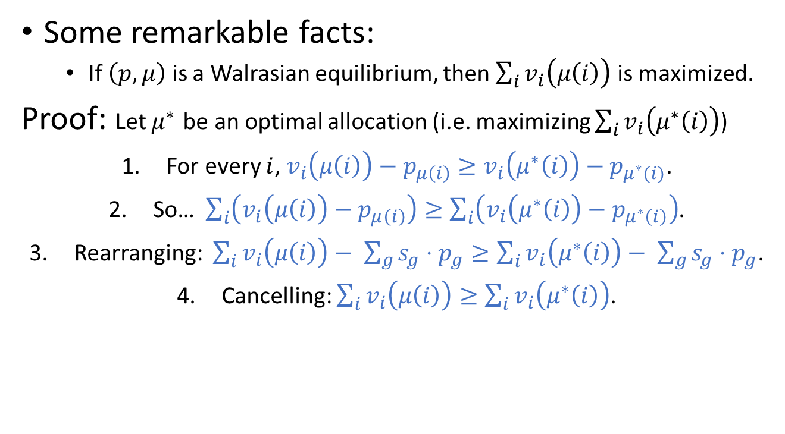
What does the theory tell us?
Some remarkable facts:
  If $\left(p,μ\right)$ is a Walrasian equilibrium, then $\sum_{i}{v_{i}\left(μ\left(i\right)\right)}$ is maximized.
Proof: Let $μ^{∗}$ be an optimal allocation (i.e. maximizing $\sum_{i}{v_{i}\left(μ^{∗}\left(i\right)\right)}$)
For every $i$, $v_{i}\left(μ\left(i\right)\right)−p_{μ\left(i\right)}≥v_{i}\left(μ^{∗}\left(i\right)\right)−p_{μ^{∗}(i)}$.
So… $\sum_{i}{\left(v_{i}\left(μ\left(i\right)\right)−p_{μ\left(i\right)}\right)}≥\sum_{i}{\left(v_{i}\left(μ^{∗}\left(i\right)\right)−p_{μ^{∗}\left(i\right)}\right)}$.
Rearranging: $\sum_{i}{v_{i}\left(μ\left(i\right)\right)}− \sum_{g}{s_{g}⋅p_{g}}≥\sum_{i}{v_{i}\left(μ^{∗}\left(i\right)\right)}− \sum_{g}{s_{g}⋅p_{g}}$.
Cancelling: $\sum_{i}{v_{i}\left(μ\left(i\right)\right)}≥\sum_{i}{v_{i}\left(μ^{∗}\left(i\right)\right)}$.

Slide 7







What does the theory tell us?
Some remarkable facts:
  Walrasian equilibria always exist for “gross substitutes” valuations!
Proof by Algorithm:
Just run an ascending price auction:
  Maintain a candidate matching, initially $μ\left(i\right)=∅$ for all $i$.
  All goods $j$start at price $p_{j}=0$
  While there exist unmatched bidders $i$:
    For each unmatched $i$:
      $i$ “bids” on $j^{∗}=\arg{\max{(v_{ij}−p_{j})}}$
      Set $μ\left(i\right)=j^{∗}$
      Set $p_{j^{∗}}←p_{j^{∗}}+ε$
  Output $μ$
$0
$0
$0
$0
$0

Slide 8
What does the theory tell us?
Some remarkable facts:
  Walrasian equilibria always exist for “gross substitutes” valuations!
Proof by Algorithm:
Just run an ascending price auction:
  Maintain a candidate matching, initially $μ\left(i\right)=∅$ for all $i$.
  All goods $j$start at price $p_{j}=0$
  While there exist unmatched bidders $i$:
    For each unmatched $i$:
      $i$ “bids” on $j^{∗}=\arg{\max{(v_{ij}−p_{j})}}$
      Set $μ\left(i\right)=j^{∗}$
      Set $p_{j^{∗}}←p_{j^{∗}}+ε$
  Output $μ$
$0.10
$0
$0
$0
$0

Slide 9
What does the theory tell us?
Some remarkable facts:
  Walrasian equilibria always exist for “gross substitutes” valuations!
Proof by Algorithm:
Just run an ascending price auction:
  Maintain a candidate matching, initially $μ\left(i\right)=∅$ for all $i$.
  All goods $j$start at price $p_{j}=0$
  While there exist unmatched bidders $i$:
    For each unmatched $i$:
      $i$ “bids” on $j^{∗}=\arg{\max{(v_{ij}−p_{j})}}$
      Set $μ\left(i\right)=j^{∗}$
      Set $p_{j^{∗}}←p_{j^{∗}}+ε$
  Output $μ$
$0.20
$0
$0
$0
$0

Slide 10
What does the theory tell us?
Some remarkable facts:
  Walrasian equilibria always exist for “gross substitutes” valuations!
Proof by Algorithm:
Just run an ascending price auction:
  Maintain a candidate matching, initially $μ\left(i\right)=∅$ for all $i$.
  All goods $j$start at price $p_{j}=0$
  While there exist unmatched bidders $i$:
    For each unmatched $i$:
      $i$ “bids” on $j^{∗}=\arg{\max{(v_{ij}−p_{j})}}$
      Set $μ\left(i\right)=j^{∗}$
      Set $p_{j^{∗}}←p_{j^{∗}}+ε$
  Output $μ$
$0.20
$0
$0.10
$0
$0

Slide 11
What does the theory tell us?
Some remarkable facts:
  Walrasian equilibria always exist for “gross substitutes” valuations!
Proof by Algorithm:
Just run an ascending price auction:
  Maintain a candidate matching, initially $μ\left(i\right)=∅$ for all $i$.
  All goods $j$start at price $p_{j}=0$
  While there exist unmatched bidders $i$:
    For each unmatched $i$:
      $i$ “bids” on $j^{∗}=\arg{\max{(v_{ij}−p_{j})}}$
      Set $μ\left(i\right)=j^{∗}$
      Set $p_{j^{∗}}←p_{j^{∗}}+ε$
  Output $μ$
$0.20
$0
$0.10
$0.10
$0

Slide 12
What does the theory tell us?
Some remarkable facts:
  Walrasian equilibria always exist for “gross substitutes” valuations!
Proof by Algorithm:
Just run an ascending price auction:
  Maintain a candidate matching, initially $μ\left(i\right)=∅$ for all $i$.
  All goods $j$start at price $p_{j}=0$
  While there exist unmatched bidders $i$:
    For each unmatched $i$:
      $i$ “bids” on $j^{∗}=\arg{\max{(v_{ij}−p_{j})}}$
      Set $μ\left(i\right)=j^{∗}$
      Set $p_{j^{∗}}←p_{j^{∗}}+ε$
  Output $μ$
$0.20
$0
$0.10
$0.10
$0.10

Slide 13
What does the theory tell us?
Some remarkable facts:
  Walrasian equilibria always exist for “gross substitutes” valuations!
Proof by Algorithm:
Just run an ascending price auction:
  Maintain a candidate matching, initially $μ\left(i\right)=∅$ for all $i$.
  All goods $j$start at price $p_{j}=0$
  While there exist unmatched bidders $i$:
    For each unmatched $i$:
      $i$ “bids” on $j^{∗}=\arg{\max{(v_{ij}−p_{j})}}$
      Set $μ\left(i\right)=j^{∗}$
      Set $p_{j^{∗}}←p_{j^{∗}}+ε$
  Output $μ$
$0.30
$0
$0.10
$0.10
$0.10

Slide 14

What does the theory tell us?
Some remarkable facts:
  Walrasian equilibria always exist for “gross substitutes” valuations!
Proof by Algorithm:
Theorem: Algorithm halts after at most $n/ε$ bids.
Proof: Nobody ever bids above their value, and so prices never go above 1. So the sum of the prices never goes above $n$. But every bid increases the sum of the prices by $ε$.
Just run an ascending price auction:
  Maintain a candidate matching, initially $μ\left(i\right)=∅$ for all $i$.
  All goods $j$start at price $p_{j}=0$
  While there exist unmatched bidders $i$:
    For each unmatched $i$:
      $i$ “bids” on $j^{∗}=\arg{\max{(v_{ij}−p_{j})}}$
      Set $μ\left(i\right)=j^{∗}$
      Set $p_{j^{∗}}←p_{j^{∗}}+ε$
  Output $μ$
$0.30
$0.10
$0.10
$0.10
$0.10

Slide 15
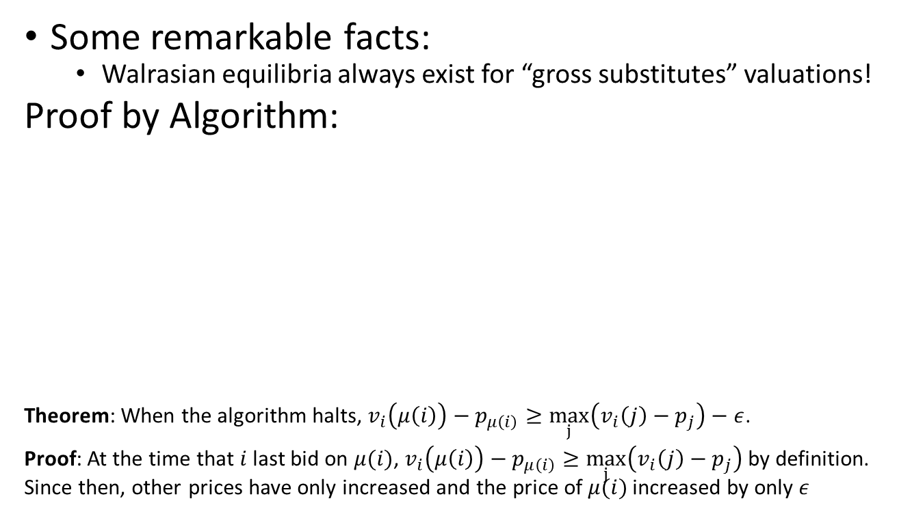

What does the theory tell us?
Some remarkable facts:
  Walrasian equilibria always exist for “gross substitutes” valuations!
Proof by Algorithm:
Theorem: When the algorithm halts, $v_{i}\left(μ\left(i\right)\right)−p_{μ\left(i\right)}≥\max_{j}\left(v_{i}\left(j\right)−p_{j}\right)−ε$.
Proof: At the time that $i$ last bid on $μ(i)$, $v_{i}\left(μ\left(i\right)\right)−p_{μ\left(i\right)}≥\max_{j}\left(v_{i}\left(j\right)−p_{j}\right)$ by definition. Since then, other prices have only increased and the price of $μ(i)$ increased by only $ε$
Just run an ascending price auction:
  Maintain a candidate matching, initially $μ\left(i\right)=∅$ for all $i$.
  All goods $j$start at price $p_{j}=0$
  While there exist unmatched bidders $i$:
    For each unmatched $i$:
      $i$ “bids” on $j^{∗}=\arg{\max{(v_{ij}−p_{j})}}$
      Set $μ\left(i\right)=j^{∗}$
      Set $p_{j^{∗}}←p_{j^{∗}}+ε$
  Output $μ$
$0.30
$0.10
$0.10
$0.10
$0.10
Taking $ε→0$:
Walrasian equilibria always exist.

Slide 16
What does the theory tell us?
  In fact, many such prices – the set of Walrasian equilibrium prices forms a lattice. The minimal Walrasian equilibrium prices are focal: many tatonnemont processes converge to them. (And for unit demand buyers, they correspond to VCG prices).
  Interpretation?
  “Prices optimally coordinate a large class of markets.”

Slide 17

Some problems with that interpretation
No coordination?
  Each bidder $i$ may have many bundles in his demand set $D_{i}(p)$, and to obtain the optimal allocation $μ$, these ties have to be broken in a coordinated manner.

Slide 18





The coordination problem
$0.50
$0.50
$0.50
$0.50
$0.50

Slide 19
The coordination problem
But that example is non-generic!

Slide 20
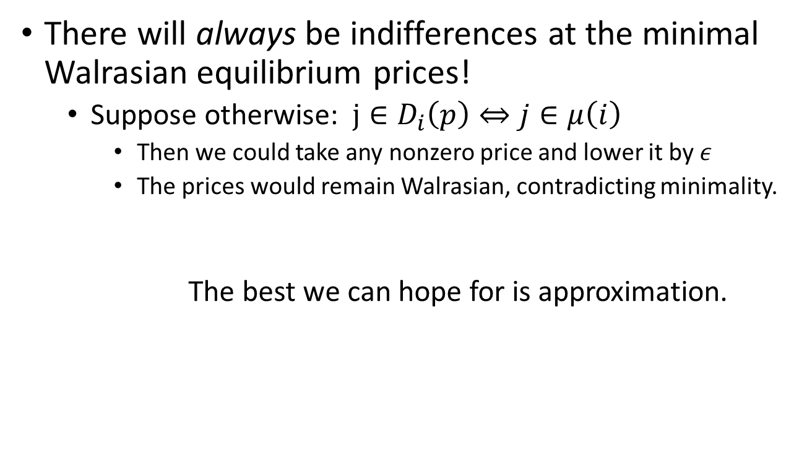
The coordination problem
There will always be indifferences at the minimal Walrasian equilibrium prices!
  Suppose otherwise: $j∈D_{i}\left(p\right)⇔j∈μ\left(i\right)$
    Then we could take any nonzero price and lower it by $ε$
    The prices would remain Walrasian, contradicting minimality.
    The best we can hope for is approximation.

Slide 21
Some problems with that interpretation
Where do the prices come from?
  There are many natural interactive auction procedures that converge to Walrasian prices.
  But in practice, we face fixed prices and do not engage in auctions.

Slide 22
Where do prices come from?
In practice, prices encode “distributional information”.
But:
  How much distributional information is necessary?
  Implies we are facing approximate equilibrium prices – only exacerbates coordination.

Slide 23






This work
$1.25
$5.99
$0.50
Minimal equilibrium prices
$k$ types of goods $j$ with supply $s_{j}$
$n$ bidders sampled $iid$ from $D$
Distribution $D$ over valuation functions

Slide 24
This work
$1.25
$5.99
$0.50
$k$ types of goods $j$ with supply $s_{j}$
Buyers buy most preferred bundles, break ties arbitrarily
$n$ bidders sampled $iid$ from $D$
Distribution $D$ over valuation functions

Slide 25
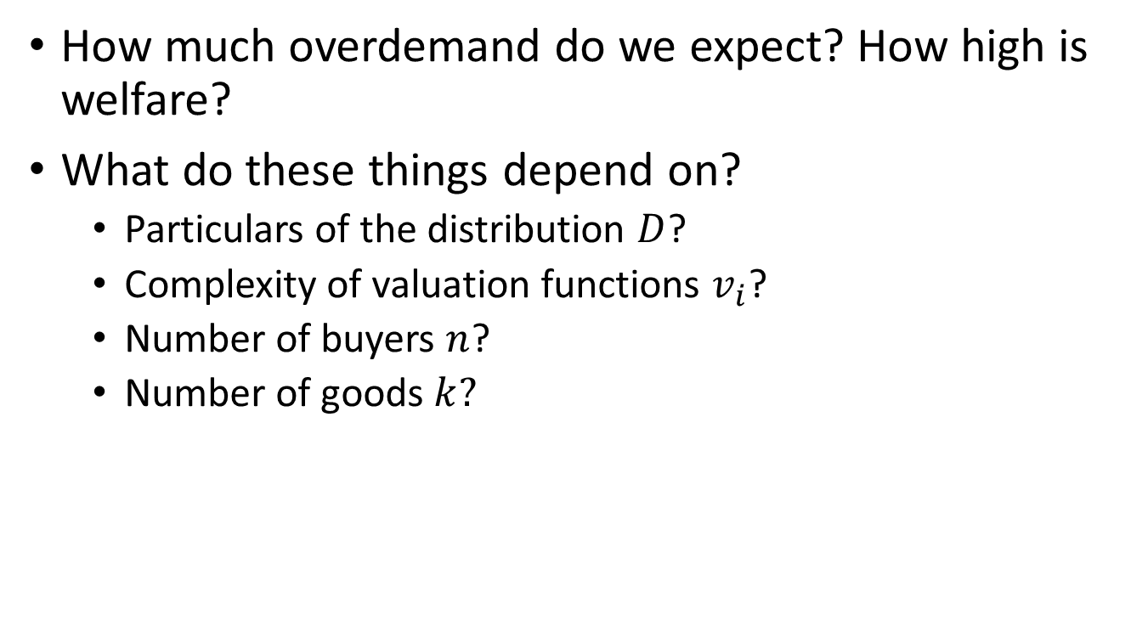
This work
How much overdemand do we expect? How high is welfare?
What do these things depend on?
  Particulars of the distribution $D$?
  Complexity of valuation functions $v_{i}$?
  Number of buyers $n$?
  Number of goods $k?$

Slide 26
This work
First question: When do exact equilibrium prices induce little overdemand?
  Remember: Not always. And we must always have some overdemand.
Second question: How well do equilibrium prices computed on a sample generalize to new buyers drawn from the same distribution?
  And how much data is needed?

Slide 27
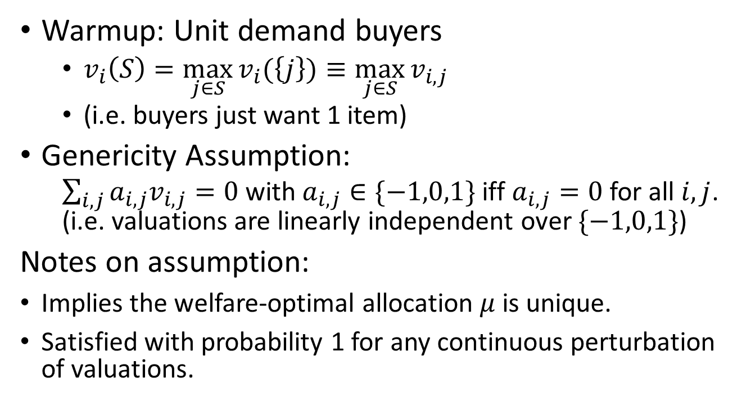
First Question
Warmup: Unit demand buyers
  $v_{i}\left(S\right)=\max_{j∈S}{v_{i}(\left\{j\right\})}≡\max_{j∈S}{v_{i,j}}$
  (i.e. buyers just want 1 item)
Genericity Assumption:
  $\sum_{i,j}{a_{i,j}v_{i,j}=0}$ with $a_{i,j}∈\{−1,0,1\}$ iff $a_{i,j}=0$ for all $i,j$. (i.e. valuations are linearly independent over $\{−1,0,1\}$)
Notes on assumption:
Implies the welfare-optimal allocation $μ$ is unique.
Satisfied with probability 1 for any continuous perturbation of valuations.

Slide 28
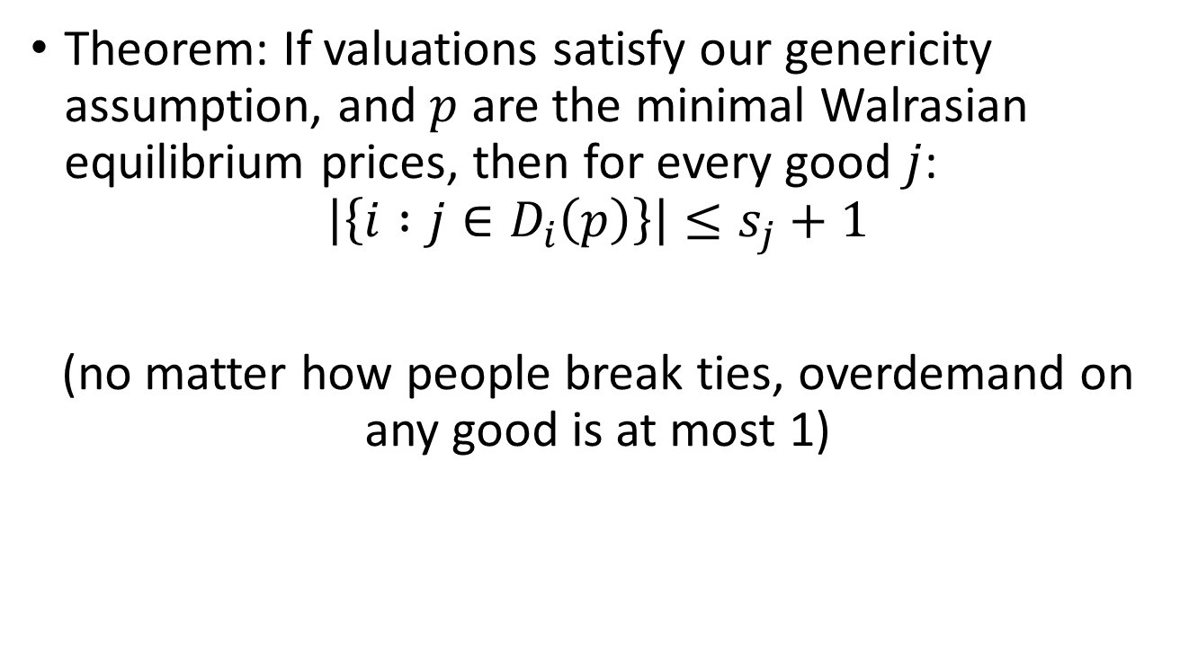
Overdemand
Theorem: If valuations satisfy our genericity assumption, and $p$ are the minimal Walrasian equilibrium prices, then for every good $j$:
$$\left|\left\{i :j∈D_{i}\left(p\right)\right\}\right|≤s_{j}+1$$
(no matter how people break ties, overdemand on any good is at most 1)

Slide 29
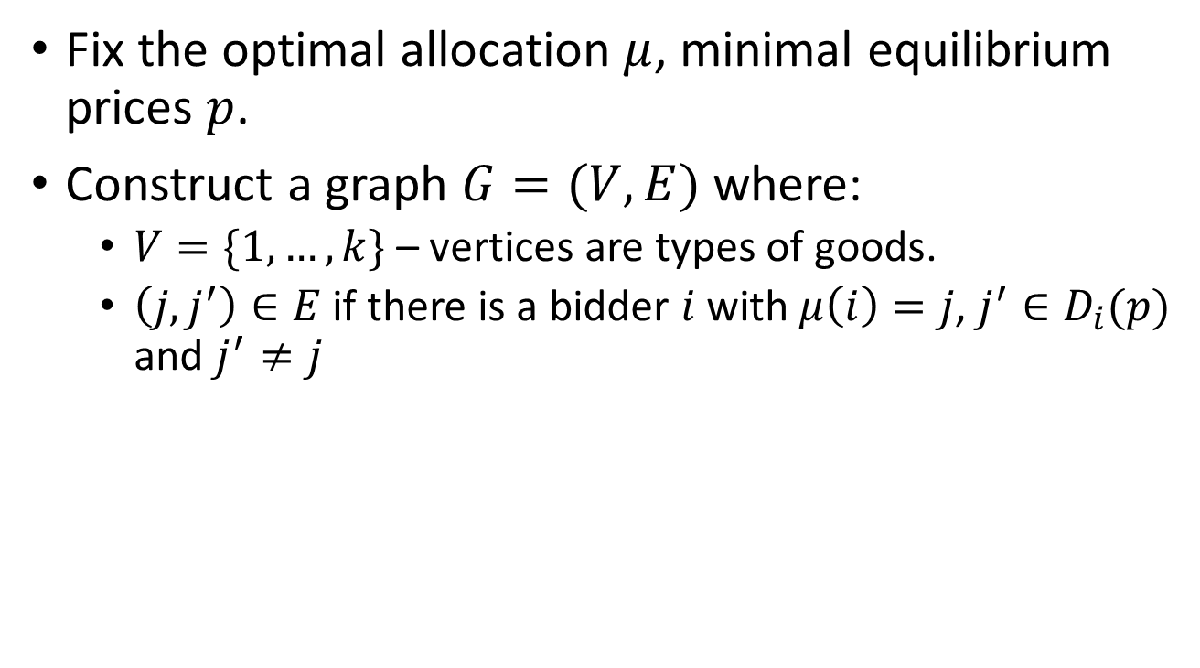
Proof
Fix the optimal allocation $μ$, minimal equilibrium prices $p$.
Construct a graph $G=(V, E)$ where:
  $V=\{1,…,k\}$ – vertices are types of goods.
  $\left(j,j^{′}\right)∈E$ if there is a bidder $i$ with $μ\left(i\right)=j$, $j^{′}∈D_{i}(p)$ and $j^{′}≠j$

Slide 30





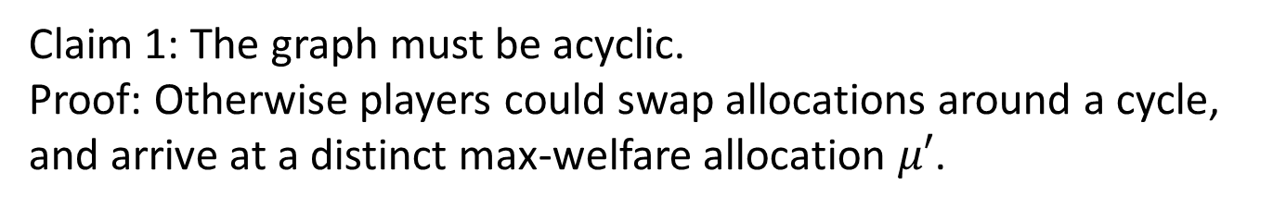
Proof
Claim 1: The graph must be acyclic.
Proof: Otherwise players could swap allocations around a cycle, and arrive at a distinct max-welfare allocation $μ′$.

Slide 31
Proof
So, we can topologically sort the graph, rename vertices in order. First vertex has indegree zero.

Slide 32



Proof
$0
$$p_{2}$$
$$p_{3}$$
$0
$$p_{5}$$
Claim 2: Any good with in-degree zero must have price 0
Proof: Otherwise we could lower the price, contradicting minimality.

Slide 33
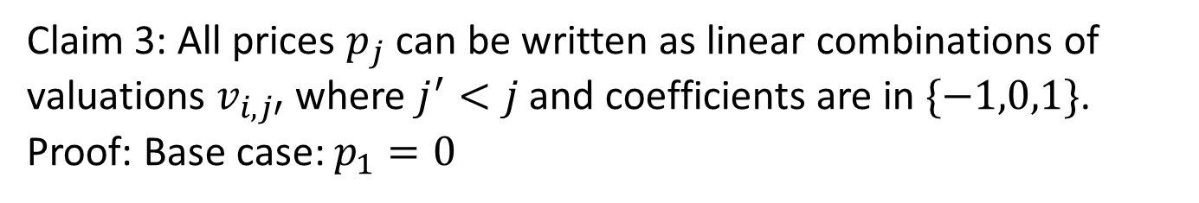
Proof
$0
$$p_{2}$$
$$p_{3}$$
$0
$$p_{5}$$
Claim 3: All prices $p_{j}$ can be written as linear combinations of valuations $v_{i,j′}$ where $j^{′}<j$ and coefficients are in $\{−1,0,1\}$.
Proof: Base case: $p_{1}=0$

Slide 34
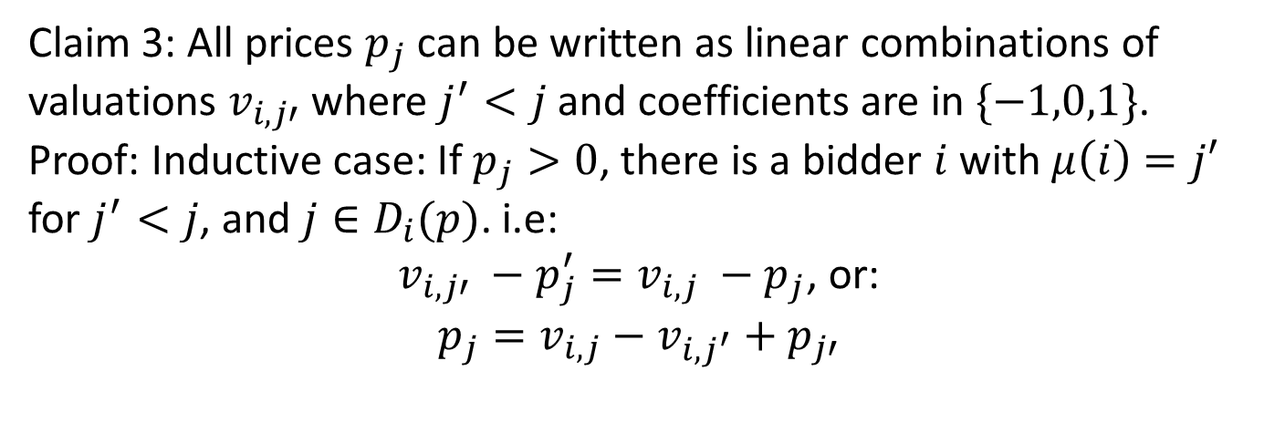
Proof
$0
$$p_{2}$$
$$p_{3}$$
$0
$$p_{5}$$
Claim 3: All prices $p_{j}$ can be written as linear combinations of valuations $v_{i,j′}$ where $j^{′}<j$ and coefficients are in $\{−1,0,1\}$.
Proof: Inductive case: If $p_{j}>0$, there is a bidder $i$ with $μ\left(i\right)=j′$ for $j^{′}<j$, and $j∈D_{i}(p)$. i.e:
$v_{i,j′} −p_{j}^{′}=v_{i,j} −p_{j}$, or:
$$p_{j}=v_{i,j}−v_{i,j^{′}}+p_{j′}$$

Slide 35
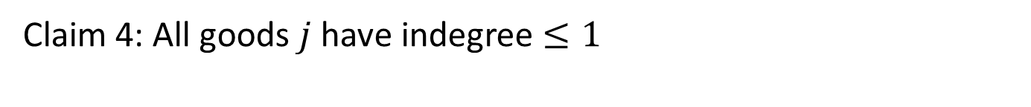
Proof
$0
$$p_{2}$$
$$p_{3}$$
$0
$$p_{5}$$
Claim 4: All goods $j$ have indegree $≤1$

Slide 36
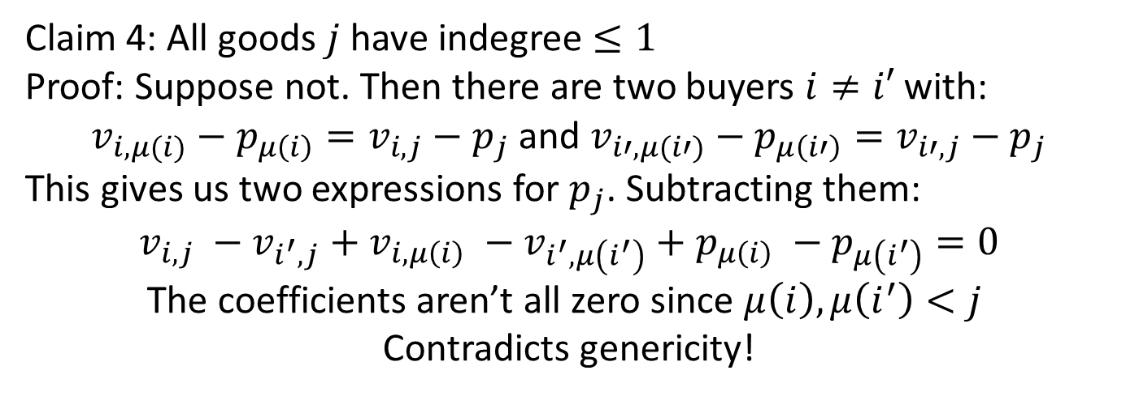
Proof
$0
$$p_{2}$$
$$p_{3}$$
$0
$$p_{5}$$
Claim 4: All goods $j$ have indegree $≤1$
Proof: Suppose not. Then there are two buyers $i≠i′$ with:
$v_{i,μ(i)}−p_{μ\left(i\right)}=v_{i,j}−p_{j}$ and $v_{i′,μ(i′)}−p_{μ\left(i′\right)}=v_{i′,j}−p_{j}$
This gives us two expressions for $p_{j}$. Subtracting them:
$$v_{i,j} −v_{i^{′},j}+v_{i, μ\left(i\right)} −v_{i^{′}, μ\left(i^{′}\right)}+p_{μ\left(i\right)} −p_{μ\left(i^{′}\right)}=0$$
The coefficients aren’t all zero since $μ\left(i\right),μ\left(i^{′}\right)<j$
Contradicts genericity!

Slide 37
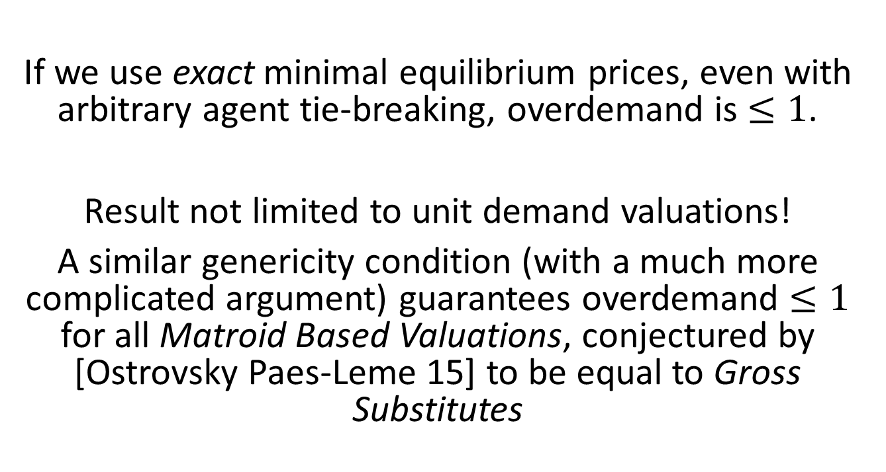
Take away
If we use exact minimal equilibrium prices, even with arbitrary agent tie-breaking, overdemand is $≤1$.
Result not limited to unit demand valuations!
A similar genericity condition (with a much more complicated argument) guarantees overdemand $≤1$ for all Matroid Based Valuations, conjectured by [Ostrovsky Paes-Leme 15] to be equal to Gross Substitutes

Slide 38
Second Question
We have a condition under which (exact) equilibrium prices computed on a population induce low over-demand.
How well does this generalize if we use the same prices on a new population?

Slide 39
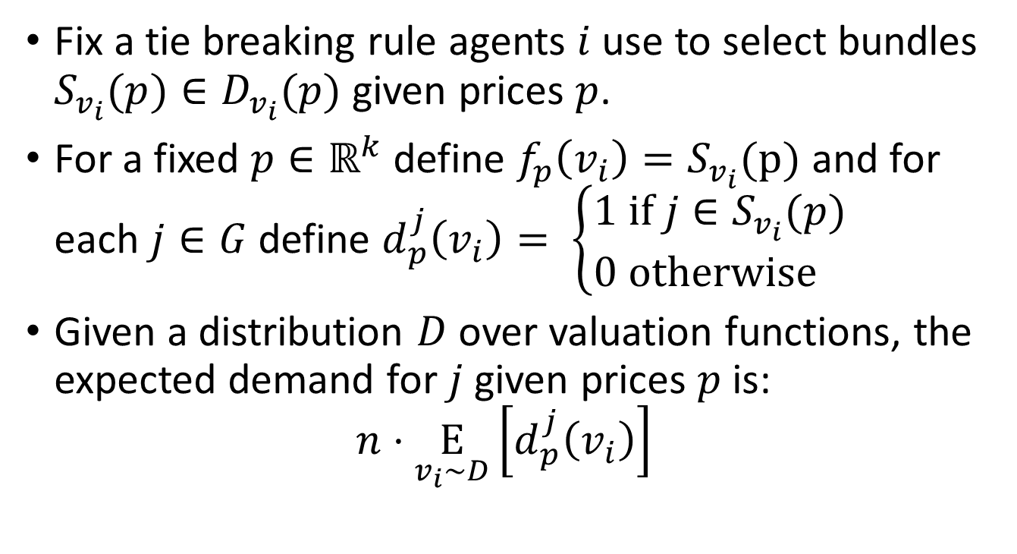
Second Question
Fix a tie breaking rule agents $i$ use to select bundles $S_{v_{i}}(p)∈D_{v_{i}}(p)$ given prices $p$.
For a fixed $p∈ℝ^{k}$ define $f_{p}\left(v_{i}\right)=S_{v_{i}}(p)$ and for each $j∈G$ define $d_{p}^{j}\left(v_{i}\right)= \left\{\begin{aligned}1 \text{if} j∈S_{v_{i}}(p) \\ 0 \text{otherwise} \end{aligned}\right.$
Given a distribution $D$ over valuation functions, the expected demand for $j$ given prices $p$ is:
$$n⋅\underset{v_{i}∼D}{E}\left[d_{p}^{j}\left(v_{i}\right)\right]$$

Slide 40
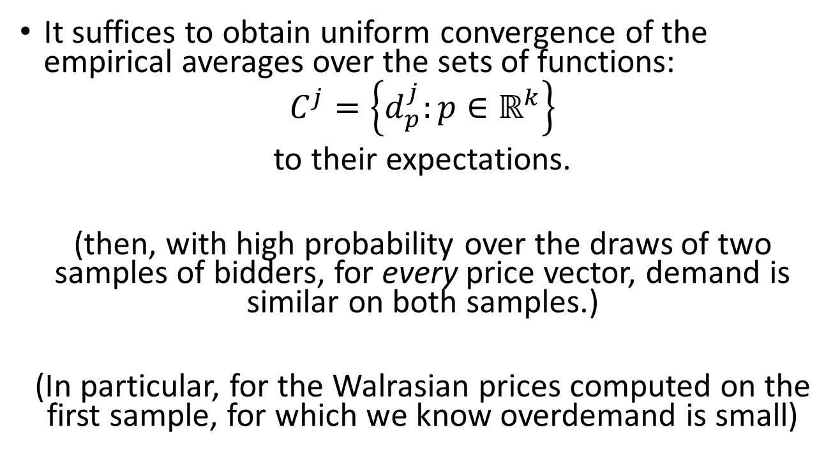
Uniform Convergence
It suffices to obtain uniform convergence of the empirical averages over the sets of functions:
$$C^{j}=\left\{d_{p}^{j}:p∈ℝ^{k}\right\}$$
to their expectations.
(then, with high probability over the draws of two samples of bidders, for every price vector, demand is similar on both samples.)
(In particular, for the Walrasian prices computed on the first sample, for which we know overdemand is small)

Slide 41



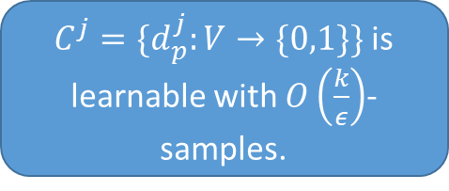
Learning and Uniform Convergence
For one dimensional, Boolean learning problems, learning over $C$ $⇔$ Uniform convergence over $C$.
  But not so for multi-dimensional/real valued learning problems.
$\{f_{p}:V→2^{[k]}\}$ is learnable with $O\left(\frac{k}{ε}\right)$-samples.
$C^{j}=\{d_{p}^{j}:V→\{0,1\}\}$ is learnable with $O\left(\frac{k}{ε}\right)$-samples.
Uniform convergence over $C^{j}$ with $O\left(\frac{k}{ε}\right)$ samples.

Slide 42
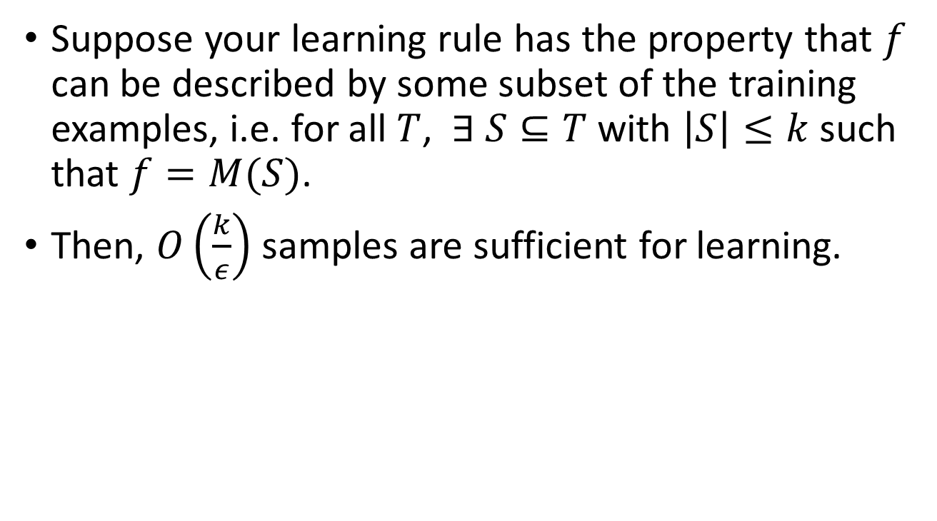
Compression Bounds
[Littlestone, Warmuth 86]
Suppose your learning rule has the property that $f$ can be described by some subset of the training examples, i.e. for all $T$, $∃ S⊆T$ with $\left|S\right|≤k$ such that $f=M(S)$.
Then, $O\left(\frac{k}{ε}\right)$ samples are sufficient for learning.

Slide 43
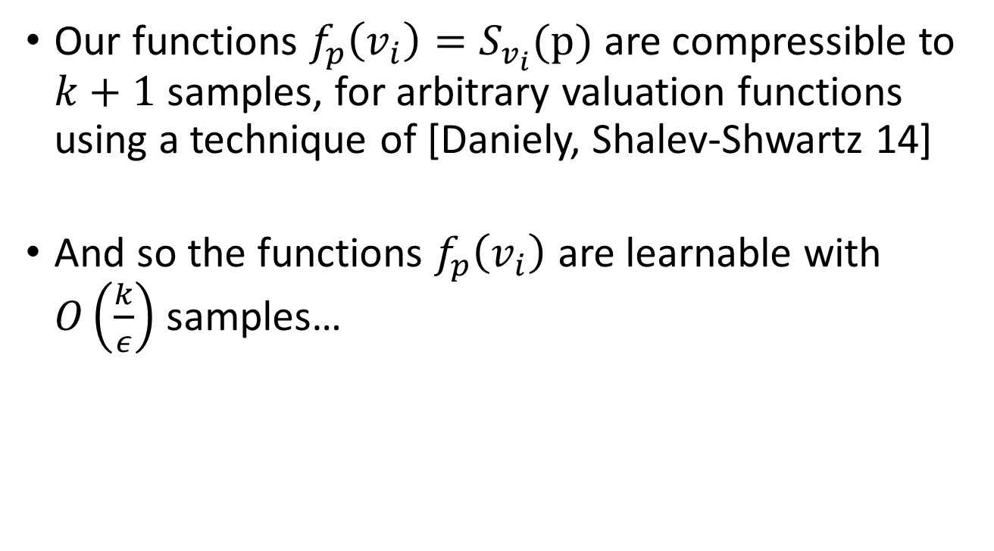
Dimension Based Linear Classifiers
Our functions $f_{p}\left(v_{i}\right)=S_{v_{i}}(p)$ are compressible to $k+1$ samples, for arbitrary valuation functions using a technique of [Daniely, Shalev-Shwartz 14]
And so the functions $f_{p}\left(v_{i}\right)$ are learnable with $O\left(\frac{k}{ε}\right)$ samples…

Slide 44
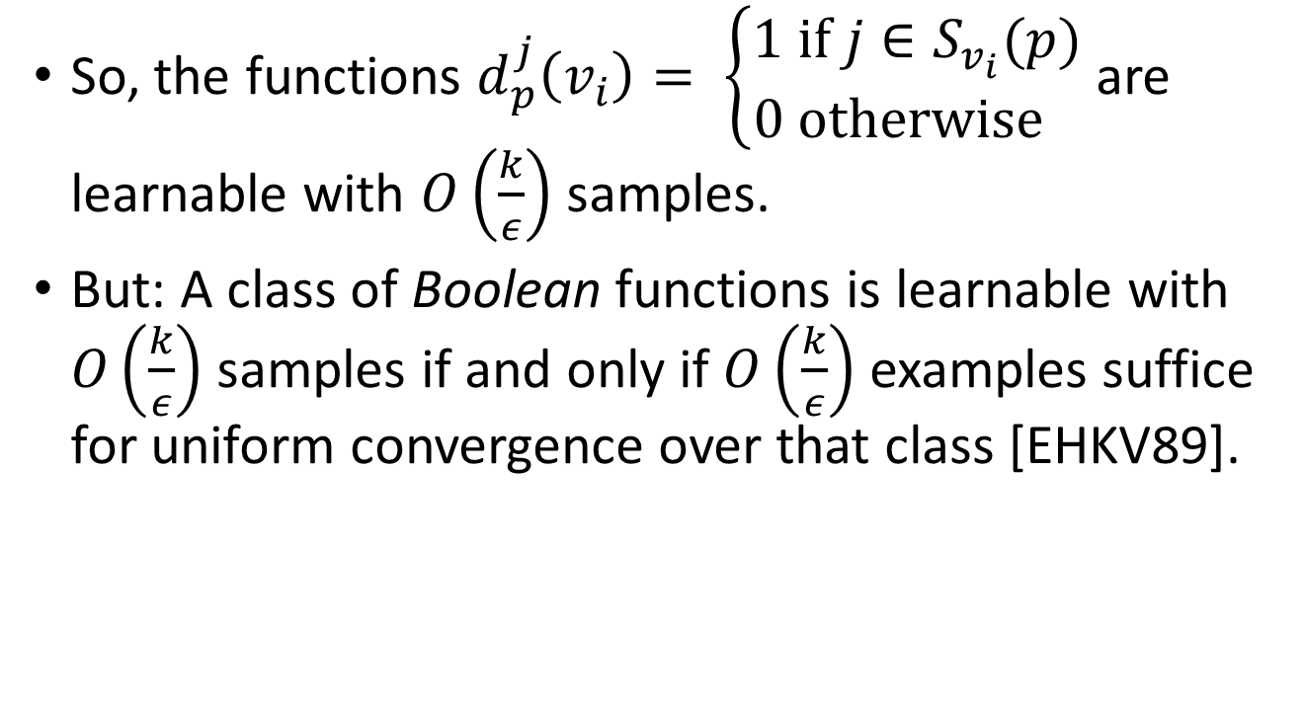
Projection down to simpler classifiers
So, the functions $d_{p}^{j}\left(v_{i}\right)= \left\{\begin{aligned}1 \text{if} j∈S_{v_{i}}(p) \\ 0 \text{otherwise} \end{aligned}\right.$ are learnable with $O\left(\frac{k}{ε}\right)$ samples.
But: A class of Boolean functions is learnable with $O\left(\frac{k}{ε}\right)$ samples if and only if $O\left(\frac{k}{ε}\right)$ examples suffice for uniform convergence over that class [EHKV89].

Slide 45
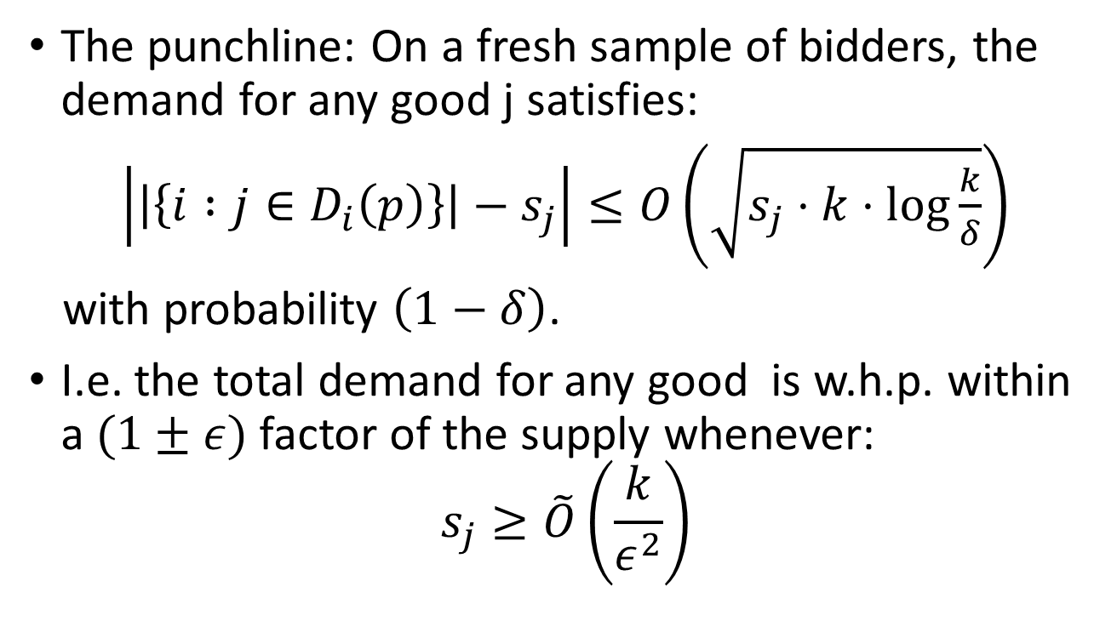
Overdemand on a fresh sample
The punchline: On a fresh sample of bidders, the demand for any good j satisfies:
$\left|\left|\left\{i :j∈D_{i}\left(p\right)\right\}\right|−s_{j}\right|≤O\left(\sqrt{s_{j}⋅k⋅\log{\frac{k}{δ}}}\right)$
with probability $\left(1−δ\right)$.
I.e. the total demand for any good is w.h.p. within a $(1±ε)$ factor of the supply whenever:
$$s_{j}≥\tilde{O}\left(\frac{k}{ε^{2}}\right)$$

Slide 46
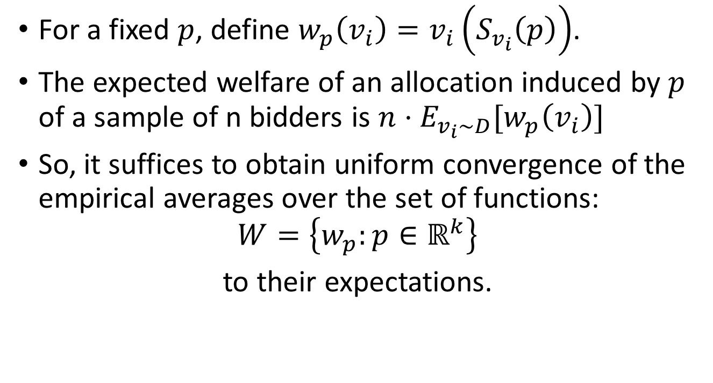
What about welfare?
For a fixed $p$, define $w_{p}\left(v_{i}\right)=v_{i}\left(S_{v_{i}}\left(p\right)\right)$.
The expected welfare of an allocation induced by $p$ of a sample of n bidders is $n⋅E_{v_{i}∼D}[w_{p}\left(v_{i}\right)]$
So, it suffices to obtain uniform convergence of the empirical averages over the set of functions:
$$W=\left\{w_{p}:p∈ℝ^{k}\right\}$$
to their expectations.

Slide 47
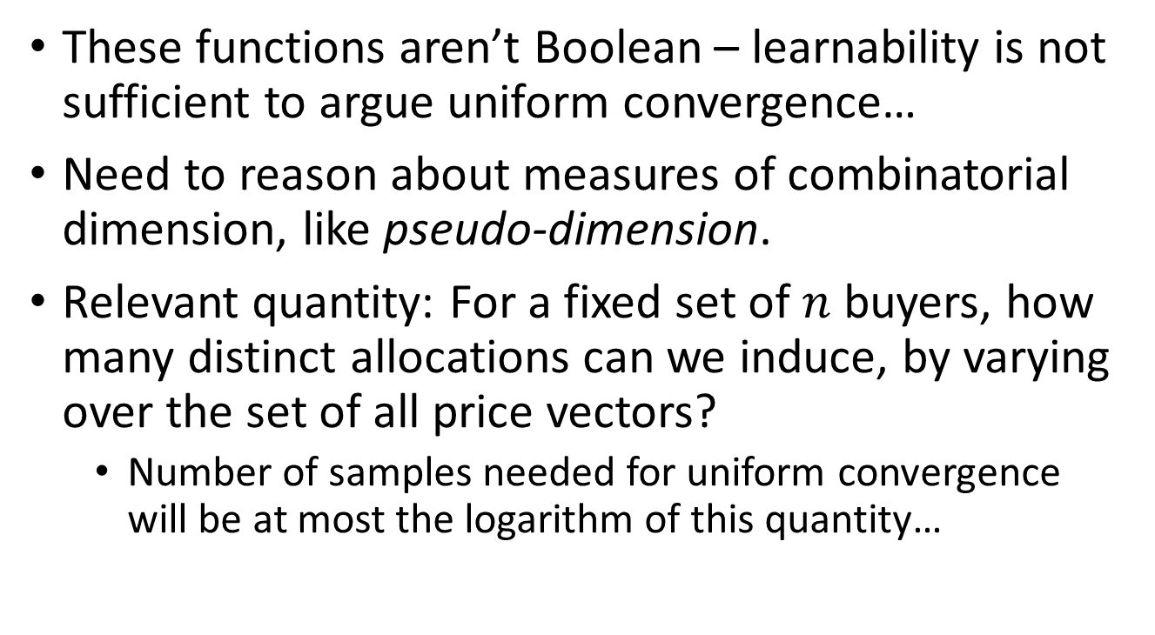
What about welfare?
These functions aren’t Boolean – learnability is not sufficient to argue uniform convergence…
Need to reason about measures of combinatorial dimension, like pseudo-dimension.
Relevant quantity: For a fixed set of $n$ buyers, how many distinct allocations can we induce, by varying over the set of all price vectors?
  Number of samples needed for uniform convergence will be at most the logarithm of this quantity…

Slide 48





How many allocations can prices induce?
$2^{k}$ choices
$n$ buyers
Naively: $2^{k⋅n}$ different choices of bundles that could be induced by price vectors…

Slide 49
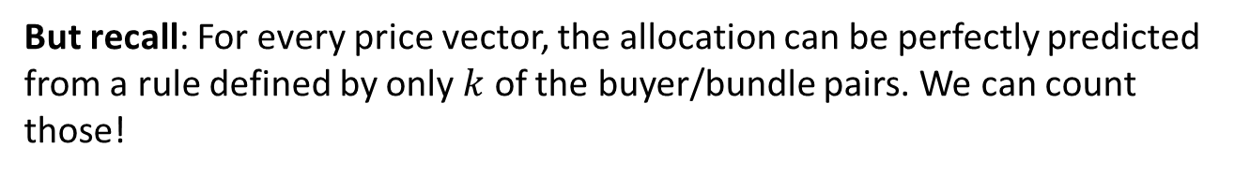
How many allocations can prices induce?
$2^{k}$ choices
$n$ buyers
But recall: For every price vector, the allocation can be perfectly predicted from a rule defined by only $k$ of the buyer/bundle pairs. We can count those!

Slide 50
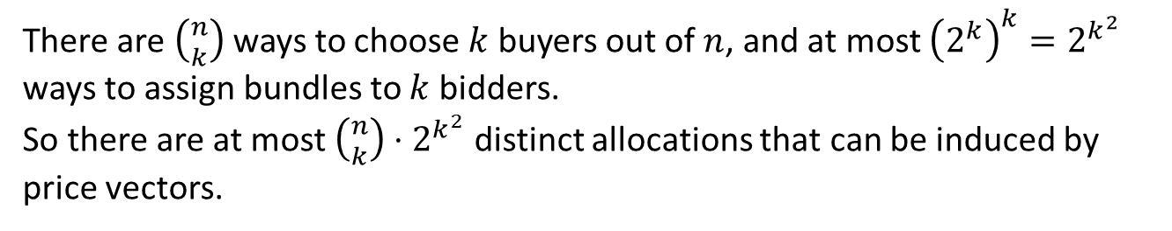

How many allocations can prices induce?
$2^{k}$ choices
$k$ buyers
There are $\left({n \atop k}\right)$ ways to choose $k$ buyers out of $n$, and at most ${\left(2^{k}\right)}^{k}=2^{k^{2}}$ ways to assign bundles to $k$ bidders.
So there are at most $\left({n \atop k}\right)⋅2^{k^{2}}$ distinct allocations that can be induced by price vectors.

Slide 51
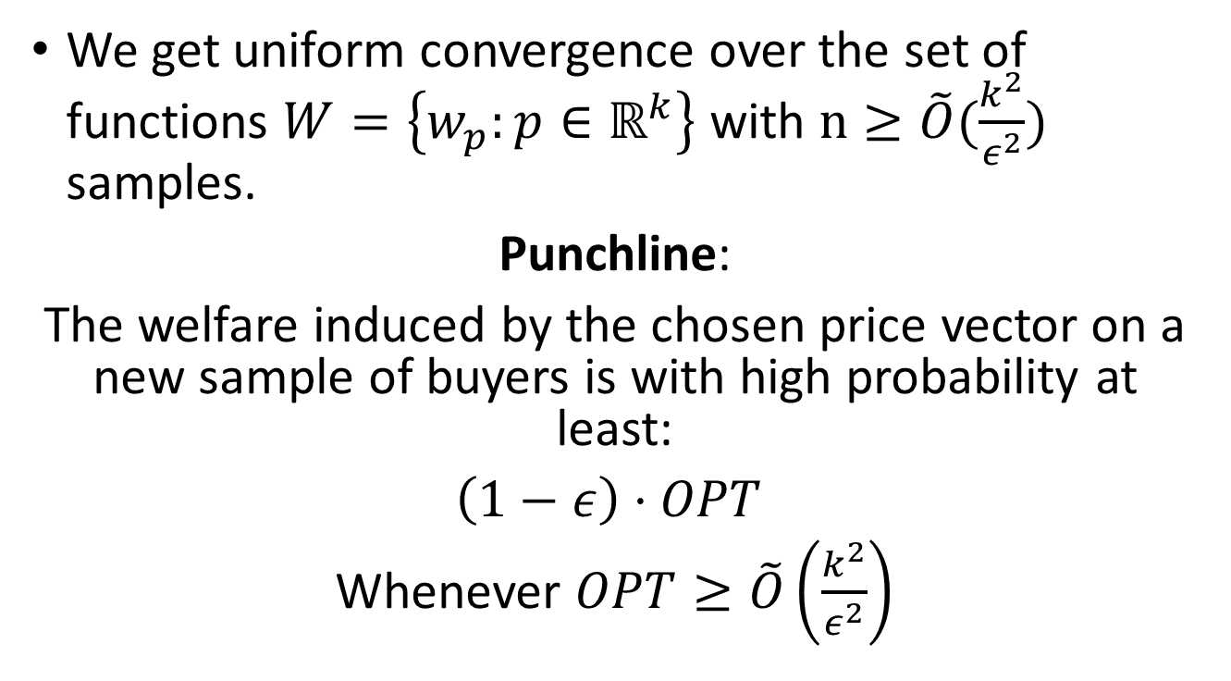
So…
We get uniform convergence over the set of functions $W=\left\{w_{p}:p∈ℝ^{k}\right\}$ with $n≥\tilde{O}(\frac{k^{2}}{ε^{2}})$ samples.
Punchline:
The welfare induced by the chosen price vector on a new sample of buyers is with high probability at least:
$\left(1−ε\right)⋅OPT$
Whenever $OPT≥\tilde{O}\left(\frac{k^{2}}{ε^{2}}\right)$

Slide 52
Thanks!

