Slide 1

Tradeoffs Between Fairness and Accuracy in Machine Learning
Aaron Roth

Slide 2
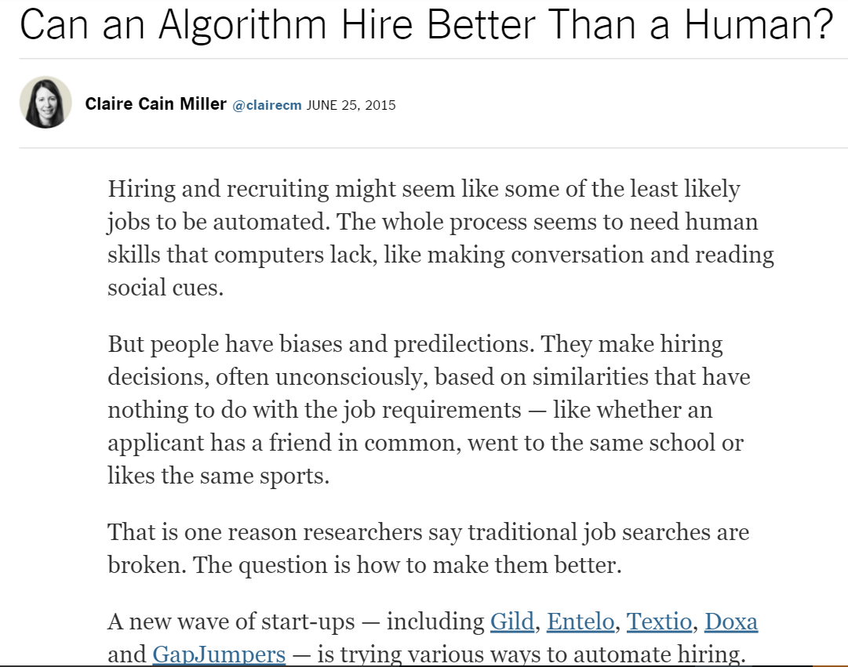
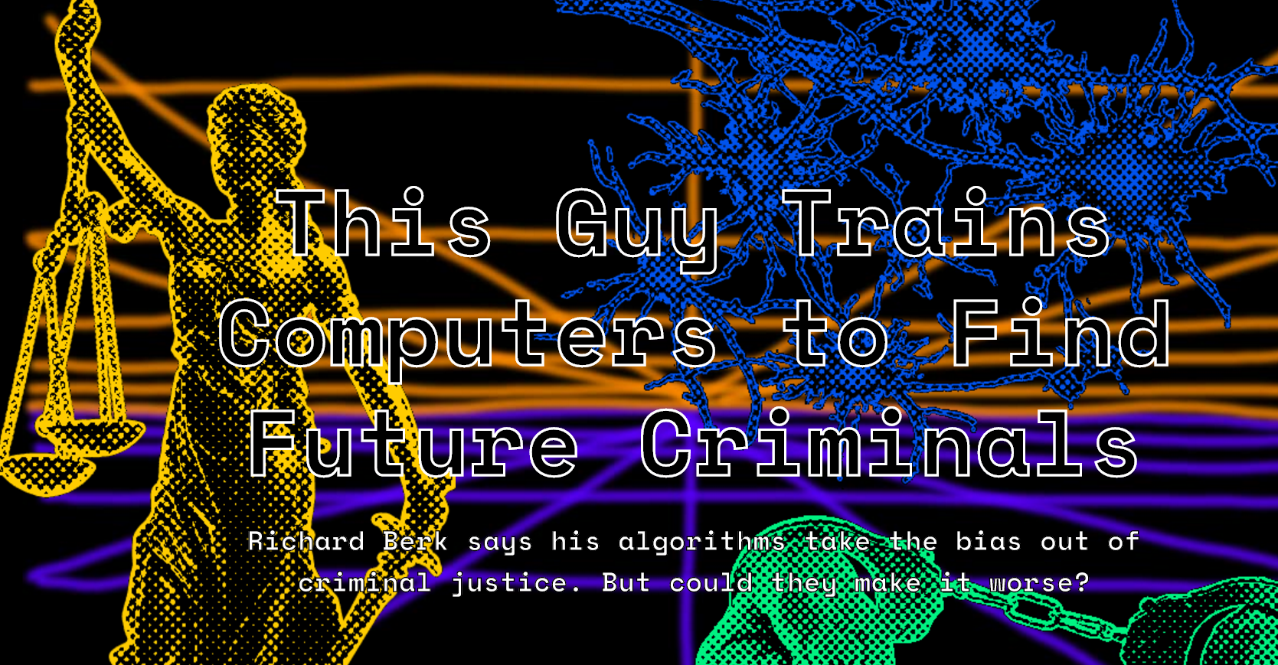
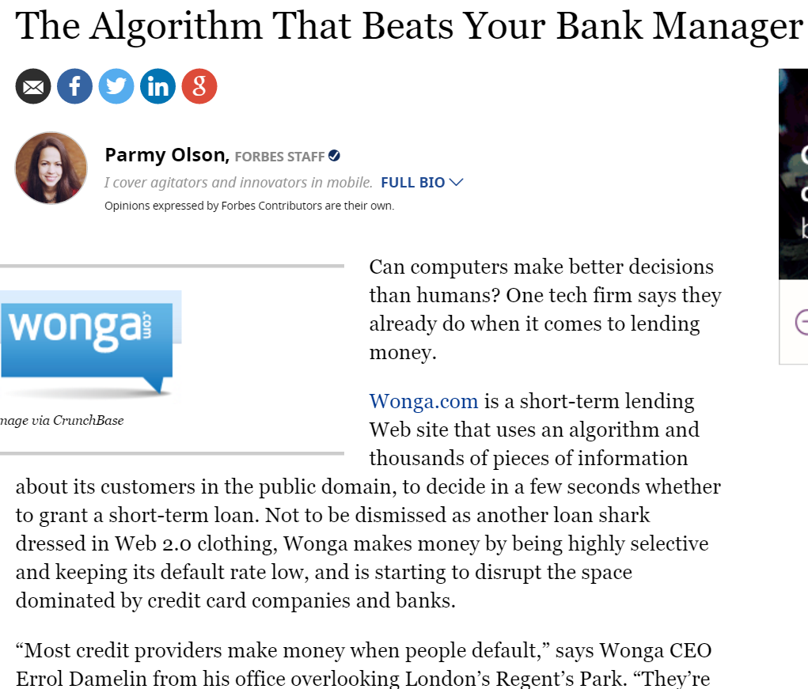
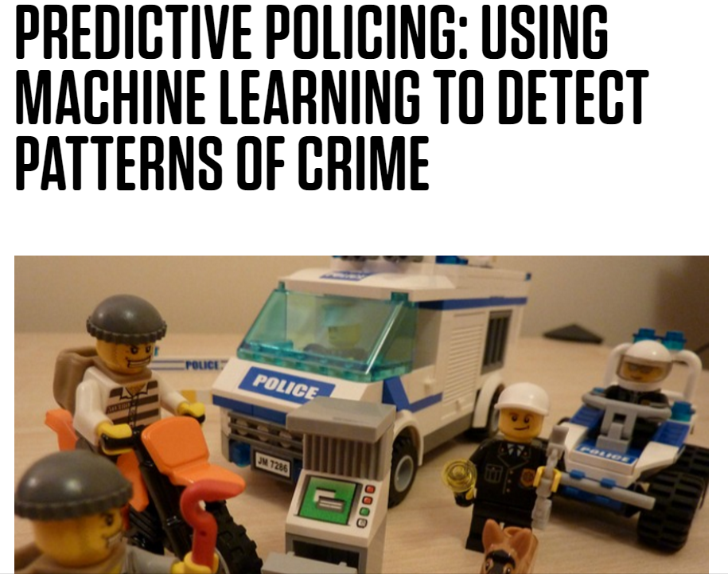
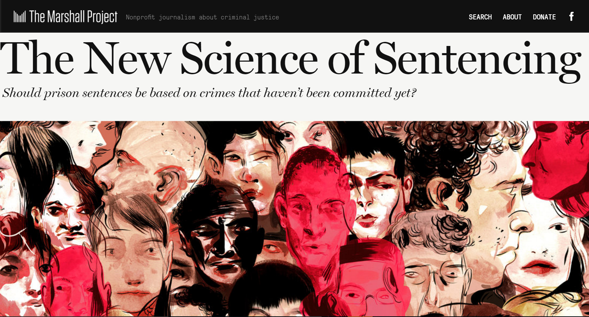

Slide 3
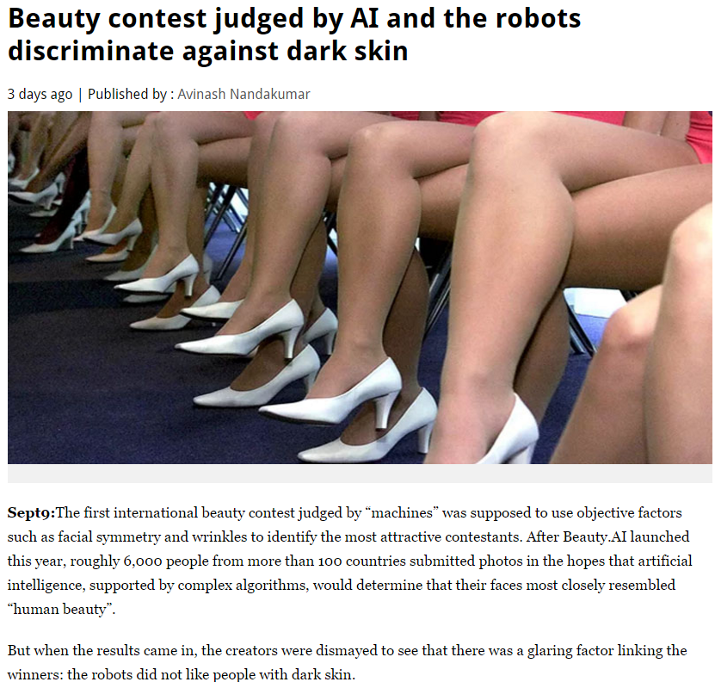
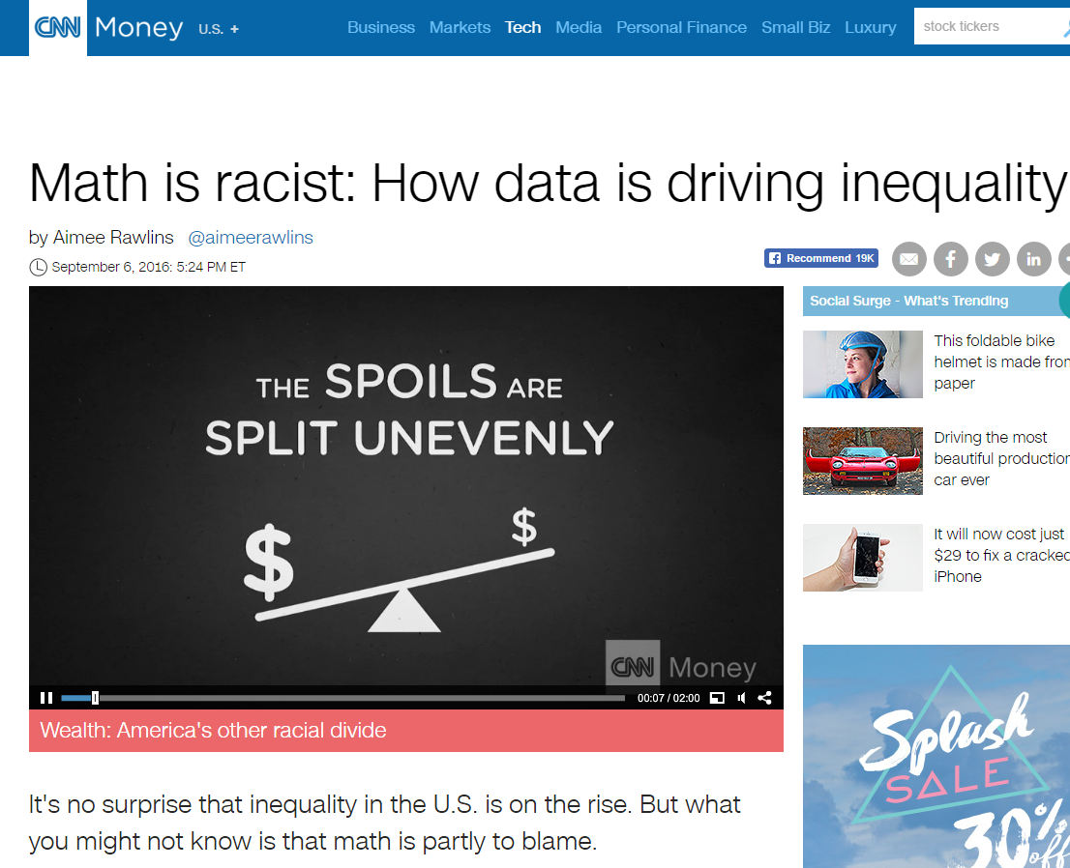
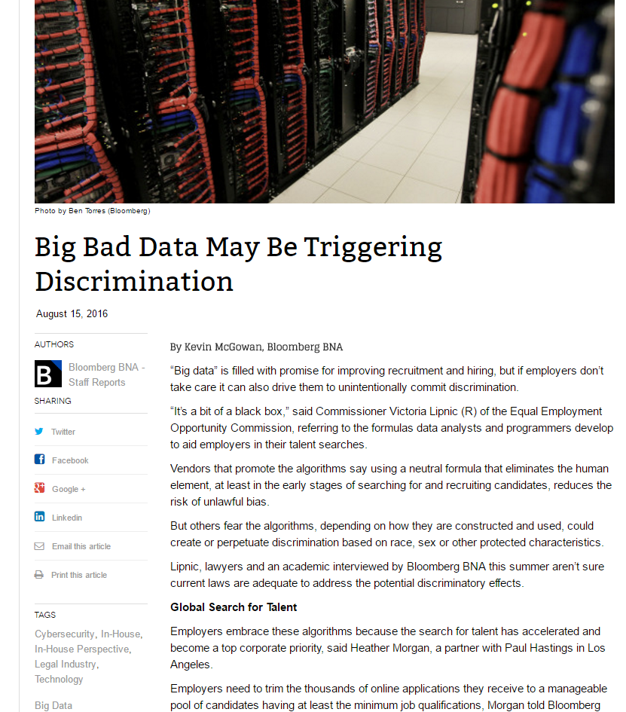
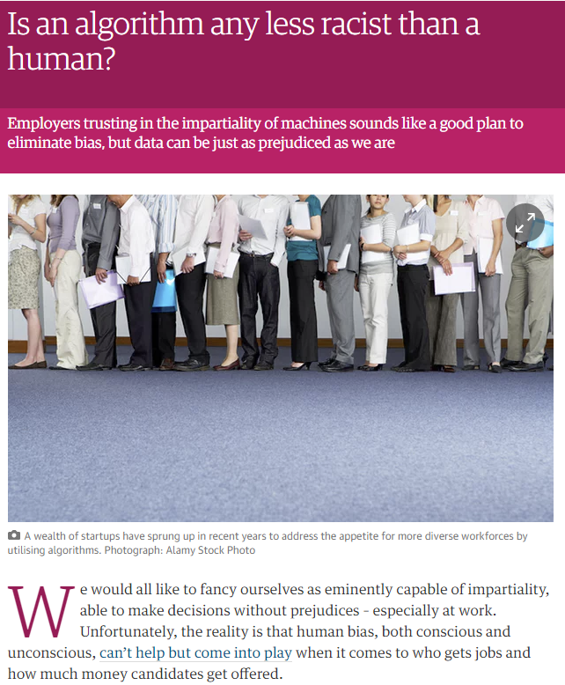
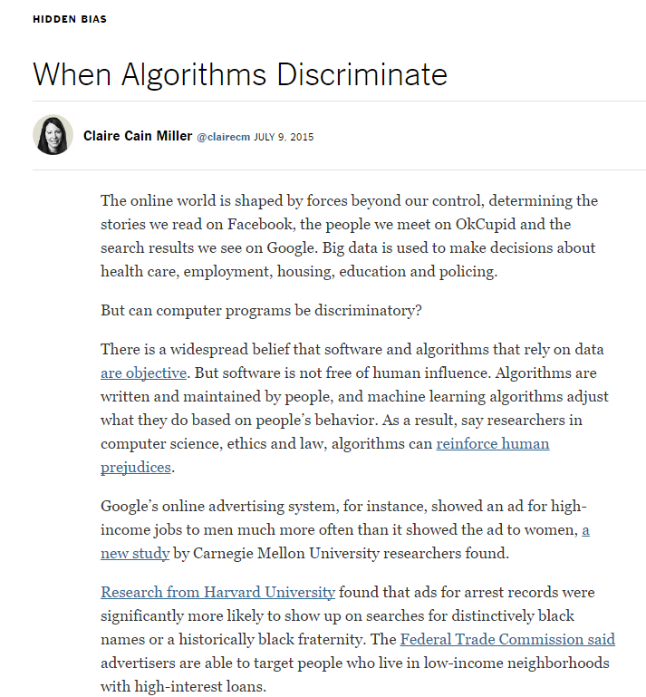
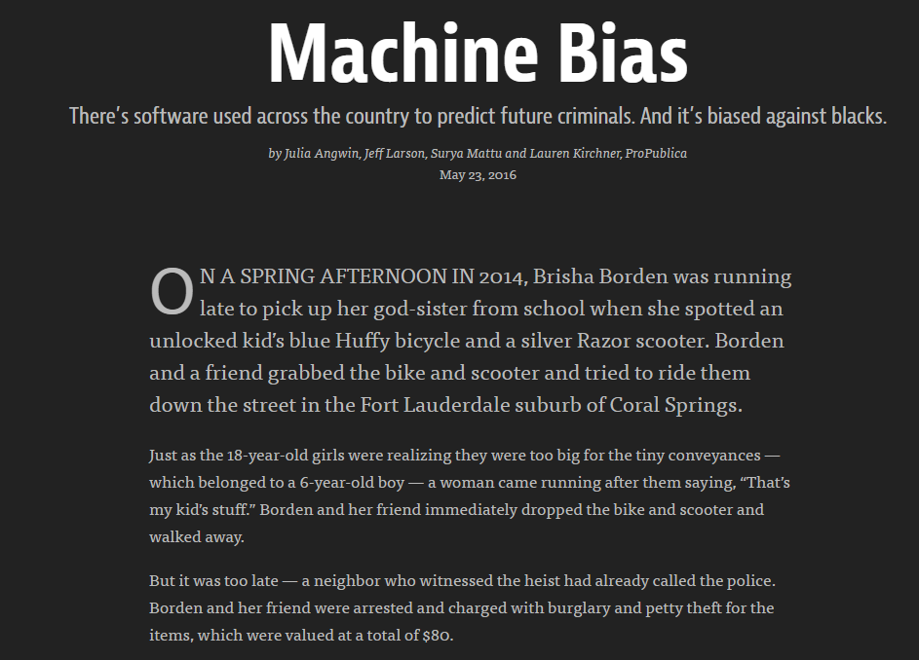

Slide 4



The Basic Setup
Given: Data, consisting of $d$ features and a label.
Goal: Find a rule to predict label from features.
College? | Bankruptcy? | Tall? | Employed? | Homeowner? | Paid back loan?
Y | N | Y | Y | N | Yes
Y | N | N | Y | N | Yes
N | N | N | N | Y | No
Y | Y | Y | Y | N | No
N | N | Y | Y | N | Yes
N | N | N | N | Y | No
N | Y | Y | Y | Y | Yes
$$x$$
$$y$$
(College and Employed and not Bankruptcy) or (Tall and Employed and not College)

Slide 5
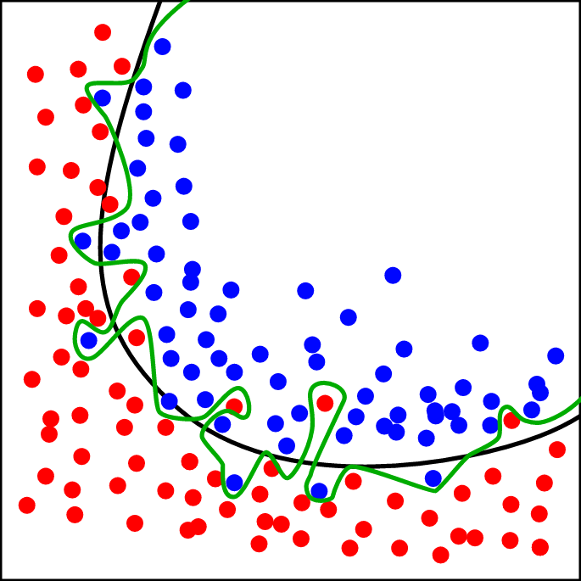

The Basic Setup
Given data, select a hypothesis $h:{\left\{Y,N\right\}}^{d}→\{Y,N\}$
Goal is not prediction on the training data, but prediction on new examples.

Slide 6








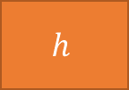


The Basic Setup
$$(x_{1}, y_{1})$$
Training Data
$$(x_{2}, y_{2})$$
$$P$$
$$(x_{3}, y_{3})$$
$$(x_{i}, y_{i})$$
$$(x_{n}, y_{n})$$
$$(x, y)$$
$$h$$
Algorithm
$$h(x)$$
The example is misclassified if $h\left(x\right)≠y$.

Slide 7
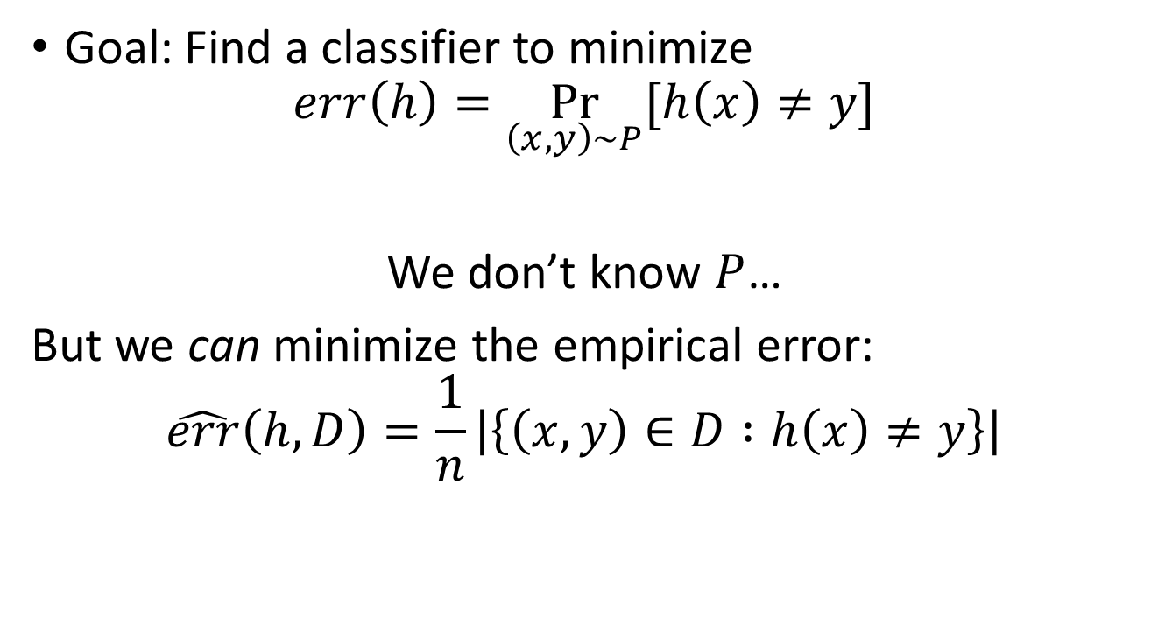
The Basic Setup
Goal: Find a classifier to minimize
$$err\left(h\right)=\underset{\left(x,y\right)∼P}{Pr}{[h\left(x\right)≠y]}$$
We don’t know $P$…
But we can minimize the empirical error:
$$\hat{err}\left(h,D\right)=\frac{1}{n}\left|\left\{\left(x,y\right)∈D :h\left(x\right)≠y\right\}\right|$$

Slide 8
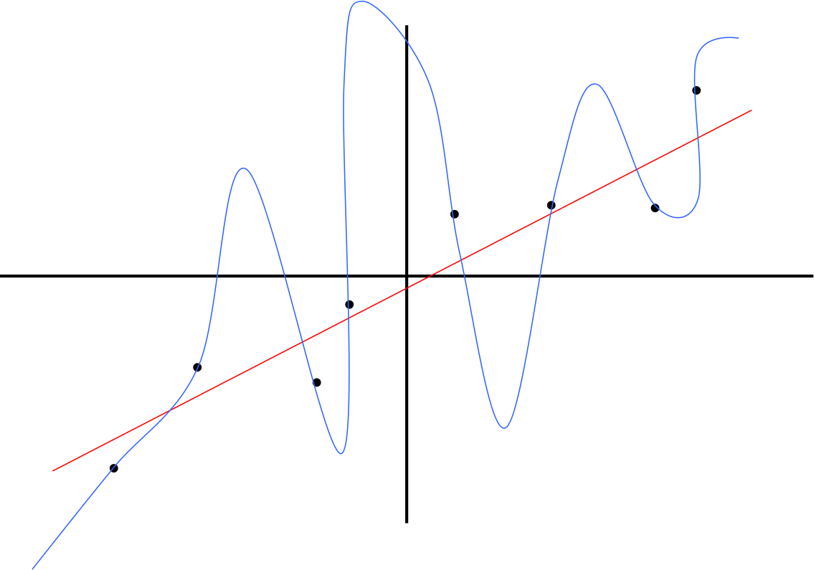
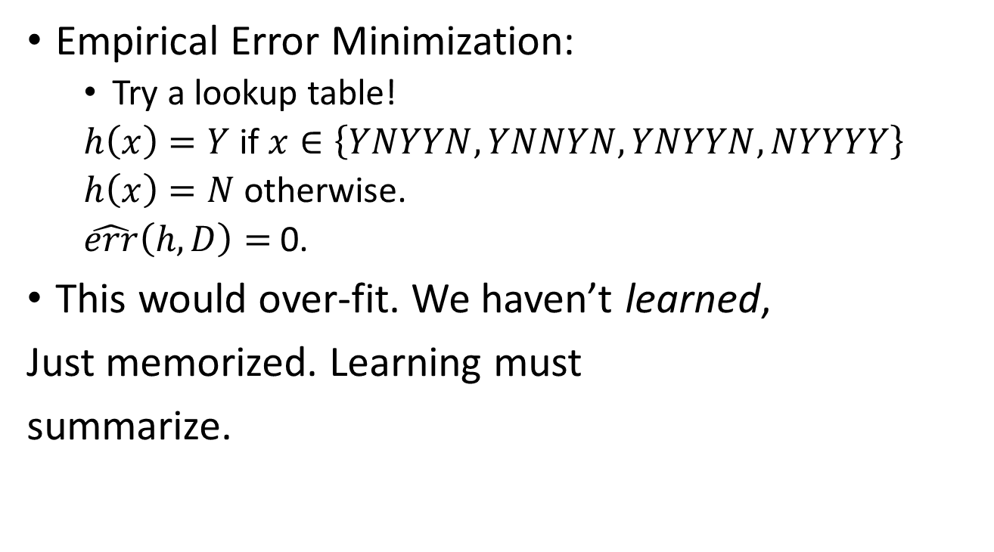
The Basic Setup
College? | Bankruptcy? | Tall? | Employed? | Homeowner? | Paid back loan?
Y | N | Y | Y | N | Yes
Y | N | N | Y | N | Yes
N | N | N | N | Y | No
Y | Y | Y | Y | N | No
N | N | Y | Y | N | Yes
N | N | N | N | Y | No
N | Y | Y | Y | Y | Yes
Empirical Error Minimization:
  Try a lookup table!
  $h\left(x\right)=Y$ if $x∈\left\{YNYYN, YNNYN, YNYYN, NYYYY\right\}$
  $h\left(x\right)=N$ otherwise.
  $\hat{err}\left(h,D\right)=$ 0.
This would over-fit. We haven’t learned,
Just memorized. Learning must
summarize.

Slide 9
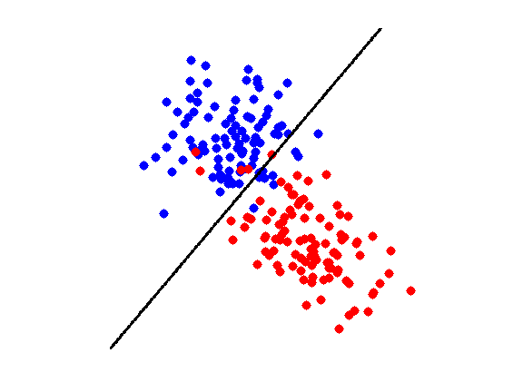
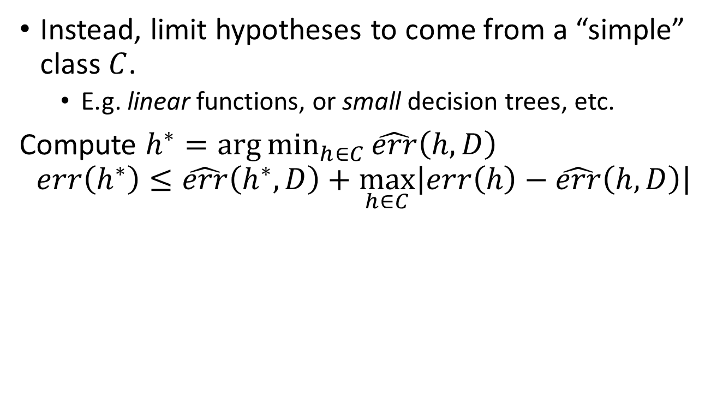
The Basic Setup
Instead, limit hypotheses to come from a “simple” class $C$.
  E.g. linear functions, or small decision trees, etc.
Compute $h^{∗}=\arg{\min_{h∈C}{\hat{err}\left(h,D\right)}}$
$$err\left(h^{∗}\right)≤\hat{err}\left(h^{∗},D\right)+\max_{h∈C}\left|err\left(h\right)−\hat{err}\left(h,D\right)\right|$$
Training Error
Generalization Error

Slide 10
Why might machine learning be “unfair”?
Many reasons:
  Data might encode existing biases.
    E.g. labels are not “Committed a crime?” but “Was arrested.”
  Data collection feedback loops.
    E.g. only observe “Paid back loan?” if the loan was granted.
  Different populations with different properties.
    E.g. “SAT score” might correlate with label differently in populations that employ SAT tutors.
  Less data (by definition) about minority populations.

Slide 11
Why might machine learning be “unfair”?
Many reasons:
  Data might encode existing biases.
    E.g. labels are not “Committed a crime?” but “Was arrested.”
  Data collection feedback loops.
    E.g. only observe “Paid back loan?” if the loan was granted.
  Different populations with different properties.
    E.g. “SAT score” might correlate with label differently in populations that employ SAT tutors.
  Less data (by definition) about minority populations.

Slide 12
SAT Score
Number of Credit Cards
Population 1
Population 2

Slide 13
SAT Score
Number of Credit Cards
Population 1
Population 2

Slide 14
SAT Score
Upshot: To be “fair”, the algorithm may need to explicitly take into account group membership.
Else, optimizing accuracy fits the majority population.
Number of Credit Cards
Population 1
Population 2

Slide 15
Why might machine learning be “unfair”?
Many reasons:
  Data might encode existing biases.
    E.g. labels are not “Committed a crime?” but “Was arrested.”
  Data collection feedback loops.
    E.g. only observe “Paid back loan?” if the loan was granted.
  Different populations with different properties.
    E.g. “SAT score” might correlate with label differently in populations that employ SAT tutors.
  Less data (by definition) about minority populations.

Slide 16
SAT Score
Number of Credit Cards
Population 1
Population 2

Slide 17
Upshot: Algorithms trained on minority populations will be less accurate.
Qualified individuals will be denied at a higher rate.
SAT Score
Number of Credit Cards
Population 1
Population 2

Slide 18
Why might machine learning be “unfair”?
Many reasons:
  Data might encode existing biases.
    E.g. labels are not “Committed a crime?” but “Was arrested.”
  Data collection feedback loops.
    E.g. only observe “Paid back loan?” if the loan was granted.
  Different populations with different properties.
    E.g. “SAT score” might correlate with label differently in populations that employ SAT tutors.
  Less data (by definition) about minority populations.

Slide 19
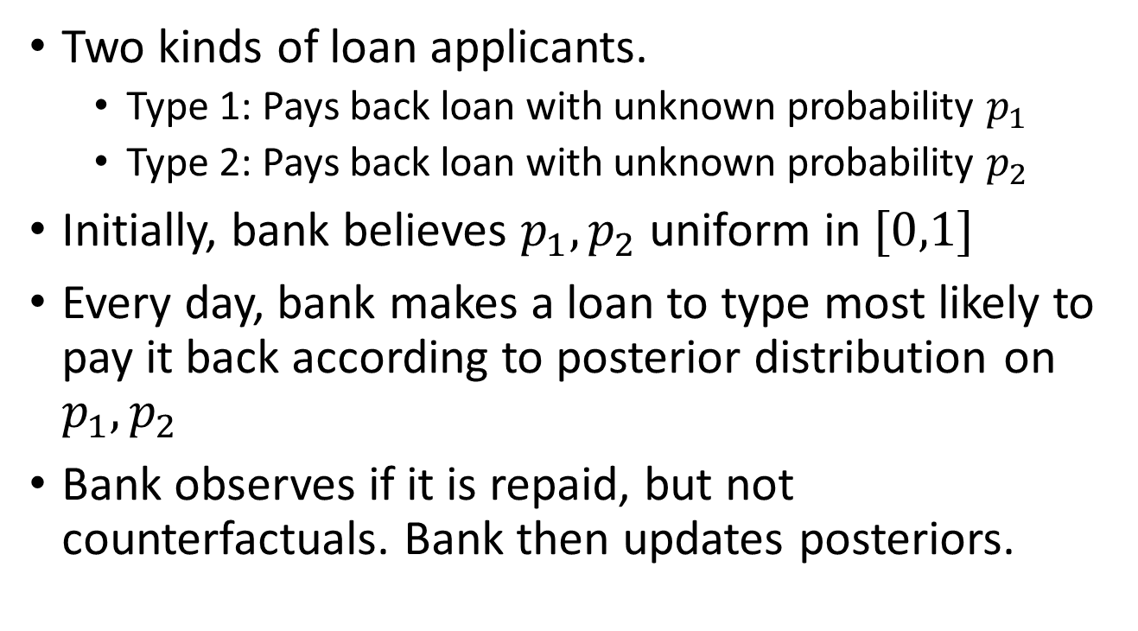
Toy Model
Two kinds of loan applicants.
  Type 1: Pays back loan with unknown probability $p_{1}$
  Type 2: Pays back loan with unknown probability $p_{2}$
Initially, bank believes $p_{1},p_{2}$ uniform in $[0,1]$
Every day, bank makes a loan to type most likely to pay it back according to posterior distribution on $p_{1},p_{2}$
Bank observes if it is repaid, but not counterfactuals. Bank then updates posteriors.

Slide 20
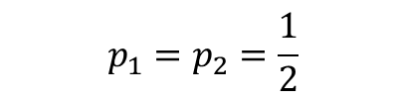



Toy Model
Suppose bank has made $n_{i}$ loans to population $i$, $s_{i}$ have paid them back , $d_{i}$ have defaulted. ($n_{i}=s_{i}+d_{i})$
Expected payoff of next loan is $\frac{s_{i}+1}{s_{i}+d_{i}+2}$
$$p_{1}=p_{2}=\frac{1}{2}$$
0.5
0.5
$$n_{i}=0$$
$$s_{i}=0$$
$$d_{i}=0$$
$$n_{i}=0$$
$$s_{i}=0$$
$$d_{i}=0$$

Slide 21

Toy Model
Suppose bank has made $n_{i}$ loans to population $i$, $s_{i}$ have paid them back , $d_{i}$ have defaulted. ($n_{i}=s_{i}+d_{i})$
Expected payoff of next loan is $\frac{s_{i}+1}{s_{i}+d_{i}+2}$
$$p_{1}=p_{2}=\frac{1}{2}$$
0.5
0.33
$$n_{i}=1$$
$$s_{i}=0$$
$$d_{i}=1$$
$$n_{i}=0$$
$$s_{i}=0$$
$$d_{i}=0$$

Slide 22

Toy Model
Suppose bank has made $n_{i}$ loans to population $i$, $s_{i}$ have paid them back , $d_{i}$ have defaulted. ($n_{i}=s_{i}+d_{i})$
Expected payoff of next loan is $\frac{s_{i}+1}{s_{i}+d_{i}+2}$
$$p_{1}=p_{2}=\frac{1}{2}$$
0.66
0.33
$$n_{i}=1$$
$$s_{i}=0$$
$$d_{i}=1$$
$$n_{i}=1$$
$$s_{i}=1$$
$$d_{i}=0$$

Slide 23

Toy Model
Suppose bank has made $n_{i}$ loans to population $i$, $s_{i}$ have paid them back , $d_{i}$ have defaulted. ($n_{i}=s_{i}+d_{i})$
Expected payoff of next loan is $\frac{s_{i}+1}{s_{i}+d_{i}+2}$
$$p_{1}=p_{2}=\frac{1}{2}$$
0.75
0.33
$$n_{i}=1$$
$$s_{i}=0$$
$$d_{i}=1$$
$$n_{i}=2$$
$$s_{i}=2$$
$$d_{i}=0$$

Slide 24

Toy Model
Suppose bank has made $n_{i}$ loans to population $i$, $s_{i}$ have paid them back , $d_{i}$ have defaulted. ($n_{i}=s_{i}+d_{i})$
Expected payoff of next loan is $\frac{s_{i}+1}{s_{i}+d_{i}+2}$
$$p_{1}=p_{2}=\frac{1}{2}$$
0.60
0.33
$$n_{i}=1$$
$$s_{i}=0$$
$$d_{i}=1$$
$$n_{i}=3$$
$$s_{i}=2$$
$$d_{i}=1$$

Slide 25

Toy Model
Suppose bank has made $n_{i}$ loans to population $i$, $s_{i}$ have paid them back , $d_{i}$ have defaulted. ($n_{i}=s_{i}+d_{i})$
Expected payoff of next loan is $\frac{s_{i}+1}{s_{i}+d_{i}+2}$
$$p_{1}=p_{2}=\frac{1}{2}$$
0.5
0.33
$$n_{i}=1$$
$$s_{i}=0$$
$$d_{i}=1$$
$$n_{i}=4$$
$$s_{i}=2$$
$$d_{i}=2$$

Slide 26

Toy Model
Suppose bank has made $n_{i}$ loans to population $i$, $s_{i}$ have paid them back , $d_{i}$ have defaulted. ($n_{i}=s_{i}+d_{i})$
Expected payoff of next loan is $\frac{s_{i}+1}{s_{i}+d_{i}+2}$
$$p_{1}=p_{2}=\frac{1}{2}$$
0.57
0.33
$$n_{i}=1$$
$$s_{i}=0$$
$$d_{i}=1$$
$$n_{i}=5$$
$$s_{i}=3$$
$$d_{i}=2$$

Slide 27

Toy Model
Suppose bank has made $n_{i}$ loans to population $i$, $s_{i}$ have paid them back , $d_{i}$ have defaulted. ($n_{i}=s_{i}+d_{i})$
Expected payoff of next loan is $\frac{s_{i}+1}{s_{i}+d_{i}+2}$
$$p_{1}=p_{2}=\frac{1}{2}$$
0.625
0.33
$$n_{i}=1$$
$$s_{i}=0$$
$$d_{i}=1$$
$$n_{i}=6$$
$$s_{i}=4$$
$$d_{i}=2$$

Slide 28

Toy Model
Suppose bank has made $n_{i}$ loans to population $i$, $s_{i}$ have paid them back , $d_{i}$ have defaulted. ($n_{i}=s_{i}+d_{i})$
Expected payoff of next loan is $\frac{s_{i}+1}{s_{i}+d_{i}+2}$
$$p_{1}=p_{2}=\frac{1}{2}$$
0.55
0.33
$$n_{i}=1$$
$$s_{i}=0$$
$$d_{i}=1$$
$$n_{i}=7$$
$$s_{i}=4$$
$$d_{i}=3$$

Slide 29
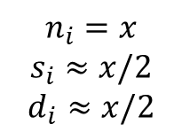
Toy Model
Upshot: Algorithms making myopically optimal decisions may forever discriminate against a qualified population because of unlucky prefix.
Less myopic algorithms balance exploration and exploitation – but this has its own unfairness issues.
Suppose bank has made $n_{i}$ loans to population $i$, $s_{i}$ have paid them back , $d_{i}$ have defaulted. ($n_{i}=s_{i}+d_{i})$
Expected payoff of next loan is $\frac{s_{i}+1}{s_{i}+d_{i}+2}$
$$p_{1}=p_{2}=\frac{1}{2}$$
0.5000001
0.33
$$n_{i}=1$$
$$s_{i}=0$$
$$d_{i}=1$$
$$n_{i}=x$$
$$s_{i}≈x/2$$
$$d_{i}≈x/2$$

Slide 30
So what can we do?
A solution in a stylized model…
Joint work with:
Matthew Joseph,
Michael Kearns,
Jamie Morgenstern
Seth Neel.

Slide 31
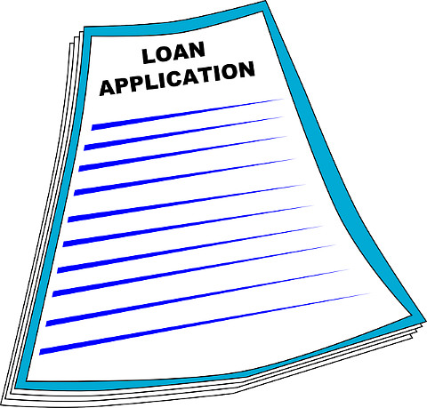

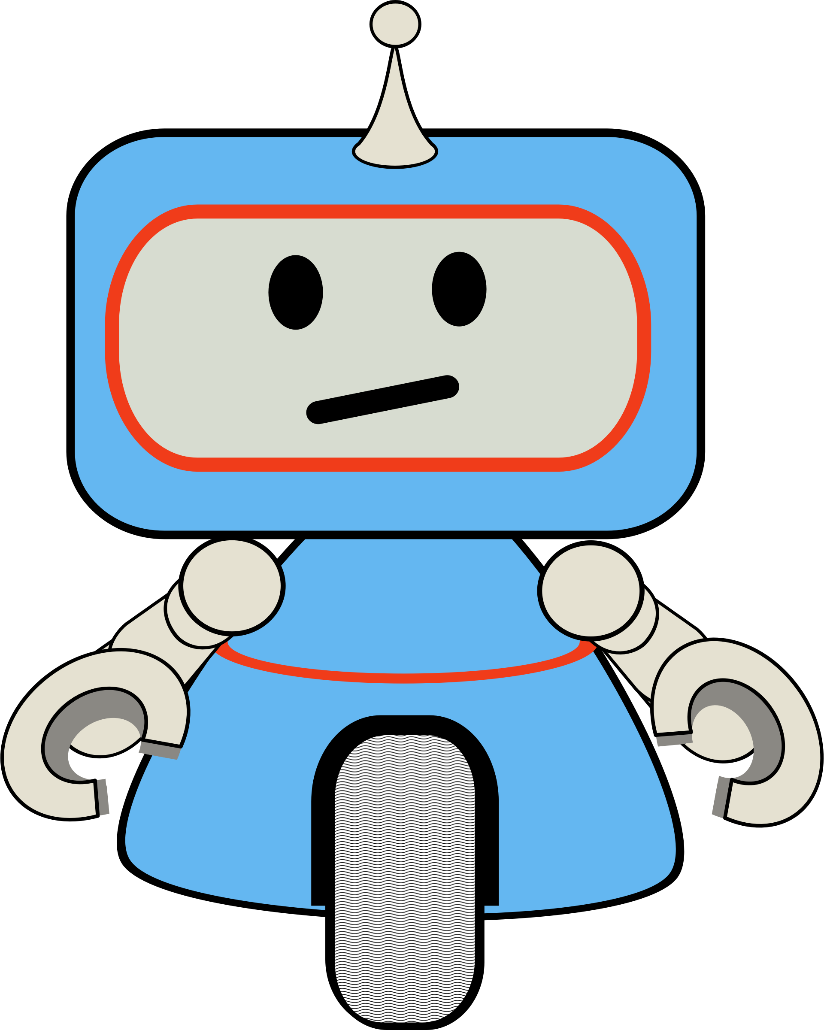

A Richer Model

Slide 32

A Richer Model

Slide 33
A Richer Model

Slide 34
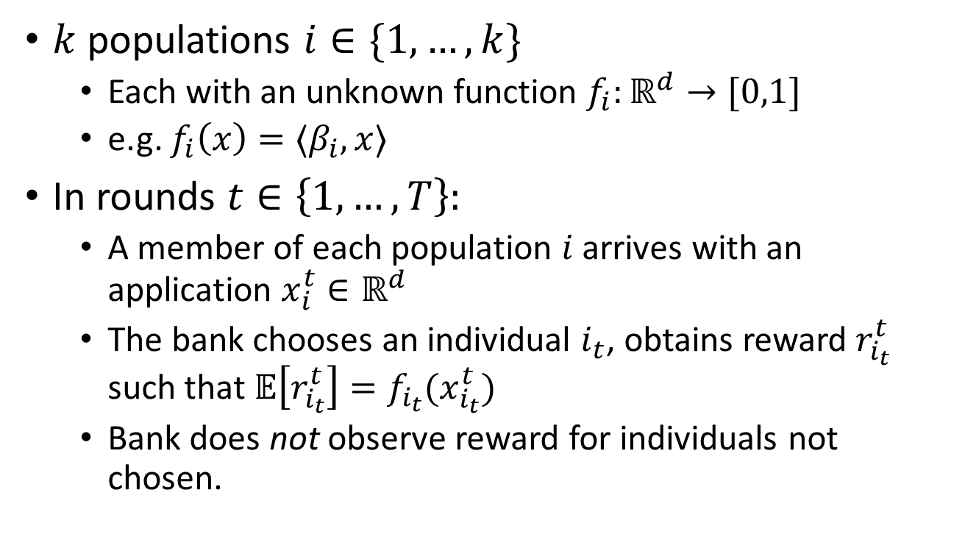
The Contextual Bandit Problem
$k$ populations $i∈\{1,…, k\}$
  Each with an unknown function $f_{i}:ℝ^{d}→[0,1]$
  e.g. $f_{i}\left(x\right)=〈β_{i},x〉$
In rounds $t∈\left\{1,…,T\right\}:$
  A member of each population $i$ arrives with an application $x_{i}^{t}∈ℝ^{d}$
  The bank chooses an individual $i_{t}$, obtains reward $r_{i_{t}}^{t}$ such that $𝔼\left[r_{i_{t}}^{t}\right]=f_{i_{t}}(x_{i_{t}}^{t})$
  Bank does not observe reward for individuals not chosen.

Slide 35

The Contextual Bandit Problem
Measure performance of the algorithm via Regret:
Regret = $\frac{1}{T}\left(\sum_{t}{\max_{i}{f_{i}\left(x_{i}^{t}\right)} − \sum_{t}{f_{i_{t}}\left(x_{i_{t}}^{t}\right)}}\right)$
“UCB” style algorithms can get regret $O\left(\frac{\sqrt{d⋅k}}{\sqrt{T}}\right)$

Slide 36
A Fairness Definition
“Fair Equality of Opportunity”:
“… assuming there is a distribution of natural assets, those who are at the same level of talent and ability, and have the same willingness to use them, should have the same prospects of success regardless of their initial place in the social system.” – John Rawls

Slide 37
A Fairness Definition
“Fair Equality of Opportunity”:
The algorithm should never preferentially favor (i.e. choose with higher probability) a less qualified individual over a more qualified individual.

Slide 38
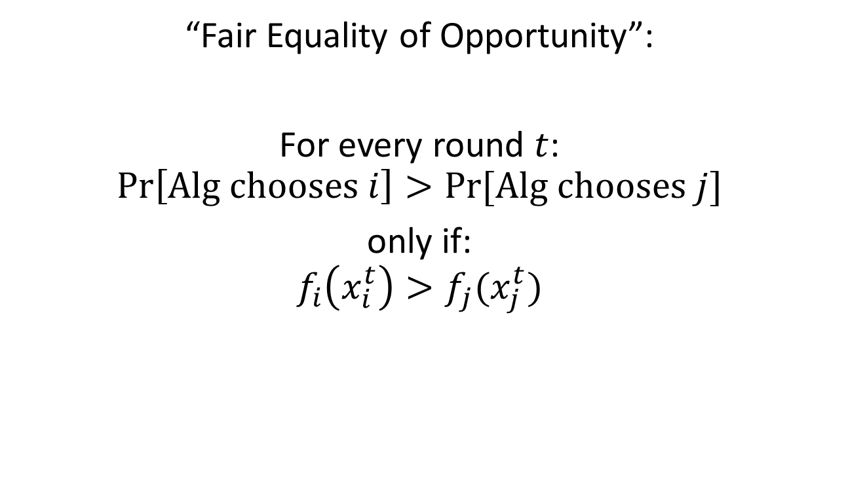
A Fairness Definition
“Fair Equality of Opportunity”:
For every round $t$:
$$\operatorname{Pr}\left[\text{Alg} \text{chooses} i\right]>Pr⁡[\text{Alg} \text{chooses} j]$$
only if:
$$f_{i}\left(x_{i}^{t}\right)>f_{j}(x_{j}^{t})$$

Slide 39
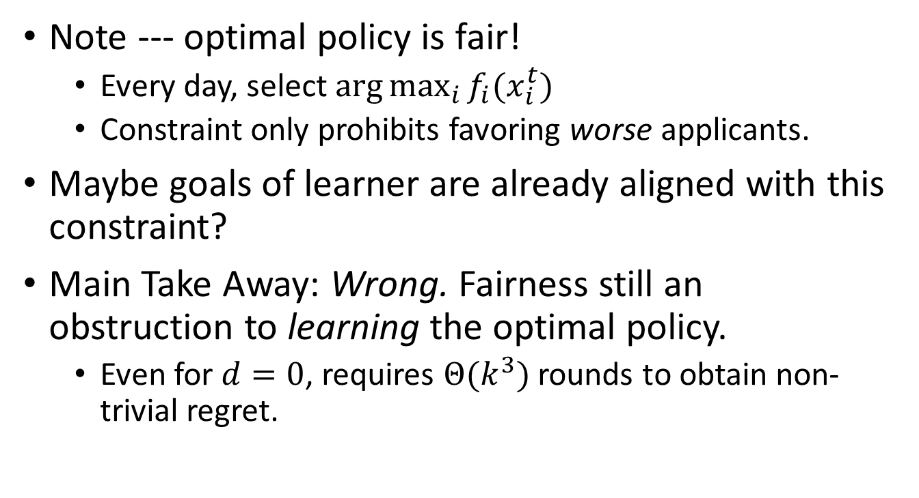
Is Fairness in Conflict with Profit?
Note --- optimal policy is fair!
  Every day, select $\arg{\max_{i}{f_{i}(x_{i}^{t})}}$
  Constraint only prohibits favoring worse applicants.
Maybe goals of learner are already aligned with this constraint?
Main Take Away: Wrong. Fairness still an obstruction to learning the optimal policy.
  Even for $d=0$, requires $Θ(k^{3})$ rounds to obtain non-trivial regret.

Slide 40













FairUCB
If two intervals overlap,
don’t know which is better.
If two intervals overlap,
play with = probability
$${〈{\hat{β}}_{1}^{t},x_{1}^{t}〉=\hat{μ}}^{t}$$
Reward
“Standard”
choice
[Auer et al ’02]
What
about
me?
40￼

Slide 41
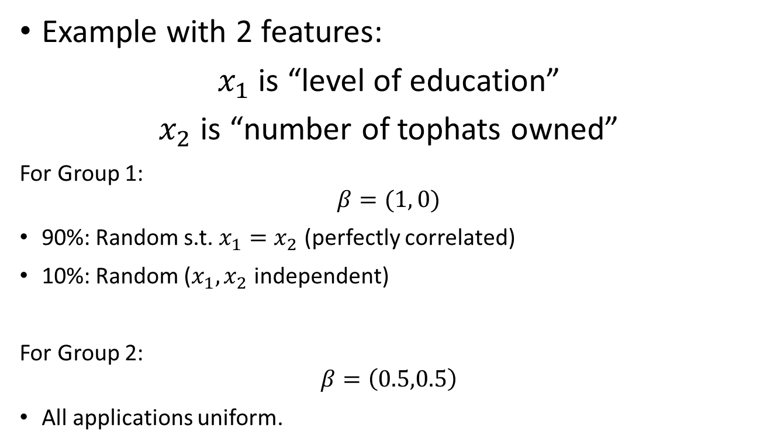
“Standard Approach” Biases Towards Uncertainty
Example with 2 features:
$x_{1}$ is “level of education”
$x_{2}$ is “number of tophats owned”
For Group 1:
$$β=(1, 0)$$
90%: Random s.t. $x_{1}=x_{2}$ (perfectly correlated)
10%: Random ($x_{1},x_{2}$ independent)
For Group 2:
$$β=\left(0.5,0.5\right)$$
All applications uniform.

Slide 42
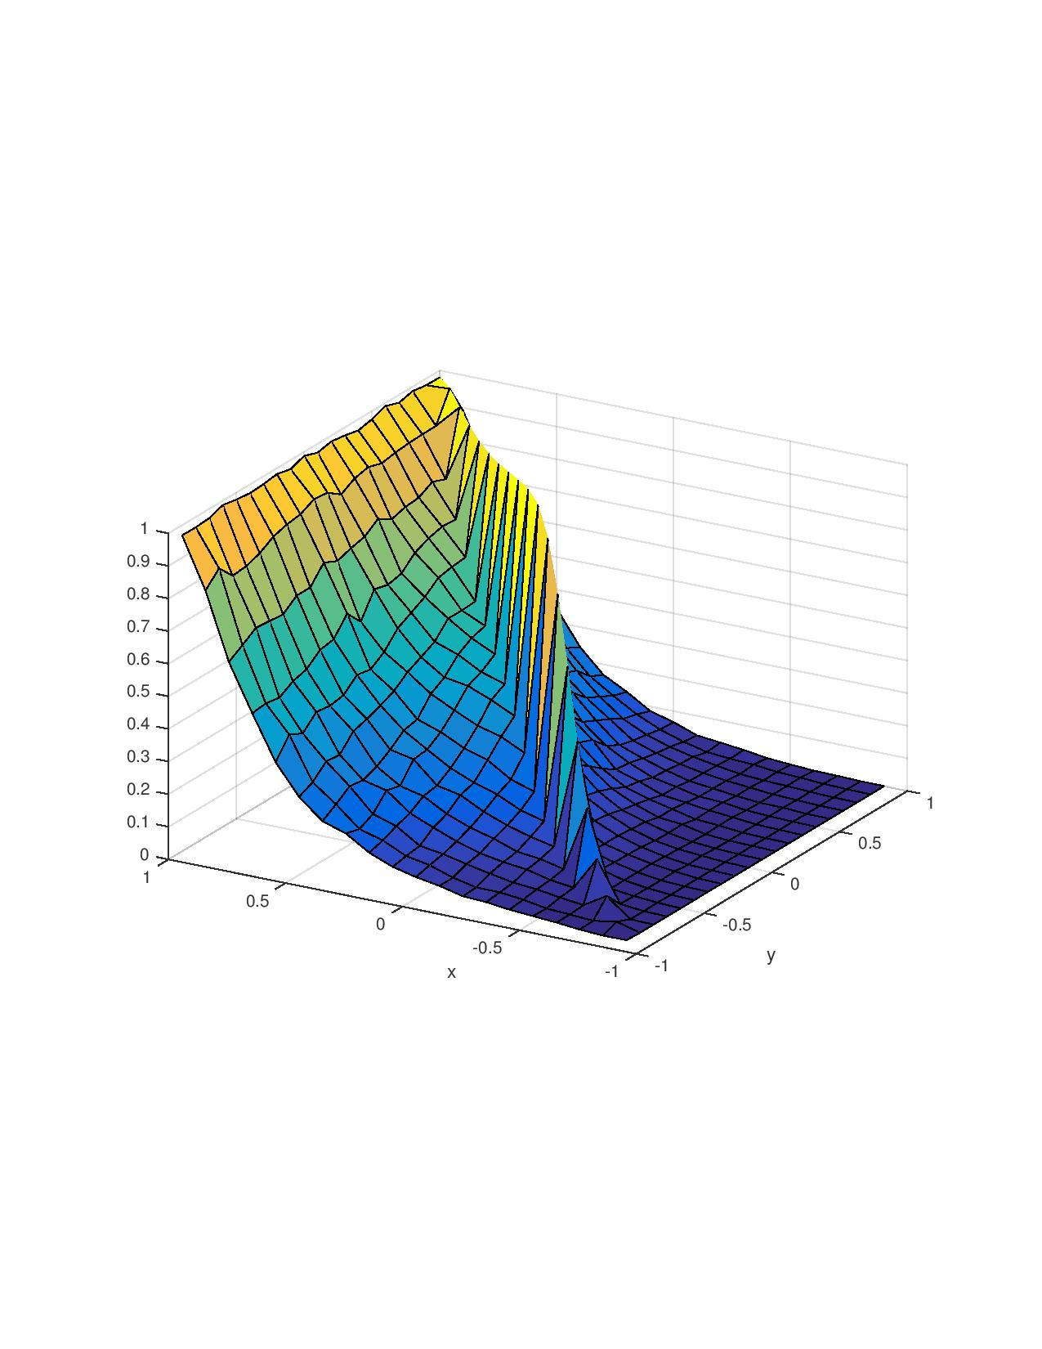

“Standard Approach” Biases Towards Uncertainty
“Unfair Rounds”: $t$ s.t. Algorithm selects sub-optimal applicant.
Discrimination Index for Individual: Probability of victimization conditioned on participating in being present at unfair round.

Slide 43
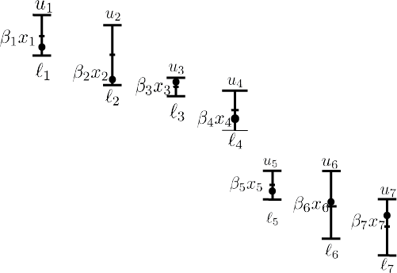
Chaining:
Chained

Slide 44
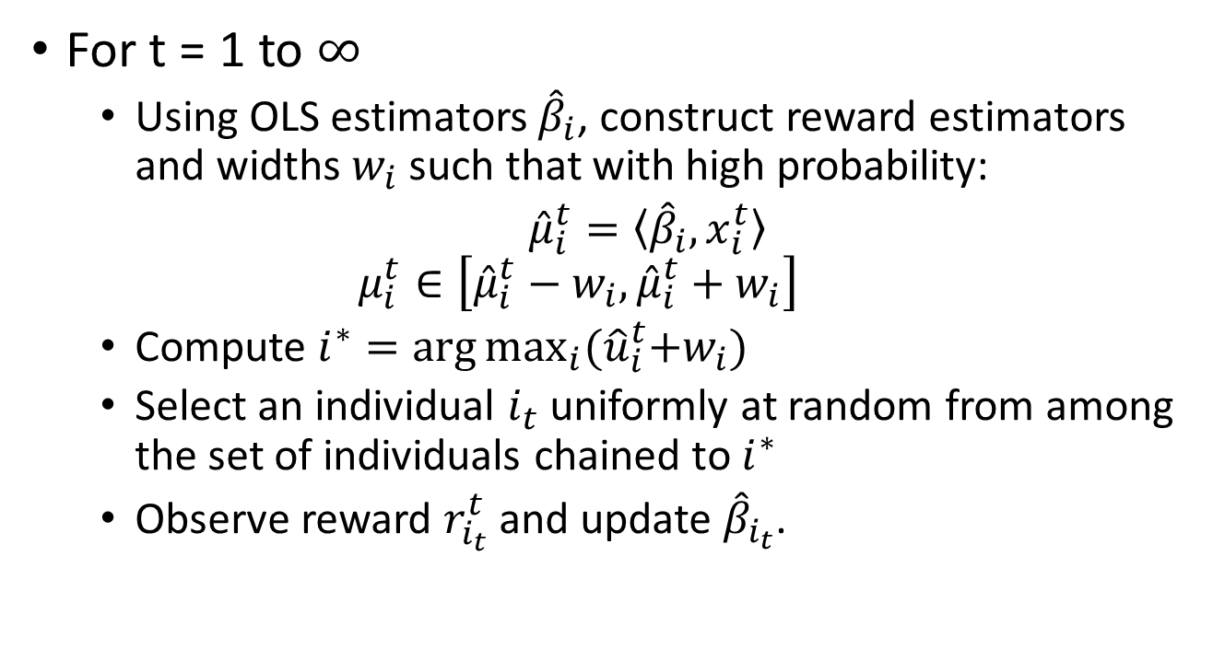
FairUCB Pseudo-Code
For t = 1 to $∞$
  Using OLS estimators ${\hat{β}}_{i}$, construct reward estimators and widths $w_{i}$ such that with high probability:
  ${\hat{μ}}_{i}^{t}=〈{\hat{β}}_{i},x_{i}^{t}〉$
  $$μ_{i}^{t}∈\left[{\hat{μ}}_{i}^{t}−w_{i},{\hat{μ}}_{i}^{t}+w_{i}\right]$$
  Compute $i^{∗}=\arg{\max_{i}{{(\hat{u}}_{i}^{t}+w_{i}) }}$
  Select an individual $i_{t}$ uniformly at random from among the set of individuals chained to $i^{∗}$
  Observe reward $r_{i_{t}}^{t}$ and update ${\hat{β}}_{i_{t}}$.

Slide 45
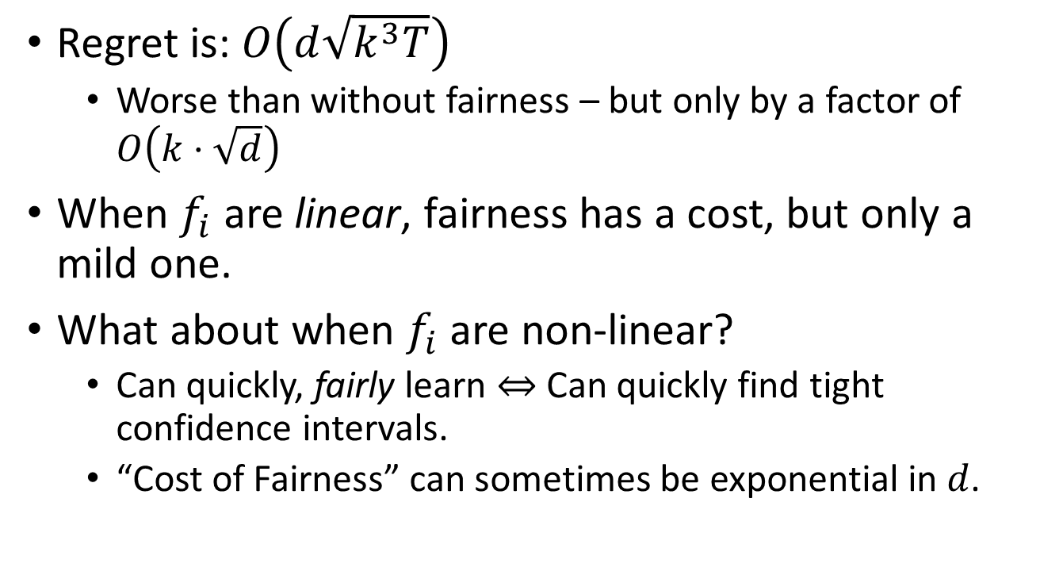
FairUCB’s Guarantees:
Regret is: $O\left(d\sqrt{k^{3}T}\right)$
  Worse than without fairness – but only by a factor of $O\left(k⋅\sqrt{d}\right)$
When $f_{i}$ are linear, fairness has a cost, but only a mild one.
What about when $f_{i}$ are non-linear?
  Can quickly, fairly learn $⇔$ Can quickly find tight confidence intervals.
  “Cost of Fairness” can sometimes be exponential in $d$.

Slide 46
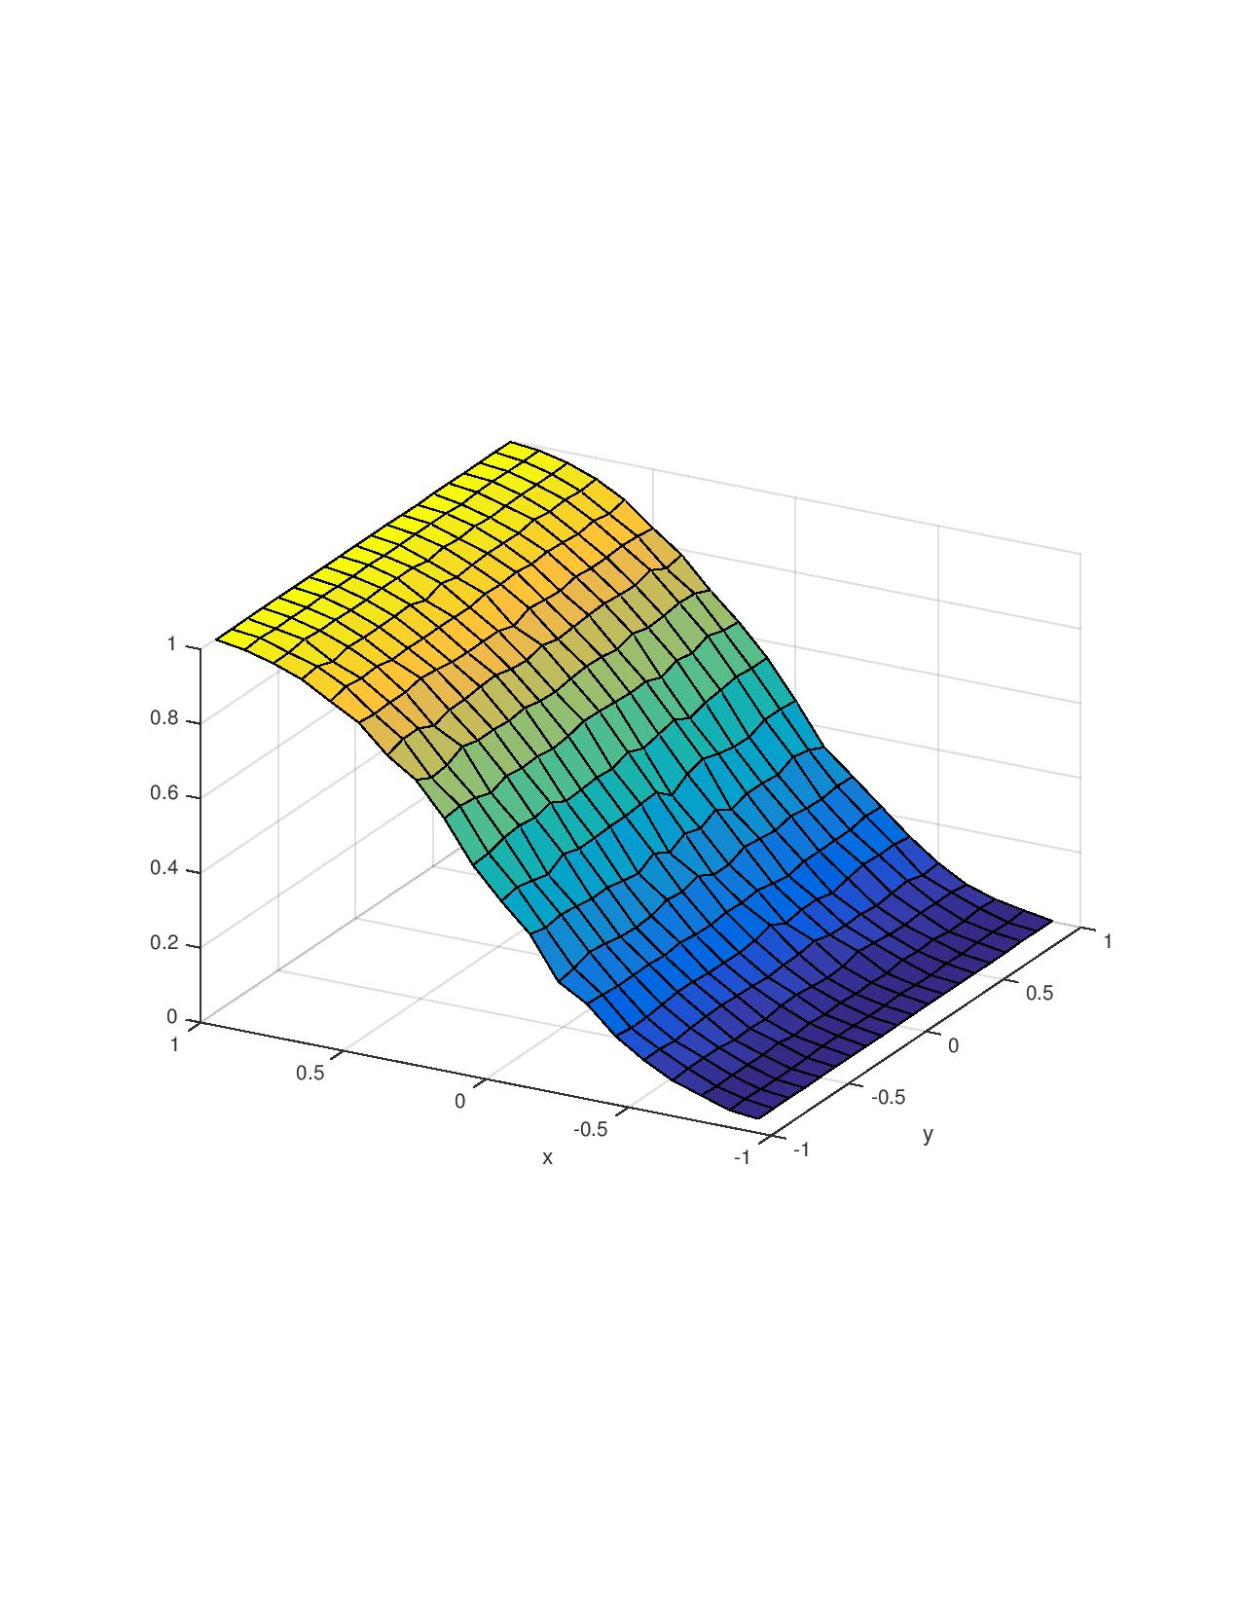
Discrimination Index
Standard UCB
Fair UCB

Slide 47
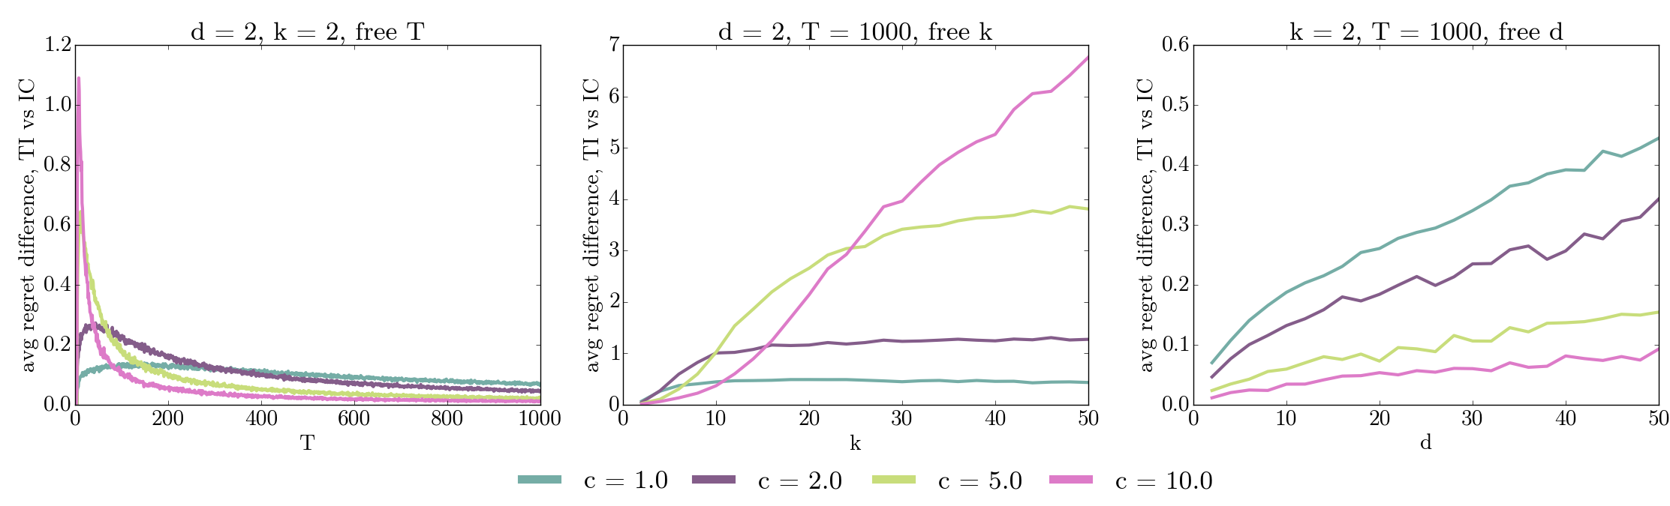
Performance

Slide 48
Discussion
Even without a taste for discrimination “baked in”, natural (optimal) learning procedures can disproportionately benefit certain populations.
Imposing “fairness” constraints is not without cost.
  Must quantify tradeoffs between fairness and other desiderata
  No Pareto dominant solution – how should we choose between different points on the tradeoff curve?
None of these points is unique to “algorithmic” decision making.
  Just allows formal analysis to bring these universal issues to the fore.

Slide 49






Fairness Definition

Slide 50

Where does cost of fairness come from?
Distribution over instances
k Bernoulli arms
Only uncertainty is their means
Arm i has mean μi which is either

Slide 51



Lower bound particulars
bk
Must play w. =
probability until confident they’re different
bk-1
b’k
b’k-1
Mean of Distribution
51￼

Slide 52

Lower bound particulars
Must play w. =
probability until confident they’re different
bk-1
bk-2
b’k-1
Mean of Distribution
b’k-2
52￼

Slide 53
Lower bound particulars
Must play w. =
probability until confident they’re different
Mean of Distribution
53￼

Slide 54


Lower bound particulars
Must play w. =
probability until confident they’re different
Mean of Distribution
b2
b1
b’2
b’1
54￼

Slide 55

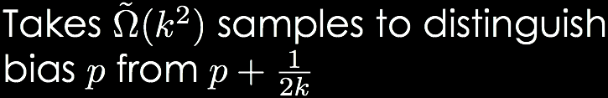
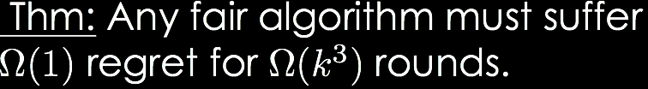
Lower bound particulars
pk
Must play w. =
probability until confident they’re different
pk-1
p’k
Mean of Distribution
p’k-1
p2
p1
p’2
p’1

Slide 56


So, there’s a separation between fair/unfair learning
Without fairness one can achieve regret
but this lower bound implies fair regret of

