Slide 1
Disaggregation and the Application
Sebastian Angel Mihir Nanavati Siddhartha Sen

Slide 2
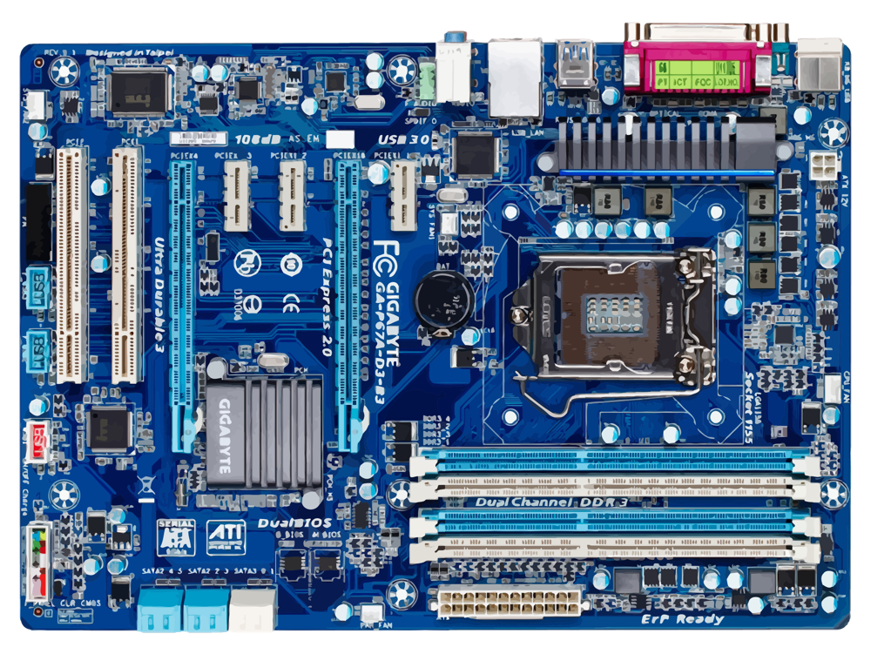
Traditional data center racks
CPUs
RDMA NIC
GPUs
Memory
Storage

Slide 3
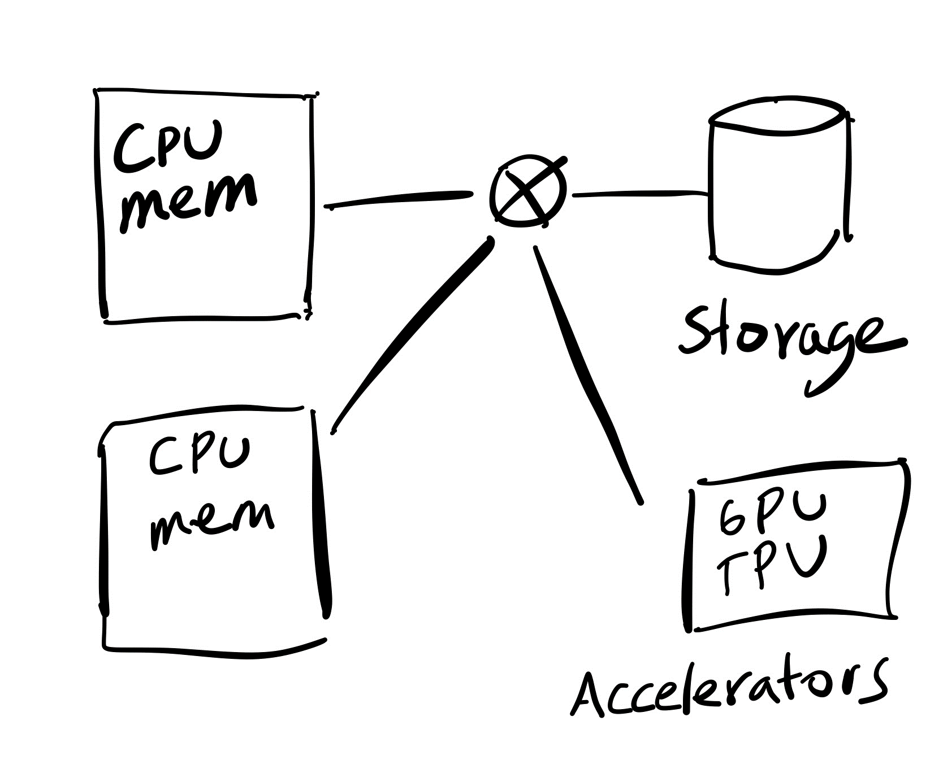
Prior and current disaggregation efforts

Slide 4
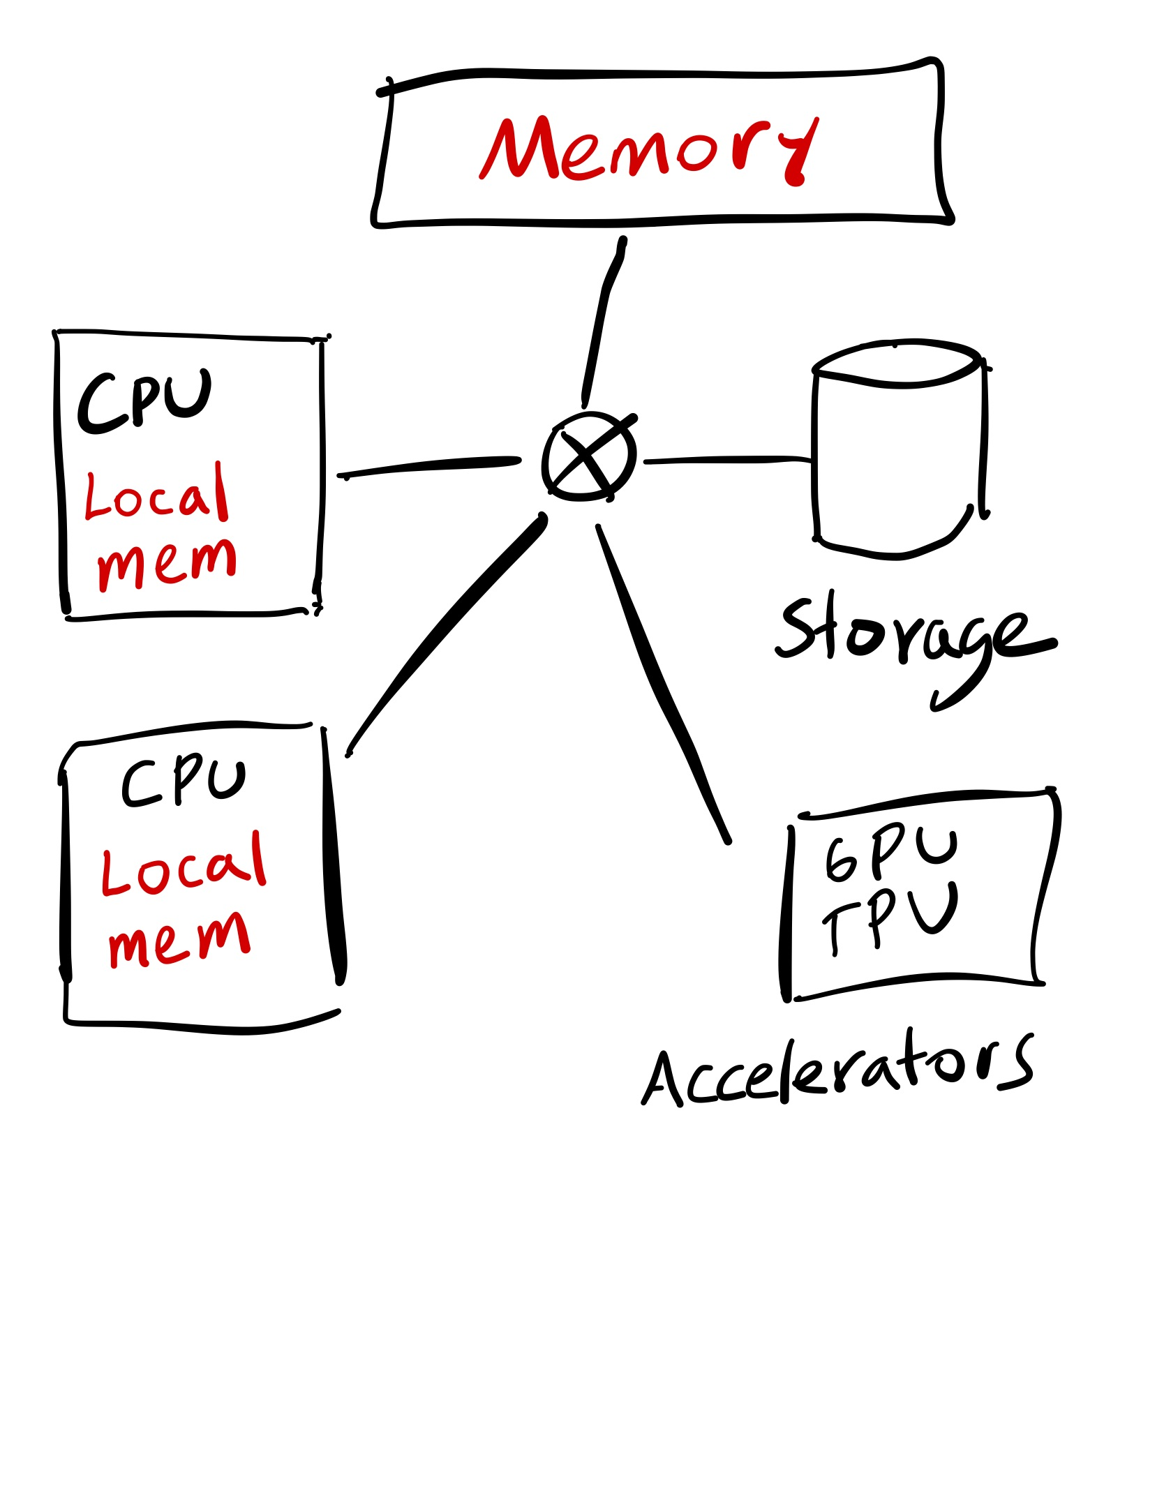
Towards DDCs
OS kernel
+
Cache

Slide 5
Why? Many benefits for operators
1) Independence
Evolve independently
Scale independently
Fail separately
2) Flexible provisioning
3) Less waste

Slide 6
Can you run regular applications on DDCs?
Yes! OSes such as LegoOS [OSDI ‘18] provide a transparent POSIX API

Slide 7
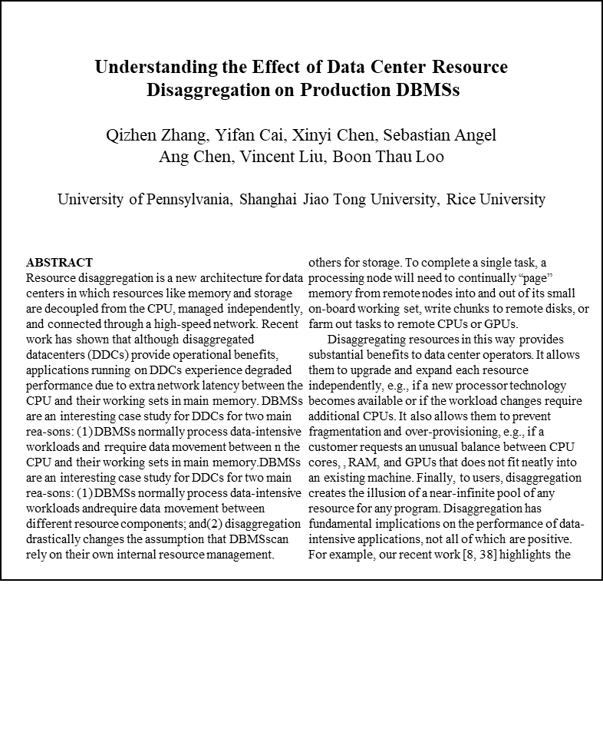
Should you run regular applications on DDCs?
Summary: terrible performance

Slide 8
Key issue: Too much data movement
Goal: send data from App 1 to App 2
App 1
App 2

Slide 9
Key issue: Too much data movement
Goal: send data from App 1 to App 2
App 1
App 2

Slide 10
Our position:
OSes should expose the disaggregated nature of DDCs to applications and let them exploit it for their benefit

Slide 11
In the rest of this talk
What abstractions should DDC OSes expose to applications?
Which applications can benefit from these abstractions?

Slide 12
OSes can expose:
That processes access the same memory nodes
Failure independence
Memory nodes might have a CPU/FPGA
Useful for near-data processing / computation offloading

Slide 13
We propose three new OS abstractions
Memory grant
Memory steal
Failure informers / Spies

Slide 14
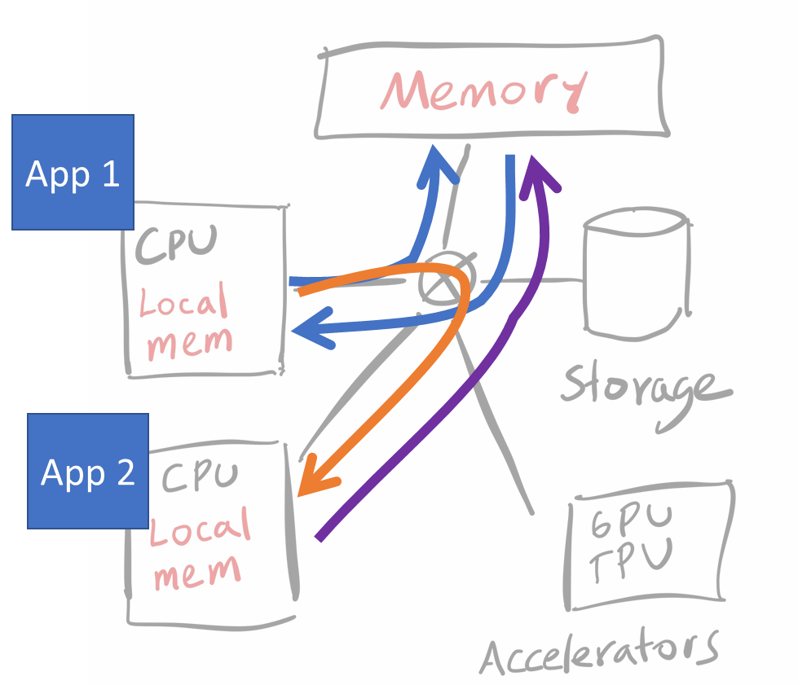
Memory grant
App 1
1) Grant pages to App 2
App 2
2) Notify that new pages are available

Slide 15
Properties of Grant
Grant has move semantics
Grantor loses access to the memory
Similar to vmsplice with “GIFT” flag in Linux
Virtual memory addresses remain the same
To preserve correctness of internal references
Problem: what if grantee already used those addresses?

Slide 16
Memory steal
App 1
2) Notify that pages are gone!
App 2
1) Steal pages from App 1

Slide 17
Properties of Steal
Same semantics as Grant
But is involuntary: Can happen at any time
Meant to be used by different instances of the same app
Can coordinate through the network / use capabilities
Incorrect steal = bug
Must ensure stolen memory is consistent
Can model with crash consistency

Slide 18
Failure informers / Spies
App 1
“FYI: My memory failed”
App 2
ok… so now what?

Slide 19
In the rest of this talk
What abstractions should DDC OSes expose to applications?
Which applications can benefit from these abstractions?

Slide 20
Some applications
Dataflow applications could
Use Grant to pass data around
Use Steal to deal with stragglers
New memcached instances can Steal part of object space (scale out)
Paxos can use failure informers for quicker reconfigurations
Memory dies → Paxos replica informs others and then kills itself
CPU dies → New replica takes over the dead CPU’s memory and keeps going

Slide 21
Summary
Running existing applications on DDC is not advisable
There is potential in modifying apps to exploit the nature of DDCs
OSes should expose more information and control to applications
Grant
Steal
Spy

