Slide 1

Algorithmic Approaches to Preventing Overfitting in Adaptive Data Analysis
Part 1
Aaron Roth

Slide 2

The 2015 ImageNet competition
An image classification competition during a heated war for deep learning talent amongst big tech companies.
Training set of 1.5 million images, to be classified into 1,000 different categories.
  E.g. “frilled lizard”, “banded gecko”, “reflex camera”, “osciliscope”
Held out validation set of 100,000 images.
  Competitors could submit models twice per week to check performance on validation set.

Slide 3
The 2015 ImageNet competition
In March, Baidu announced it had achieved record accuracy, beating Google.
  Posted a paper: “Deep Image: Scaling up Image Recognition”
  Team lead: “our company is now leading the race in computer intelligence…We have great power in our hands—much greater than our competitors.”
  4.82% error -> 4.58% error
But they had cheated!
  Registered 30 fake accounts to circumvent the 2 validations per week rule.
  Upon discovery, they were banned from the competition, the paper was withdrawn, and team lead was fired.
  Why did this help and how can we prevent it?

Slide 4
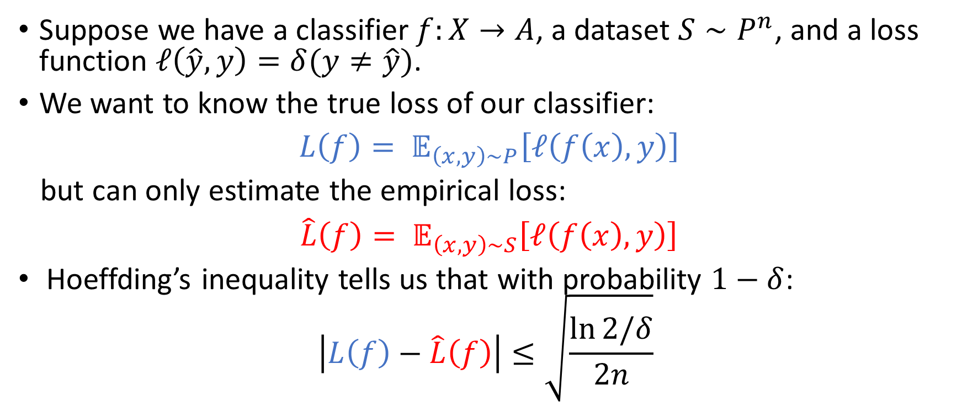
The Multiple Comparisons Problem
(and Uniform Convergence)
Suppose we have a classifier $f:X→A$, a dataset $S∼P^{n}$, and a loss function $ℓ\left(\hat{y},y\right)=δ(y≠\hat{y})$.
We want to know the true loss of our classifier:
$L\left(f\right)= 𝔼_{\left(x,y\right)∼P}\left[ℓ\left(f\left(x\right),y\right)\right]$
but can only estimate the empirical loss:
$\hat{L}\left(f\right)= 𝔼_{\left(x,y\right)∼S}\left[ℓ\left(f\left(x\right),y\right)\right]$
Hoeffding’s inequality tells us that with probability $1−δ$:
$$\left|L\left(f\right)−\hat{L}\left(f\right)\right|≤\sqrt{\frac{\ln{2/δ}}{2n}}$$

Slide 5
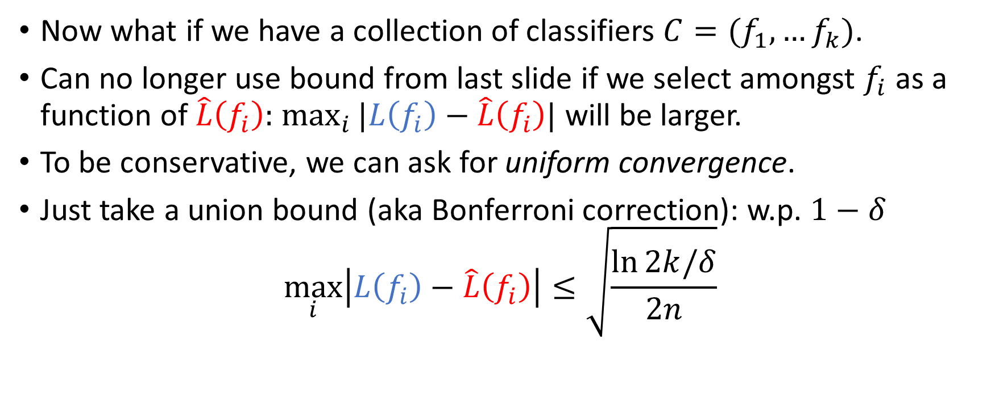
The Multiple Comparisons Problem
(and Uniform Convergence)
Now what if we have a collection of classifiers $C=(f_{1},…f_{k})$.
Can no longer use bound from last slide if we select amongst $f_{i}$ as a function of $\hat{L}\left(f_{i}\right):$ $\max_{i}{|L\left(f_{i}\right)−\hat{L}\left(f_{i}\right)|}$ will be larger.
To be conservative, we can ask for uniform convergence.
Just take a union bound (aka Bonferroni correction): w.p. $1−δ$
$$\max_{i}\left|L\left(f_{i}\right)−\hat{L}\left(f_{i}\right)\right|≤\sqrt{\frac{\ln{2k/δ}}{2n}}$$

Slide 6
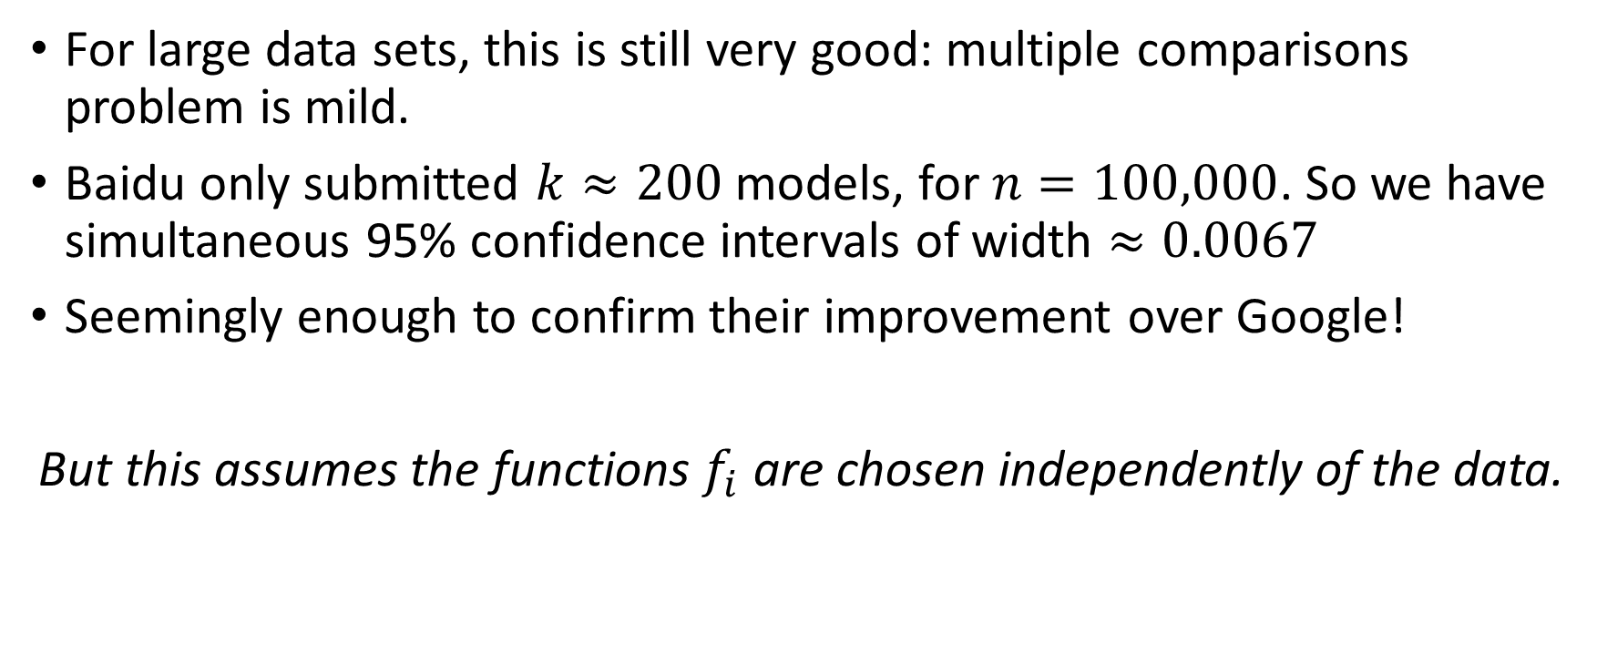
The Multiple Comparisons Problem
(and Uniform Convergence)
For large data sets, this is still very good: multiple comparisons problem is mild.
Baidu only submitted $k≈200$ models, for $n=100,000$. So we have simultaneous 95% confidence intervals of width $≈0.0067$
Seemingly enough to confirm their improvement over Google!
But this assumes the functions $f_{i}$ are chosen independently of the data.

Slide 7
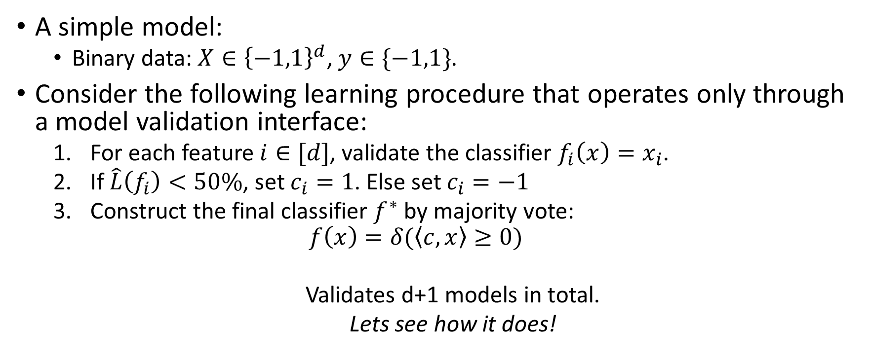
What can go wrong
A simple model:
  Binary data: $X∈{\left\{−1,1\right\}}^{d}$, $y∈\{−1,1\}$.
Consider the following learning procedure that operates only through a model validation interface:
  For each feature $i∈[d]$, validate the classifier $f_{i}\left(x\right)=x_{i}$.
  If $\hat{L}\left(f_{i}\right)<50\%$, set $c_{i}=1$. Else set $c_{i}=−1$
  Construct the final classifier $f^{∗}$ by majority vote:
  $$f\left(x\right)=δ(\left\langle c, x\right\rangle ≥0)$$
  Validates d+1 models in total.
  Lets see how it does!

Slide 8
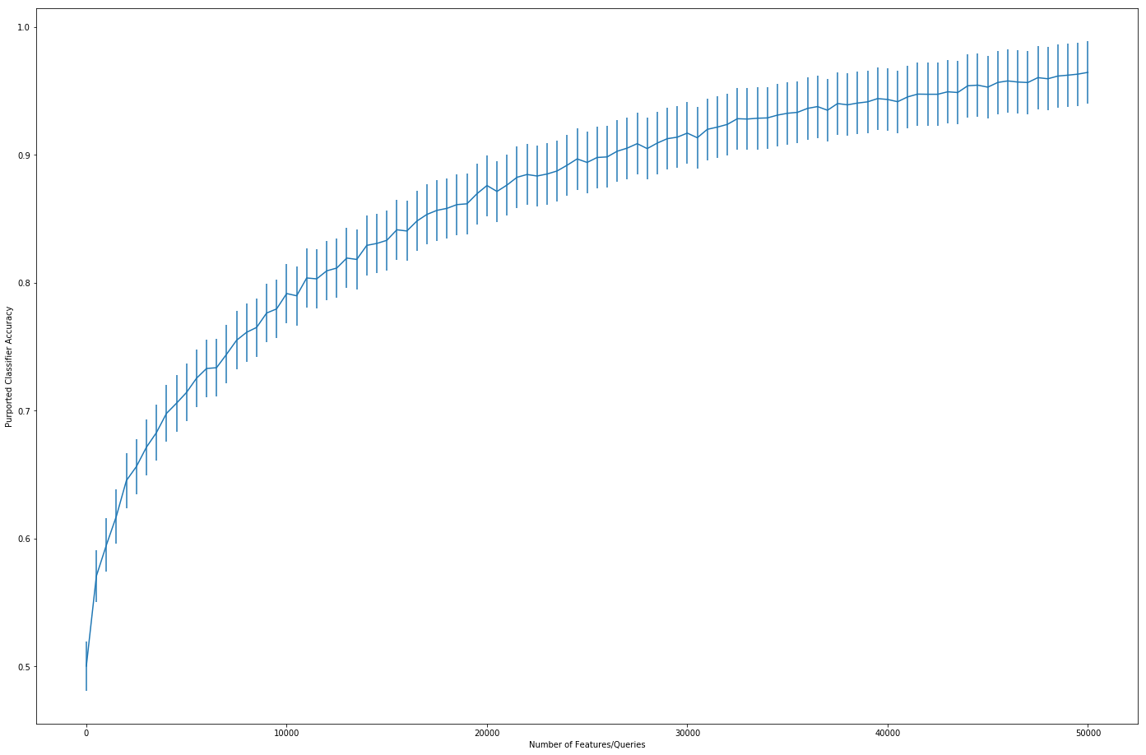

What can go wrong
$$n=10,000 d∈[1,…,50,000]$$
Plot: Accuracy + Bonferroni Corrected Confidence Intervals vs. $d$

Slide 9

What can go wrong
The data: $X, y$ uniformly distributed and uncorrelated.
  All classifiers have error = $50\%$.
  Bonferroni correction disastrously failed.

Slide 10





























The Garden of the Forking Paths [GL14]
We can map out what our algorithm would have done in every eventuality:
$$q_{1}$$
$$q_{2}$$
$$q_{2}$$
$$…$$
$$q_{3}$$
$$q_{3}$$
$$d$$
$$…$$
$$…$$
$$…$$
$$q_{4}$$
$$q_{4}$$
$$q_{4}$$
$$q_{4}$$
$$…$$
$$…$$
$$…$$
$$q_{5}$$
$$q_{5}$$
$$…$$
$$…$$
$$…$$
$$q_{d}$$
$$q_{d}$$
$$q_{d}$$
$$q_{d}$$
$$q_{d}$$
$$q_{d}$$
$$2^{d}$$

Slide 11






The Garden of the Forking Paths [GL14]
We can map out what our algorithm would have done in every eventuality:
$$q_{1}$$
$$q_{2}$$
$$q_{2}$$
$$…$$
$$q_{3}$$
$$q_{3}$$
$$d$$
$$…$$
$$…$$
$$…$$
$$q_{4}$$
$$q_{4}$$
$$q_{4}$$
$$q_{4}$$
$$…$$
$$…$$
$$…$$
$$q_{5}$$
$$q_{5}$$
$$…$$
$$…$$
$$…$$
$$q_{d}$$
$$q_{d}$$
$$q_{d}$$
$$q_{d}$$
$$q_{d}$$
$$q_{d}$$
$$2^{d}$$

Slide 12
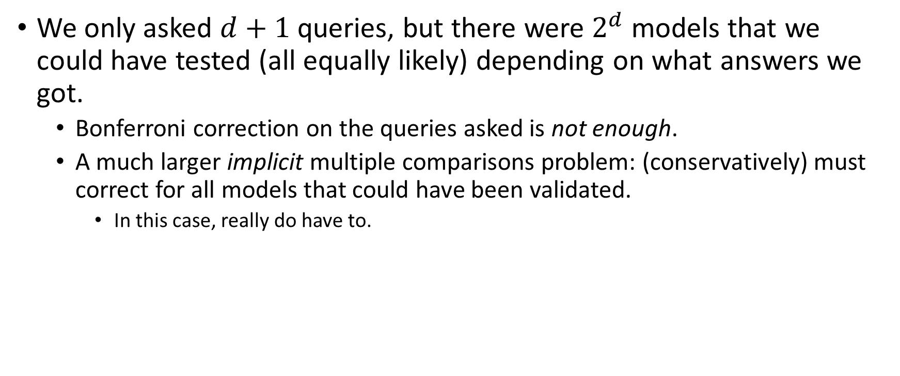
The Garden of the Forking Paths [GL14]
We only asked $d+1$ queries, but there were $2^{d}$ models that we could have tested (all equally likely) depending on what answers we got.
  Bonferroni correction on the queries asked is not enough.
  A much larger implicit multiple comparisons problem: (conservatively) must correct for all models that could have been validated.
    In this case, really do have to.

Slide 13
The Garden of the Forking Paths [GL14]
Issues:
  These corrections are giant: adaptivity leads to exponential blowup in multiple comparisons problem.
  Generally, we won’t have a map of the garden.
    e.g. whenever human decision making is involved, or algorithms are complicated.
Solution: Pre-registration?
  Gates off the garden. Forces analysis to walk a straight line.
  Safe but overly conservative. Incompatible with data re-use.
  How can we make it safe to wander the garden?

Slide 14

A Formalization of the Problem: Statistical Queries
A data universe $X$ (e.g. $X={\left\{0,1\right\}}^{d}$)
A distribution $P∈ΔX$
A dataset $S∼P^{n}$ consisting of $n$ points $x∈X$ sampled i.i.d. from $P$.

Slide 15
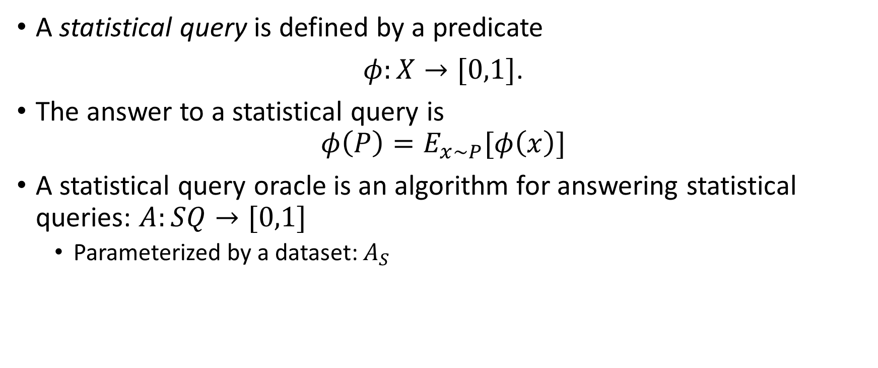
A Formalization of the Problem: Statistical Queries
A statistical query is defined by a predicate
$φ:X→[0,1]$.
The answer to a statistical query is
$$φ\left(P\right)=E_{x∼P}[φ\left(x\right)]$$
A statistical query oracle is an algorithm for answering statistical queries: $A:SQ→[0,1]$
  Parameterized by a dataset: $A_{S}$

Slide 16








A Formalization of the Problem: Statistical Queries
$$P$$
Adaptively Chosen Queries:
$$φ_{1}$$
$$A$$
$$D$$
$$a_{1}$$

Slide 17


A Formalization of the Problem: Statistical Queries
$$P$$
Adaptively Chosen Queries:
$$φ_{2}$$
$$A$$
$$D$$
$$a_{2}$$

Slide 18



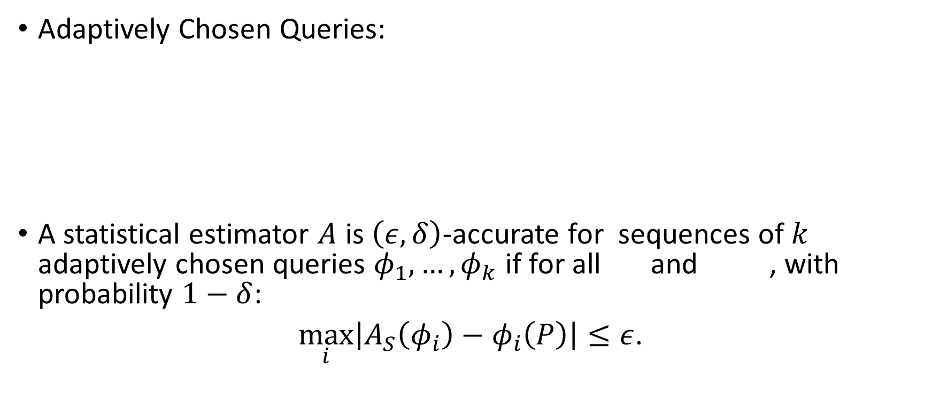


A Formalization of the Problem: Statistical Queries
$$P$$
Adaptively Chosen Queries:
A statistical estimator $A$ is $\left(ε,δ\right)$-accurate for sequences of $k$ adaptively chosen queries $φ_{1},…,φ_{k}$ if for all and , with probability $1−δ$:
$\max_{i}\left|A_{S}\left(φ_{i}\right)−φ_{i}\left(P\right)\right|≤ε$.
$$φ_{i}$$
$$A$$
$$φ_{k}$$
$$D$$
$$a_{k}$$
$$a_{i}$$
$$P$$

Slide 19
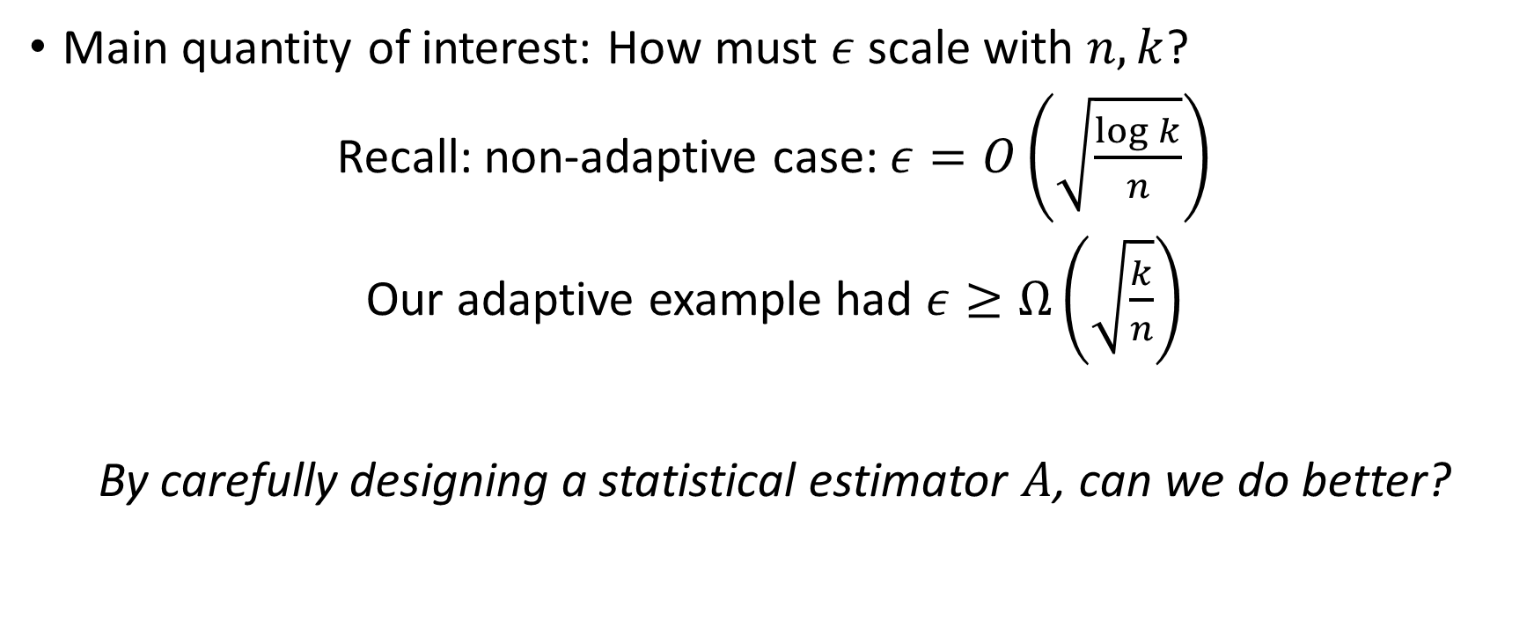
A Formalization of the Problem: Statistical Queries
Main quantity of interest: How must $ε$ scale with $n, k$?
Recall: non-adaptive case: $ε=O\left(\sqrt{\frac{\log{k}}{n}}\right)$
Our adaptive example had $ε≥Ω\left(\sqrt{\frac{k}{n}}\right)$
By carefully designing a statistical estimator $A$, can we do better?

Slide 20
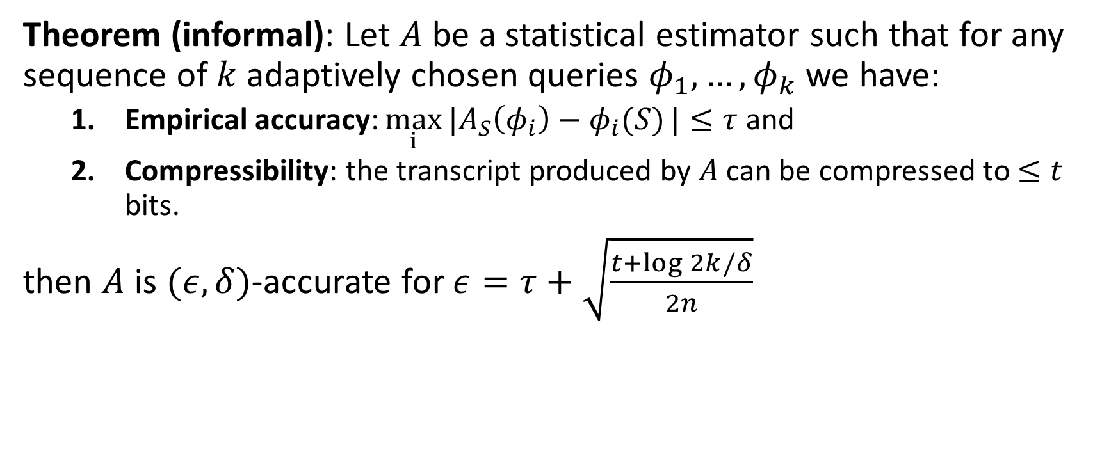
Warmup: An Easy Theorem (If Pigs Could Fly)
Theorem (informal): Let $A$ be a statistical estimator such that for any sequence of $k$ adaptively chosen queries $φ_{1},…, φ_{k}$ we have:
  Empirical accuracy: $\max_{i}{|A_{S}\left(φ_{i}\right)−φ_{i}(S)}|≤τ$ and
  Compressibility: the transcript produced by $A$ can be compressed to $≤t$ bits.
then $A$ is $(ε,δ)$-accurate for $ε=τ+\sqrt{\frac{t+\log{2k/δ}}{2n}}$

Slide 21
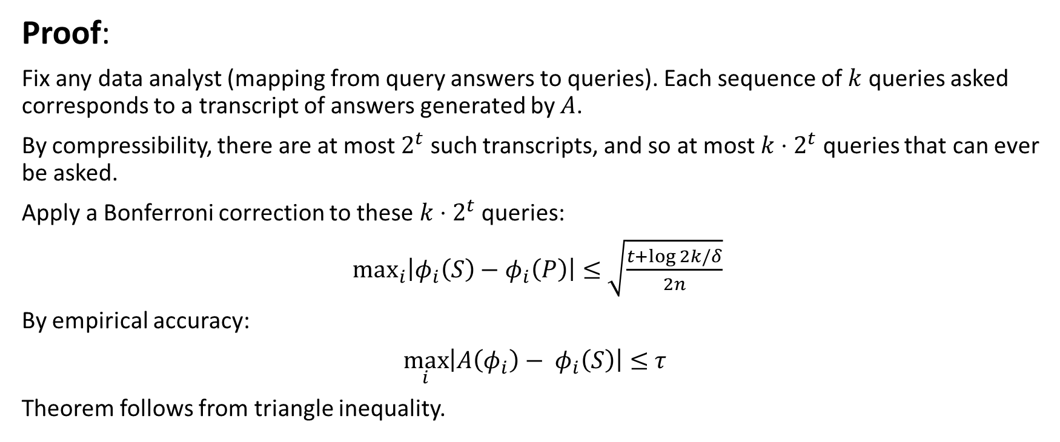
Warmup: An Easy Theorem (If Pigs Could Fly)
Proof:
Fix any data analyst (mapping from query answers to queries). Each sequence of $k$ queries asked corresponds to a transcript of answers generated by $A$.
By compressibility, there are at most $2^{t}$ such transcripts, and so at most $k⋅2^{t}$ queries that can ever be asked.
Apply a Bonferroni correction to these $k⋅2^{t}$ queries:
$\max_{i}\left|φ_{i}\left(S\right)−φ_{i}\left(P\right)\right|≤$ $\sqrt{\frac{t+\log{2k/δ}}{2n}}$
By empirical accuracy:
$\max_{i}\left|{A\left(φ_{i}\right)− φ}_{i}\left(S\right)\right|≤$ $τ$
Theorem follows from triangle inequality.

Slide 22
Strengths of this style of theorem
Don’t need a map of the garden: can apply Bonferroni correction to a small set of queries even if we don’t know what they are.
  So don’t need to understand data analyst – can be a human being e.g.
Don’t need to constrain data analyst at all (e.g. as in pre-registration) except that they should access data only via our interface.
Are there non-trivial estimators that satisfy the conditions of our theorem?

Slide 23
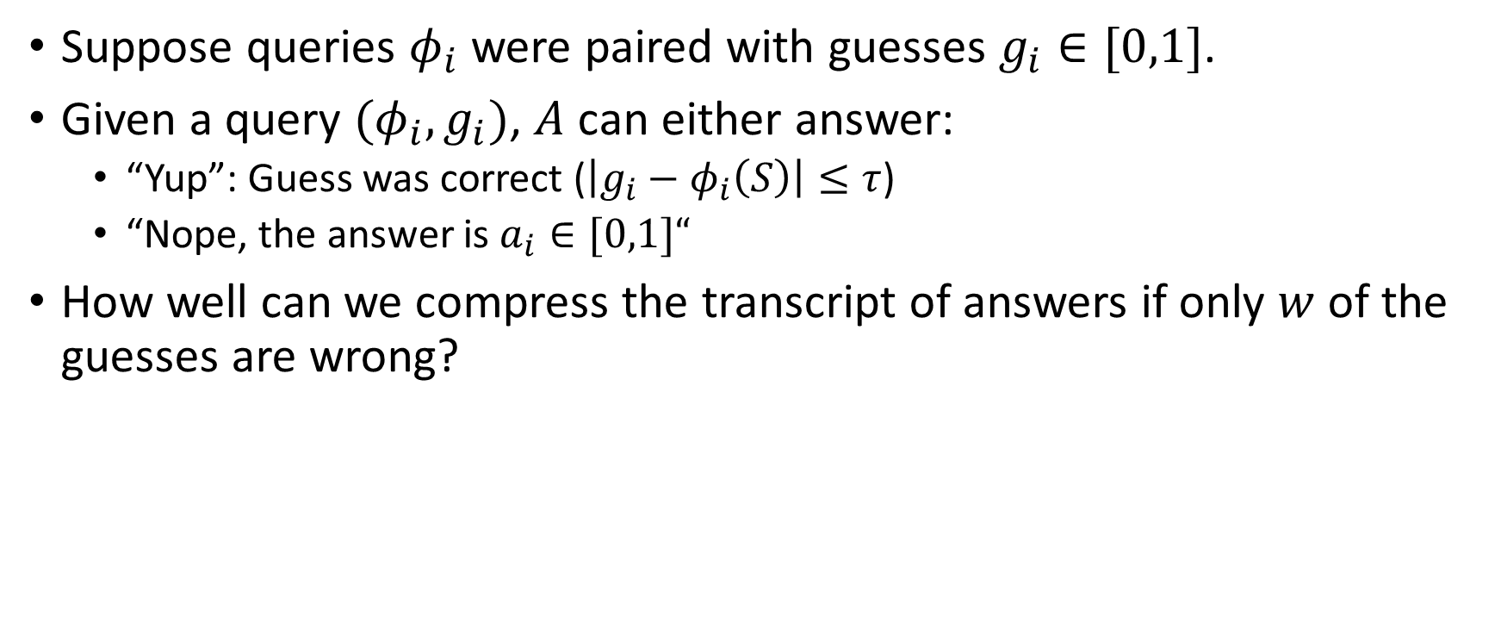
Towards Compressible Estimators
Suppose queries $φ_{i}$ were paired with guesses $g_{i}∈[0,1]$.
Given a query $(φ_{i}, g_{i})$, $A$ can either answer:
  “Yup”: Guess was correct ($\left|g_{i}−φ_{i}\left(S\right)\right|≤τ$)
  “Nope, the answer is $a_{i}∈[0,1]“$
How well can we compress the transcript of answers if only $w$ of the guesses are wrong?

Slide 24
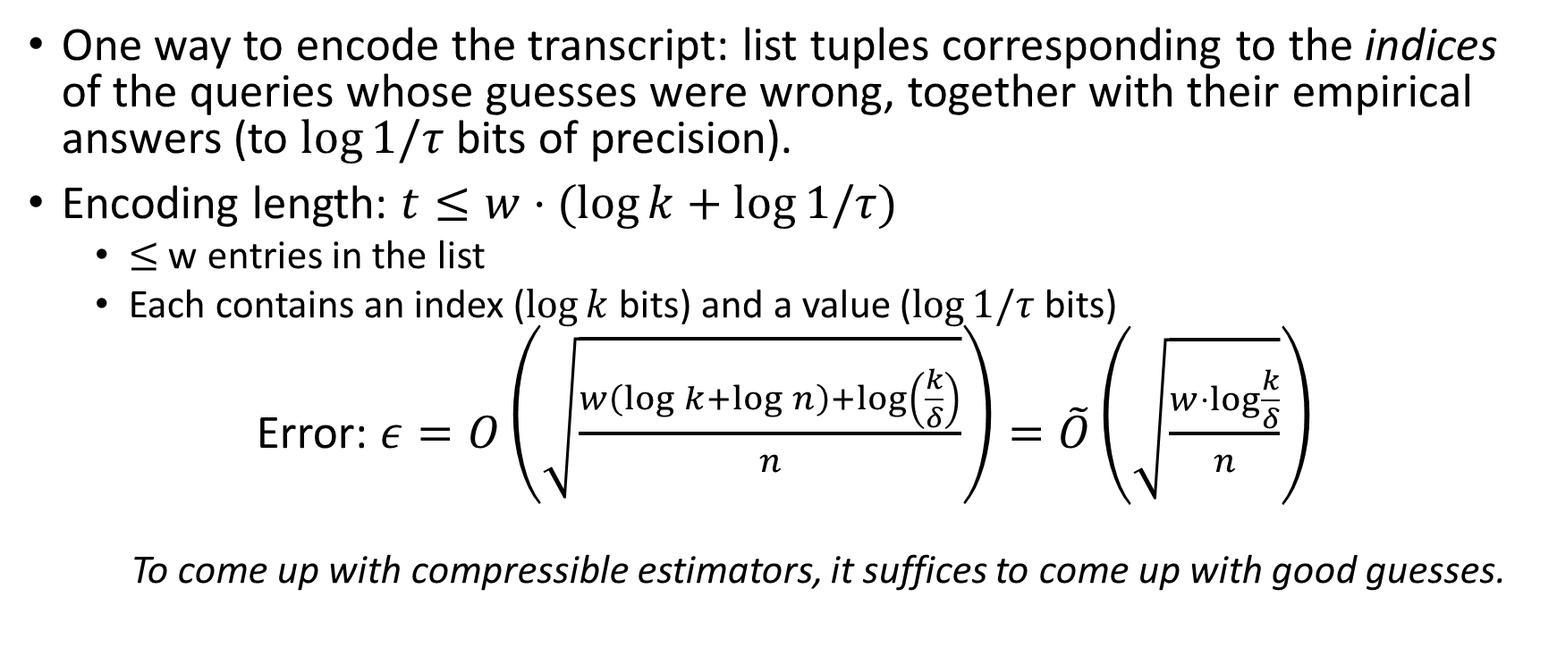
Towards Compressible Estimators
One way to encode the transcript: list tuples corresponding to the indices of the queries whose guesses were wrong, together with their empirical answers (to $\log{1/τ}$ bits of precision).
Encoding length: $t≤w⋅(\log{k}+\log{1/τ})$
  $≤$ w entries in the list
  Each contains an index ($\log{k}$ bits) and a value ($\log{1/τ}$ bits)
Error: $ε=O\left(\sqrt{\frac{w\left(\log{k}+\log{n}\right)+\log\left(\frac{k}{δ}\right)}{n}}\right)=\tilde{O}\left(\sqrt{\frac{w⋅\log{\frac{k}{δ}}}{n}}\right)$
  To come up with compressible estimators, it suffices to come up with good guesses.

Slide 25
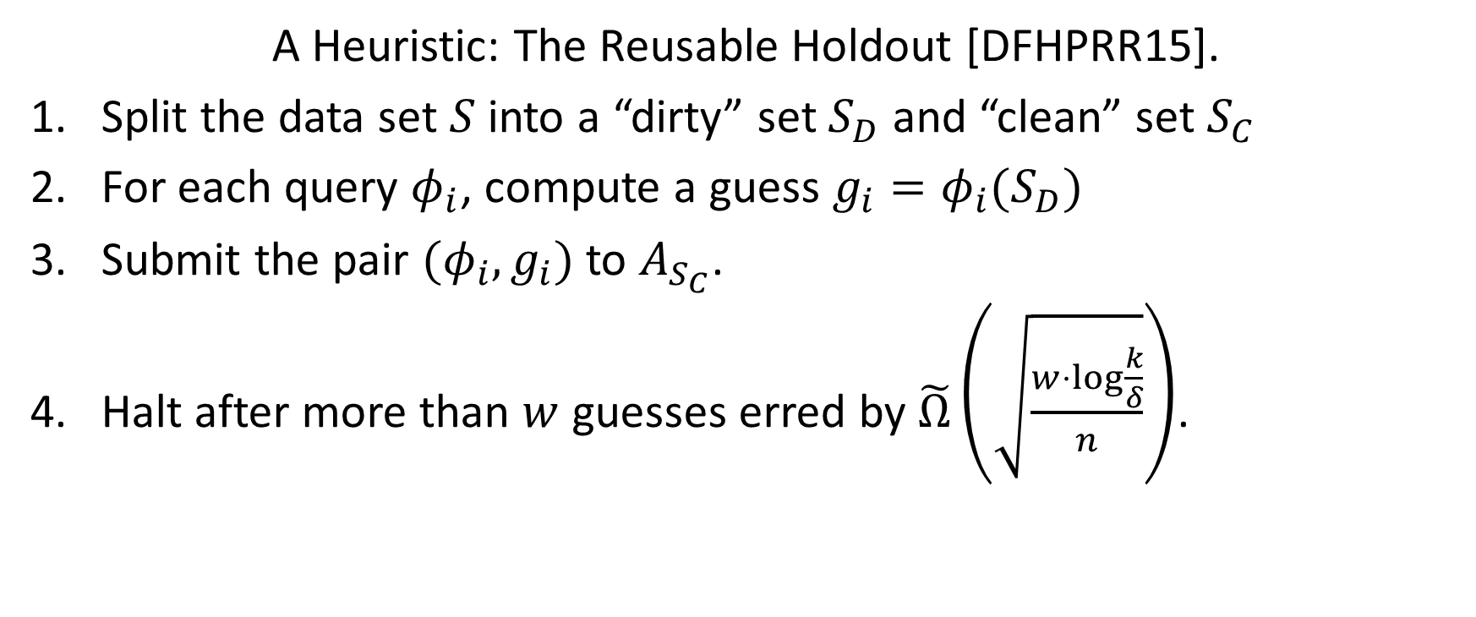
Coming up with good guesses
A Heuristic: The Reusable Holdout [DFHPRR15].
Split the data set $S$ into a “dirty” set $S_{D}$ and “clean” set $S_{C}$
For each query $φ_{i}$, compute a guess $g_{i}=φ_{i}(S_{D})$
Submit the pair $(φ_{i},g_{i})$ to $A_{S_{C}}$.
Halt after more than $w$ guesses erred by $\tilde{Ω}\left(\sqrt{\frac{w⋅\log{\frac{k}{δ}}}{n}}\right)$.

Slide 26
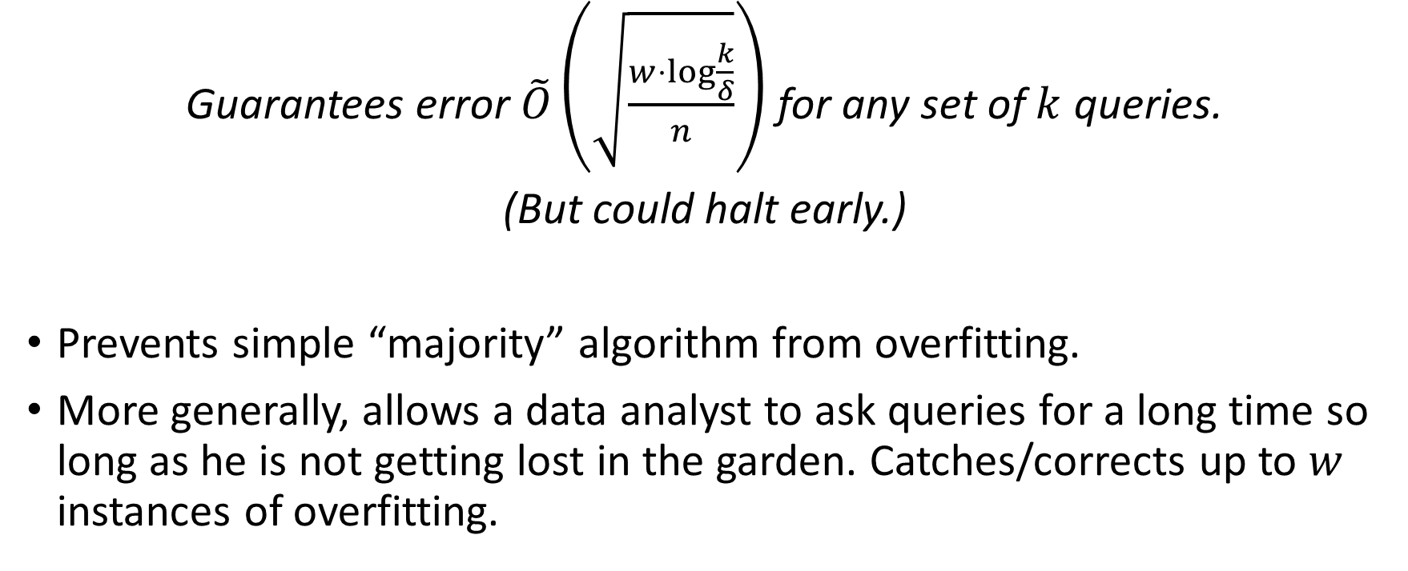
Coming up with good guesses
Guarantees error $\tilde{O}\left(\sqrt{\frac{w⋅\log{\frac{k}{δ}}}{n}}\right)$ for any set of $k$ queries.
(But could halt early.)
Prevents simple “majority” algorithm from overfitting.
More generally, allows a data analyst to ask queries for a long time so long as he is not getting lost in the garden. Catches/corrects up to $w$ instances of overfitting.

Slide 27
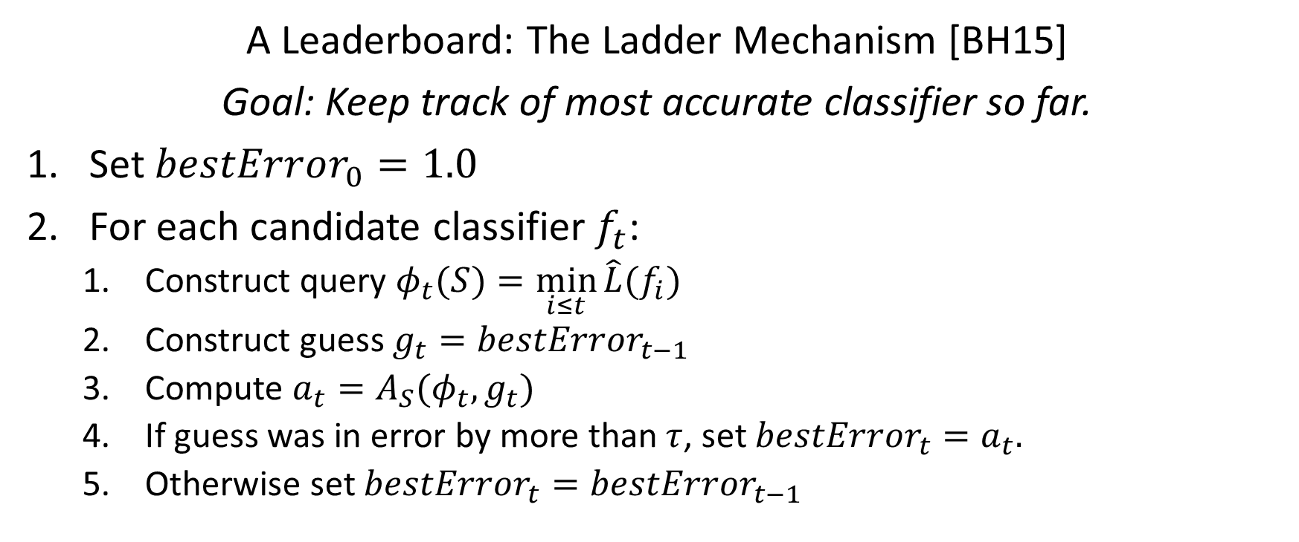
Coming up with good guesses
A Leaderboard: The Ladder Mechanism [BH15]
Goal: Keep track of most accurate classifier so far.
Set $bestError_{0}=1.0$
For each candidate classifier $f_{t}$:
  Construct query $φ_{t}(S)=\min_{i≤t}{\hat{L}(f_{i})}$
  Construct guess $g_{t}=bestError_{t−1}$
  Compute $a_{t}=A_{S}(φ_{t},g_{t})$
  If guess was in error by more than $τ$, set $bestError_{t}=a_{t}.$
  Otherwise set $bestError_{t}=bestError_{t−1}$

Slide 28
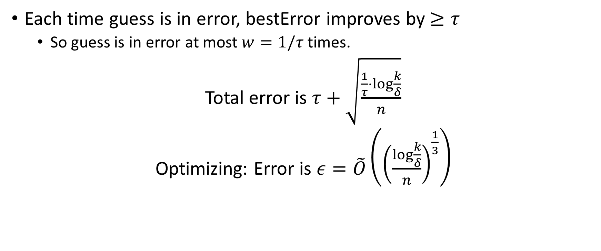
Coming up with good guesses
Each time guess is in error, bestError improves by $≥τ$
  So guess is in error at most $w=1/τ$ times.
Total error is $τ+\sqrt{\frac{\frac{1}{τ}⋅\log{\frac{k}{δ}}}{n}}$
Optimizing: Error is $ε=\tilde{O}\left({\left(\frac{\log{\frac{k}{δ}}}{n}\right)}^{\frac{1}{3}}\right)$

Slide 29
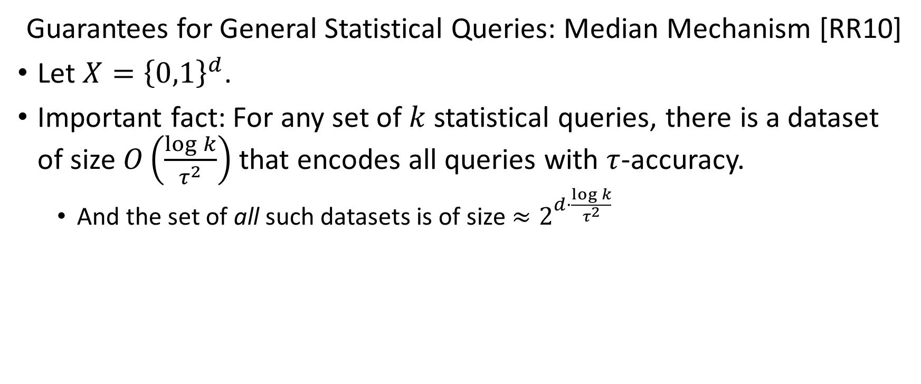
Coming up with good guesses
Guarantees for General Statistical Queries: Median Mechanism [RR10]
Let $X={\left\{0,1\right\}}^{d}$.
Important fact: For any set of $k$ statistical queries, there is a dataset of size $O\left(\frac{\log{k}}{τ^{2}}\right)$ that encodes all queries with $τ$-accuracy.
  And the set of all such datasets is of size $≈2^{d⋅\frac{\log{k}}{τ^{2}}}$

Slide 30
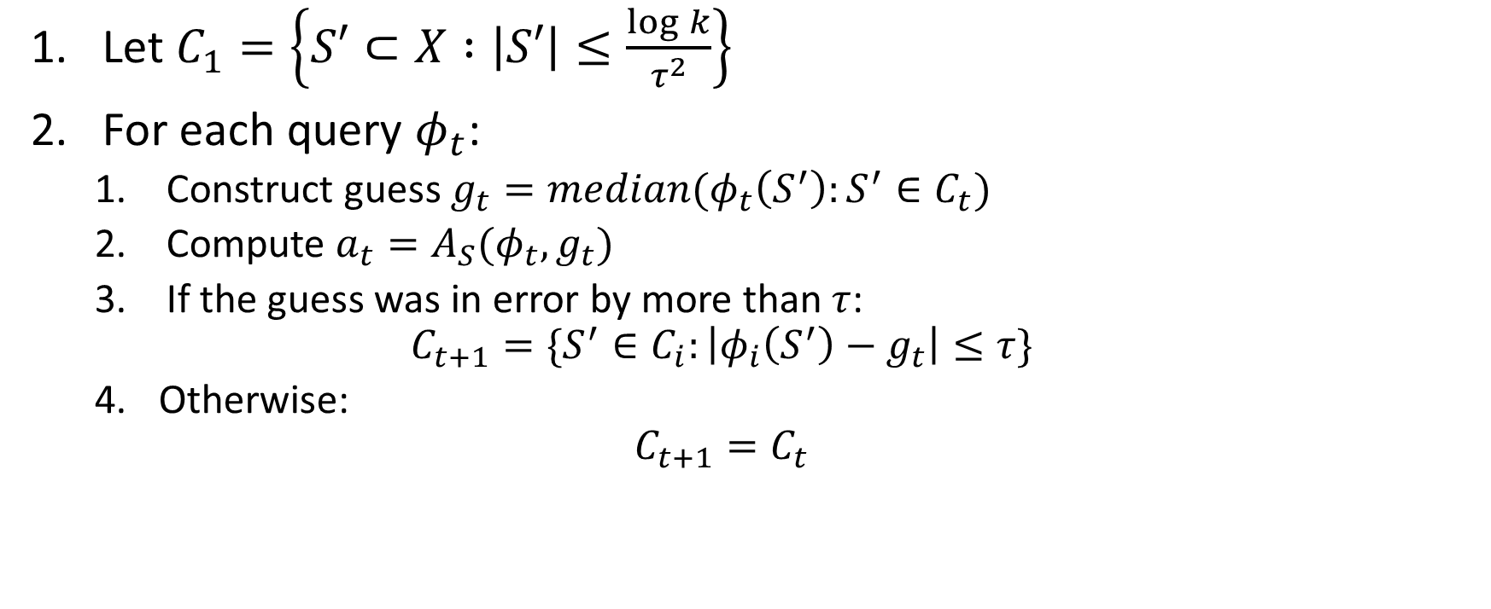
Coming up with good guesses
Let $C_{1}=\left\{S′⊂X :\left|S′\right|≤\frac{\log{k}}{τ^{2}}\right\}$
For each query $φ_{t}$:
  Construct guess $g_{t}=median(φ_{t}\left(S^{′}\right):S^{′}∈C_{t})$
  Compute $a_{t}=A_{S}(φ_{t},g_{t})$
  If the guess was in error by more than $τ$:
  $$C_{t+1}=\{S^{′}∈C_{i}:\left|φ_{i}\left(S^{′}\right)−g_{t}\right|≤τ\}$$
  Otherwise:
  $$C_{t+1}=C_{t}$$

Slide 31
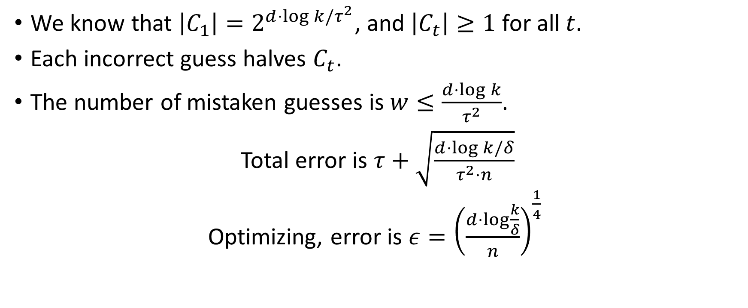
Coming up with good guesses
We know that $\left|C_{1}\right|=2^{d⋅\log{k}/τ^{2}}$, and $\left|C_{t}\right|≥1$ for all $t$.
Each incorrect guess halves $C_{t}$.
The number of mistaken guesses is $w≤\frac{d⋅\log{k}}{τ^{2}}$.
Total error is $τ+\sqrt{\frac{d⋅\log{k/δ}}{τ^{2}⋅n}}$
Optimizing, error is $ε={\left(\frac{d⋅\log{\frac{k}{δ}}}{n}\right)}^{\frac{1}{4}}$

Slide 32
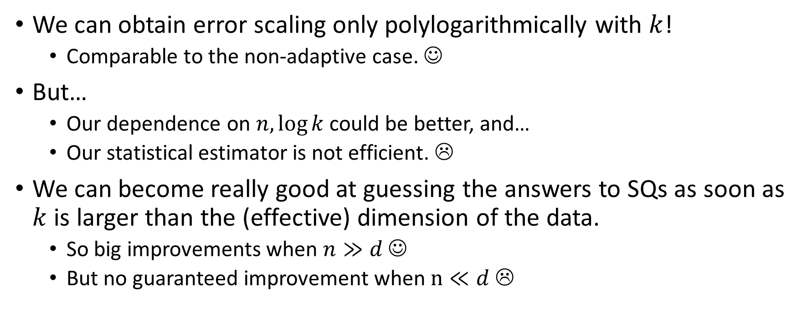
Takeaway
We can obtain error scaling only polylogarithmically with $k$!
  Comparable to the non-adaptive case. ☺
But…
  Our dependence on $n,\log{k}$ could be better, and…
  Our statistical estimator is not efficient. ☹
We can become really good at guessing the answers to SQs as soon as $k$ is larger than the (effective) dimension of the data.
  So big improvements when $n≫d$ ☺
  But no guaranteed improvement when $n≪d$ ☹

Slide 33
Takeaway
We don’t yet fully understand how to mitigate all of these caveats.
But we can get part way there.
Need to move beyond description length.
  Some information theoretic measure?
  Needs to be robust to “post-processing” and should compose well.

Slide 34
Differential Privacy [Dwork, McSherry, Nissim, Smith]
D
Bob
Xavier
Alice
Chris
Donna
Ernie
Algorithm
Pr [r]

Slide 35
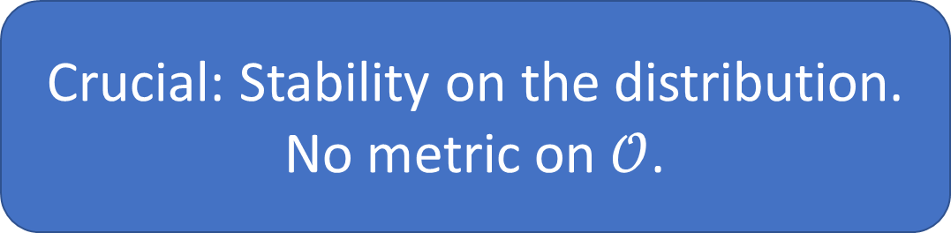

A stability condition on the output distribution:
$A:X^{n}→𝒪$ is $(α,β)$-differentially private if for every pair of neighboring datasets $S,S′$, and outcome $E$:
$$\operatorname{Pr}\left[A\left(S\right)∈E\right]≤e^{α}\operatorname{Pr}\left[A\left(S^{′}\right)∈E\right]+β$$
Crucial: Stability on the distribution.
No metric on $𝒪$.

Slide 36
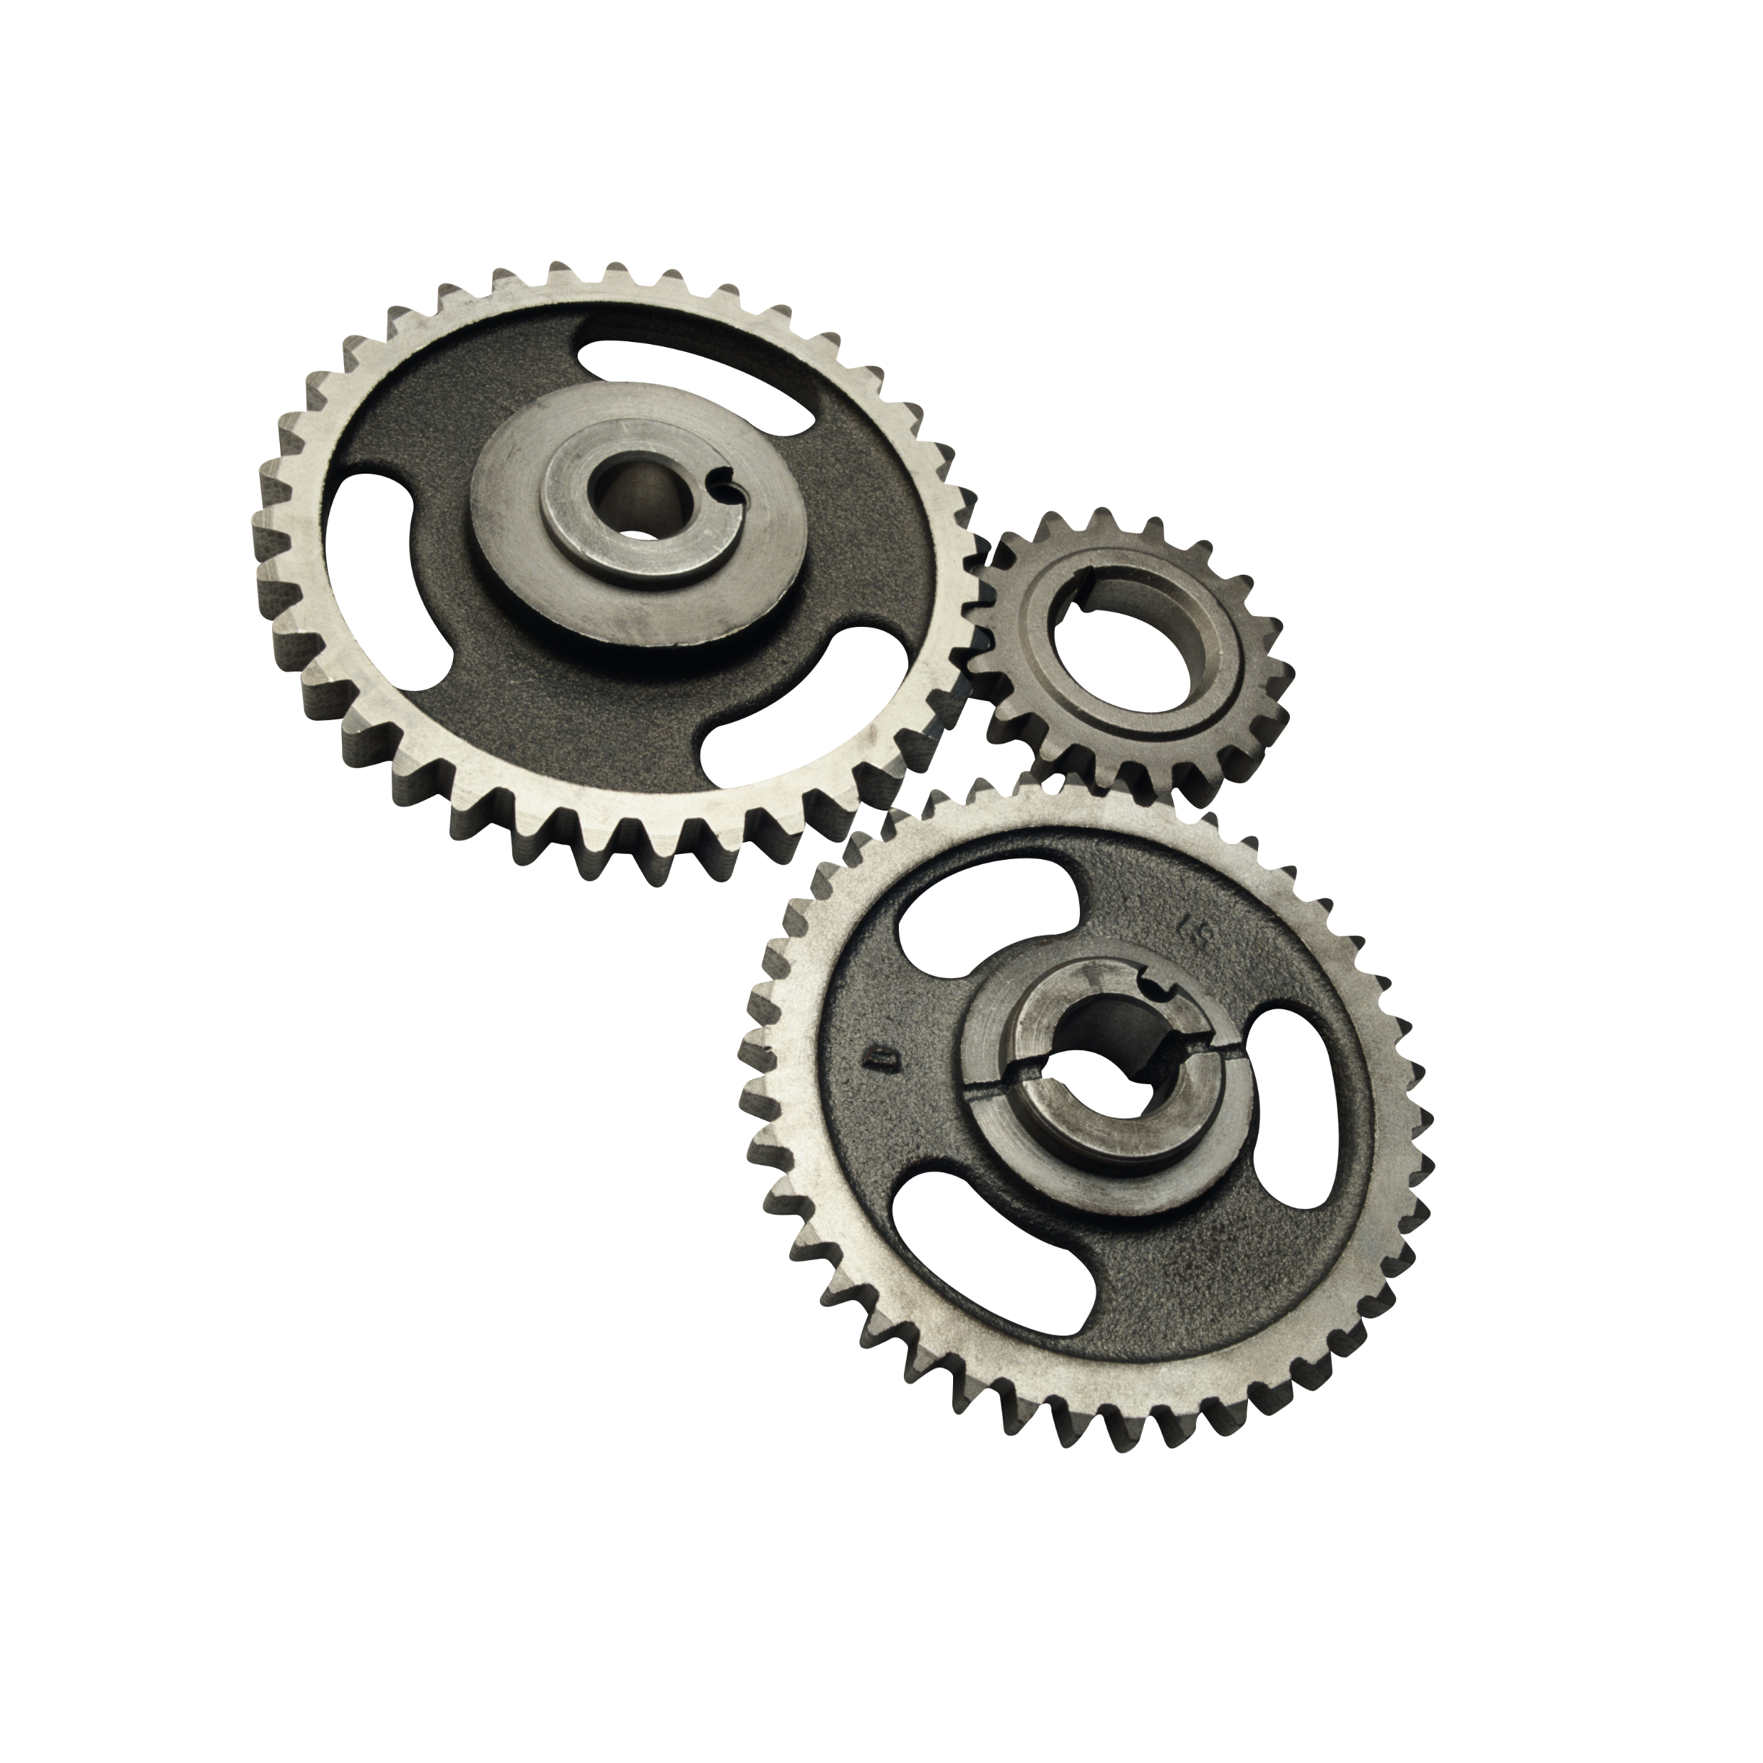
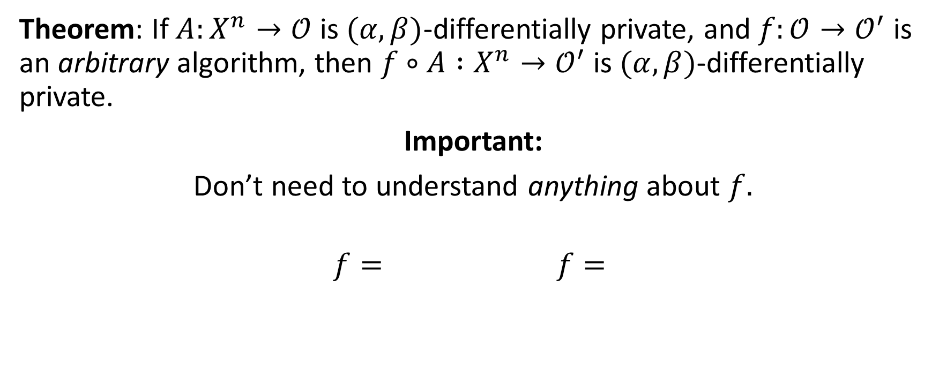
Distributional Stability Yields Robustness to Postprocessing
Theorem: If $A:X^{n}→𝒪$ is $(α,β)$-differentially private, and $f:𝒪→𝒪^{′}$ is an arbitrary algorithm, then $f∘A :X^{n}→𝒪^{′}$ is $(α,β)$-differentially private.
Important:
Don’t need to understand anything about $f.$
$$f= f=$$

Slide 37
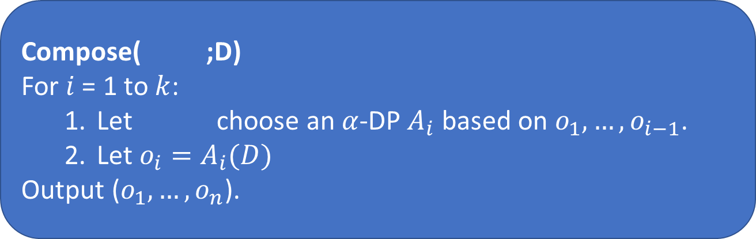

Distributional Stability Degrades Gracefully Under Composition
Compose( ;D)
For $i$ = 1 to $k$:
  Let choose an $α$-DP $A_{i}$ based on $o_{1},…,o_{i−1}$.
  Let $o_{i}=A_{i}(D)$
Output ($o_{1},…,o_{n}$).
Theorem* [DRV]: For every , and $β^{′}$, Compose( ;D) is $\left(α^{′},β^{′}\right)$-differentially private for:
$α^{′}$=$O\left(α⋅\sqrt{k⋅\ln\left(\frac{1}{β^{′}}\right)}\right)$

Slide 38
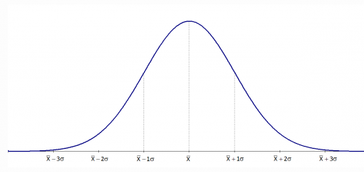
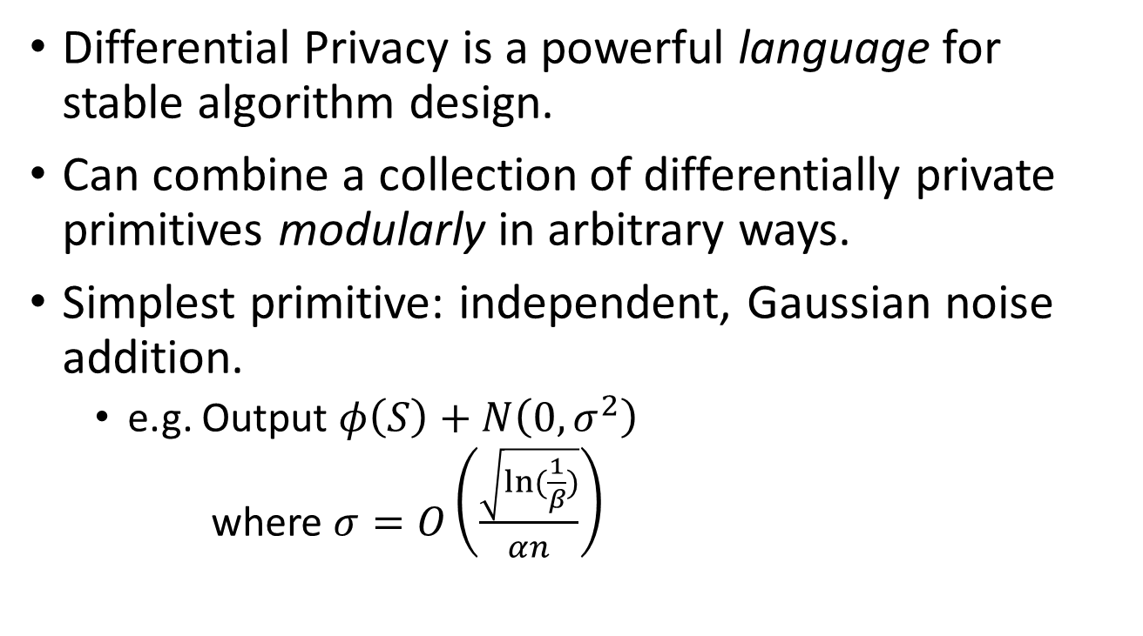
Composition and Post-processing:
Modular Algorithm Design
Differential Privacy is a powerful language for stable algorithm design.
Can combine a collection of differentially private primitives modularly in arbitrary ways.
Simplest primitive: independent, Gaussian noise addition.
  e.g. Output $φ\left(S\right)+N\left(0,σ^{2}\right)$
  where $σ=O\left(\frac{\sqrt{ln⁡(\frac{1}{β})}}{αn}\right)$

Slide 39
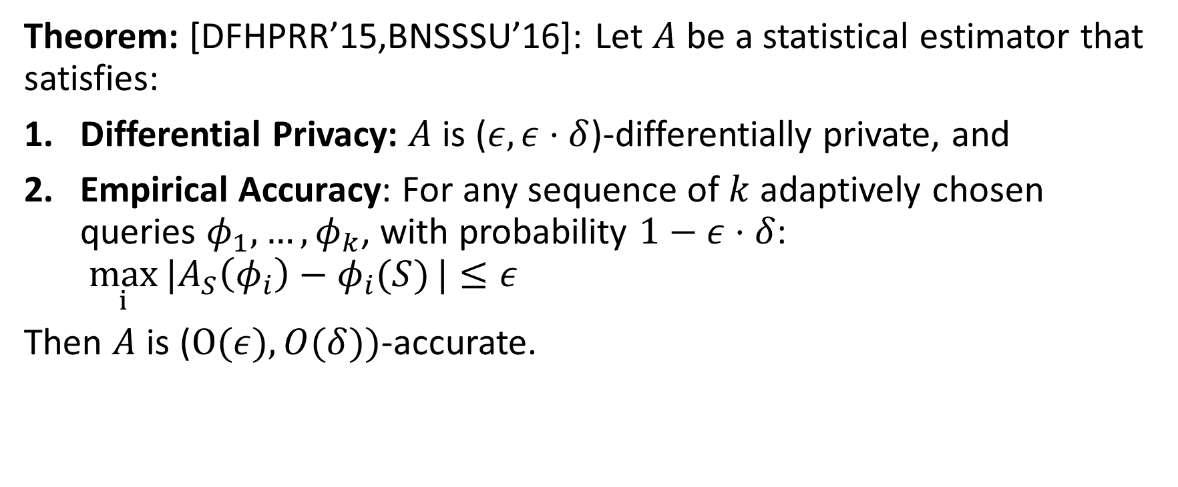
Another Transfer Theorem
Theorem: [DFHPRR’15,BNSSSU’16]: Let $A$ be a statistical estimator that satisfies:
Differential Privacy: $A$ is ($ε,ε⋅δ$)-differentially private, and
Empirical Accuracy: For any sequence of $k$ adaptively chosen queries $φ_{1},…, φ_{k}$, with probability $1−ε⋅δ$: $\max_{i}{|A_{S}\left(φ_{i}\right)−φ_{i}(S)}|≤ε$
Then $A$ is ($O(ε), O(δ))$-accurate.

Slide 40
References
[RR10] “Interactive privacy via the median mechanism.” Roth, Roughgarden. STOC 2010.
[GL14] “The Statistical Crisis in Science.” Gelman, Loken. American Scientist, 2014.
[DFHPRR15] Dwork, Feldman, Hardt, Pitassi, Reingold, Roth. 2015.
  “Preserving statistical validity in adaptive data analysis” STOC
  “Generalization in adaptive data analysis and holdout reuse” NIPS
  “The reusable holdout: Preserving validity in adaptive data analysis” Science
[BH15] “The ladder: A reliable leaderboard for machine learning competitions.” Blum, Hardt. ICML 2015.
[BNSSSU16] “Algorithmic stability for adaptive data analysis.” Bassily, Nissim, Smith, Steinke, Stemmer, Ullman. STOC 2016.
See http://www.adaptivedataanalysis.com for lecture notes.

