Slide 1



Temporal Information Extraction and
Shallow Temporal Reasoning
Dan Roth*, Heng Ji†, Taylor Cassidy†, Quang Do*
*Computer Science Department
University of Illinois at Urbana-Champaign
†Computer Science Department and Linguistics Department,
Queens College and the Graduate Center
City University of New York
December 8, 2012
1
Notes:
1

Slide 2

2
Notes:
2
by clustering sentences into topics and ordering sentences on a time line. However, many sentences in news articles include multiple events with different time arguments. And it was not clear how the errors of topic clustering techniques affected the inference scheme. Therefore it will be valuable to design inference methods for more fine-grained events.

Slide 3
Slides are available at
http://nlp.cs.qc.cuny.edu/tietutorial.pptx
3
3
Notes:
3

Slide 4
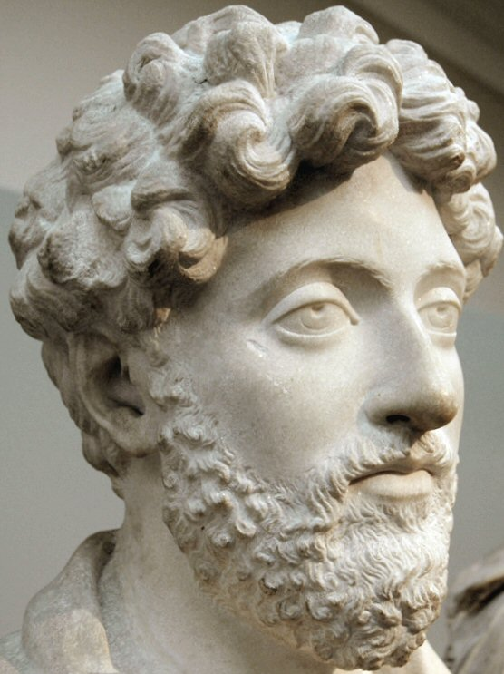
“Time is a sort of river of passing events, and strong is its current; no sooner is a thing brought to sight than it is swept by and another takes its place, and this too will be swept away.”
- Marcus Aurelius
4
Notes:
Check five percent improvement in spouse
We need significance testing for the result pairs
Backup slide with number of instances for each type
4

Slide 5

Outline
Background: Motivations and Goals
Temporal Information Representation Theories
Temporal Expression Extraction and Normalization
Temporal Slot Filling
Tea Break
Event Timelining and Temporal Reasoning
Resources and Demos
Conclusions
9:30
9:35
10:10
10:30
11:30
12:00
12:55
1:00
5
Notes:
5

Slide 6

Background
6

Slide 7
Why Extracting Temporal Information?
Many relations and events are temporally bounded
  a person's place of residence or employer
  an organization's members
  the duration of a war between two countries
  the precise time at which a plane landed
  …
Temporal Information Distribution
  One of every fifty lines of database application code involves a date or time value (Snodgrass,1998)
  Each news document in PropBank (Kingsbury and Palmer, 2002) includes eight temporal arguments
7
Notes:
by clustering sentences into topics and ordering sentences on a time line. However, many sentences in news articles include multiple events with different time arguments. And it was not clear how the errors of topic clustering techniques affected the inference scheme. Therefore it will be valuable to design inference methods for more fine-grained events.

Slide 8
Why Extracting Temporal Information?
Important to many NLP applications
  Textual inference (Baral et al., 2005)
  Multi-document text summarization (Barzilay e al., 2002),
  Temporal event tracking (e.g. Chambers et al., 2009; Ji and Chen, 2009)
  Temporal grounding for semantic relations (Do et al., 2012)
  Template based question answering (Ahn et al., 2006, Schockaert et al., 2006)
  Knowledge Base Population (Ji et al., 2011)
8
Notes:
by clustering sentences into topics and ordering sentences on a time line. However, many sentences in news articles include multiple events with different time arguments. And it was not clear how the errors of topic clustering techniques affected the inference scheme. Therefore it will be valuable to design inference methods for more fine-grained events.

Slide 9
Outline
Background: Motivations and Goals
Temporal Information Representation Theories
Temporal Expression Extraction and Normalization
Temporal Slot Filling
Tea Break
Event Timelining and Temporal Reasoning
Resources and Demos
Conclusions
9:35
9
Notes:
9

Slide 10
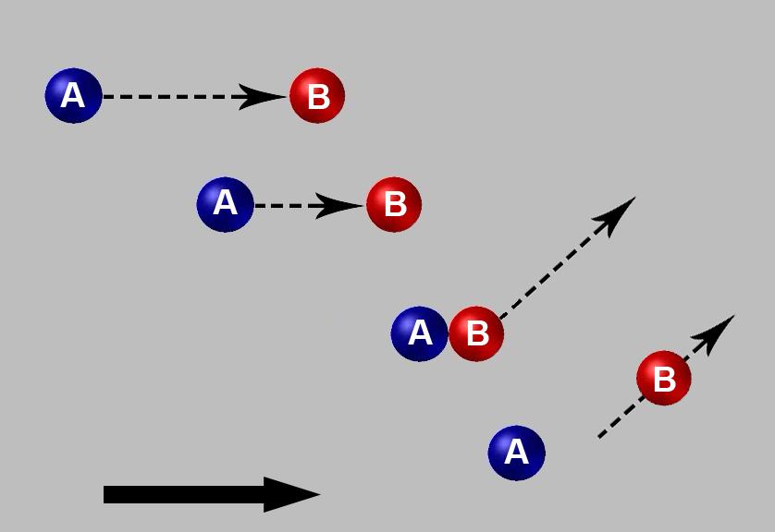
Temporal Information Representation Theories
10
10
Notes:
10

Slide 11
Temporal Information Representation Theories
General Goal
Semantics of Events
Grounding Eventualities in Time
Temporal Representation Formalisms
  Allen Relation (Allen, 1983)
  TimeML (Pustejovsky et al., 2003)
  Temporal Closure (Verhagen, 2005)
  Fuzzy Intervals (Schockaert et al., 2008)
  4-Tuple Temporal Representation (Ji et al., 2011)
  Timeline Representation (Do et al., 2012)
11
11
Notes:
11
by clustering sentences into topics and ordering sentences on a time line. However, many sentences in news articles include multiple events with different time arguments. And it was not clear how the errors of topic clustering techniques affected the inference scheme. Therefore it will be valuable to design inference methods for more fine-grained events.

Slide 12
Temporal information
Concept of time
  Communicate and reason about change and action
Temporal Representation Scheme
  Determines the order of and distance between events and states, i.e., eventualities*
  Admits of varying granularities and levels of certainty
  Consists of scalar quantities and relations that hold between them
Provides a target to which a system maps linguistic objects
  Cognitive/Human or Computational/NLP
12
* We often use event to refer to events and states from here on
12
Notes:
12
We express facts, opinions, and desires in natural language by applying predicates to entities in order to indicate which relationships hold between them.
Their semantic content includes information about change… Events occur, and states obtain, and both are encoded in time.
Whether conceptualized as simply a mode to express relations between eventualities, or as a set of scalar quantities independent thereof,
time is necessary for natural language understanding.

Slide 13
Time expressions in language
Temporal Expressions (TE)
  Denote intervals and points at varying granularity and (under-) specificity
  Can be combined with temporal functors
Calendar based TE
  in 1992; 1990’s; on Dec. 8th, 1992; at 8:00 am
  From Monday to Friday; between 9 and 10 am
  This/next Century; year; day; hour; minute; second, …
  Before 1992; until next year; for (about) one year; tomorrow; after 8:00;
  Tuesdays; first of the month; several times per week; often
13
13
Notes:
13
We denote quantity and position in units of time with temporal expressions.
These expressions refer to time independent of eventualities;
There is an analogy between definite and indefinite nouns, and
Quantity and position temporal expressions; <- check literature for vocabulary
For example, “the apple” refers to a particular apple, whereas apple refers to an equivalence class;
Similarly, 3pm to 4pm on Friday, December 8th, 2012 refers to a particular hour, whereas
3pm to 4pm, December 8th from 3 to 4pm, and one hour all refer to equivalence classes of varying levels of under-specification.
In this tutorial we make use of a calendar system. Units of time are hierarchically organized in the familiar way.
Under-specification is a concept distinct from granularity.
Granularity of a temporal expression is the unit, in terms of which the “amount” of time denoted by the expression is interpreted.
Here, by granularity we mean that an interval, or its endpoints can be specified in units that subsume other units to a greater or lesser degree. Hypothetically we can be as fine or coarse grained in our interpretation
As our coordinate system allows.
What interval of time is precisely referred to depends on which event the interval serves as an argument of…
Light a match at 3:00pm occurs during some appx 2 second interval between 3:00pm and 3:01pm, whereas
Return the car on Thursday occurs during an interval of time (anywhere form a few minutes to a few hours during the interval denoted by Thursday)
Lost his job in 1992 refers to (conceptually) an instant during which he was officially no longer employed (does it occur when he finds out? Someone signs a paper? Last day at work?)
In/on/at achieve the same result here.
Also different parts of the interval can be referred to:
Return the car in three weeks means that the end (and beginning) of the return-car event will take place at reference time + three weeks.
The granularity should be days (so if R is Tuesday, Jan 3rd, “in three weeks” refers to Jan 24th in this case (or the 25th?)
But if we change this to “build a house”, we are unambiguously referring to the end, not the beginning, presumably because it takes more than one day to build a house.
(build the house in one year, e.g., means that the moment at which this is achieved is to be during the day one year after the day of utterance. Actually,
In three weeks specifies the day. If someone says “in one year”, the day-granularity feels a bit strict unless it is specified expicitly).
We can specify the value of either an entire interval or it’s endpoints. We can describe an endpoint of an interval, and the size of an interval, with varying granularities. This is because
All points are actually intervals at a finer granularity.

Slide 14
Under-specification and granularity
Now → December 8th, 2012, 3:00pm.
  2012-12-08-T15:00
“December 8th, 2012
  2012-12-08-TXX:XX
  (2012-12-08T00:00, 2012-12-08-T11:59)
“December 8^{th”}
  xxxx-12-08-Txx:xx
  Set of all December 8th’s
  Each is an interval
    { (xxxx-12-08:T00:00, xxxx-12-08:T11:59) }
14
Notes:
Granularity is relevant when we combine temporal expressions to yield new ones,
As well as when we ground eventuality in time.
Consider “tomorrow” and “within one day”.
If these expressions are evaluated with respect to Dec 8th 2012 at 3pm,
Even though both make use of the quantity one day, their respective functions may operate over
Different granularities.

Slide 15
Granularity during composition
One day
“Tomorrow”
“within twenty-four hours”
Now  Tomorrow
  → 2012-12-09
  +0000-00+01 (Dale and Mazur, 2006)
Now  “within twenty-four hours”
  → (2012-12-08-T15:00, 2012-12-09-T15:00)
Finish the assignment tomorrow
Finish the assignment within twenty-four hours
15
Notes:
The concept of one day can be conceptualized as an arbitrary 24 hour period.
Intuitively the phrase tomorrow can be conceptualized as a function taking
a particular time and moving forward one day.
However, tomorrow refers to an entire day.
The function operates at the day granularity.
Composing Now and Tomorrow can yield the interval spanning all of the day following today.
Note that this is not the same as denoting an interval of length one day from the time of utterance;
This meaning requires the use of a phrase like “within 24 hours”
But note the two sentences at the bottom – interpretation a temporal expression value often
interact with expressions about eventualities. But how?

Slide 16
Event structure & classification
Event reification & subatomic semantics
  Quantification over and predication of: events (Davidson; 1967)
  ∃e[Stabbing(e)∧AG(B, e)∧TH(C, e)∧Violently(e)∧ with(K, e)]
  …on Friday → […∧on(Friday, e)] (Parsons, 1990)
  See also: Tenny & Pustejovksy (2000)
Verb phrase classes/Aktionsarten/Lexical Aspect (LA)
  State, activity, accomplishment, achievement (Vendler, 1957)
  Coercion by adv modification (Moens and Steedman, 1998)
  Generalized coercion with fine-grained categories (Dölling, 2011)
  Structural analogy with nouns (Bach 1986; Krifka, 1998)
  Telicity: Telic events require result/goal to occur
  Dynamicity: Distinguishes states from other events
  Durativity: Is event conceptualized as instantaneous?
16
Notes:
The Davidsonian account of event semantics was developed further by parsons in an in depth analysis of events in English.
Intuitively, statements about change can be seen as referring to a sort of entity, an event, and specifying it’s properties
In terms of other predicates.
The sentence “Brutus stabbed Caesar violently with a knife on Friday” is shown in logical form
Though initially attractive for it’s ability to easily capture entailment properties, it provides notational convenience
For other analyses, including analysis of events in NLP;
Eventualities can be differentiated based on their structural elements.
Originally, Vendler proposed four classes: states, activities, accomplishments, and achievements.
Other authors proposed other schemata, and it’s been generally agreed upon that
The classifications should ultimately apply to the entire event predicate – usually an optionally modified VP.
Tenny and Pustejovsky have pointed out that in many languages there are tests that can indicate
The class of an eventuality in it’s canonical reading; for example, one may run to the store “in an hour” but not “for an hour”, at least cannonically.
That said, the concept of coercion has somewhat blurred these lines.
The main dimensions used in classification have been telicity, dynamicity, and durativity.

Slide 17
Granularity during anchoring
Now → 2012-12-08-T15:00
“Finish the assignment tomorrow”
  Achievement
  Concerns a single TBD point within 2012-12-09
“Do the assignment tomorrow”
  Accomplishment
  Concerns a TBD subinterval of 2012-12-09
“Be good tomorrow”
  State
  Event is co-extensional within 2012-12-09
17
Notes:
Events are anchored to extensions in time.
The nature of this process depends on both the temporal and event ontology.
Consider modifying each event listed with the time expression tomorrow, uttered at the now time given.
As alluded to above, tomorrow denotes a particular day-long interval;
But the event being anchored determines the relation employed
Inclusion or simultaneity.
Note further that Finishing the assignment entails what moens and steedman called a preparatory process, which
May have begun before the beginning of the interval denoted by tomorrow.

Slide 18
What is an event?
Topic Detection and Tracking (TDT)
Temporal order of coarse-grained
groups of events (“topics”)
Automatic Content Extraction
(ACE)
Defined 33 types of events,
each event mention
includes a trigger word and
arguments with roles
Propbank,
Timebank,
Discourse
Treebank
Each verb is an event type, no arguments
Some nominals and adjectives allowed
18
Notes:
18
18
In addition to properties of the temporal expression system and lexical aspect of verb phrases,
and their interaction, tense and grammatical aspect (ill call this aspect) are morphological properties that
locate an event’s extension with respect to the time of utterance of utterance. In English, for example,
-ed is a past tense morpheme, and using the auxiliary verb to have marks perfective aspect.
9. P18: add the definition of events, granuality, triangle, involve arguments or not
Quang has some slides about E.
to say it's not completely defined
the definition of event is open; here are some examples
- add Dan's hiearchical event for political domains

Slide 19
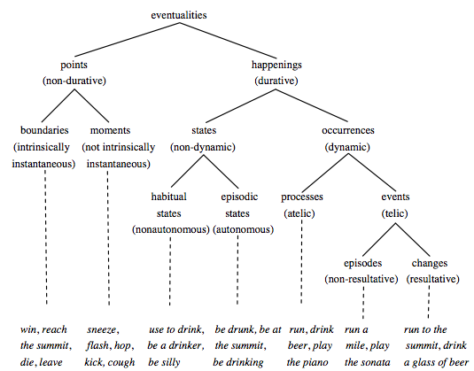
Types of eventualities
Chart from (Dölling, 2011)
Notes:
Dolling breaks down eventualities by the key properties durativity, dynamicity, and telicity.
Within points we have boundaries, or achievements, which are inherently timeless, and moments which are conceptually timeless in their default reading
These categories are a little more fine grained than most previous work.
Activities are called processes, and their telic counterparts, accomplishments, are called here events, which
Either result in a change of state or do not. These are all subsumed under “happenings”

Slide 20
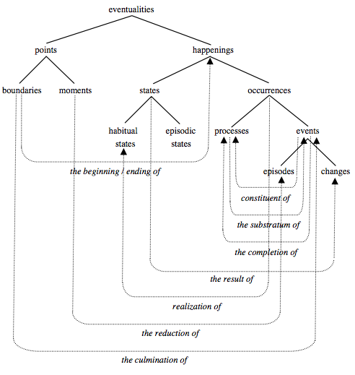
Inter-eventuality relations
A boundary begins/ends a happening
A boundary culminates an event
A moment is the reduction of an episode
A state is the result of a change
A habitual state is realized by a class of occurrences
A Processes is made of event constituents …
Chart from (Dölling, 2011)
Notes:
Modification of a given predicate of eventualities can change its constraints on aspectual class
These constraints are given in Dolling’s theory in terms of the relationships between eventualities,
Either subsortal hierarchical relationships or intersortal relationships in terms of the structural
Componants of eventualities that define them.

Slide 21
Aspectual coercion
Event Predicate
Win:= λe. win(e)
Type restrictions
∀e[win(e) → BOUNDARY(e)]
∀e∀t [for(e, t) → Time_Int(t) ∧ (STATE(e) ∨ PROCESS(e)]
Inter-eventuality
relations
∀e [HAPPENING(e) →∃e’∃e’’[BEG(e’,e)]∧END(e’’,e)]]
∀e∀e’ [END(e, e’) →BOUNDARY(e)∧HAPPENING(e’)]
∀e [EVENT(e) →∃e’[CULM(e’, e)]
∀e∀e’ [CULM(e, e’) → EVENT(e’) ∧END(e, e’)
∀e [BOUNDARY(e) → BEG(e)∨END(e)
∀e [PROC(e) → ∃e’∃e’’[CONST(e’,e)∧CONST(e’’,e)
∧ADJ(e’,e’’)]]
∀e∀e’ [CONST(e, e’) → EVENT(e)∧PROCESS(e’)]
Additive coercion
λPλe. ∃e’:CULM(e’,e)[P(e’)]
Iterative coercion
λPλe. ∀e’:CONST(e’,e)[P(e’)]
Generalized Coercion
λPλe. Qe’:R(e’,e)[P(e’)]
Notes:
For example, a win event is a boundary, and for is a durative adverbial modifier that takes only states and processes, canonically.
Inter-eventuality or inter-sortal relations are given in terms of eventuality parts;
For example, if an event e is a happening, there exists to subevents e’ and e’’ which begin and end it, each
Of which are boundaries.
Coercion is done compositionally, in terms of a property, a quantifier over events, and an inter-eventuality relation.
These parameters may be left unfilled leading to a canonical reading, or they may be filled based on pragmatics, knowledge, etc..
See the paper for further generalization.

Slide 22
Aspectual coercion
Event Predicate
A win is a win
Type restrictions
Wins are of type BOUNDARY
Only a STATE or PROCESS can happen for a time
Inter-eventuality
relations
HAPPENINGS have a beginning and end
Each end is a BOUNDARY of a HAPPENING
EVENTS must culminate
Culminations are the ends of EVENTS
Any BOUNDARY is a beginning or an end
A PROCESS consists of two or more temporally adjecent
Constituents.
Any constituent is an EVENT that makes up part of a PROCESS
Additive coercion
Apply the property to the EVENT the BOUNDARY culminates
Iterative coercion
Apply the property to the PROCESS of which the EVENT is a constituent
Notes:
Here are some English translations.
Additive coercion, for instance, provides a compositional account of changing the interpretation of
Applying a property introduced by a verbal predicate, or an adverbial predicate,
To the EVENT that a BOUNDARY culminates, as opposed to the BOUNDARY, which presumably is
Not compatible with the property in question as-is.

Slide 23
Chris won for three hours
A win is a BOUNDARY, but one can only engage in a STATE or PROCESS for three hours.
A PROCESS is made of two or more temporally adjacent EVENTS. An EVENT is a HAPPENING that must end due to some BOUNDARY occurring. Since every BOUNDARY is a beginning or an end of some happening, the natural interpretation of the proposition is that there was a PROCESS consisting of two or more EVENTS, each of which culminated with a BOUNDARY of type win.
Thus, the proposition will be true just in case there are two or more EVENTS whose boundaries are wins that make up such a PROCESS, lasting three hours.
win: λe. win(e)
win: λe. ∀e’:CONST(e’,e)[∃e’’:CULM(e’’,e’)[win(e’’)]]
∃e[AG(chris, e)∧∀e’:CONST(e’,e) [∃e’’ : CULM(e’’,e’) [win(e’’)]∧for(e, 3hours)]
Notes:
Here, our property is a win. We want to say Chris won for three hours, but this does not make sense given our
Cannonical denotation of to win.
Ultimately we want a process, so, we observe that a win must culminate some sort of EVENT, presumably a game…
A process is built from event constituents, therefore the sentence must mean that multiple game events were culminated
With a win; the agent being Chris

Slide 24
Ordering of events in time
Order of events conveyed and understood
  Event to time interval mapping
  In terms of inherent ordering on time intervals
  In terms of events to event relations
Tense and Grammatical Aspect (T)
  Expressed morpho-syntactically
  Past, Present, Future (-ed; will + V)
  Perfective, Imperfective, Unmarked (Has + V_{part}; V-ing)
TE, LA, & T, guided by commonsense knowledge interact to anchor events in time
24
24
Notes:
24
The temporal extents of many events are either systematically underspecified, implicit, or left to interpretation.
In addition to properties of the temporal expression system and lexical aspect of verb phrases,
and their interaction, tense and grammatical aspect (ill call this aspect) are morphological properties that
locate an event’s extension with respect to the time of utterance of utterance. They provide another tool
For locating an event in time, and ultimately ordering events in a discourse.
In English, for example, -ed is a past tense morpheme, and using the auxiliary verb to have marks perfective aspect.

Slide 25
Ordering events in time
  Speech (S), Event (E), & Reference (R) time (Reichenbach, 1947)
Tense: relates R and S; Gr. Aspect: relates R and E
R associated with temporal anaphora (Partee 1984)
Order events by comparing R across sentences
By the time Boris noticed his blunder, John had (already) won the game
Sentence | Tense | Order
John wins the game | Present | E,R,S
John won the game | Simple Past | E,R<S
John had won the game | Perfective Past | E<R<S
John has won the game | Present Perfect | E<S,R
John will win the game | Future | S<E,R
Etc… | Etc… | Etc…
25
25
See Michaelis (2006) for a good explanation of tense and grammatical aspect
Notes:
25
Reichenbach formalized tense and aspect in terms of the time of utterance, time that the event actually takes place, and
Reference time.
Reference time can be viewed as an intermediary between speech time and event time.
Tense helps to denote a point of reference, before, at or after speech time. Aspect then locates the event time with respect to
The reference time. The proposition about the event is expressed with respect to the reference time.
Each ordering of S, E, & R under the before and equals relations corresponds with a possible tense/aspect combination.
Some of these are listed in the table here.
So for example, if we say “John won the game”, his winning occurred before the time of utterance.
However, if we say “John had won the game”, his winning is located prior to a reference time which is itself prior to the time of utterance.
The reference time in the last example is the time point at which Boris notices the blunder, which is in the past. This time binds
To an anaphor introduced by the past tense in “had won”, and the occurrence of the winning is located prior to that reference time
At which boris noticed his (own) blunder.

Slide 26
Ordering events in a discourse
Incorporation into Discourse Representation Theory (e.g. Hinrichs, 1986)
  Default assumption: Eventualities in consecutive clauses may not overlap unless one or both are stative
Temporal Discourse Interpretation Principle (Dowty 1986)
  Particulars of reference time movement and aspectual class of verbs interact, but both are significantly informed by world knowledge
“It is crucial … that semantic theory determine what options may be left open by the information given, so that other modules of information may provide additional constraints that the central logic “service” of the system may exploit in generating conclusions” (Ter Meulen, 1991)
Syntax, semantics, causal and linguistic knowledge accounted for in single logic without reference time (Lascarides and Asher; 1992)
Semantics Literature does not fully address:
  How are pragmatic/world knowledge constraints on meaning represented and how might they be learned?
  Representation and reasoning over temporal information of widely varying granularity and scope
  How exactly do we associate events with their temporal arguments?
26
26
Notes:
26
The tools just introduced help to order events mentioned across sentences, in an entire discourse,
And have been incorporated into semantic analyses.
I won’t do them justice here.
Incorporation into discourse representation theory provided machinery for simple ordering.
One key assumption is that eventualities in consecutive clauses may not overlap unless at least one is a state,
though clearly this is a simplifying assumption.
Dowty’s 1986 paper proposed the temporal discourse interpretation principle, which did more to specify the role of pragmatics,
albeit informally, by pointing out (1) where it matters and (2) it’s significance
Ter Meulen aptly pointed out that while semantics is not the business of specifying how knowledge of phenomena like causation, and other commonsense
Knowledge, it is supposed to specify precisely what sort of details are to be specified by other modules, and how this knowledge is used.
These considerations are left to artificial intelligence and cognitive science.

Slide 27
Ordering events in discourse
(1 ) John entered the room at 5:00pm.
(2) It was pitch black.
(3) It had been three days since he’d slept.
State: John Slept
Time: 3 days
Event: John entered the room
Time: 5pm
Time: Now
State: Pitch Black
27
27
Notes:
27
After processing a discourse we can answer questions about the order, duration and location of the events that were portrayed.
So what sort of information do we make use of to do this?

Slide 28
Grounding eventualities in time
(1 ) John entered the room at 5:00pm.
(2) It was pitch black.
(3) It had been three days since he’d slept.
Perfective Past | E—R—S
State: John Slept
Time: 3 days
Event: John entered the room
Time: 5pm
Time: Now
Event: John fell asleep
State: Pitch Black
State: LOC(John, room)
28
28
Notes:
28
We can use the tools already introduced to draw some inferences about when events might occur.
For example, If John enters the room, an achievement occurs, but so does the
State of john’s being in the room.
Conversely, a state of darkness entails beginning and end. But where are these?
To interpret the expression “Three days since he’d slept” locates a portion of a prior sleeping event – its end point – as being
Three days prior to the point of reference, which we know based on the perfective grammatical aspect;
and, we know this reference time is in the past, at some 5 pm, which is passed forward through the discourse.
But how do we know about how long John Slept?

Slide 29
Role of knowledge
29
29
Recognize events and temporal expressions
Determine which are related
Determine type of relation
Draw Inferences about implicit events and relations
  Cause/effect, contingency, etc…
Notes:
29
There are several types of knowledge needed for the processing and representing temporal information.
From identifying the possible forms of relevant expressions to determining their relationships,
inferring implicit information, applying knowledge-based constraints, and reasoning to obtain a response to a query.
========================================================================
So, world knowledge must come into play, and must interact with the temporal representation.
World knowledge might be worked into the temporal reasoning framework.
Another approach is to use statistical NLP as a proxy to world knowledge;
In this case world knowledge is broken into two parts: mapping of text to the initial event graph structure, and then a propagation algorithm is seen as a proxy to the second component of world knowledge. This is inaccurate but may be a good start.
In any case, we will need labeled data:

Slide 30
Linguistic knowledge
John worked for company A in 1999
John worked for company A in 1999
[S [VP t [V’[V’’[V ][PP ]][PP ]]]]
Activity d∧di∧=
Lexical knowledge needed to identify event triggers and temporal expressions.
Syntactic and Semantic knowledge needed to determine whether, and if so how, an event and temporal expression are related
30
30
Notes:
Linguistic knowledge is needed to identify our ingredients and outline relationships.

Slide 31
John was hired in 1999
1999
Temporal Representation framework needed to map temporal expressions to their extents
Knowledge of verb class determines type of interval
  Punctuated or Persistent?
Knowledge of the mode in which prepositions map an event to its time argument
  Requires interval-based reasoning
?
John worked for company A in 1999
1999
John worked for company A until 1999
1999
31
31
Notes:
We need a framework to map the identified expressions to their extensions in time, informed by
Knowledge about events and their structural properties.

Slide 32
John worked for company A until 1999
…
Immediately after leaving company A, John worked for company B for one year.
1999
Relations between events interact with relations between events and time intervals, and vice versa
Controlled by:
  1. Mapping from events & temporal expressions, to intervals
  2. Interval relations
Goal: Enrich text with information that enables machines to (learn to) extract necessary temporal information
32
32
Notes:
Thus, we need a labeling scheme for linguistic information, its mapping to temporal extents, and which is capable of capturing
the sort of framework proposed by Allen. Enter TimeML…

Slide 33
Commonsense Knowledge
(1) John [exercised]_{e1a} during his [lunch break]_{e1b}.
(2) He [stretched,]_{e2a} [lifted weights,]_{e2b} and [ran]_{e2c}.
(3) He [showered,]_{e3a} [got dressed,]_{e3b} and [returned to work.]_{e3c}
Explicit: e_{1a}⊆e_{1b}
Implicit: e_{2a}, e_{2b}, e_{2c,}⊆e_{1a} ∧e_{3a} < e_{3b} < e_{3c} ∧e_{3a}, e_{3b}, e_{3c}⊆e_{1b}
  Requires an appeal to the “normal course of events”
lunch break
Exercised
stretch
lift
run
shower
dress
return
33
Notes:
Some decisions about ordering must be informed by knowledge about the way things tend to happen.
For example, consider (1) followed by (2).
Since stretching, lifting weights, and running are component of exercise, those must have occurred during the working out.
Conversely, consider (1) followed by (3); since showering and dressing typically follow exericise, the correct ordering is inferred.

Slide 34
Temporal representation formalisms
Representation required to specify ordering and extension of eventualities in time
TR in general
  Eventualities and Temporal Expressions map to intervals
  Reasoning
    Relations among intervals, world knowledge, some notion of uncertainty and under-specification
    Determine order of events to some degree
Ultimate test: Question Answering with temporal awareness
34
34
Notes:
34
Plenty of reasoning takes place in terms of the representation itself, even after many events have been to some extent reliably mapped
Temporal representation formalisms have been proposed, within which reasoning and inference can take places, based on properties inherent to the representation.

Slide 35
Temporal relations – motivation
(Pustejovsky et al., 2005)
Answering temporally relevant queries requires reasoning
Reasoning requires the ability to represent eventualities, temporal extents, and relations between them
  E-T E-E T-T
    Who won the Turing award in 1966?
    Who died during The Clinton Administration?
    On what day was Dec 25th in 2004?
Temporal extents can be referred to explicitly
  Date, indirect reference, WH-word
Or implicitly, via events
35
35
Notes:
35
Reasoning in terms of anchored events and time expressions is necessary to answer queries
For “typology of queries” read “typologies of temporally relevant queries” in the paper
Intuitively, for some queries we don’t have the answer stored explicitly.
Perhaps we have a list of Turing award winners by year, so the first query is simple.
But if we have a list of people that died by year, in order to determine who died during the clinton
administration we need to observe the mapping between that event and its extension in time;
For each death associated with a time we can check to see if the time is included in the
Extension of the clinton administration at an appropriate granularity.
What are the properties of such a framework?

Slide 36
Allen interval relations (Allen, 1983)
Ideal Framework will allow
  Imprecision
  Uncertainty
  Varying granularity
  Persistence
Proposed Framework
  13 Interval relations
  Inference algorithm to characterize understanding of implicit temporal relation information in terms of what’s explicitly provided
36
36
Notes:
36
Allen’s framework was motivated by the desire to represent information about what happened and when in a way
That would support the type of reasoning that is actually performed in practice.
For example, we can know that events are temporally related without knowing exactly when either event occurred
Or, we can narrow down the relationship to a subset of all possible relationships.
===============================================
A general framework will be able to capture different units of time. This is important for type coercion as we’ll see later, but also the
Duration expressed by linguistic expressions such as “immediately thereafter” might be best defined given a contextually salient granularity
(Think describing historical events vs events in a basketball game)
The notion of persistence has received a wide treatment in the AI literature;
Essentially by default we assume that states continue to persist unless otherwise indicated. (note: I am not sure to what extent Allen’s framework
Really captures this, furthermore I am not sure to what extent such as assumption is the responsibility of the representation and basic
Reasoning componant – it seems to me that this should be taken care of where reasoning and World Knowledge interact)
Allen proposes 13 basic relations – 7 relations and their inverses; note that equality is its own inverse.

Slide 37
Allen interval relations (Allen, 1983)
Relation | Symbol | Inverse | Example
X before Y | < | >
X meets Y | m | mi
X overlaps Y | o | oi
X during Y | d | di
X starts Y | s | si
X finishes Y | f | fi
X equals Y | = | =
13 total relations
One or more relations hold between any pair of eventualities
Reasoning done via propagation, using transitivity table
  (see Allen, 1983)
Transitivity table facilitates compositions of sets of interval relations
X
Y
X
Y
X
Y
X
Y
X
Y
X
Y
X
Y
37
37
37
Notes:
Allen defined 7 interval relations, between two intervals X and Y, and their inverses (= is it’s own inverse).
As alluded to above, not all relations between intervals tend to be expressed in a text,
and after processing, which relationships are salient might be determined based on
The content of queries that are independent from the original purpose of the text
Allen proposed a propagation algorithm, the most important part of which is the application of
Transitivity. Ideally, all possible relations between all events in a text would be resolved
To the extent possible; refinements and details of the algorithm can be found in the literature.

Slide 38
Propagation (Allen, 1983)
i1
{<, m, o, d, s, f, =, >, mi, oi, di, si, fi}
i2
{<, m, o, d, s, f, =, >, mi, oi, di, si, fi}
i3
{s, si, =}
{<, m}
{<, m, o, d, s, f, =, >, mi, oi, di, si, fi}
{<, m, o, di, fi}
A priori: no information is known about how any two intervals are related
Partial information is acquired…
Reasoning is performed…
38
38
38
Notes:
38
Given a pair of intervals, a priori, any relation might hold between them,
But once we have information from a discourse, typically most possible relations can be eliminated.
Given three intervals, the set of possible relations between the first and the third can be inferred
Upon inspecting the possible conjunctions of relations between the first and second and second and third.
38

Slide 39
Propagation (Allen, 1983)
i1
{s, si, =}
i2
{<, m}
i3
?
{s, si, =}X{<, m} → { (s, <), (s, m), (si, <), (si, m), (=, <), (=, m)}
i1 - i2 | i2 - i3 | i1 - i3
s | < | <
s | m | <
si | < | <, o, m, fi, di
si | m | o, fi, di
= | < | <
= | m | m
{<, m, o, di, fi}
OR
AND
→
OR
39
39
39
Notes:
39
Suppose we obtain some information constraining the two relation sets.
We take the cross product of the two relation sets.
For each pair, we fix an i1-i2 relation and an i2-i3 relation accordingly,
Then we determine the possible ways in which i1 could relate to i3. using the transitivity table
For example, if we fix i1 si (or start-inverse) i2, and i2 m (meets) i3, we can see that either i1 overlaps i3, i1 inverse finishes i3 (i1 fi i3),
or i1 is inverse during i3 (i1 di i3).
After all this, we take the union over the possible i1-i3 relations for each element of that cross product, and we obtain all the
Possible i1-i3 relations.
Whereas a priori there were 13 such relations, after propagation, there are 5.
39

Slide 40
Potential to augment IE?
i1
{s, si, =}
i2
{<, m}
i3
{<, m, o, di, fi}
John was hired as a technician by company A in June of 2006,
and he began training shortly thereafter. After that, He worked for company B in 2010.
J worked for A, some time passed, J started working for B. (<)
J worked for A. This ended, and J started working for B simultaneously. (m)
J worked for A, at some point J began working for B, his employment at A ended during this time. (o)
J worked for A, then stopped. Later on he was working for B. In fact, he started working for B first, and still was upon leaving A. (di)
J was working for B, started working for A, and stopped working for A and B at the exact same time. (fi)
40
40
Notes:
40
Let’s map this process to a real example.
From the text shown some IE system extracts the relations between the events in the graph.
Suppose I1 represents the State of John’s employment at company A, i2 represents the entire training event, and i3 represents the entire
State of employment at company B.
Suppose IE tells us that i2 (training) begins at the same time as i1, but we need world knowledge to tell us which state lasts longer.
Then suppose IE infers that “that” in “after that” refers to the training.
Then either the training meets employment at B, or else it ends, some time passes, and employment at B begins.
Based on the propagation we see all possible relations between i1 and i3. Here are there interpretations
Based on common sense, we know that the first option is correct.
=============================================================
Based on what we know about employment and training, it’s impossible that training at A exceeded employment at A. Based on what we know about language, “after that” probably means that after working at A, J worked at B.
It is actually possible that i2 meets i3, but this is only the case if J left company A to work at B, in one instant, and at this time he was still in the training phase for A; in this case i1=i2.
The purpose of this example is to show that in theory it’s possible for imperfect temporal IE + reasoning to make strong inferences.
40

Slide 41
TimeML: mark-up language for time
(Pustejovsky et al., 2005)
Annotation language for marking temporal and event expressions, as well as links between them
  Components: TIMEX3, EVENT, SIGNAL, LINK
Broad community effort of design & specification
  Annotation guidelines (Saurí et al, 2006)
  Resource instantiation:
    annotation ‘standard’; appeals both to annotation and analysis
    TimeBank corpus (Sundheim and Radev, 2002)
Evolution of design
  TERQAS / TANGO workshops : 2002 — 2003
Builds upon TIDES’ Timex2, Sheffield STAG
41
41
Notes:
41
The particularly essential, and relevant, characteristic of TimeML is the factoring out – in a non-consuming, relation-like, tag – the notion of a link between events and temporal expressions, and events and events. The links are heavily encumbered with additional typing information which, among other things, further describes the nature of the temporal relation.
TimeML is not a KR language. At the same time, it is designed so that all the information ultimately to be captured in a formal temporal representation is available – in the style more or less accepted (as it has evolved over time) by the variety of community-wide IE annotation schemes (XML tags, attributes, different classes of entities, relationships among these, non-consuming mark-up, and so forth). Thus, it is properly regarded as an intermediate representation between the free text and a formal encapsulation of its temporal characteristics; this representation is,
on the one hand, can be the focus of an IE effort;
it can also, on the other hand, be the starting point for a mapping to a formal ontology of time.

Slide 42
TimeML : problems addressed
Dependencies among events and timex
  Specifying an event’s temporal extent
  Ordering of events, relative to one another
Reasoning
  with underspecified temporal expressions : “last week”, “eight years before”, “October (of 2003)”
  About duration of events & outcomes of events
Signals used to form complex temporal expressions
  Signals: for, during, at, before, after, while, …
Complex event structures
  Aspectual phrase: initiation (e.g. started working), continuation, …
  Subordinating relations: counterfactive (prevented the attack), reporting...
  Polarity indicators: not, no, none, …
Temporal quantification:
  twice, three times, everyday…
42
42
Notes:
42
In addition to the two points just discussed, (first and second item here: time stamping ⬄ current slide – 2; ordering of events ⬄ current slide - 1), there are a few other characteristics of TimeML worth emphasising here.
Past attempts for determining temporal relationships have been driven, by and large, by normalising tExprs, and deploying an ‘algebra’ over tExpr values. This only works when a value can be calculated. TimeML offers a general mechanism for interpretation (possibly deferred) of contextually underspecified temporal expressions.
TimeML also tries to make explicit statement about the persistence of events. Consider the very simple examples: “... Stopped singing”, “... Was a member till the end of the war”, “... Spoke while the film was being shown”.

Slide 43
Time ML example
John was hired as a technician by company A in June of 2006.
He began training shortly thereafter. He worked for company B in 2008.
43
43
Notes:
Each of the highlighted expressions could be annotated in timeML.
In fact, began and training will be tagged as two different events

Slide 44
Time ML annotation
John was hired as a technician by company A in June of 2006.
He began training shortly thereafter. He worked for company B in 2008.
…
After leaving Company B, John earned a degree in engineering.
?
?
?
Left
B
Deg.
Deg.
Deg.
Hired
Working (at A)
Working (at B)
Left
B
Training (A)
J
2008
2006
2007
2008
44
44
Notes:
As we’ve seen, the temporal information can be mapped to intervals, and the possible locations of intervals, with respect to both one another
And a timeline, can be represented.

Slide 45
Time ML annotation
John was
<EVENT eid=e1 class=“OCCURRENCE”>
Hired </EVENT>
as a
<EVENT eid=e2 class=“STATE”>
technician </EVENT>
by company A
<SIGNAL sid=s1>
in </SIGNAL>
<TIMEX3 tid=t1 type=“DATE” value=“200606XX” temporalFunction=“true”>
June of 2006. </TIMEX3>
…
He
<EVENT eid=e4 class=“OCCURRENCE”> worked </EVENT>
for company B
<SIGNAL sid=s2> in </SIGNAL>
<TIMEX3 tid=t2 type=“DATE” value=“2008XXXX” temporalFunction=“true”> 2008 </TIMEX3>
…
<SIGNAL sid=s3> After </SIGNAL>
<EVENT eid=e3 class=“OCCURRENCE”> leaving </EVENT>
the company, John <EVENT eid=e5 class=“OCCURRENCE”> earned a degree in engineering</EVENT>
45
45
Notes:
TimeML uses xml style tags, where timex, events, and signals are
annotated as objects with attributes.

Slide 46
Time ML annotation
<MAKEINSTANCE eiid=“ei1” eventID=“e1” pos=“VERB” tense=“PAST” aspect=“NONE” …>
<TLINK eventInstanceId=“ei1” signalID=s1 relatedToTime=“t1” relType=“IS_INCLUDED”>
<TLINK eventInstanceId=“ei2” signalId=s2 relatedToTime=“t2” relType=“DURING”>
<TLINK eventInstanceId=“ei2” signalId=s2 relatedToTime=“t2” relType=“DURING_INV”>
<TLINK eventInstanceId=“ei4” signalId=s3 relatedToEventInstanceId=“ei3” relType=“AFTER”>
Hired
june
Limit one relType!
Working at B
Working at B
2008
2008
Earned a degree in engineering
After
Left B
46
46
Notes:
46
Relations between objects are annotated with links, which are labeled for relation type.
For example, the second working event is linked to the timex representing the year 2008 via the signal “in”,
Indicating a during relationship. However, note that during here is strictly during, which may not be right, and
Disjunctions of relations would be preferable.
Note that “unknown” relation type was added to TimeML according Verhagen (2005), as well as his Thesis (time between the lines).
46

Slide 47
Tempeval
Tempeval-1
  Relate an event and a timex in the same sentence
  Relate an event and the document creation time
  Relate the main events of two consecutive sentences
Tempeval-2 added
  Find timex and events and their attributes
  Restrict event/time relations to where event syntactically dominates timex, or both appear in the same NP
  Relate events where one syntactically dominates the other
  Italian, Chinese, Spanish, & Korean
Tempeval-3: Bottom-up TIE
  Find timex, events, & attributes (including event class)
  Determine which temporal entities need to be related, provide any TimeML relation type
Notes:
The tempeval (cite?) evaluation campaigns have motivated the development of more sophisticated temporal information extraction systems.
Initially, in tempeval-1, the tax were isolated and somewhat simple (though perhaps not easy)
In tempeval-2 the linking tasks were narrowed to more specific formulations,
While timex themselves were found and normalized and more languages were introduced
tempeval-3 moves to a bottom-up task, where temporal elements and their properties need to be extracted;
In addition, the relation types are expanded.
Tempeval 2
Attributes for timex are val (normalized value) and type (time, date, duration, set)
Attributes for event are tense, aspect, polarity, modality
Relations for 1 and 2
before, after, overlap, before-oroverlap, overlap-or-after and vague
Event class – somewhat corresponds to lexical aspect
Temporal entities that can be related
Event and timex same sent; event and dct, main events in consecutive sents;
Pairs of events in same sentence
Relations for 3
before, after, includes, is-included, during, simultaneous, immediately after, immediately before, identity, begins, ends, begun-by and ended-by.

Slide 48
Time ML annotation
Would you annotate this?
Earned Degree in Engineering (ei5)
Training (ei2)
After
<TLINK eventInstanceId=“ei5” relatedToEventInstanceId=“ei2” relType=“AFTER”>
Given this?
John was hired as a technician by company A in June of 2006.
He began training shortly thereafter. He worked for company B in 2010.
…
After leaving Company B, John earned a degree in engineering.
48
48
Notes:
One problem with TimeML is that each pair of events cannot possible be annotated by human annotators.
Some pairs are far apart, some seem irrelevant to annotators.

Slide 49
John was hired as a technician by company A in June of 2006.
He began training shortly thereafter. He worked for company B in 2008.
…
After leaving Company B, John met Mary.
How about all of these?
49
49
Notes:
So, full annotation is unrealistic.

Slide 50
Temporal closure (Verhagen, 2005)
Can we annotate all temporal relations in a text?
Few temporal relations are expressed explicitly
N(N-1)/2 relations given N events & timex
  Annotators cover about 1-5%
  Annotators disagree on what to annotate
System annotation is unable to capture complex cases
Solution: harness strengths of both types
50
50
Notes:
Verhagen noted that humans are good for annotating tough examples, but computers are good for annotating many seemingly trivial
Pairs of relatable objects.
Although we can propagate as alluded to above after the fact, the relations holding between
Events might still be highly underspecified. If human and computer could work together, iteratively,
A more complete annotation could be produced.

Slide 51
Temporal closure
SputLink (Verhagen, 2005)
TimeML mapped into reduced Allen relations in terms of interval endpoints
Human annotates; Machine propagates
  Annotation task linear in document size
  No need to compare distant items
Drastically improves number of annotated pairs (density) while minimizing inconsistencies (UzZaman and Allen, 2011; Setzer et al, 2003)
Use closure to aid temporal IE evaluation
Initial annotation
Initial closure
Interactive Closure
51
51
Notes:
51
SputLink is a component that can be incorporated into an annotation process.
Temporal closure is sought using propagation techniques similar to what was shown earlier to
Infer relations between events and temporal expressions not explicitly related by the annotation.
51

Slide 52
Fuzzy intervals and reasoning (Schockaert et al., 2008)
Allen relations are not 100% realistic
Real life is fuzzier...
We saw incomplete knowledge
  Disjunction of interval relations
But relations and events may be inherently vague
  “Roosevelt died just before the cold war”
Approach: Allen relations are a special case of a more general framework
52

Slide 53


“Long Before”
α = 0
β = 0
a
b
53
53
Notes:
53
53
Having trouble writing the relation $L^{<<}_{\alpha, \beta}$ in powerpoint, will fix for final version, writing X for now…

Slide 54

“Long Before”
α = 0
β = 0
a = 1
b = 1
54
54
Notes:
54
54
Having trouble writing the relation $L^{<<}_{\alpha, \beta}$ in powerpoint, will fix for final version, writing X for now…

Slide 55
“Long Before”
α = 50
100-1 > 50 + 10
99 > 60
β = 10
a = 1
b = 100
55
55
Notes:
55
55
Having trouble writing the relation $L^{<<}_{\alpha, \beta}$ in powerpoint, will fix for final version, writing X for now…

Slide 56

“Long Before”
α = 100
100-1 <= 100 + 10
99 <= 110
β = 10
a = 1
b = 100
56
56
Notes:
56
56
Having trouble writing the relation $L^{<<}_{\alpha, \beta}$ in powerpoint, will fix for final version, writing X for now…

Slide 57

“Long Before”
α = 50
100-1 <= 100 + 10
99 <= 110
β = 60
a = 1
b = 100
57
57
Notes:
57
57
Having trouble writing the relation $L^{<<}_{\alpha, \beta}$ in powerpoint, will fix for final version, writing X for now…

Slide 58
Fuzzy time periods
Also defined:
  a occurs before or at approximately the same time as b
  a occurs at approximately the same time as b
  a occurs just before b
Intuitive notions follow from fuzzy logic
  E.g. “if b is long before a, a and b cannot be at approximately the same time, and b cannot be before a”
Relations among fuzzy time periods, fuzzy transitivity table, defined in terms of fuzzy time point orderings
Conclusions drawn about degree to which two fuzzy time periods stand in a fuzzy relation to one another:
E.g. The degree to which A is during B and the degree to which B more or less meets C can be used to compute a lower bound for the degree to which A is long before C
58
58

Slide 59
4-tuple representation (Ji et al., 2011)
Challenges:
    Be consistent with ‘data base’ approach of Knowledge Base Population (KBP)
    Accommodate incomplete information
    Accommodate uncertainty
    Accommodate different granularities
Solution:
    express constraints on start and end times for slot value
    4-tuple <t₁, t₂, t₃, t₄>: t₁ < t_{start} < t₂ t₃ < t_{end} < t₄
Document text (2001-01-01) | T1 | T2 | T3 | T4
Chairman Smith | -infinite | 20010101 | 20010101 | +infinite
Smith, who has been chairman for two years | -infinite | 19990101 | 20010101 | +infinite
Smith, who was named chairman two years ago | 19990101 | 19990101 | 19990101 | +infinite
Smith, who resigned last October | -infinite | 20001001 | 20001001 | 20001031
Smith served as chairman for 7 years before leaving in 1991 | 19840101 | 19841231 | 19910101 | 19911231
Smith was named chairman in 1980 | 19800101 | 19801231 | 19800101 | +infinite
59
59
Notes:
The 4-tuple representation was used for a task, which Heng will talk about in more detail, called temporal slot filling.
Given the expression of an event, a 4 tuple specifies bounds on it’s beginning and end, to the extent that this information can be
Inferred from its context.
Consider a document dated Jan 1st, 2001.
We can put different constraints on Smith’s state of being chairman depending on how this event is expressed, in conjunction with
Temporal expressions, in light of the time of utterance – the document creation time.
For example, the occurrence of the phrase “Chairman Smith” means that he is chairman for at least the DCT.
Naively, the beginning of the relation could have been infinitely earlier, and the end date could be infinitely later,
But at latest the relation began on Jan 1st 2010, and at earliest it ended that same day.
This representation accommodates uncertainty and varying granularity.
However, the infinities are almost always too conservative;
Similarly, consider “smith has been chairman for two years”; this can mean he’s been chairman for less than 3 years.
But probably not for 2 years and 364 days.

Slide 60
Time ML annotation
Wouldn’t you want to annotate this?
Hired
Working (at A)
J
2006
Given this?
John was hired as a technician by company A in June of 2006.
He began training shortly thereafter. He worked for company B in 2010.
…
After leaving Company B, John earned a degree in engineering.
And this?
Hiring
Employment
Employee_of(J, A) → <20060601, 20060630, 20060601, ∞>
60
60
Notes:
Another issue with TimeML is that implied events are not annotated.
Annotation of implied events may be necessary in order to imbue a system with knowledge about
Which events are contingent upon others.
In TimeML implied relations are not annotated, so extracting them is a matter of inference,
Based on combination with another annotation.

Slide 61
Limitations of TimeML
61
Redundancy: no need to have temporal relations between all pairs of events and time points and events and events
Normalization: Hard to construct a timeline of events across documents
Inference: Does not support well global inference for timelines
Notes:
In spite of the effectveness of SputLink, in reality relations between each pair of events may not be necessary.
In addition, as is, mapping from timeML to a timeline representation is non-trivial.

Slide 62
An Interval based Representation
(Do et al., 2012)
An interval-based representation
Each temporal expression is normalized to an absolute interval and put on a universal timeline
Each event is associated with an interval and thus is in partial order relation with other events on the timeline
The interval-based representation allows one to construct an absolute timeline of events, so it’s easy to construct timeline of events across document
This representation supports a concise inference model
62

Slide 63
Timeline Relation Representation & Mapping
Each event is represented by a time interval, denoted by (e⁻, e⁺):
  e⁻ and e⁺ are two time endpoints.
  represent the lower and upper bounds of the time interval of an event.
Example:
  The election was held in September, 2008.
  e⁻ = ‘2008-09-01’, e⁺ = ‘2008-09-30’
3 base relations on endpoints
  Before (⧼), After (⧽) Equal (=)
  (Denis and Muller, 2011)
Hard constraint: e⁻ ⪯ e⁺
Transitivity constraints of endpoints (supports inference):
 | ⧼ | ⪯ | ⧽ | ⪰ | =
⧼ | ⧼ | ⧼ |  |  | ⧼
⪯ | ⧼ | ⪯ |  |  | ⪯
⧽ |  |  | ⧽ | ⧽ | ⧽
⪰ |  |  | ⧽ | ⪰ | ⪰
= | ⧼ | ⪯ | ⧽ | ⪰ | =
63

Slide 64
A Calculus for Interval Representation
Comments:
The timeline relations are used to represent both event-event and event-temporal expression relations.
There is no explicit equal relation, however, we define two events to be equal iff they occur during each other.
The relations can apply both to ttime intervals and time points.
Transitivity constraints of timeline relations:
An application can selectively enforce the constraints. In our work, we used a slightly different sets of relations and constraints.
TL relation | Endpoint | Graphical illustration
b | (⧼, ⪯, ⧼, ⧼)
o | (⧼, ⧽, ⧼, ⧼)
d | (⪰, ⪰, ⪯, ⪯)
bi | (⧽, ⧽, ⪰, ⧽)
oi | (⧽, ⧽, ⧼, ⧽)
di | (⪯, ⪰, ⪰, ⪯)
Given two events
  e₁ = (e₁⁻, e₁⁺) and
  e₂ = (e₂⁻, e₂⁺),
we represent the temporal relation between e₁ and e₂ by a 4 tuple:
((e₁⁻, e₂⁻), (e₁⁺, e₂⁻), (e₁⁻, e₂⁺), (e₁⁺, e₂⁺))
This allows the use of 3 base timeline relations for events, including:
(b)efore, (o)verlap, (d)uring
Together with their inverse relations, there are 6 timeline relations in total, which can be used to order events on a timeline
(e₁⁻ , e₁⁺)
(e₂⁻ , e₂⁺)
 | b | o | d | bi | oi | di
b | b | b | b/o/d |  | b/o/d | b
o | b | b/o | o/d | bi/oi/di | oi/di | b/o/di
d | b | b/o/d | d | bi | d/bi/oi
bi |  | d/bi/oi | d/bi/oi | bi | bi | d/bi/oi
oi | b/o/di | o/d/oi | d/oi | bi | bi/oi | bi/oi/di
di | b/o/di | o/di |  | bi/oi/di | oi/di | di
64

Slide 65
Interval Representation: Summary
The Interval based formulation provides an interval based representation of time along with:
  Calculus for reasoning about end points
  Transitivity reasoning for end points
  Calculus for reasoning about intervals and this also events)
  Transitivity reasoning for intervals (and thus events)
As we will see, these properties give rise to natural way to reason about events and time, resulting in inference for time lining of event.
65

Slide 66
Outline
Background: Motivations and Goals
Temporal Information Representation Theories
Temporal Expression Extraction and Normalization
Temporal Slot Filling
Tea Break
Event Timelining and Temporal Reasoning
Resources and Demos
Conclusions
10:10
66
Notes:
66

Slide 67

Temporal Expression Extraction and Normalization
67

Slide 68
Temporal Expression Examples
Expression | Value in Timex Format
December 8, 2012 | 2012-12-08
Friday | 2012-12-07
today | 2012-12-08
1993 | 1993
the 1990's | 199X
midnight, December 8, 2012 | 2012-12-08T00:00:00
5pm | 2012-12-08T17:00
the previous day | 2012-12-07
last October | 2011-10
last autumn | 2011-FA
last week | 2012-W48
Thursday evening | 2012-12-06TEV
three months ago | 2012:09
Reference Date = December 8, 2012
68
Notes:
Note : “Thursday evening” is ambiguous

Slide 69
Timex Value Attribute
the early 1990's : value="199X" MOD="START"
the past 10 years : value="P10Y" anchor_val="2012" anchor_dir="BEFORE"
the next week : value="P1W"
anchor_val="2012-W49"
anchor_dir="AFTER"
the previous day : [ cf. point above ]
recent : value=“PAST_REF” anchor_val=“2012-12-08T09:00” anchor_dir=“BEFORE”
69
Notes:
“the previous day” could be a “P1D”

Slide 70
Temporal Expression Extraction
Rule-based (Strtotgen and Gertz, 2010; Chang and Manning, 2012; Do et al., 2012)
Machine Learning
  Risk Minimization Model (Boguraev and Ando, 2005)
  Conditional Random Fields (Ahn et al., 2005; UzZaman and Allen, 2010)
State-of-the-art: about 95% F-measure for extraction and 85% F-measure for normalization
70
Notes:
by clustering sentences into topics and ordering sentences on a time line. However, many sentences in news articles include multiple events with different time arguments. And it was not clear how the errors of topic clustering techniques affected the inference scheme. Therefore it will be valuable to design inference methods for more fine-grained events.

Slide 71
A Grammar for Date Expressions
(Boguraev and Ando, 2005)
1to9 = [ 1 | 2 | 3 | 4 | 5 | 6 | 7 | 8 | 9 ]
0to9 = [ %0 | 1to9 ]
SP = [ “, “ ]
Day = [ Monday | Tuesday | ... | Sunday ]
Month = [ January | February | ... | December ]
Date = [ 1to9 | [ 1 | 2 ] 0to9 | 3 [ %0 | 1 ] ]
Year = 1t09 ( 0t09 ( 0to9 0to9 ) ) )
Date Expression =
Day | ( Day Sp ) Month “ “ Date ( SP Year )
71

Slide 72
Example Rules (Chang and Manning, 2012)
Token Patterns
  “4 to 5 years”:
  { ruleType: "tokens",
  pattern: ( ($NUM) /to|-/ ($NUM) [ "-" ]? ($TEUNITS_NODE) ),
  result: Duration( $1, $2, $3) }
String Patterns
  “3-years”:
  { ruleType: "text",
  pattern: /(\d+)[-\s]($TEUnits)(s)?([-\s]old)?/ ,
  result: Duration($1, $2) }
Time Patterns
  “Date at Time”:
  { ruleType: "composite",
  pattern: ( ( [ { temporal::IS_TIMEX_DATE } ] ) /at/ ( [ { temporal::IS_TIMEX_TIME } ] ) ),
  result: TemporalCompose(INTERSECT, $0[0].temporal,
  $0[-1].temporal) }
72
Notes:
by clustering sentences into topics and ordering sentences on a time line. However, many sentences in news articles include multiple events with different time arguments. And it was not clear how the errors of topic clustering techniques affected the inference scheme. Therefore it will be valuable to design inference methods for more fine-grained events.

Slide 73
Machine Learning: Sequential Labeling
Output tags: B-Timex2, I-Timex2, O
IOB2 encoding (Sang & Veenstra, 1999)
Lexical features include word, shape, is year, is date of week, is month, is number, is time, is day, is quarter, is punctuation, if belong to word-list like init-list7, follow-list8
O | O | O | B-Timex2 | I-Timex2 | O
| | | | | | | | | | |
Elections | are | on | November | 2nd | .
Elections are on <TIMEX2> November 2nd </TIMEX2> .
Several other approaches have been attempted but, so far, the extraction step seems simple enough and rule based systems perform besetfollow-list8
73

Slide 74
Rule-based Normalization (Ahn et al., 2005)
Lexical lookup: mapping names to numbers, units to ISO values, etc.
Context-independent composition: combining the values of the lexical tokens within a timex to produce a context-independent semantic representation
Context-dependent classification: determining whether a timex is a point or duration, looks forward or backward, makes specific or generic reference, etc.
Reference time, or temporal focus, tracking: for anaphoric timexes, whose values must be computed with respect to a reference time
Final computation: combining the results of all of these steps to produce a final normalized value
74
Notes:
by clustering sentences into topics and ordering sentences on a time line. However, many sentences in news articles include multiple events with different time arguments. And it was not clear how the errors of topic clustering techniques affected the inference scheme. Therefore it will be valuable to design inference methods for more fine-grained events.

Slide 75
Rules for “today”
“today” has a possessive inflection?
“today” is inside of a quotation?
“said”/”will”/”even”/”most”/… in sentence?
“year” in same sentence?
CCYY (4-digit year)/DOW in same sentence?
POS__{before} “today” POS__{after}
………
75

Slide 76
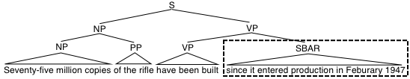
An Extended Approach Extraction (Do et al., 2012)
Built on top of a state-of-the-art temporal expression extractor¹ to extract basic expressions.
  For example: February 1947
Extends the basic extractor to capture complex expressions by using full syntactic parse tree.
  For example: since […] February 1947
Normalized to canonical absolute time intervals [start point, end point]
Compared the normalized intervals by directly comparing their endpoints: before, before-n-overlap, contain, equal, after, after-n-overlap
Currently, we capture: since, between, before, after, from
¹ We used the HeidelTime package: http://code.google.com/p/heideltime/
This system achieved the best performance in the extraction task in TempEval-2 (2010)

Slide 77
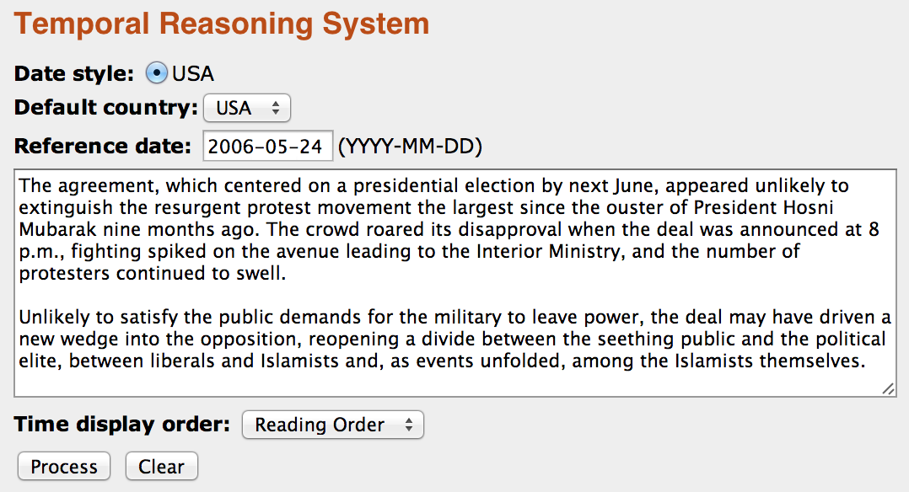
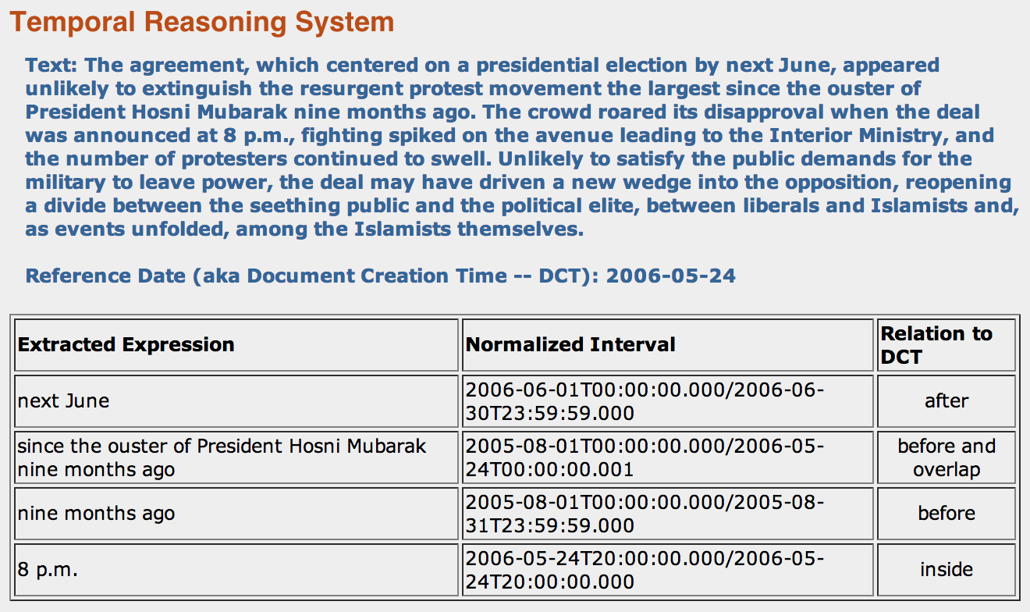
An Extended Approach Extraction (Do et al., 2012)
Demo URL: http://cogcomp.cs.illinois.edu/demo/tempdemo

Slide 78
Evaluation
HeidelTime: High Qualitiy Rule-based Extraction and Normalization of Temporal Expressions, [Jannik Strötgen and Michael Gertz: HeidelTime, SemEval’10]
  Data: TempEval’10 data sets derived from TimeBank.
  Precision: 90%
  Recall: 82%
  F₁: 86%
IllinoisTime: A Robust Shallow Temporal Reasoning System, [Ran Zhao, Quang Do and Dan Roth, NAACL’12 Demo]
  486 sentences from 183 articles in TimeBank 1.2, which contain at least one of the five temporal connectives since, between, from, before, after
Extractor
Normalizer & Comparator
Connective | # sent. | # appear. | Prec. | Rec. | F₁
since | 31 | 31 | 1.0 | 1.0 | 1.0
between | 32 | 33 | 1.0 | 1.0 | 1.0
from | 340 | 366 | 0.8 | 1.0 | 0.89
before | 33 | 33 | 0.8 | 1.0 | 0.89
after | 78 | 81 | 0.72 | 1.0 | 0.84
Average |  |  | 0.86 | 1.0 | 0.92
Module | Correct | Incorrect | Accuracy
Normalizer | 191 | 16 | 0.92
Comparator | 191 | 0 | 1.0

Slide 79
Outline
Background: Motivations and Goals
Temporal Information Representation Theories
Temporal Expression Extraction and Normalization
Temporal Slot Filling
Tea Break
Event Timelining and Temporal Reasoning
Resources and Demos
Conclusions
10:30
79
Notes:
79

Slide 80

Temporal Slot Filling
80

Slide 81
Temporal Slot Filling
Task Definition
Approach Overview
Annotation Challenges and Solutions
  Distant Supervision and its Problems
  Multi-layer Annotations
  Global Time Discovery
  Feature Reduction and Instance Re-labeling
  Multi-instance Multi-class Learning
  Pattern Re-weighting
Temporal Classification Challenges and Solutions
  Capturing Long Contexts
  Flat Approach
  Structured Approach
81
Notes:
by clustering sentences into topics and ordering sentences on a time line. However, many sentences in news articles include multiple events with different time arguments. And it was not clear how the errors of topic clustering techniques affected the inference scheme. Therefore it will be valuable to design inference methods for more fine-grained events.

Slide 82
Common Information Extraction (IE) Bottleneck
One of the initial goals for IE was to create a knowledge base (KB) from the entire input corpus, such as a profile or a series of activities about any entity, and allow further logical reasoning on the KB
Such information may be scattered among a variety of sources (large-scale documents, languages, genres and data modalities)
Problem: the KB constructed from a typical IE pipeline often contains lots of erroneous and conflicting facts
  Single-document event extraction < 70%; Cross-document slot filling < 30%; worse for non-newswire genres, languages, multimedia data
Improve Quality of IE: Identify topically-related documents and to integrate facts, possibly redundant, possibly complementary, possibly in conflict, coming from these documents
82

Slide 83
Knowledge Base Population (KBP)
General Goal
  Promote research in discovering facts about entities to create and expand a knowledge source automatically
What’s New
  Extraction at large scale (> 3 million documents)
  Using a representative collection (not selected for relevance)
  Cross-document entity resolution (extending the limited effort in ACE)
  Linking the facts in text to a knowledge base
  Support multi-lingual information fusion
  Capture temporal information – Temporal Slot Filling
83
Notes:
83

Slide 84
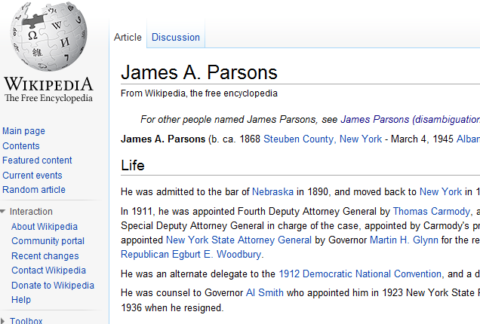
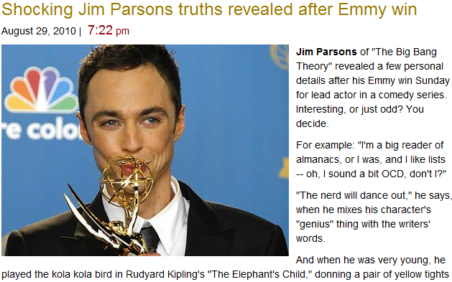

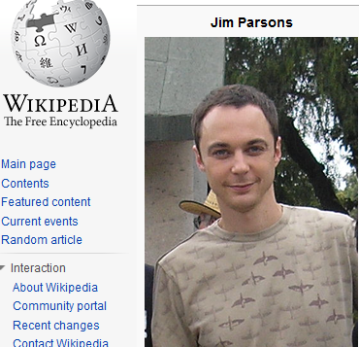
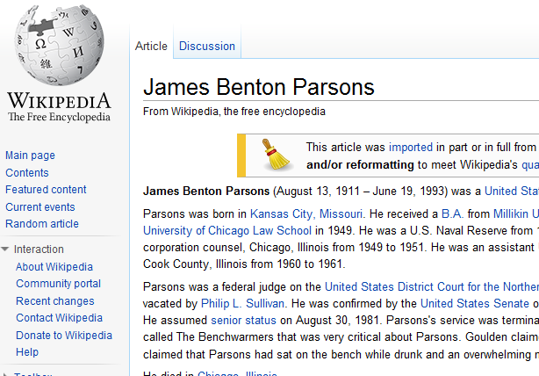
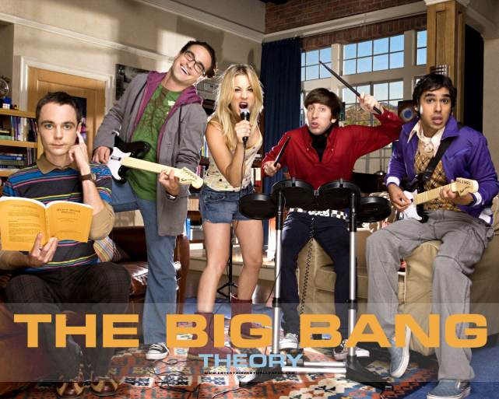
Entity Linking
NIL
Query = “James Parsons”
(Chen and Ji, EMNLP2011)
Notes:
So what’s new here. First of all we can disamgiguate queries. When we want to construct a wikipedia page for james parsons, our techniques can tell whether he is the james. A. parsons or james. B. parsons, or neither of them

Slide 85
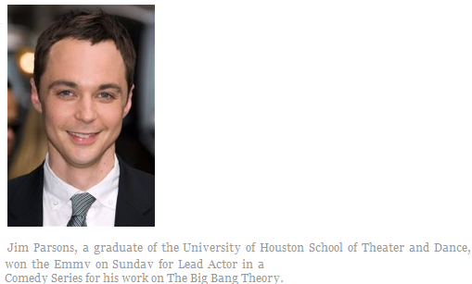
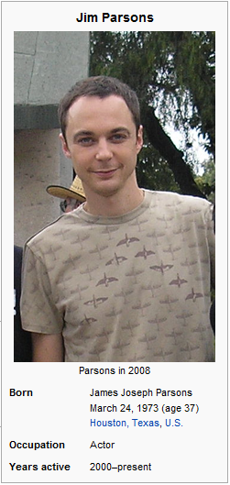
Slot Filling
School Attended: University of Houston

Slide 86
Time-intensive Slot Types
Person |  | Organization
per:alternate_names | per:title | org:alternate_names
per:date_of_birth | per:member_of | org:political/religious_affiliation
per:age | per:employee_of | org:top_members/employees
per:country_of_birth | per:religion | org:number_of_employees/members
per:stateorprovince_of_birth | per:spouse | org:members
per:city_of_birth | per:children | org:member_of
per:origin | per:parents | org:subsidiaries
per:date_of_death | per:siblings | org:parents
per:country_of_death | per:other_family | org:founded_by
per:stateorprovince_of_death | per:charges | org:founded
per:city_of_death |  | org:dissolved
per:cause_of_death |  | org:country_of_headquarters
per:countries_of_residence |  | org:stateorprovince_of_headquarters
per:stateorprovinces_of_residence |  | org:city_of_headquarters
per:cities_of_residence |  | org:shareholders
per:schools_attended |  | org:website
86

Slide 87
Temporal Slot Filling (TSF)
Given a query entity, a knowledge base (KB) and a source corpus, a system must return slot fills and temporal information must be gathered across the entire corpus
Query Example
  <query id="SFT201">
  <name>Angela Merkel</name>
  <docid>NYT_ENG_20071015.0123.LDC2009T13</docid>
  <enttype>PER</enttype>
  <nodeid>E0288830</nodeid>
  </query>
Output Example
  SFT201 per:countries_of_residence T2 20051231 AFP_ENG_20081022.0383 Germany
  SFT201 per:countries_of_residence T3 20081022 AFP_ENG_20081022.0383 Germany
  SFT201 per:spouse T1 19980101 APW_ENG_20051122.0372.LDC2007T07 Joachim Sauer
  SFT201 per:spouse T2 19981231 APW_ENG_20051122.0372.LDC2007T07 Joachim Sauer
  SFT201 per:spouse T3 20051122 APW_ENG_20051122.0372.LDC2007T07 Joachim Sauer
87

Slide 88
Scoring Metric
Temporal Quality
  Let <t₁, t₂, t₃, t₄> be system output, <g₁, g₂, g₃, g₄> be gold standard
  An error of c time units produces a 0.5 score; scores produced with c = 1 year
  Each element in tuple is scored independently
  For temporal SF task, a correct slot fill with temporal information t gets credit Q(S) (instead of 1)
Overall Metric
  M: the number of system output tuples
  N: the number of gold standard tuples
  C(S): the number of instances that have correct slot fills
88

Slide 89
Evaluation Metric and Formal Constraints (Cont’)
Parameterization Constraint
  A parameter should determine if a certain amount of vagueness is worse/better than a certain amount of over-constraining
If :
If :
Parameterization Constraint
  A parameter should determine if a certain amount of vagueness is worse/better than a certain amount of over-constraining
If :
If :
g₁
g₂
g₃
g₄
t₂
t₁
t₃
t₄
t₁
t₂
t₃
t₄

Slide 90
Evaluation Examples
Infinite = 10000 -Infinite = 0
C_{cons} = C_{vag} = 5
t₃
S
Q=0.25
t₁
t₂
t₃
t₄
S
Q=0.61
t₁
t₂
t₃
t₄
S
Q=0.33
t₁
t₂
t₃
t₄
S
Q=0.5
t₁
t₂
t₃
t₄
S
Q=1
g₁
g₂
g₃
g₄
S_{g}
1940
1945
1950
1955
1960
1965
1970
1975
1980
1985
1990

Slide 91
Evaluation Examples
Infinite = 10000 -Infinite = 0
C_{cons} = C_{vag} = 5
t₁
t₂
t₃
t₄
S
Q=0.5
t₂
t₃
S
Q=1
g₂
g₃
S_{g}
1940
1945
1950
1955
1960
1965
1970
1975
1980
1985
1990

Slide 92
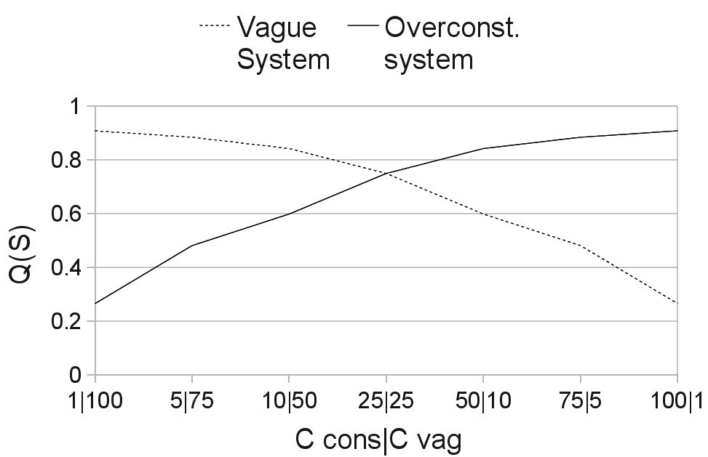
Parameterization
Randomly generate 100 gold standard tuples
Randomly generate Over-cons tuple and Vague tuple for each gold standard tuple by adding the same offsets to each element
Our metric is able to differentiate Over-cons and Vagueness by using different C_{cons} and C_{vag}

Slide 93
Approach
Overview
(Li et al., 2011;
Artiles et al., 2011)
Query
Regular Slot Filling
Source Collection
Slot Fills
Document Retrieval
Document
Level
Relevant Documents
Document Annotation
Name Tagging
TIMEX/TimeML
Coreference Resolution
Dependency Parsing
Sentence Retrieval
Sentence/Passage
Level
Time-Rich Relevant Sentences
Temporal Classification
Training Data/
External KB
(Distant Learning)
Time Expression
Level
Pattern
Classifier
Rules
Temporal Aggregation
Temporal Tuple
Level
Temporal Reasoning
Rules
Temporal Tuples
93
Notes:
To add details of each step; Retrieve the relevant documents from the KBP source collection.
Pre-process the documents with name tagging, coreference and dependency parsing
Find sentences that mention both the entity and slot value (looking into coreference chains).
We consider two problems:
Classification of temporal expressions
Aggregation of temporal information

Slide 94
Regular Slot Filling
(Chen et al., 2010; Tamang and Ji, 2011)
Query expansion based on templates and Wikipedia links
Pattern Learning
  Selection of query-answer pairs from Wikipedia Infobox
    split into two sets
  Pattern extraction
    For each {q,a} pair, generalize patterns by entity tagging and regular expressions e.g. <q> died at the age of <a>
  Pattern assessment
    Evaluate and filter based on matching rate
  Pattern matching
    Combine with coreference resolution
  Answer filtering based on entity type checking, dictionary checking and dependency parsing constraint filtering
94
Notes:
KBP specific: have to combine with coref, candidate answer extraction, give example
CUNY-NLP Seminar

Slide 95
Regular Slot Filling (Cont’)
Automatic Content Extraction (ACE) Information Extraction
  Apply ACE Cross-document IE (Ji et al., 2009)
  Mapping ACE to KBP
Question Answering
  Apply open domain QA system, OpenEphyra (Schlaefer et al., 2007)
  Relevance metric related to PMI and CCP
      P (q, a) = P (q NEAR a): NEAR within the same sentence boundary
  Heuristic rules for Answer Filtering
95
Notes:
Relevance metric is needed b/c it is very noisy data
CUNY-NLP Seminar

Slide 96
Regular Slot Filling (Cont’)
Maximum Entropy (MaxEnt) based supervised re-ranking model to re-rank candidate answers for the same slot
Low-Transparency Features
  System and Slot Type: identifies the system of origin and the slot type
  Number of Tokens and Slot Type: the number of tokens in the answer by the slot type
  Answer Frequency
High-Transparency Features
  Answer Name Type: the name type of the candidate answer
  Dependence Parse and its length
  Trigger Words: if a slot type related trigger word is in the system provided context sentence
  Comma Delimited List: if the context sentence is a long comma delimited list
  Query Subset of Answer: if the query is a subset of the answer
  Invalid Answer: if an answer is listed in set of predefined invalid answers (e.g., \the" or \city")
  Date/Age/Number Validation
  Country, City, Nationality and Title Validation with gazetteer
  …
96
Notes:
Extract the following features using the context sentence, slot type, answer name type etc
Use a training set to model the max ent distribution for the answer set and generate feature weights.
Feature weights obtained from training set are then used to re-rank answers by updating confidence values.

Slide 97
Temporal Classification
In 1975, after being fired from Columbia amid allegations that he used company funds to pay for his son's bar mitzvah, Davis founded Arista
  Is ‘1975’ related to the employee_of relation between Davis and Arista?
  If so, does it indicate START, END, HOLDS… ?
Each classification instance represents a temporal expression in the context of the entity and slot value.
We consider the following classes
  START Rob joined Microsoft in 1999.
  END Rob left Microsoft in 1999.
  HOLDS In 1999 Rob was still working for Microsoft.
  RANGE Rob has worked for Microsoft for the last ten years.
  NONE Last Sunday Rob’s friend joined Microsoft.
97

Slide 98
Temporal Aggregation
What is the best way to combine a set of classified temporal expressions in a 4-tuple?
  Individual classifications can be in conflict
  Temporal classifier makes mistakes
A temporal expression is normalized, classified and mapped to a 4-tuple
  START <T_{a}, T_{b}, T_{a}, +INF>
  END <-INF, T_{b}, T_{a}, T_{b}>
  HOLDS <-INF, T_{a}, T_{b}, +INF>
  RANGE <T_{a}, T_{b}, T_{a}, T_{b}>
  NONE <-INF, INF, -INF, INF>
Iterative aggregation (Li et al., 2012)
Aggregation with global constraints (McClosky and Manning, 2012)
Notes:
98
Mention the problems of aggregation
Different granularities (year, month…).
Classification errors.
We consider document creation time and simple timeline blocks in the text

Slide 99
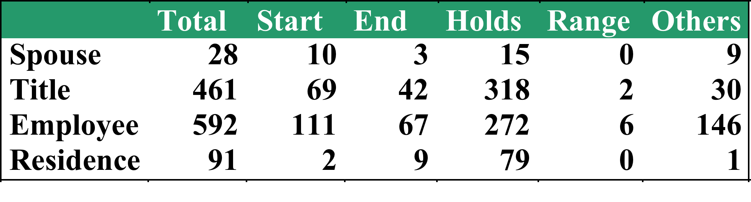
Annotation Challenges
Manually annotated data is not enough (1,172 instances
for 8 slot types)
Moderate inter-annotator agreement (pairwise Cohen's Kappa of 0.57)
Many simple but useless sentences/patterns:
  ``Tom LaSorda, president and CEO, Sept. 2005-Aug. 2007
  Dieter Zetsche, president and CEO, Nov. 2000- Sept. 2005
  …
  Eugene A. Cafiero, president, Oct. 1975-Nov. 1978”
99
Notes:
. Such instances are not representative of the entire source collection and not useful for learning new features
by clustering sentences into topics and ordering sentences on a time line. However, many sentences in news articles include multiple events with different time arguments. And it was not clear how the errors of topic clustering techniques affected the inference scheme. Therefore it will be valuable to design inference methods for more fine-grained events.

Slide 100
Annotation Challenges (Cont’)
Explicit temporal information is very sparse and scattered across documents
  35 of the 107 KBP queries with “employee_of” answers have documents including temporal arguments
  1/3 queries could be reliably associated with either a start or end date
  On average 518 relevant documents returned for <entity, slot>, but only 21 sentences returned for <entity, slot, temporal expression>
100
Notes:
. Such instances are not representative of the entire source collection and not useful for learning new features
by clustering sentences into topics and ordering sentences on a time line. However, many sentences in news articles include multiple events with different time arguments. And it was not clear how the errors of topic clustering techniques affected the inference scheme. Therefore it will be valuable to design inference methods for more fine-grained events.

Slide 101
Solution: Distant Supervision (Mintz et al., 2009)
Retrieve events from a Knowledge Base (Freebase)
Collect top web search results for
“Entity A” “Entity B”
Collect all sentences that mention the two entities.
Label to each temporal expression.
We compare with the corresponding information in the Knowledge Base
Slot type: per_spouse
<John, Mary, 1997, 2003>
www.mary-and-john.com
www.mymarriage.com/john33/
www.wedding-photos.com/joma/
...
On 1997, John and Mary renewed their vows in Florida.
START---HOLDS---END
KB.: 1997 2003
Sent.: 1997
101
Notes:
Distant supervision is a learning paradigm that exploitsknown relations (usually obtained from an existing database) toextract contexts from a large documentcollection and automatically label them accordingly.
The general intuition is that whenever twoentities that are known to participate in a relation appear in thesame context, this context is likely to express this relation in someway. By extracting many such contexts, different ways ofexpressing the same relation will be captured and a general model maybe abstracted by applying machine learning methods to the annotated data.
In addition to providing a mechanism to create a labeled training set when no human annotated dataset is available, classifiers trained with distant supervision present the benefit that they are less prone to over-fitting than those learned from manual annotations.
We assume that we can label a context containing a temporal expression and an entity/slot fill pair by comparing the temporal expression to the start/end temporal information that is stored in our database.For instance, Freebase states that ``John" worked for ``Nissan" between ``2001" and ``2009". Confronted with the sentence, ``\emph{Nissan chief engineer JohnSmith gave a lecture at UCLA on the 12 of December 2003.}'' our distant supervision method compares the temporal expression ``\emph{12 of December2003}'' to the known temporal information in the database. Since this time expression ``2003" falls in between the 2001 and 2009, it's assigneda ``\emph{HOLD}" label.
Add examples about noisy examples
Make more clear that a date that falls outside the KB information will turn into a NONE label
How do we justify that DS is better than manual quantitatively?
Can we train with the manual data?
Add motivation for Distant Supervision
Look at the results with the manual data from first TSF submission

Slide 102
Distant Supervision Results
Category | Type | Total | Start | End | Holds | Range | Others
Spouse | Manual | 28 | 10 | 3 | 15 | 0 | 9
 | Automatic | 10,196 | 2,463 | 716 | 1,705 | 182 | 5,130
Title | Manual | 461 | 69 | 42 | 318 | 2 | 30
 | Automatic | 14,983 | 2,229 | 501 | 7,989 | 275 | 3,989
Employment | Manual | 592 | 111 | 67 | 272 | 6 | 146
 | Automatic | 17,315 | 3,888 | 965 | 5,833 | 403 | 6,226
Residence | Manual | 91 | 2 | 9 | 79 | 0 | 1
 | Automatic | 4,168 | 930 | 240 | 727 | 18 | 2,253
We obtained over 50k training instances with no human intervention
102
Notes:
by clustering sentences into topics and ordering sentences on a time line. However, many sentences in news articles include multiple events with different time arguments. And it was not clear how the errors of topic clustering techniques affected the inference scheme. Therefore it will be valuable to design inference methods for more fine-grained events.

Slide 103
Advantages of Distant Supervision
Diverse contexts that can be captured
  Common patterns
  Alexander and Susan married on Jan. of 2005.
  Less common patterns
  On September 2002 Mary Jones and John Smith eloped on the SF bay.
  Implied information…
  After John's death in 2003, Mary fought with his children over the distribution of the Senator’s state.
103
Notes:
by clustering sentences into topics and ordering sentences on a time line. However, many sentences in news articles include multiple events with different time arguments. And it was not clear how the errors of topic clustering techniques affected the inference scheme. Therefore it will be valuable to design inference methods for more fine-grained events.

Slide 104
More Annotation Challenges
Each knowledge base entry includes temporal information in addition to an entity, slot fill pair
Noise can be introduced when the unlabeled data is collected from the Web:
  Coreference errors yield incorrect name matching
  Temporal expressions are normalized incorrectly
  Temporal information with different granularities
  “John married Mary in 1997” → “September 3, 1997” as a START?
  Knowledge base may contain incorrect or contradictory information with Web documents
Over 100,000 features are required to generalize the complicated contexts for each slot type, data sparsity → Learning supervised models becomes unfeasible
104
Notes:
by clustering sentences into topics and ordering sentences on a time line. However, many sentences in news articles include multiple events with different time arguments. And it was not clear how the errors of topic clustering techniques affected the inference scheme. Therefore it will be valuable to design inference methods for more fine-grained events.

Slide 105
Wrong Assumptions
One sense per query
  Raul Castro set the date for local (city and town) general elections as October 21 with a second round October 28.
One query per context
  Slow Club ’s Chris Kronner faced similar challenges taking on his second executive chef position at Serpentine , which opened in December.
One sentence per query
  Applied at the sentence-level, e.g. assume three elements in the tuple should exist in the same sentence after entity coreference resolution
  Invalid when a document is typically talking about a centroid entity (e.g. the employment history of a person or an organization)
105
Notes:
One basic assumption of distant supervision is that an unstructured
context containing elements matching a structured KB entry
expresses the same relation as the KB entry. This assumption is often
invalid, especially when an element of the entry has more than
one sense. For example, one KB entry indicates “RAUL CASTRO"
is a “general" during the document creation time; the one sense per
query assumption leads to the following false positive:
A context sentence that mentions the tuple of <query, slot fill,
time expression> is likely to express the relations among these
three elements. However, any given temporal expression is related
to a multitude of events and relations. Thus, in the presence of other
entities that could in principle be related to a context temporal
expression, it can be difficult to determine the context actually expresses
the relationship that holds between the query, slot fill, and
temporal expression in question. A possible solution is to assume
that all entities are competing for the temporal expression. Then we
can compare their confidence values to filter out some false positives.
In the following example that is identified as a context sentence
for <Chris Kronner, Slow Club, December>:
. In such a document, a distant supervision approach
should locate the centroid query or slot fill and search for
context sentences that include the other elements of a KB entry for
that query.

Slide 106
Solutions 1: Multi-layer Annotations
(Artiles et al., 2011)
Document segmentation for fine-grained reference date extraction
  “Aug. 6, 2007: Bob Nardelli appointed Chrysler chairman and CEO. “
Multi-layer annotations to expand relevant sentence matching
  name tagging
  co-reference chains
  dependency parses
106
Notes:
by clustering sentences into topics and ordering sentences on a time line. However, many sentences in news articles include multiple events with different time arguments. And it was not clear how the errors of topic clustering techniques affected the inference scheme. Therefore it will be valuable to design inference methods for more fine-grained events.

Slide 107
Solution 2: Global Time Discovery
Half of the event instances don’t include explicit time arguments
Prior work of detecting implicit time arguments
  Filatova and Hovy, 2001; Mani et al., 2003; Lapata and Lascarides, 2006; Eidelman, 2008
  Most work focused on sentence level
  Linguistic evidence such as verb tense was used for inference
Cross-event Inference (Gupta and Ji, 2009)
  More fine-grained events
  An event mention and all of its coreferential event mentions do not include any explicit or implicit time expressions
107
Notes:
107
by clustering sentences into topics and ordering sentences on a time line. However, many sentences in news articles include multiple events with different time arguments. And it was not clear how the errors of topic clustering techniques affected the inference scheme. Therefore it will be valuable to design inference methods for more fine-grained events.

Slide 108
Observations about Events in News
Based on series of events
  Various situations are evolving, updated, repeated and corrected in different event mentions
Events occur as chains
  Conflict→Life-Die/Life-Injure
  Justice-Convict → Justice-Charge-Indict/Justice-Trial-Hearing
Writer won’t mention time repeatedly
  To avoid redundancy, rarely provide time arguments for all of the related events
Reader is expected to use inference
  On Aug 4 there is fantastic food in Suntec…Millions of people came to attend the IE session. → the IE session is on Aug 4
108

Slide 109
Background Knowledge Reasoning
Time Search from Related Documents
  [Test Sentence]
  <entity>Al-Douri</entity> said in the <entity>AP</entity> interview he would love to return to teaching but for now he plans to remain at the United Nations.
  [Sentences from Related Documents]
  In an interview with <entity>The Associated Press</entity>
  <time>Wednesday<time> night, <entity>Al-Douri</entity> said he will continue to work at the United Nations and had no intention of defecting.
Time Search from Wikipedia
  [Test Sentence]
  <person>Diller</person> started his entertainment career at <entity>ABC</entity>, where he is credited with creating the ``movie of the week'' concept.
  [Sentences from Wikipedia]
  <person>Diller</person> was hired by <entity>ABC</entity> in <time>1966</time> and was soon placed in charge of negotiating broadcast rights to feature films.
109
Notes:
109

Slide 110
Time Propagation between Events
Event Mention with time
Kurdish
Injured Russian diplomats and a convoy of America's Kurdish comrades in arms
were among unintended victims caught in crossfire and friendly fire Sunday.
Kurds said 18 of their own died in the mistaken U.S. air strike.
America
fire
Sunday
crossfire
[Sunday]
Event Mention without time
Kurds
died
U.S.
strike
Event Mention with time
A state security court suspended a newspaper critical of the government
Saturday after convicting it of publishing religiously inflammatory material.
The sentence was the latest in a series of state actions against the Monitor,
the only English language daily in Sudan and a leading critic of conditions in the
south of the country, where a civil war has been waged for 20 years.
state security court
newspaper
Saturday
[Saturday]
convicting
Event Mention without time
sentence
state
Monitor
(Gupta and Ji, 2009)
110
Notes:
110

Slide 111
Inference Rules
Same-Sentence Propagation
  EM_{i} and EM_{j} are in the same sentence and only one time expression exists in the sentence
Relevant-Type Propagation
  type_{i}= “Conflict”, type_{i}= “Life-Die/Life-Injure”
  arg_{i} is coreferential with arg_{j}
  role_{i}=“Target” and role_{j}=“Victim”, or role_{i}=role_{j}= “Instrument”
Same–Type Propagation
  arg_{i} is coreferential with arg_{j}, type_{i}= type_{j}, role_{i}= role_{j}, and match time-cue roles
Results: 72.2% F-measure
Type_{i} | Role_{i} | Type_{i} | Role_{i}
Conflict | Target/Attacker/Crime | Movement-Transport | Destination/Origin
Justice | Defendant/Crime/Plaintiff | Transaction | Buyer/Seller/Giver/Recipient
Life-Die/Life-Injure | Victim | Contact | Person/Entity
Life-Be-Born/Life-Marry/Life-Divorce | Person/Entity | Personnel | Person/Entity
 |  | Business | Organization/Entity
111

Slide 112
Solutions 3: Feature Reduction and Instance Re-labeling (Tamang and Ji, 2012)
Feature Reduction
  Test the statistical significance of each feature as a predictor for a temporal class label using multi-class logistic regression
  Create a minimal feature set
Relabeling
  Approximately 0.01% of the distant supervision data for each slot was labeled
  Lasso regression was used to classify the unlabeled instances using self-training techniques
112
Notes:
by clustering sentences into topics and ordering sentences on a time line. However, many sentences in news articles include multiple events with different time arguments. And it was not clear how the errors of topic clustering techniques affected the inference scheme. Therefore it will be valuable to design inference methods for more fine-grained events.

Slide 113
Solutions 4: Multi-instance Multi-label Learning (Surdeanu et al., 2012)
n: the number of distinct tuples in knowledge base
M_{i}: the set of mentions for the i^{th} entity pair
x: a sentence
z: latent relation classification for x
w_{z}: weight for muli-class mention-level classifier
y_{j}: top-level classification decision as to whether the j^{th} relation holds
w_{j}: weight vector for binary top-level classifier for the j^{th} relation
Training based on Expectation Maximization (EM)
w₁
…
w_{j}
…
w_{k}
…
y₁
y_{k}
…
y_{j}
z
x
|M_{i}|
n
w_{z}
113
Notes:
by clustering sentences into topics and ordering sentences on a time line. However, many sentences in news articles include multiple events with different time arguments. And it was not clear how the errors of topic clustering techniques affected the inference scheme. Therefore it will be valuable to design inference methods for more fine-grained events.

Slide 114
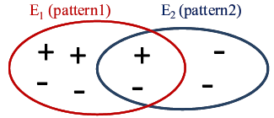
Solutions 5: Pattern Re-weighting
(Takamatsu et al., 2012)
A generative model to predict whether each pattern expresses each relation via hidden variables
Remove wrong labels using the negative pattern list
Probability of instances in E1 expressing pattern 1 = 3/6=0.5
Probability of instances in E2 expressing pattern 2 = 3/6*2/4=0.25
114
Notes:
by clustering sentences into topics and ordering sentences on a time line. However, many sentences in news articles include multiple events with different time arguments. And it was not clear how the errors of topic clustering techniques affected the inference scheme. Therefore it will be valuable to design inference methods for more fine-grained events.

Slide 115
Temporal Classification Challenges
Problems
  Capture long contexts
Solutions
  Use parsing structures to compress long contexts
  Core NLP annotation tools (e.g. dependency parsing, coreference) are far from perfect, not robust enough
  Tradeoff between flat representation and structured representation
115
Notes:
by clustering sentences into topics and ordering sentences on a time line. However, many sentences in news articles include multiple events with different time arguments. And it was not clear how the errors of topic clustering techniques affected the inference scheme. Therefore it will be valuable to design inference methods for more fine-grained events.

Slide 116
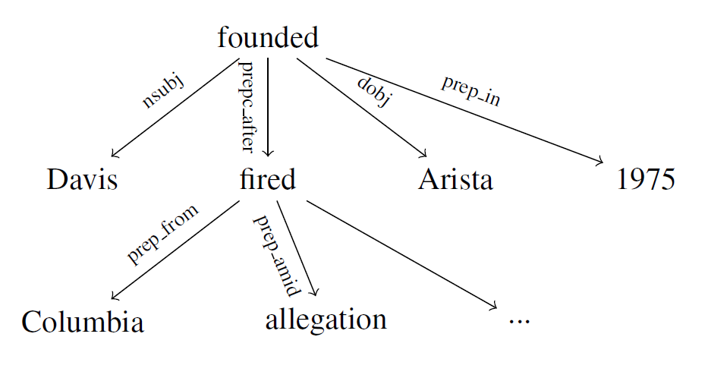
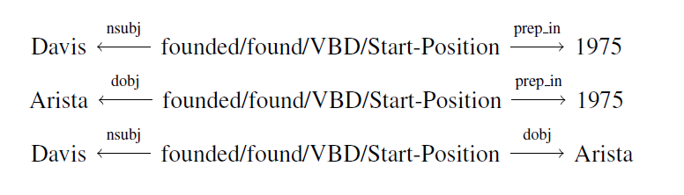
Structured Representation Approach
Representation based on three shortest dependency paths
In 1975, after being fired from Columbia amid allegations that he used company funds to pay for his son's bar mitzvah, Davis founded Arista.
Surface sentence:
  Long distance between 1975 and Davis founded Arista
  Some words in between cause ambiguity: fired
Dependency paths:
  Help remove irrelevant information
  Build syntactic and semantic links from long distance
116

Slide 117
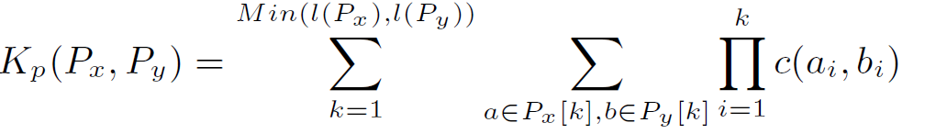
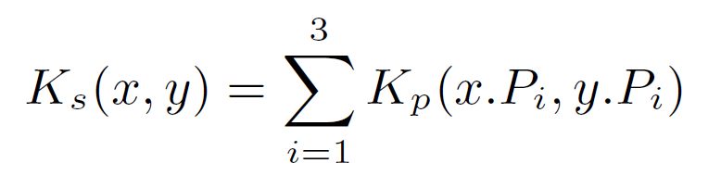
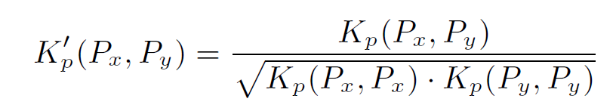
Structured Representation Approach
Kernel function on two paths: enumerate all sub-patterns in two paths
  Count number of common substrings
  a is any substring of P_{x} with length k
  c(a_{i}, b_{i}) is inner product of feature vector of nodes a_{i} and b_{i}
Kernel function on two sentences: combine kernel values of three paths
Normalization: avoid bias towards long paths
117
Notes:
117
Replace these sentences with the purpose of the formula, just like the last bullet

Slide 118
Flat Representation Approach
Window of words around TARGET_DATE, TARGET_ENTITY and TARGET_ATTRIBUTE.
Shallow Dependency Features: governor and dependent words of the target entity, date and attribute
Sentences are normalized for the specific query (entity and attribute) and target date.
  In 1975, after being fired from Columbia amid allegations that he used company funds to pay for his son's bar mitzvah, Davis founded Arista.
  In TARGET_DATE, after being fired from ORGANIZATION amid allegations that TARGET_ENTITY used company funds to pay for TARGET_ENTITY son's bar mitzvah, TARGET_ENTITY founded TARGET_ATTRIBUTE.
118
Notes:
Animate to show from the example the win
No need to explain what a window feature is
Window Features: words surrounding the target entity, date and attribute.
TARGET_DATE: in, after, fired…
TARGET_ENTITY: allegations, company…
TARGET_ATTRIBUTE: founded, TARGET_ENTITY...
.
TARGET_DATE governs: found
TARGET_ENTITY governs: used, son, found
TARGET_ATTRIBUTE governs: found

Slide 119

Evaluation Data Set
KB: October 2008 dump of English Wikipedia, 818,741 nodes
Source Corpus: includes 1,286,609 newswire documents, 490,596 web documents and hundreds of transcribed spoken documents
100 queries, 80 person entities and 20 organization entities
Gold-standard creation: pooled the responses from all the systems and human annotators; human assessors judged the responses
Slot Type | # of Tuples
per:countries_of_residence | 287
per:statesorprovinces_of_residence | 44
per:cities_of_residence | 109
per:member_of | 86
per:employee_of | 20
per:title | 89
per:spouse | 52
org:top_members/employees | 24
total | 711
Notes:
119
Animate to show from the example the win
No need to explain what a window feature is
Window Features: words surrounding the target entity, date and attribute.
TARGET_DATE: in, after, fired…
TARGET_ENTITY: allegations, company…
TARGET_ATTRIBUTE: founded, TARGET_ENTITY...
.
TARGET_DATE governs: found
TARGET_ENTITY governs: used, son, found
TARGET_ATTRIBUTE governs: found

Slide 120
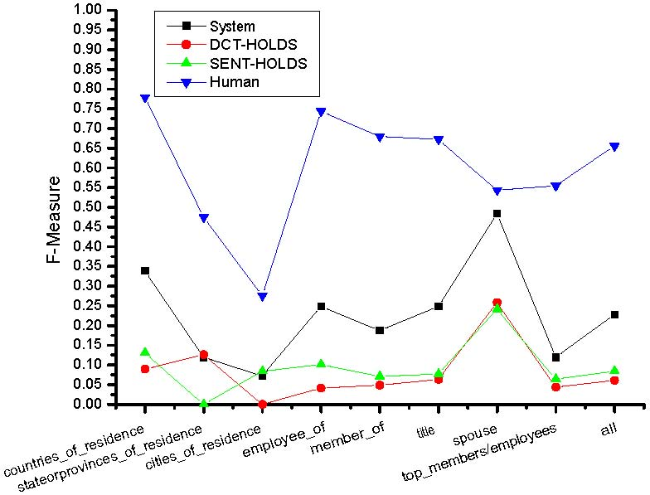
Overall Performance
DCT-HOLDS: use document creation time as HOLD
SENT-HOLDS: using explicit time in sentence as HOLD
Ranked Top 1 in NIST TAC-KBP 2011 Evaluation
120
Notes:
120
Animate to show from the example the win
No need to explain what a window feature is
Window Features: words surrounding the target entity, date and attribute.
TARGET_DATE: in, after, fired…
TARGET_ENTITY: allegations, company…
TARGET_ATTRIBUTE: founded, TARGET_ENTITY...
.
TARGET_DATE governs: found
TARGET_ENTITY governs: used, son, found
TARGET_ATTRIBUTE governs: found

Slide 121
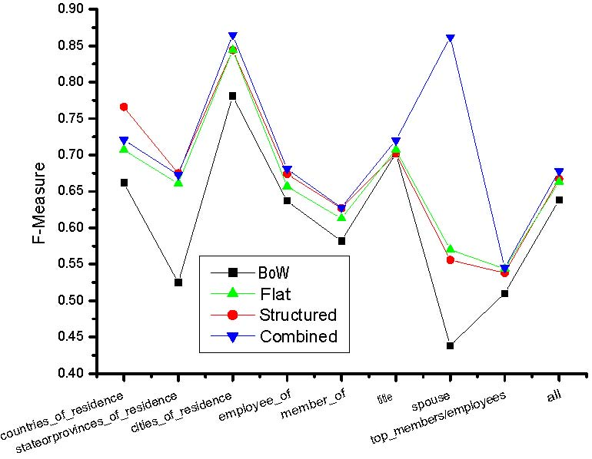
Comparison on Classification Approaches
121
Notes:
121
Structured approach outperforms the flat approach for all slot types except “per:title" which usually involves shorter contexts.
Combining both approaches can achieve a higher performance.
Gains by the structured approach are highly correlated with the compression rate for certain slot types.
1 - lengths of dependency paths [query, slot fill, time expression]
# context words
Animate to show from the example the win
No need to explain what a window feature is
Window Features: words surrounding the target entity, date and attribute.
TARGET_DATE: in, after, fired…
TARGET_ENTITY: allegations, company…
TARGET_ATTRIBUTE: founded, TARGET_ENTITY...
.
TARGET_DATE governs: found
TARGET_ENTITY governs: used, son, found
TARGET_ATTRIBUTE governs: found

Slide 122
Flat works but Structured doesn’t
Structured fails to distill informative pattern from parsed tree
  Avi Dichter per_employee_of Brookings Institute Sep 2005 In September 2005, Dichter left office and became a research fellow at the Brookings Institute in Washington , D.C.
Flat classifier: Start
Structured classifier: None
Dependency paths are inappropriate:
Dichter (nsubj)← left →(prep_in) September
Institute (prep_at)← fellow (conj_and)← left →(prep_in)September
Dichter (nsubj)← left →(conj_and) fellow →(prep_at)Institute
122

Slide 123
Structured works but Flat doesn’t
Central Theoretical Council org_top_members_employees Nguyen Phu 2001
  Trong became secretary of the Hanoi Party Committee in January 2000, chairman of the Central Theoretical Council in 2001, member of the CPVCC in April 2001, and member of the Political Bureau in April 2006.
  TARGET_ENTITY became TITLE_GAZ of the ORGANIZATION in DATE, TITLE_GAZ of the TARGET_ATTRIBUTE in TARGET_DATE, member of the cpvcc in DATE , and member of the ORGANIZATION in DATE
Flat classifier : None
Structured classifier: Start
Dependency Paths:
Trong (nsubj)← became→(dobj) secretary→(conj_and) chairman→(prep_of) Council→(prep_in) 2001
Council→(prep_in) 2001
Trong (nsubj)← became→(dobj) secretary→(conj_and) chairman→(prep_of)Council
123

Slide 124
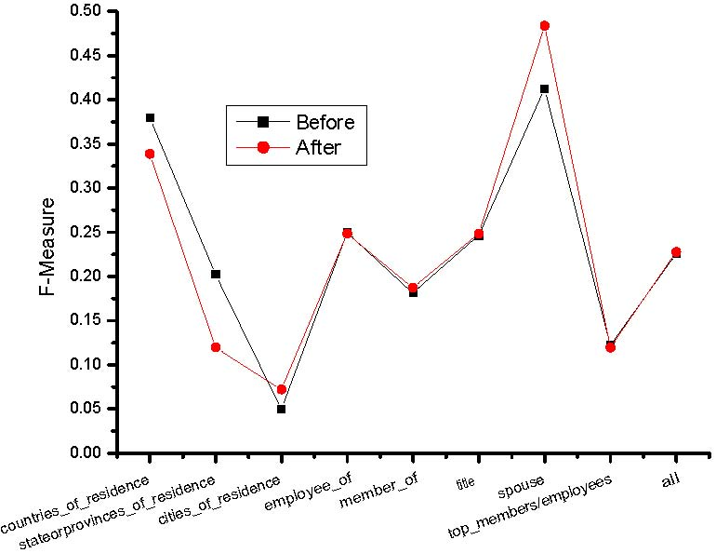
Re-labeling Results
Features | residence | title | spouse | employment
Initial set | 10757 | 31947 | 40979 | 51399
Final set | 451 | 2024 | 1247 | 2151
Reduction (%) | 95.81 | 93.67 | 96.96 | 95.82
For structured approach
124
Notes:
by clustering sentences into topics and ordering sentences on a time line. However, many sentences in news articles include multiple events with different time arguments. And it was not clear how the errors of topic clustering techniques affected the inference scheme. Therefore it will be valuable to design inference methods for more fine-grained events.

Slide 125
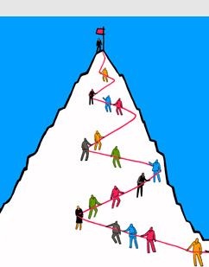
Remaining Challenges
125
Notes:
125

Slide 126
Capture Implicit and Wide Context
Sutil, a trained pianist, tested for Midland in 2006 and raced for Spyker in 2007 where he scored one point in the Japanese Grand Prix.
Daimler Chrysler reports 2004 profits of $3.3 billion; Chrysler earns $1.9 billion.
“Daimler Chrysler is not yet where we want it to be, but we are headed precisely in the right direction”, Schrempp says.
126
Notes:
126
Add examples

Slide 127
Coreference Resolution Errors
Name Coreference: “R” = “Republican Party”, “Brooklyn Dodgers” = “Brooklyn”
Nominal Coreference
  Almost overnight, he became fabulously rich, with a $3-million book deal, a $100,000 speech making fee, and a lucrative multifaceted consulting business, Giuliani Partners. As a celebrity rainmaker and lawyer, his income last year exceeded $17 million. His consulting partners included seven of those who were with him on 9/11, and in 2002 Alan Placa, his boyhood pal, went to work at the firm.
  After successful karting career in Europe, Perera became part of the Toyota F1 Young Drivers Development Program and was a Formula One test driver for the Japanese company in 2006.
  “Alexandra Burke is out with the video for her second single … taken from the British artist’s debut album”
  “a woman charged with running a prostitution ring … her business, Pamela Martin and Associates”
Pronoun Coreference
  Meteorologist Kelly Cass became an On-Camera Meteorologist at The Weather Channel, after David Kenny was named the chairman and chief executive. She first appeared on air at The Weather Channel in January 2000.
127
Notes:
127
IE’s application

Slide 128
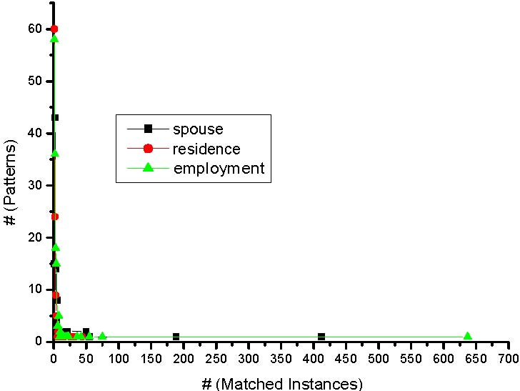
Long-tail distribution of patterns
would join
would be appointed
will start at
went to work
was transferred to
was recruited by
took over as
succeeded PERSON
began to teach piano
…
128
Notes:
128
Add examplesA few patterns match many instances, while a high percentage of patterns match only a few instances.

Slide 129
Toward Temporal Reasoning
Sheetrit is a Knesset (parliament) member.
Sheetrit was born in Morocco and immigrated to Israel in 1957.
Reference date = December 8, 2012
Without Reasoning
Query | Slot Type | Slot Fill | T1 | T2 | T3 | T4
Sheetrit | Member_of | Knesset | -∞ | 2012-12-08 | 2012-12-08 | +∞
Sheetrit | Resident | Morocco | -∞ | -∞ | 1957-01-01 | 1957-12-31
Sheetrit | Resident | Israel | 1957-01-01 | 1957-12-31 | +∞ | +∞
129
Notes:
129
Add examples

Slide 130
Facts are often Inter-dependent
Sheetrit is a Knesset (parliament) member.
Sheetrit was born in Morocco and immigrated to Israel in 1957.
Reference date = December 8, 2012
With Reasoning
Query | Slot Type | Slot Fill | T1 | T2 | T3 | T4
Sheetrit | Member_of | Knesset | -∞ | 2012-12-08 | 2012-12-08 | +∞
Sheetrit | Resident | Morocco | -∞ | -∞ | 1957-01-01 | 1957-12-31
Sheetrit | Resident | Israel | 1957-01-01 | 1957-12-31 | +∞ | +∞
2012-12-08
1957-01-01
Member (S, K) ^ Located (K, I) → Resident (S, I)
Member (S, K) cannot be earlier than Resident (S, I)
130
Notes:
130
Add examples

Slide 131
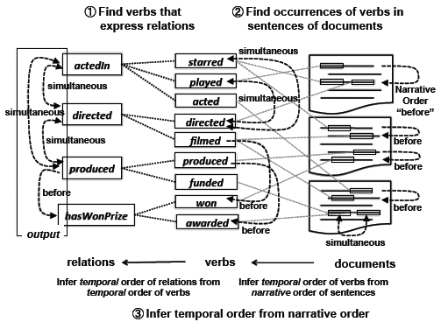
Learning Temporal Constraints among Relations (Talukdar et al., 2012)
131

Slide 132
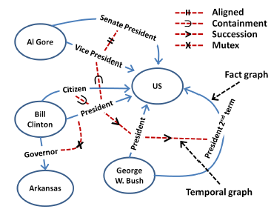
Joint Inference for TSF (Talukdar et al., 2012)
Solved by an Integer Linear Programming framework
132

Slide 133
Outline
Background: Motivations and Goals
Temporal Information Representation Theories
Temporal Expression Extraction and Normalization
Temporal Slot Filling
Tea Break
Event Timelining and Temporal Reasoning
Resources and Demos
Conclusions
11:30
133
Notes:
133

Slide 134
Outline
Background: Motivations and Goals
Temporal Information Representation Theories
Temporal Expression Extraction and Normalization
Temporal Slot Filling
Tea Break
Event Timelining and Temporal Reasoning
Resources and Demos
Conclusions
12:00
134
Notes:
134

Slide 135
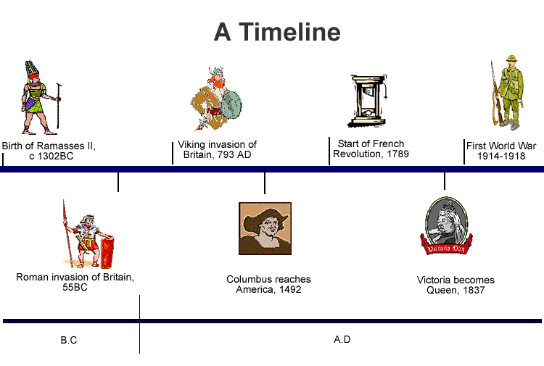
Event Timelining and Shallow Temporal Reasoning
135

Slide 136
An Example
Seventy-five million copies of the rifle have been
built since it entered production in February 1947.
(Publishing date: Feb. 27th, 1998)
Extraction | Normalization
 | Start point | End point
February 1947 | 1947-02-01 00:00:00 | 1947-02-28 23:59:59
since […] February 1947 | 1947-02-01 00:00:00 | 1998-02-27 23:59:59
Feb. 27th, 1998 | 1998-02-27 00:00:00 | 1998-02-27 23:59:59
basic
complex
Comparison examples:
Interval 1 | Interval 2 | I1 Vs. I2
February 1947 | since […] February 1947 | inside
February 1947 | Feb. 27th, 1998 | before

Slide 137
Event Timeline Construction
Wed., May 24th, 2006
[…] The Iraqi insurgents attacked a police station in Tal Afar on Tuesday killing 6 policemen and injuring 8 other people. This action is allegedly to respond to the bombing action by the coalition armies three days earlier in Baghdad. The police is now sketching a plan to arrest the insurgents in a campaign next week. […]
Motivation
Notes:
First of all, let me demonstrate the task by a concrete example.
We are now given a new text saying that “The Iraqi insurgents … in a campaign next week.”
137

Slide 138
Event Timeline Construction
Wed., May 24th, 2006
[…] The Iraqi insurgents attacked a police station in Tal Afar on Tuesday killing 6 policemen and injuring 8 other people. This action is allegedly to respond to the bombing action by the coalition armies three days earlier in Baghdad. The police is now sketching a plan to arrest the insurgents in a campaign next week. […]
Motivation
Event | Type | Trigger | Arguments
e₁ | Attack | attacked | Iraqi insurgents, police station, Tal Afar
e₂ | Kill | killing | Iraqi insurgents, 6 policemen, Tal Afar
e₃ | Injuring | injuring | Iraqi insurgents, 8 other people, Tal Afar
e₄ | Bombing | bombing | coalition armies, Baghdad
e₅ | Arrest | arrest | police, insurgents
Notes:
From this text, we can extract at least 5 events, including Attack, Kill, Injuring, Bombing and Arrest events. Each event is associated with the event trigger and a list of arguments. For example the Attack event is evoked by the “attacked” trigger and it takes some arguments including “Iraqi insurgents”, “police station”, and “Tal Afar”.
138

Slide 139
Event Timeline Construction
Document creation time: Wed., May 24th, 2006
[…] The Iraqi insurgents attacked a police station in Tal Afar on Tuesday killing 6 policemen and injuring 8 other people. This action is allegedly to respond to the bombing action by the coalition armies three days earlier in Baghdad. The police is now sketching a plan to arrest the insurgents in a campaign next week. […]
Motivation
Event | Type
e₁ | Attack
e₂ | Kill
e₃ | Injuring
e₄ | Bombing
e₅ | Arrest
Time | Temporal Expression
DCT | Wed., May 24th, 2006
t₁ | Tuesday
t₂ | three days earlier
t₃ | now
t₄ | next week
Normalized Time
2006-05-24
2006-05-23
2006-05-21
2006-05-24
2006-05-29
DCT = Document Creation Time
Notes:
Furthermore, we can also extract several temporal phrases from the text, such as Tuesday, three days earlier, now and next week. In addition, the document creation time is also another piece of temporal information. We can also normalize the temporal expressions to some canonical form.
139

Slide 140
Event Timeline Construction
Wed., May 24th, 2006
[…] The Iraqi insurgents attacked a police station in Tal Afar on Tuesday killing 6 policemen and injuring 8 other people. This action is allegedly to respond to the bombing action by the coalition armies three days earlier in Baghdad. The police is now sketching a plan to arrest the insurgents in a campaign next week. […]
Motivation
Event | Type
e₁ | Attack
e₂ | Kill
e₃ | Injuring
e₄ | Bombing
e₅ | Arrest
Time | Normalized Time
DCT | 2006-05-24
t₁ | 2006-05-23
t₂ | 2006-05-21
t₃ | 2006-05-24
t₄ | 2006-05-29
Temp. Relation
Overlaps(e₁, t₁)
Overlaps(e₂, t₁)
Overlaps(e₃, t₁)
Overlaps(e₄, t₂)
After(e₅, t₄)
Notes:
Now assume that we have an approach that can automatically associate the events and the time expressions with each other with some temporal relations such as “Occurs-At” and “Occurs-At-or-After”, we then can organize the events on a timeline based on their occurrence time.
140

Slide 141
Event Timeline Construction
A notational convention: granularity + axioms
Applications:
Event timeline supports discourse understanding, question answering, and news summarization.
Event timeline allows us to visualize the order of events’ occurrence and thus could support better data & knowledge acquisition.
Problem Definition:
Input:
+ A temporal ontology O_{T}
+ An event ontology O_{E}
+ A set of documents D
+ A list of events E=<e₁, e₂, …, e_{n}>
in D, following O_{E}
Output:
+ Order of events in E on a timeline with respect to O_{T}
Timeline
t₂=2006-06-21
t₁=2006-06-23
t₄=2006-06-29
e₄
e₁, e₂, e₃
e₅
Event | Type
e₁ | Attack
e₂ | Kill
e₃ | Injuring
e₄ | Bombing
e₅ | Arrest
Time | Normalized Time
DCT | 2006-05-24
t₁ | 2006-05-23
t₂ | 2006-05-21
t₃ | 2006-05-24
t₄ | 2006-05-29
Temp. Relation
Overlaps(e₁, t₁)
Overlaps(e₂, t₁)
Overlaps(e₃, t₁)
Overlaps(e₄, t₂)
After(e₅, t₄)
Notes:
Event timeline is important to support discourse understanding, question answering and news summarization. Also, event timeline allows us to visualize the occurrence order of events, and supports machines to acquire data effectively.
We define the problem as follows.
The system is given a temporal ontology OT, an event ontology OE, a set of documents D and a list of events E in D, following OE.
The system is expected to output the order of events in E on a timeline with respect to OT.
141

Slide 142
Towards Time Line Construction
There has been much work proposing various temporal ontologies and representations (e.g. Allen, 1983; Pustejovsky et al., 2003; Hobbs and Pan, 2004).
In order to support time line construction there is a need to extend existing representations. We will use the interval based representation described earlier to create a universal timeline relation representation that unifies the efforts of developing many temporal reasoning systems.
We will then present a timeline construction system that works and performs reasoning on the proposed universal representation.
Other temporal representations and data can be mapped to the universal representation, thus can be handled by the timeline construction system presented.
Notes:
There has been much work proposing various temporal ontologies and representation. We see that there is a need to unify the effort in this direction by introducing a universal timeline relation representation. We then develop a timeline construction system that works and performs reasoning on the proposed universal representation. When a new data comes in, its temporal ontology and data will first be mapped to the universal representation, thus can be handled by our timeline construction system.
142

Slide 143
An Overview of the Time Lining Approach
Input:
<O_{T}, O_{E}, D, E>
Recognizing temporal expressions in input documents.
Background Knowledge
Associating events and temporal expressions
Mapping input temporal ontology and data into the universal timeline relation representation.
Identifying relations between pairs of events and between event and temporal expressions.
Background Knowledge
Integrating background knowledge in a joint global inference model.
Output: Timeline

Slide 144
Interval Based Event Timeline Construction
Publishing date: Wed., May 24th, 2006
[…] The Iraqi insurgents attacked a police station in Tal Afar on Tuesday killing 6 policemen and injuring 8 other people. This action brings the casualties to over 3000 since the invasion of the coalition armies on 3/20/2003. Police wants to arrest the insurgents in a campaign next week. […]
Notes:
144

Slide 145
Interval Based Event Timeline Construction
Publishing date: Wed., May 24th, 2006
[…] The Iraqi insurgents attacked a police station in Tal Afar on Tuesday killing 6 policemen and injuring 8 other people. This action brings the casualties to over 3000 since the invasion of the coalition armies on 3/20/2003. Police wants to arrest the insurgents in a campaign next week. […]
e₁
e₂
e₃
e₄
e₅
e₆
Notes:
145

Slide 146
Interval Based Event Timeline Construction
Publishing date: Wed., May 24th, 2006
[…] The Iraqi insurgents attacked a police station in Tal Afar on Tuesday killing 6 policemen and injuring 8 other people. This action brings the casualties to over 3000 since the invasion of the coalition armies on 3/20/2003. Police wants to arrest the insurgents in a campaign next week. […]
e₁
e₂
e₃
e₄
e₅
e₆
EVENT: attacked
Agent: Iraqi insurgents
Victim: a police station
Location: Tal Afar
Time: Tuesday
killing(…)
arrest(…)
casualties(…)
injuring(…)
invasion(…)
Notes:
From this text, we can extract at least 5 events, including Attack, Kill, Injuring, Bombing and Arrest events. Each event is associated with an event trigger and a list of arguments. For example the Attack event is evoked by the “attacked” trigger and it takes some arguments including “Iraqi insurgents”, “police station”, and “Tal Afar”.
146

Slide 147
Interval Based Event Timeline Construction
I₁
Publishing date: Wed., May 24th, 2006
[…] The Iraqi insurgents attacked a police station in Tal Afar on Tuesday killing 6 policemen and injuring 8 other people. This action brings the casualties to over 3000 since the invasion of the coalition armies on 3/20/2003. Police wants to arrest the insurgents in a campaign next week. […]
I₂
I₄
I₃
I₅
Wed., May 24th, 2006
From: 2006-05-24 00:00:00
To: 2006-05-24 23:59:59
Tuesday
From: 2006-05-23 00:00:00
To: 2006-05-23 23:59:59
since […] 3/20/2003
From: 2003-03-20 00:00:00
To: 2006-05-24 23:59:59
3/20/2003
From: 2003-03-20 00:00:00
To: 2003-03-20 23:59:59
next week
From: 2006-05-29 00:00:00
To: 2006-06-04 23:59:59
Notes:
Furthermore, we can also extract several temporal phrases from the text, such as Tuesday, three days earlier, now and next week. In addition, the document publishing date is also another piece of temporal information. We can also normalize the temporal expressions to some intervals.
147

Slide 148
Interval Based Event Timeline Construction
I₁
Publishing date: Wed., May 24th, 2006
Comments on timepoint representation (in previous work):
As annotated in the TimeML corpus.
A collection of temporal relations between both event-time and event-event.
Redundant relations
Hard to construct a timeline of events across documents.
Inference model becomes cumbersome and less concise (compared to our representation).
[…] The Iraqi insurgents attacked a police station in Tal Afar on Tuesday killing 6 policemen and injuring 8 other people. This action brings the casualties to over 3000 since the invasion of the coalition armies on 3/20/2003. Police wants to arrest the insurgents in a campaign next week. […]
e₁
I₂
e₂
e₃
e₄
I₄
e₅
I₃
e₆
I₅
Previous work: Timepoint Representation
e₁
overlap
Tuesday
e₁
before
e₂
e₁
after
3/20/2003
e₂
overlap
e₃
e₅
before
next week
e₆
after
e₅
…
…
…
…
…
…
Notes:
Related work in literature usually uses a timepoint representation to model the problem. This representation is actually annotated in the TimeML corpus, which is a popular corpus in this research direction.
The timepoint representation is a collection of temporal relations between events and timepoints and events and events.
We argue that this representation has some limitation. First of all, to construct a timeline of event, it’s redundant to have temporal relations between all pairs of events and timepoints and events and events. Also, with this representation, it’s hard to construct a timeline of events across documents. Furthermore, it makes the inference model less concise compared to our representation, which I will present in the next slide.
148

Slide 149

Interval Based Event Timeline Construction
I₁
Publishing date: Wed., May 24th, 2006
Comments on our interval-based representation:
Allows constructing absolute timeline of events.
Supports constructing timeline of events across documents.
Concise inference model.
(For more discussion, see Do et. al, EMNLP 2012)
[…] The Iraqi insurgents attacked a police station in Tal Afar on Tuesday killing 6 policemen and injuring 8 other people. This action brings the casualties to over 3000 since the invasion of the coalition armies on 3/20/2003. Police wants to arrest the insurgents in a campaign next week. […]
e₁
I₂
e₂
e₃
e₄
I₄
e₅
I₃
e₆
I₅
Our interval representation:
casualties
e₄
invasion
attacked
killing
injuring
arrest
e₅
e₁
e₂/e₃
e₆
-∞
I₃
I₂
I₁
I₅
+∞
I₄
3/20/2003
since […] 3/20/2003
Tuesday
Wed., May 24th, 2006
next week
Notes:
We propose an interval-based representation. In our representation, each temporal expression is normalized to an absolute interval and put on a universal timeline. Each event is associated with an interval and have partial orders with some other event on the timeline. For example, event e1, e2 and e3 are map the to same interval I2, but e1 happends before e2 and e3, while e2 and e3 overlap with each other.
Our interval-based representation allows us to construct absolute timeline of events, so it’s easy to construct timeline of events across document. Also, our representation produces concise inference model.
149

Slide 150
Interval Based Event Timeline Construction
Our proposed document temporal structure:
I₁
I₂
I₃
I₄
I₅
e₁
e₂
e₃
e₅
e₄
e₆
Our interval representation:
casualties
e₄
invasion
attacked
killing
injuring
arrest
e₅
e₁
e₂/e₃
e₆
-∞
I₃
I₂
I₁
I₅
+∞
I₄
since […] 3/20/2003
3/20/2003
Tuesday
Wed., May 24th, 2006
next week
Notes:
In this work, based on the interval-based representation, we propose a document temporal structure, where events are associated with their corresponding intervals and events hold partial order temporal relations among them.
150

Slide 151
Global Inference for Timeline construction
Given the interval-based representation we can now reason about relations between events and relations between events and temporal intervals
We will learn two models:
  C_{E-E}: Does event A follows event B?
  C_{T-E}: The relation between event E and time interval T
We then generate a timeline that attempts to optimize:
  Respecting the proposals of the two models
  Respecting common sense constraints

Slide 152
Background Knowledge for Timeline
Constructing a timeline requires “putting things together”: reasoning about temporal intervals & about events and requires incorporating background knowledge
  Temporal Constraints
    Enforcing global agreement among the relations between pairs of events and between events and temporal intervals (e.g. reflexivity and transitivity)
  Statistical Properties
    Events described in text usually follow a temporal order conveyed via language markers (discourse connectives).
    Discourse markers and the surrounding context to can be used to time-line temporal entities.

Slide 153
Detour: How to “Put Things Together”
We will briefly discuss a framework that allows us to
  incorporate multiple statistical models, along with
  declarative and statistical background knowledge.
The knowledge will be modeled as
  constraints on the outputs of the models and
The decision problem
  will be formulated as an Integer Linear Program (ILP)
The goal is to combine components (models) that have views on parts of the output space in a coherent way—respecting both the models suggestions and the domain/tasks specific background knowledge.

Slide 154
Inference with General Constraint Structure [Roth&Yih’04,07]
Recognizing Entities and Relations
Improvement over no inference: 2-5%
other | 0.05
per | 0.85
loc | 0.10
other | 0.05
per | 0.85
loc | 0.10
other | 0.10
per | 0.60
loc | 0.30
other | 0.10
per | 0.60
loc | 0.30
other | 0.05
per | 0.50
loc | 0.45
other | 0.05
per | 0.50
loc | 0.45
other | 0.05
per | 0.50
loc | 0.45
Y = argmax ∑_{y} score(y=v) [[y=v]] =
= argmax score(E₁ = PER)¢ [[E₁ = PER]] + score(E₁ = LOC)¢ [[E₁ = LOC]] +…
score(R₁ = S-of)¢ [[R₁ = S-of]] +…..
Subject to Constraints
An Objective function that incorporates learned models with knowledge (constraints)
A constrained Conditional Model
  Dole ’s wife, Elizabeth , is a native of N.C.
  E1 E2 E3
Key Questions:
How to guide the global
inference?
- Why not learn Jointly?
R₁₂
R₂₃
irrelevant | 0.05
spouse_of | 0.45
born_in | 0.50
Note:
Non Sequential Model
irrelevant | 0.05
spouse_of | 0.45
born_in | 0.50
irrelevant | 0.05
spouse_of | 0.45
born_in | 0.50
irrelevant | 0.10
spouse_of | 0.05
born_in | 0.85
irrelevant | 0.10
spouse_of | 0.05
born_in | 0.85
Models could be learned separately; constraints may come up only at decision time.
Notes:
154
154
Let’s look at another example in more details.
We want to extract entities (person, location and organization) and relations between them (born in, spouse of).
Given a sentence, suppose the entity classifier and relation classifier have already given us their predictions along with the confidence values. The blue ones are the labels that have the highest confidence individually. However, this global assignment has some obvious mistakes. For example, the second argument of a born_in relation should be location instead of person. Since the classifiers are pretty confident on R23, but not on E3, so we should correct E3 to be location.
Similarly, we should change R12 from “born_in” to “spouse_of”

Slide 155
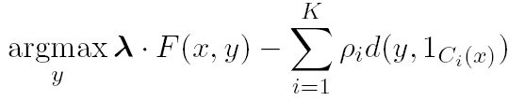
Constrained Conditional Models
Penalty for violating
the constraint.
(Soft) constraints component
Weight Vector for “local” models
Features, classifiers; log-linear models (HMM, CRF) or a combination
How far y is from
a “legal” assignment
How to solve?
This is an Integer Linear Program
Solving using ILP packages gives an exact solution.
Cutting Planes, Dual Decomposition & other search techniques are possible
How to train?
Training is learning the objective function
Decouple? Decompose?
How to exploit the structure to minimize supervision?
Notes:
155

Slide 156
Examples: CCM Formulations
CCMs can be viewed as a general interface to easily combine declarative domain knowledge with data driven statistical models
  Formulate NLP Problems as ILP problems (inference may be done otherwise)
    1. Sequence tagging (HMM/CRF + Global constraints)
    2. Sentence Compression (Language Model + Global Constraints)
    3. SRL (Independent classifiers + Global Constraints)
Sequential Prediction
HMM/CRF based:
Argmax ∑ ¸_{ij} x_{ij}
Sentence Compression/Summarization:
Language Model based:
Argmax ∑ ¸_{ijk} x_{ijk}
Linguistics Constraints
Cannot have both A states and B states in an output sequence.
Linguistics Constraints
If a modifier chosen, include its head
If verb is chosen, include its arguments
Notes:
156

Slide 157
Semantic Role Labeling
I left my pearls to my daughter in my will .
[I]_{A0} left [my pearls]_{A1} [to my daughter]_{A2} [in my will]_{AM-LOC} .
A0 Leaver
A1 Things left
A2 Benefactor
AM-LOC Location
I left my pearls to my daughter in my will .
Notes:
157
In the context of SRL, the goal is to predict for each possible phrase in a given sentence if it is an argument or not and what type it is.

Slide 158
Algorithmic Approach
I left my nice pearls to her
candidate arguments
Identify argument candidates
  Pruning [Xue&Palmer, EMNLP’04]
  Argument Identifier
    Binary classification
Classify argument candidates
  Argument Classifier
    Multi-class classification
Inference
  Use the estimated probability distribution given by the argument classifier
  Use structural and linguistic constraints
  Infer the optimal global output
I left my nice pearls to her
I left my nice pearls to her
[ [ [ [ [
] ] ] ] ]
I left my nice pearls to her
Notes:
We follow a now seemingly standard approach to SRL.
Given a sentence, first we find a set of potential argument candidates by identifying
which words are at the border of an argument.
Then, once we have a set of potential arguments, we use a phrase-level classifier to tell us how likely an argument is to be of each type.
Finally, we use all of the information we have so far to find the assignment of types to argument that gives us the “optimal” global assignment.
Similar approaches (with similar results) use inference procedures tied to their represntation.
Instead, we use a general inference procedure by setting up the problem as a linear programming problem.
This is really where our technique allows us to apply powerful information that similar approaches can not.

Slide 159
Semantic Role Labeling (SRL)
0.5
0.15
0.15
0.1
0.1
0.05
0.1
0.2
0.6
0.05
0.15
0.6
0.05
0.05
0.05
0.05
0.05
0.7
0.05
0.15
0.3
0.2
0.2
0.1
0.2
I left my pearls to my daughter in my will .
Notes:
159
Here is how we use it to solve our problem. Assume each line and color here represent all possible arguments and argument types with the grey color means null or not actually an argument. Associated with each line is the score obtained from the argument classifier.

Slide 160
Semantic Role Labeling (SRL)
0.5
0.15
0.15
0.1
0.1
0.05
0.1
0.2
0.6
0.05
0.15
0.6
0.05
0.05
0.05
0.05
0.05
0.7
0.05
0.15
0.3
0.2
0.2
0.1
0.2
I left my pearls to my daughter in my will .
Notes:
160
If we were to let the argument classifier to make the final prediction, we would have this output which violates the non-overlapping constarints.

Slide 161
Semantic Role Labeling (SRL)
0.5
0.15
0.15
0.1
0.1
0.05
0.1
0.2
0.6
0.05
0.15
0.6
0.05
0.05
0.05
0.05
0.05
0.7
0.05
0.15
0.3
0.2
0.2
0.1
0.2
One inference problem for each verb predicate.
I left my pearls to my daughter in my will .
Notes:
161
Instead, when we use the ILP inference, it will eliminate bottom argument which is now the assignment that maximizes the linear summation of the scores that also satisfy the non-overlapping constraints.

Slide 162



Constraints
Any Boolean rule can be encoded as a set of linear inequalities.
No duplicate argument classes
Reference-Ax
Continuation-Ax
Many other possible constraints:
    Unique labels
    No overlapping or embedding
    Relations between number of arguments; order constraints
    If verb is of type A, no argument of type B
If there is an Reference-Ax phrase, there is an Ax
If there is an Continuation-x phrase, there is an Ax before it
Universally quantified rules
Learning Based Java: allows a developer to encode constraints in First Order Logic; these are compiled into linear inequalities automatically.
Notes:
162
Animation to show the following 3 constraints step by step
Binary constraints
Summation = 1 assures that it’s assigned only one label
Non-overlapping constraints
Remember to put a small bar picture

Slide 163
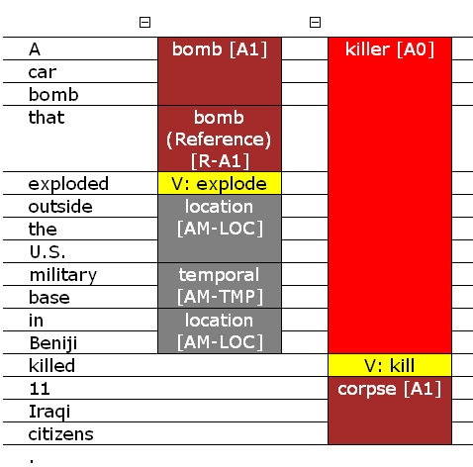
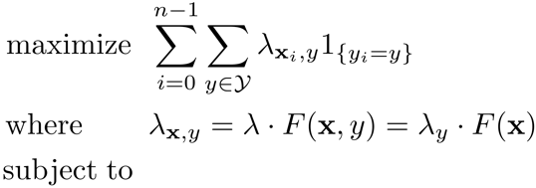
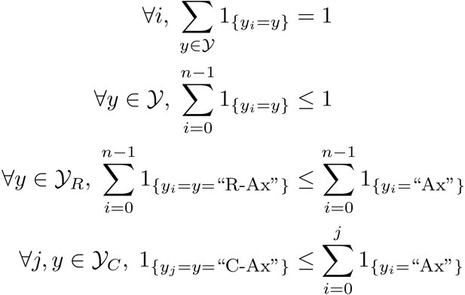
SRL: Posing the Problem
Demo: http://cogcomp.cs.illinois.edu/
Top ranked system in CoNLL’05 shared task
Key difference is the Inference

Slide 164
Constrained Conditional Models
—A Summary
Constrained Conditional Models – ILP formulations – have been shown useful in the context of many NLP problems
[Roth&Yih, 04,07: Entities and Relations; Punyakanok et. al: SRL …]
  Summarization; Co-reference; Information & Relation Extraction; Event Identifications; Transliteration; Textual Entailment; Knowledge Acquisition; Sentiments; Temporal Reasoning, Dependency Parsing,…
Some theoretical work on training paradigms [Punyakanok et. al., 05 more; Constraints Driven Learning, PR, Constrained EM…]
Some work on Inference, mostly approximations, bringing back ideas on Lagrangian relaxation, etc.
Summary of work & a bibliography: http://L2R.cs.uiuc.edu/tutorials.html
See also: Chang, Ratinov & Roth, Machine Learning Journal 2012.

Slide 165
Interval Based Event Timeline Construction
Publishing date: Wed., May 24th, 2006
[…] The Iraqi insurgents attacked a police station in Tal Afar on Tuesday killing 6 policemen and injuring 8 other people. This action brings the casualties to over 3000 since the invasion of the coalition armies on 3/20/2003. Police wants to arrest the insurgents in a campaign next week. […]
Notes:
165

Slide 166
Interval Based Event Timeline Construction
Publishing date: Wed., May 24th, 2006
[…] The Iraqi insurgents attacked a police station in Tal Afar on Tuesday killing 6 policemen and injuring 8 other people. This action brings the casualties to over 3000 since the invasion of the coalition armies on 3/20/2003. Police wants to arrest the insurgents in a campaign next week. […]
e₁
e₂
e₃
e₄
e₅
e₆
Notes:
166

Slide 167
Interval Based Event Timeline Construction
Publishing date: Wed., May 24th, 2006
[…] The Iraqi insurgents attacked a police station in Tal Afar on Tuesday killing 6 policemen and injuring 8 other people. This action brings the casualties to over 3000 since the invasion of the coalition armies on 3/20/2003. Police wants to arrest the insurgents in a campaign next week. […]
e₁
e₂
e₃
e₄
e₅
e₆
EVENT: attacked
Agent: Iraqi insurgents
Victim: a police station
Location: Tal Afar
Time: Tuesday
killing(…)
arrest(…)
casualties(…)
injuring(…)
invasion(…)
Notes:
From this text, we can extract at least 5 events, including Attack, Kill, Injuring, Bombing and Arrest events. Each event is associated with an event trigger and a list of arguments. For example the Attack event is evoked by the “attacked” trigger and it takes some arguments including “Iraqi insurgents”, “police station”, and “Tal Afar”.
167

Slide 168
Interval Based Event Timeline Construction
I₁
Publishing date: Wed., May 24th, 2006
[…] The Iraqi insurgents attacked a police station in Tal Afar on Tuesday killing 6 policemen and injuring 8 other people. This action brings the casualties to over 3000 since the invasion of the coalition armies on 3/20/2003. Police wants to arrest the insurgents in a campaign next week. […]
I₂
I₄
I₃
I₅
Wed., May 24th, 2006
From: 2006-05-24 00:00:00
To: 2006-05-24 23:59:59
Tuesday
From: 2006-05-23 00:00:00
To: 2006-05-23 23:59:59
since […] 3/20/2003
From: 2003-03-20 00:00:00
To: 2006-05-24 23:59:59
3/20/2003
From: 2003-03-20 00:00:00
To: 2003-03-20 23:59:59
next week
From: 2006-05-29 00:00:00
To: 2006-06-04 23:59:59
Notes:
Furthermore, we can also extract several temporal phrases from the text, such as Tuesday, three days earlier, now and next week. In addition, the document publishing date is also another piece of temporal information. We can also normalize the temporal expressions to some intervals.
168

Slide 169
Interval Based Event Timeline Construction
I₁
Publishing date: Wed., May 24th, 2006
[…] The Iraqi insurgents attacked a police station in Tal Afar on Tuesday killing 6 policemen and injuring 8 other people. This action brings the casualties to over 3000 since the invasion of the coalition armies on 3/20/2003. Police wants to arrest the insurgents in a campaign next week. […]
e₁
I₂
e₂
e₃
e₄
I₄
e₅
I₃
e₆
I₅
Our interval representation:
casualties
e₄
invasion
attacked
killing
injuring
arrest
e₅
e₁
e₂/e₃
e₆
-∞
I₃
I₂
I₁
I₅
+∞
I₄
3/20/2003
since […] 3/20/2003
Tuesday
Wed., May 24th, 2006
next week
Notes:
We propose an interval-based representation. In our representation, each temporal expression is normalized to an absolute interval and put on a universal timeline. Each event is associated with an interval and have partial orders with some other event on the timeline. For example, event e1, e2 and e3 are map the to same interval I2, but e1 happends before e2 and e3, while e2 and e3 overlap with each other.
Our interval-based representation allows us to construct absolute timeline of events, so it’s easy to construct timeline of events across document. Also, our representation produces concise inference model.
169

Slide 170
Interval Based Event Timeline Construction
Our proposed document temporal structure:
I₁
I₂
I₃
I₄
I₅
e₁
e₂
e₃
e₅
e₄
e₆
Our interval representation:
casualties
e₄
invasion
attacked
killing
injuring
arrest
e₅
e₁
e₂/e₃
e₆
-∞
I₃
I₂
I₁
I₅
+∞
I₄
since […] 3/20/2003
3/20/2003
Tuesday
Wed., May 24th, 2006
next week
Notes:
In this work, based on the interval-based representation, we propose a document temporal structure, where events are associated with their corresponding intervals and events hold partial order temporal relations among them.
170

Slide 171
Global Inference for Timeline construction
Given the interval-based representation we can now reason about relations between events and relations between events and temporal intervals
We will learn two models:
  C_{E-E}: Does event A follows event B?
  C_{T-E}: The relation between event E and time interval T
We then generate a timeline, via a constrained conditional model that attempts to optimize:
  Respecting the proposals of the two models
  Respecting common sense constraints

Slide 172
Background Knowledge for Timeline
Constructing a timeline requires “putting things together”: reasoning about temporal intervals & about events and requires incorporating background knowledge
  Temporal Constraints
    Enforcing global agreement among the relations between pairs of events and between events and temporal intervals (e.g. reflexivity and transitivity)
  Statistical Properties
    Events described in text usually follow a temporal order conveyed via language markers (discourse connectives).
    Discourse markers and the surrounding context to can be used to time-line temporal entities.

Slide 173
A Joint Timeline Model
[1] Event-Time Association: the E-T classifier
I₁
I₂
I₃
I₄
I₅
e₁
e₂
e₃
e₅
e₄
e₆
Temporal relations:
before, after, overlap and no relation
[2] Event-Event Temporal Order: the E-E classifier
Notes:
To construct a document temporal structure for a document, we build a joint timeline model which consists of 2 local classifiers. The first one is the Event-Time or E-T classifier. This classifier associates an event to its corresponding interval. And the second classifier is the Event-Event classifier which identifies the temporal relation between any two events. In this work, we focus on 4 temporal relations including before, after, overlap and no relation.
173

Slide 174
A Joint Timeline Model
[1] Event-Time Association: the E-T classifier
Supervised Learning
[3] A Global Joint Inference Model
with Common Sense Knowledge
Constrained Conditional Model
[2] Event-Event Temporal Order: the E-E classifier
Notes:
The two local classifiers are put into a joint inference model which use common sense knowledge to maximizes the prediction score of the whole document temporal structure. The two local classifier are supervised classifiers. We now focus on the global joint inference model.
174

Slide 175
Features of the Temporal Classifiers
Some selective features for a pair of (Event, Time Interval):
The Iraqi insurgents attacked a police station in Tal-Afar on Tuesday.
(Publishing date: Wed., May 24th, 2006)
Temporal entities: attacked (event), Tuesday (time interval)
Syntactic Parse Tree:
(ROOT
(S
(NP (DT The) (JJ Iraqi) (NNS insurgents))
(VP (VBD attacked)
(NP (DT a) (NN police) (NN station))
(PP (IN in)
(NP (NNP Tal-Afar)))
(PP (IN on)
(NP (NNP Tuesday))))
(. .)))
Lexical features: Word, lemma, POS of the target temporal entities and the surrounding context[1,2]. The modal verbs surrounding the event mention[1]. The temporal connectives between the event mentions[2].
Syntactic features: Temporal entities appears first in the text[1,2]. Whether the temporal entities are in the same sentence[1,2] The number of sentence between two temporal entities[1,2]. Whether the event mention is covered by prepositional phrases[1,2]. The head of the prepositional phrase[1,2]. The lease common constituent on the syntactic parse tree[1,2]. Whether the input events are close to any temporal expression[1].
Semantic features: Whether the input event mentions have a common synonym from WordNet[2]. The input event mentions have a common derivational form derived from WordNet[2].
Linguistics features: The tense and the aspect of the input event mentions (we use an in-house tense-aspect extractor)[1,2].
Time interval features: Whether the input intervals are explicit or implicit[1]. The type of an input interval if it is implicit (dct, past, future, entire timeline)[1]. Whether the input interval is before, after or overlap with the DCT[1].
Syntactic features:
Appearance order: Event_First = True
Same sentence: Same_Sent = True
# of sentences between: Numb_Sent_Diff = None
Prepositional-event phrase: Covered_By_PP = False
Least common non-terminal: LCNT = S
Linguistic features:
Aspect: Event_Aspect = Simple
Tense: Event_Tense = Past
Time interval features:
Explicitness: Explicit_Interval = True
Relative to DCT: Compare_Dct = Before
Note: [1] and [2] denote the features that are used for the C_{E-T} and C_{E-E} classifiers, respectively.

Slide 176
The Joint Inference Model
E-T
E-E
Probability of event e associating with time interval t
Probability of two events e-e holding temporal relation r
subject to: temporal constraints
(omitting basic ILP constraints)
E-T indicator variable
E-E indicator variable
The ILP objective function:
Notes:
In this joint model, we construct an ILP objective function which is the linear combination of the prediction scores from the two local classifiers. In this function, p<et,1> is the probability of the event e that associates with time interval t. x<et,1> is an indicator variable for the E-T classifier. Similarly, p<ee,r> is the probability of event pair ee holds temporal relation r, and y<ee,r> is an indicator variable of the E-E classifier. The objective function is maximized subject to some temporal constraints.
176

Slide 177
Temporal Constraints
Reflexivity constraints
A before B ➔ B after A
A after B ➔ B before A
A overlap B ➔ B overlap A
A has no relation with B ➔ B has no relation with A
Transitivity constraints
A before B, B before C ➔ A before C
A after B, B after C ➔ A after C
A overlaps B, B overlaps C ➔ A overlaps C
A before B, B overlaps C ➔ A before C
A after B, B overlaps C ➔ A after C
A overlaps B, B before C ➔ A before C
A overlaps B, B after C ➔ A after C
1 | Each event pair can have only one temporal relation.
2 | Each event is associated with only one time interval.
3 | (Reflectivity)
4 | (Transitivity)
5
e₁
e₂
e₂
e₁
e₁
e₂
e₃
e₁
e₃
I₁
⧼
I₂
e₁
e₂
e₁
e₂
Notes:
The first group of constraints requires that each event pair can get only one temporal relation, while the second constraint requires that each event is associated with only one time interval.
Constraint group number 3 is a reflectivity rule. For example, if e1 is before e2 then e2 must be after e1.
Constraint group number 4 is a transitivity rule. For example, if e1 is before e2 and e2 is before e3, then e1 must be before e3.
The last group of constraints states that if e1 and e2 are associated with I1 and I2 respectively, and if we know that I1 precedes I2 on the timeline, then e1 must happen before e2.
177

Slide 178
Knowledge from Event-Coreference
Notes:
We use the knowledge from event-coreference as an additional knowledge source to improve the performance of the timeline construction system.
Publishing date: March 11th, 2003
Sotheby’s and Christie’s auction houses have agreed to pay₁ 40 million dollars to settle an international price-fixing scam. The payment, if approved by the courts, would settle a slew of suits by clients over auctions held between 1993 and 2000. Sotheby’s and Christie’s will each pay₂ 20 million dollars.
between 1993 and 2000
[March 11, 2003, +∞)
[March 11, 2003, +∞)
appear in the same sentence!
pay₁
payment
payment
Event-Coreference Cluster
pay₂
Notes:
Next, I will present event-coreference as an additional knowledge source that helps the task of event timeline construction.
First I would like to demonstrate the importance of event coreference knowledge. Assume that we have a document published on March 11, 2003, that reads “Sotheby’s and …dollars.”
For the E-T local classifier, it’s possible to associate the “payment” event to the time interval between 1993 and 2000 because one of the strong evidences is that they appear in the same sentence. However, this prediction is incorrect. The correct prediction should associate the payment event with the interval between March 11, 2003, which is the publishing date of the document, and the future.
So can we overcome this problem? We argue that the knowledge from event coreference may help us in this case. From the event coreference knowledge, we know that pay1, pay2 and payment are actually 3 event mentions that refer to the same event, so they belong to one event coreference cluster. In we are lucky that the E-T classifier is strongly confident in the association between pay1 and the interval from March 11, 2003 to the future, then we can overwrite other predictions to associate other payment event mentions to the same interval.
And again, I want to emphasize that besides our local classifiers and the joint inference model, we use the knwoledge from event coreference as an additional knowledge source to improve the performance of the system.
178

Slide 179
Knowledge from Event-Coreference
We propose two principles that make use of event coreference knowledge.
  (P₁) All mentions of a unique event are associated with the same
  time interval, and overlap with each other.
  (P₂) All mentions of an event have the same temporal relation with all mentions of another event.
Procedure to Incorporate Event-Coreference Knowledge:
[1] Performing classifications with C_{E-T} and C_{E-E}.
[2] Using (P1) and (P2) to overwrite the prediction probabilities in [1].
(Note: if we stop here, we get the outputs of the local classifiers enhanced by event-coreference.)
[3] Applying the joint inference model on the probabilities from [2].
[March 11, 2003, +∞)
pay₁
pay₁
payment
after
payment
suits
Event-Coreference Cluster
Event-Coreference Cluster
pay₂
pay₂
Notes:
In this work, we propose 2 principles that make use of event coreference knowledge.
The first principle states that “All mentions of a unique event are associated with the same time interval, and overlap with each other.
The second principle states that “All mentions of an event get the same termporal relation with all mentions of another event.
179

Slide 180
Experiments: Data
Notes:
⇰ We do not use the TimeML corpus because:
1. It does not focus on significant events (e.g. Attack, Kill)
2. It does not have event coreference information.
⇰ However, we have some additional experiments on
TimeML to compare with previous work (see our paper).
Data | #Intervals | #E-mentions | #E-T | #E-E
Initial | 232 | 324 | 305 | 376
Saturated | 232 | 324 | 324 | 5940
20 newswire articles published in March 2003, from the ACE05 corpus.
  Gold Event Co-reference: annotated
  Learned Event Co-reference: A Pairwise Coreference Model, Feature Impact and Evaluation for Event Coreference Resolution, Z. Cheng, H. Ji and R. Harallick, 2009
Time intervals are extracted using IllinoisTime, NAACL-12-Demo.
Data annotation:
  Event mentions Vs. Time intervals: Association
  Event mentions Vs. Event mentions: Temporal relations (b, a, o)
Annotation saturation:
  Orphan event mentions are associated with (-∞, +∞)
  Adding inferred relations between event mentions with reflexivity and transitivity.
Notes:
In our experiments, we use 20 documents published in March 2003 from the ACE05 corpus.
To extract time intervals from the document, we use our tool which was published in NAACL-Demo this year.
The data is anntoated with event to time interval associations and the temporal relations between events.
After that the annotation is saturated with some rule to make a complete annotated dataset.
Here are some statistics on the data. We note that in our main experiments, we do not use the TimeML corpus because it does not focus on significant events such as Attack or Kill events, and it doesn’t have event coreference information.
But we have some additional experiments on the TimeML corpus to compare our work with previous work.
180

Slide 181
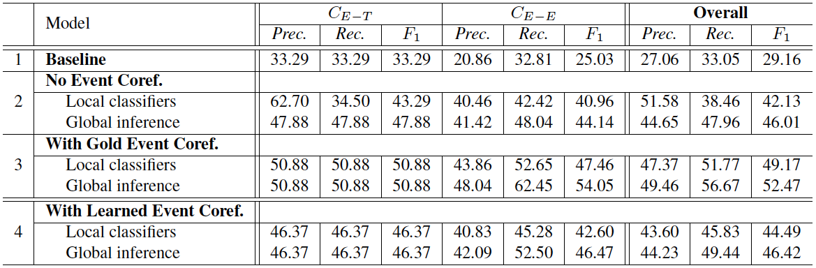
Experiments: Results
All figures are averaged scores from 5-fold cross validation experiments.
Baseline:
For E-T:
1. Associates an event mention to the closest interval in the same sentence.
2. If such interval is not found, associates with the closest interval to the left.
3. Otherwise, associates the event mention with the publishing date.
For E-E:
4. Event mentions appear earlier precedes event mentions that come later.
Significance test: Bootstrap Re-sampling (Koehn, 2004)
The overall improvement with the joint inference model is
statistically significant over the local classifiers (p ~ 0.01).
The performance of an event coref system can have significant impact on the task.
An open question: Can event coref benefit from our local classifiers with a joint inference framework?
Notes:
In the main experiments, we first develop a baseline system as follow:
For event to time interval assiciation, the system associates an event to its closest interval in the same sentence. If there is no interval in the same sentence, it links the event to the closest interval to the left, otherwise, it associates the event to the document publishing date.
On the other hand, to recognize the temporal relation between events, the baseline system consider events that appear ealier in the text to happen before other events that appear later in the text.
The baseline system gets the overal F1 of 29.16.
Next, we evaluate our local classifiers and the joint inference model. The overall performance of our local classifiers is 4x.xx while the joint inference model outperforms the local classifiers. This improvement is statistically significant.
We then inject the gold knowledge from event coreference into the local classifiers and the joint inference model to gain further significant improvement.
We finally experiment with the knowledge provided by a learned event coreference system, but the improvement is not significant.
So we believe that the performance of an event coreference system can have signficant impact on the timeline construction task. And we open a question that can event coreference benefit from our local classifiers with a joint inference framework. We would like to leave this question to a future investment.
181

Slide 182
Outline
Background: Motivations and Goals
Temporal Information Representation Theories
Temporal Expression Extraction and Normalization
Temporal Slot Filling
Tea Break
Event Timelining and Temporal Reasoning
Resources and Demos
Conclusions
12:55
182
Notes:
182

Slide 183

Resources and Demos
183

Slide 184
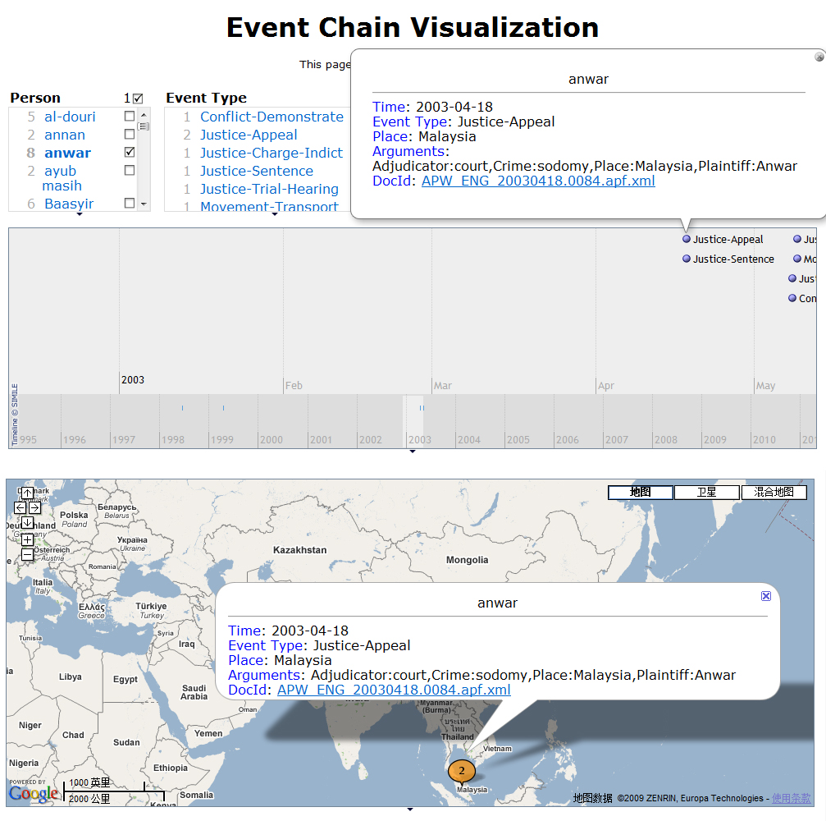
Demo: Temporal Event Tracking
(Chen and Ji, 2009)
http://nlp.cs.qc.cuny.edu/demo/personvisual.html
184

Slide 185
Resources
Time Expression Extraction and Normalization
  Illinois Temporal Extraction and Comparison
  http://cogcomp.cs.illinois.edu/demo/tempdemo/?id=29
  Stanford SU Time
  http://nlp.stanford.edu/software/sutime.shtml
  HeidiTime
  http://code.google.com/p/heideltime/
CUNY Temporal Knowledge Base Population
  Entity Linking and Regular Slot Filling Programs;
  http://nlp.cs.qc.cuny.edu/kbptoolkit-1.5.0.tar.gz
  Temporal Slot Filling Programs:
  http://nlp.cs.qc.cuny.edu/Temporal_Slot_Filling_1.0.1.tar.gz
  Distantly supervised Data:
  http://nlp.cs.qc.cuny.edu/instances.tar.gz
  Freely available for research purpose
185
Notes:
ADD related work (in Seminar slides). As Javier already mentioned.
185

Slide 186

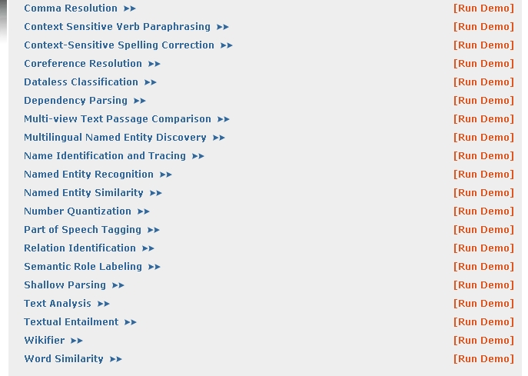
Related Resources
Illinois NLP Suite
  Named Entity Recognition (Coarse and Fine)
  http://cogcomp.cs.illinois.edu/demo/
  Wikification
  http://cogcomp.cs.illinois.edu/demo/
  Co-reference Resolution
  http://cogcomp.cs.illinois.edu/demo/
  Additional relevant tools, including, similarity metrics, taxonomic relations, etc.
Curator: A distributed system for managing multiple NLP preprocessing tools; Programmatic interface and Cashing.
186
Notes:
ADD related work (in Seminar slides). As Javier already mentioned.
186

Slide 187
Outline
Background: Motivations and Goals
Temporal Information Representation Theories
Temporal Expression Extraction and Normalization
Temporal Slot Filling
Tea Break
Event Timelining and Temporal Reasoning
Resources and Demos
Conclusions
1:00
187
Notes:
187

Slide 188

Conclusions
188

Slide 189
Other Related Work
TempEval shared task (Verhagen et al., 2007; Pustejovsky et al., 2009)
  Single-document, ordering and relation extraction between events and time expressions using TimeBank (Pustejovsky et al., 2003)
  Flat approaches based on lexical and shallow dependency features (Chambers and Jurafsky, 2008&2009; Yoshikawa et al., 2009; Ling and Weld, 2011)
  Structured approaches based on syntactic tree and dependency paths (Puscasu, 2007; Cheng et al., 2007; Bethard and Martin, 2007&2008)
Joint inference for temporal relations (Yoshikawa et al., 2009; Eidelman, 2008; Chambers et al., 2008; Ling, 2010)
  Focused on single-document and single domain (e.g. medical)
189
Notes:
have promoted information retrieval into real application
, which requires us to resolve more conflicts and ambiguities. In addition, we.
. On the other hand, we cannot simply transfer the traditional relevance or salience based ranking approaches in IR and summarization because of the incorrect facts extracted from IE. Therefore we
Study the temporal event linking task on top of IE results; extend the representation of each node in the chains from an event trigger to a structured aggregated event including fine-grained information such as event types, arguments and their roles
Incorporating global evidence we correct the original extracted facts and discover time arguments which were not explicitly expressed in the original test documents.

Slide 190
Conclusions
The “Time” world is fascinating but also challenging
A lot of problems are open
Some are easy to define:
  “Grounding” events and relations
    Why are we doing so badly?
  Time lines
    Why are we doing so badly?
Some are still ill-defined:
    I’ve played Tennis for 10 years vs. I’ve played Tennis for an hour
Technical Advances require
  Cross-document aggregation and grounding
  Robust Temporal Reasoning
  Methods that capture long and complex contexts
  Fast and Accurate ways to obtain training data
Thank you
190
Notes:
In this paper we only presented event chains centered around person entities, but this approach can be naturally extended to other entity types, such as tracking company start/end/acquire/merge activities. In addition we plan to

Slide 191
References
D Ahn, S.F. Adafre, and M. de Rijke. 2005. Extracting temporal information from open domain text: A comparative exploration. In Digital Information Management.
Enrique Amigo, Javier Artiles, Qi Li and Heng Ji. 2011. An Evaluation Framework for Aggregated Temporal Information Extraction. Proc. SIGIR2011 Workshop on Entity-Oriented Search.
J. F. Allen. 1983. Maintaining Knowledge about Temporal Intervals. Communications of the ACM, November 1983, Volume 26, Number 11, volume 26, pages 832-843, New York, NY, USA.
Silvana Badaloni, Marco Falda and Massimiliano Giacomin. 2004. Integrating Quantitative and Qualitative Fuzzy Temporal Constraints. AI Communications, vol. 17 (4), 187-200, IOS Press.
Chitta Baral, Gregory Gelfond, Michael Gelfond and Richard B. Scherl. 2005. Textual Inference by Combining Multiple Logic Programming Paradigms. Proc. AAAI 2005 Workshop on Inference for Textual Question Answering.
Steven Bethard, James H. Martin and Sara Klingenstein. 2007. Finding Temporal Structure in Text: Machine Learning of Syntactic Temporal Relations. International Journal of Semantic Computing (IJSC), 1(4), December 2007.
Steven Bethard and James H. Martin. 2008. Learning Semantic Links from a Corpus of Parallel Temporal and Causal Relations. Proc. Annual Meeting of the Association for Computational Linguistics: Human Language Technologies (ACL-HLT).
Branimir Bouguraev and Rie Kubota Ando. 2005. TimeBank-Driven TimeML Analysis. Proc. Annotating, Extracting and Reasoning about Time and Events. IBFI, Schloss Dagstuhl, Germany.
Philip Bramsen, Pawan Deshpande, Yoong Keok Lee, and Regina Barzilay. 2006. Inducing temporal graphs. Proc. Conference on Empirical Methods in Natural Language Processing (EMNLP 2006).
Nathanael Chambers and Dan Jurafsky. 2008. Jointly Combining Implicit Constraints Improves Temporal Ordering. Proc. Empirical Methods in Natural Language Processing (EMNLP2008).
Nathanael Chambers and Dan Jurafsky. 2009. Unsupervised Learning of Narrative Schemas and their Participants. Proc. the 47th Annual Meeting of the Association for Computational Linguistics and the 4th International Joint Conference on Natural Language Processing of the Asian Federation of Natural Language Processing (ACL-IJCNLP 2009).
191
Notes:
Add examples

Slide 192
References (Cont’)
DARPA. 2012. Machine Reading Program. http://www.darpa.mil/Our_Work/I2O/Programs/Machine_Reading.aspx.
Quang Do, YeeSeng Chan and Dan Roth. 2011. Minimally Supervised Event Causality Identification. Proc. Empirical Methods in Natural Language Processing (EMNLP2012).
Quang Do, Wei Lu and Dan Roth. 2012. Joint Inference for Event Timeline Construction. Proc. Empirical Methods for Natural Language Processing (EMNLP2012).
Noemie Elhadad, Regina Barzilay and Kathleen McKeown. 2002. Inferring Strategies for Sentence Ordering in Multidocument Summarization. Journal of Artificial Intelligence Research,17:35-55.
Prashant Gupta and Heng Ji. 2009. Predicting Unknown Time Arguments based on Cross-event propagation. Proc. the 47th Annual Meeting of the Association for Computational Linguistics and the 4th International Joint Conference on Natural Language Processing of the Asian Federation of Natural Language Processing (ACL-IJCNLP 2009).
Heng Ji, Ralph Grishman, Zheng Chen and Prashant Gupta. 2009. Cross-document Event Extraction and Tracking: Task, Evaluation, Techniques and Challenges. Proc. Recent Advances in Natural Language Processing 2009.
Heng Ji and Ralph Grishman. 2011. Knowledge Base Population: Successful Approaches and Challenges. Proc. The 49th Annual Meeting of the Association for Computational Linguistics: Human Language Technologies (ACL-HLT 2011).
Heng Ji, Ralph Grishman and Hoa Trang Dang. 2011. An Overview of the TAC2011 Knowledge Base Population Track. Proc. Text Analysis Conference (TAC2011).
Paul Kingsbury and Martha Palmer. 2002. From TreeBank to PropBank. Proc. the 3rd International Conference on Language Resources and Evaluation (LREC-2002).
Qi Li, Javier Artiles, Taylor Cassidy and Heng Ji. 2012. Combining Flat and Structured Approaches for Temporal Slot Filling or: How Much to Compress?. Lecture Notes in Computer Science, 2012, Volume 7182/2012, 194-205.
Mirella Lapata and Alex Lascarides. 2006. Learning Sentence-internal Temporal Relations. Journal of Artificial Intelligence Research 27. pp. 85-117.
192
Notes:
Add examples

Slide 193
References (Cont’)
Xiao Ling and Daniel S. Weld. Temporal Information Extraction. Proc. the Twenty-Fourth Conference on Artificial Intelligence (AAAI 2010).
James Pustejovsky, Patrick Hanks, Roser Saurí, Andrew See, Robert Gaizauskas, Andrea Setzer, Dragomir Radev, Beth Sundheim, David Day, Lisa Ferro and Marcia Lazo. 2003. The TIMEBANK Corpus. Proceedings of Corpus Linguistics 2003: 647-656.
James Pustejovsky, Jos M. Castao, Robert Ingria, Roser Sauri, Robert J. Gaizauskas, Andrea Setzer, Graham Katz, and Dragomir R. Radev. 2003. TimeML: Robust Specification of Event and Temporal Expressions in Text. In Mark T. Maybury, editor, New Directions in Question Answering, pages 28-34. AAAI Press.
James Pustejovsky and Marc Verhagen. 2009. Semeval-2010 Task 13: Evaluating Events, Time Expressions, and Temporal Relations (Tempeval-2). Proc. the Workshop on Semantic Evaluations: Recent Achievements and Future Directions.
Steven Schockaert, Martine De Cock, and Etienne E. Kerre. 2008. Fuzzifying Allen’s Temporal Interval Relations. IEEE Transactions on Fuzzy Systems, Vol. 16, No. 2.
Richard Snodgrass. 1998. Of Duplicates and Septuplets. Database Programming and Design.
Jannik Strtotgen and Michael Gertz. 2010. HeidelTime: High Quality Rule-based Extraction and Normalization of Temporal Expressions. Proc. the 5th International Workshop on Semantic Evaluation.
Naushad UzZaman and James F. Allen. 2010. TRIPS and TRIOS System for TempEval-2: Extracting Temporal Information from Text. Proc. the 5th International Workshop on Semantic Evaluation.
Naushad UzZaman and James F. Allen. 2011. Temporal Evaluation. The 49th Annual Meeting of the Association for Computational Linguistics: Human Language Technologies (ACL-HLT2011).
Marc Verhagen. 2005. Temporal Closure in an Annotation Environment. Language Resources and Evaluation.
Marc Verhagen, Roser Sauri, Tommaso Caselli, and James Pustejovsky. 2010. Semeval-2010 task 13: Tempeval 2. In Proceedings of International Workshop on Semantic Evaluations (SemEval 2010), 2010.
Lluis Vila. 1994. A Survey on Temporal Reasoning in Artificial Intelligence. AI Communications, 7(1):4.
Katsumasa Yoshikawa, Sebastian Riedel, Masayuki Asahara, and Yuji Matsumoto. 2009. Jointly Identifying Temporal Relations with Markov Logic. Proc. Joint Conference of the 47th Annual Meeting of the ACL and the 4th International Joint Conference on Natural Language Processing of the AFNLP (ACL-IJCNLP2009).
193
Notes:
Add examples

Slide 194
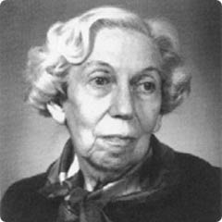
“The events in our lives happen in a sequence in time, but in their significance to ourselves they find their own order: the continuous thread of revelation.”
- Eudora Welty
194
194
Notes:
Check five percent improvement in spouse
We need significance testing for the result pairs
Backup slide with number of instances for each type
194

Slide 195


Slide 196
Backup…
196
Notes:
196

Slide 197

Temporal Event Tracking and Implicit Time Prediction
197
Notes:
197

Slide 198
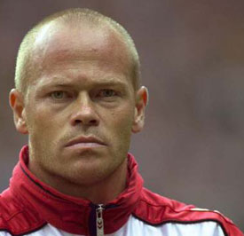
A Vision (Ji et al., 2009)
…
Centroid=“Toefting”
Rank=26
Time | 2002-01-01
Event | Attack
Person | Toefting
Place | Copenhagen
Target | workers
Time | 2003-03-15
Event | End-Position
Person | Toefting
Entity | Bolton
Time | 2003-03-31
Event | Sentence
Defendant | Toefting
Sentence | four months in prison
Crime | assault
…
Input: A test set of documents
Output: Identify a set of centroid entities, and then for each centroid entity, link and order the events centered around it on a time line
198

Slide 199
Evaluation Metrics
Centroid Entity Detection
  F-Measure: A centroid entity is correctly detected if its name (and document id) matches the full or partial name of a reference centroid
  Normalized Kendall tau distance (Centroid entities) = the fraction of correct system centroid entity pairs out of salience order
  Centroid Entity Ranking Accuracy = 1- Normalized Kendall tau distance (Centroids)
Browsing Cost: Incorporate Novelty/Diversity into F-Measure
  An argument is correctly extracted in an event chain if its event type, string and role match any of the reference argument mentions
  Two arguments in an event chain are redundant if their event types, event time, string (the full or partial name) and roles overlap
  Browsing Cost (i) = the number of incorrect or redundant event arguments that a user must examine before finding i correct event arguments
Temporal Correlation: Measure Coherence
  Temporal Correlation = the correlation of the temporal order of argset in the system output and the answer key
  Argument recall = number of unique and correct arguments in response / number of unique arguments in key
199
Notes:
199
And document id. In the reference the centroids are the top N entities ranked by the number of events in which that entity appears as an argument.
We believe for a cross-document IE task, the exact date normalization results are less crucial. In some cases the system can insert the events into the correct positions in the chains even by only detecting rough date periods (e.g. “a few weeks ago”). Our temporal correlation metric is able to assign appropriate credit to these cases.

Slide 200
Cross-document Temporal Event Tracking
Test docs
Single-doc IE
Background Data
Unconnected Events
Wikipedia
Cross-doc Argument
Refinement
Related docs
Centroid Entity Detection
Global Time Discovery
Cross-doc Event Selection & Temporal Linking
Cross-doc Event Coreference
Ranked Temporal Event Chains
200

Slide 201
Baseline Single-document IE System
Includes entity extraction, time expression extraction and normalization, relation extraction and event extraction
Event Extraction
  Pattern Matching
    British and US forces reported gains in the advance on Baghdad
  → PER report gain in advance on LOC
  Maximum Entropy Models
    Trigger Labeling: to distinguish event instances from non-events, to classify event instances by type
    Argument Identification: to distinguish arguments from non-arguments
    Argument Classification: to classify arguments by argument role
    Reportable-Event Classifier: to determine whether there is a
    reportable event instance
    Each step produces local confidence
(Grishman et al., 2005)
201

Slide 202
What’s New: Research Challenges Overview
More Salient: Detecting centroid entities using global confidence
More Accurate and Complete: Correcting and enriching arguments from the background data
More Concise: Conducting cross-document event coreference resolution to remove redundancy
202

Slide 203
Centroid Entity Detection
Cross-document Name Coreference
  Single-doc entity coreference (Ji et al., 2005) + Simple substring matching in the paper
  Ongoing work: using event chains as feedback (Dogan and Ji, in submission)
Global Entity Ranking
  Promote those arguments which are both central to the collection (high frequency) and more likely to be accurate
  (high confidence)
  {n_{j} | n_{j} is a name, n_{j} and e_{i} are coreferential or linked by a relation; and n_{j} is involved in an event mention}
203
Notes:
203
Uncertainty; delay the confidence estimation from the baseline,try to confirm or correct the results using global confidence; some examples are as follows.

Slide 204
Cross-document Argument Refinement
Hypotheses
  One Trigger Sense Per Cluster
  One Argument Role Per Cluster
Aggregate similar events across related documents and conduct statistical global inference
Remove triggers and argument annotations with local or cross-doc confidence lower than thresholds
Propagate highly consistent and frequent arguments with high global confidence to override other, lower confidence, extraction results
(Ji and Grishman, ACL 2008)
204
Notes:
204
Our within-document IE system, like most current IE techniques, focuses on processing one document at a time, and except for coreference resolution, operates one sentence at a time. Therefore the performance of event extraction is limited by the information that can be obtained from the annotated training corpora and the current test document. Any extraction errors, especially on name and time arguments, will be compounded in our new cross-doc IE task because they are vital to centroid detection and temporal ordering.

Slide 205
Cross-document Event Coreference Resolution
1. An explosion in a cafe at one of the
capital's busiest intersections killed one
woman and injured another Tuesday
4. Ankara police chief Ercument Yilmaz
visited the site of the morning blast
2. Police were investigating the cause of
the explosion in the restroom of the
multistory Crocodile Cafe in the
commercial district of Kizilay during
the morning rush hour
5. The explosion comes a month after
6. a bomb exploded at a McDonald's
restaurant in Istanbul, causing damage
but no injuries
3. The blast shattered walls and
windows in the building
7. Radical leftist, Kurdish and Islamic
groups are active in the country and have
carried out the bombing in the past
(Chen and Ji, 2009)
205

Slide 206
Spectral Graph Clustering
Trigger | explosion
Arguments | Role = Place | a cafe
 | Role = Time | Tuesday
Trigger | blast
Arguments | Role = Place | site
 | Role = Time | morning
Trigger | explosion
Arguments | Role = Place | restroom
 | Role = Time | morning rush hour
Trigger | explosion
Arguments | Role = Time | a month after
Trigger | exploded
Arguments | Role = Place | restaurant
Trigger | explosion
Arguments | Role = Place | building
Trigger | bombing
Arguments | Role = Attacker | groups
206
Notes:
206
Start with full connected graph, each edge is weighted by the coreference value

Slide 207
Spectral Graph Clustering
0.8
A
0.7
0.9
0.9
0.6
0.8
0.3
0.8
0.7
0.2
0.2
0.3
B
0.1
cut(A,B) = 0.1+0.2+0.2+0.3=0.8
207
Notes:
207
Express partitioning objectives as a function of the “edge cut” of the partition.
Cut: Set of edges with only one vertex in a group.
Start with full connected graph, each edge is weighted by the coreference value

Slide 208
Experiments: Data
106 newswire texts from ACE 2005 training corpora as test set
extracted the top 40 ranked person names as centroid entities, and manually created temporal event chains by
  Aggregated reference event mentions (Inter-annotator agreement: ~90%)
  Filled in the implicit event time arguments from the background data (Inter-annotator agreement: ~82%)
  Annotated by two annotators independently and adjudicated
278,108 texts from English TDT5 corpus and 148 million sentences from Wikipedia as the source for background data
140 events with 368 arguments (257 are unique)
The top ranked centroid entities are “Bush”, “Ibrahim”, “Putin”, “Al-douri”, “Blair”, etc.
208

Slide 209
Centroid Entity Detection Performance
F-Measure
  Single-document IE: 55% to detect 40 centroid entities
  Cross-document IE: 67.5% to detect 40 centroid entities, can cover all key centroid entities by using the top 76 system output entities
Ranking accuracy for 40 centroid entities
  Cross-document IE: 72.95%
  Baseline 1 - random ranking: 42%
  Baseline 2 - ranked by the position where the first mentions of the centroid entities appear as event arguments in the test corpus: 47.31%
209

Slide 210
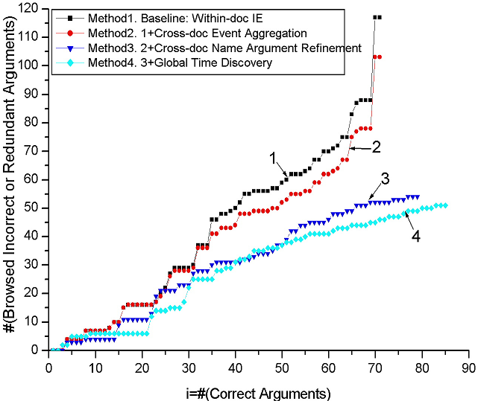
Browsing Cost
210
Notes:
210
Figure 3 indicates that for the event chains generated entirely from single-document IE, a user needs to browse 117 incorrect/redundant arguments before seeing 71 correct arguments. By adding cross-document event aggregation, the browsing effort is slightly reduced to seeing 103 incorrect/redundant arguments. The most notable result is that after applying cross-document name argument correction, the number of correct arguments is increased to 79 while the number of incorrect/redundant arguments is significantly reduced to 54. Global time discovery provided further gains: 85 correct arguments after seeing 51 incorrect/redundant ones. The final system resulted in a 60.7% user browsing effort reduction compared to the baseline before seeing 71 correct arguments; and extracted an additional 19.7% unique correct arguments.

Slide 211
Temporal Correlation
Method | Temporal Correlation | Argument Recall
Baseline: ordered by event reporting time | 3.71% | 27.63%
Method1: Single-document IE | 44.02% | 27.63%
Method2: 1+Cross-doc Event Coreference | 46.15% | 27.63%
Method3: 2+ Cross-doc Argument Refinement | 55.73% | 30.74%
Method4: 3 + Global Time Discovery | 70.09% | 33.07%
211
Notes:
211

Slide 212
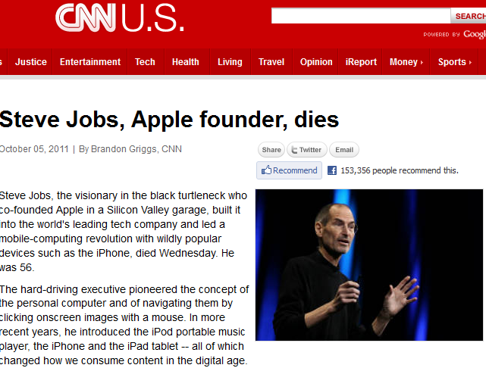
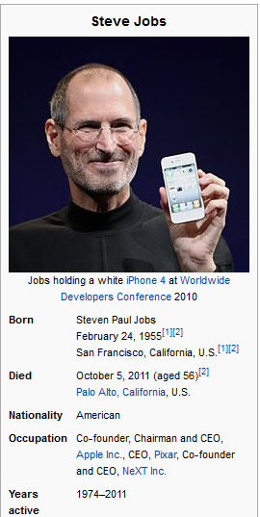
KBP Setup
Create/Expand
Source Collection
Reference KB
212
Notes:
212

Slide 213
Temporal Slot Filling (TSF)
Regular temporal task, slot fills and temporal information must be gathered across the entire corpus
Diagnostic task: the system is given a correct slot fill and must extract the time information for that slot fill from a single document
Evaluation Metric
  Let <t₁, t₂, t₃, t₄> be system output, <g₁, g₂, g₃, g₄> be gold standard
  An error of c time units produces a 0.5 score
    scores produced with c = 1 year
  Each element in tuple is scored independently
  For temporal SF task, a correct slot fill with temporal
  information t gets credit Q(S) (instead of 1)
213

