Slide 1
Programming Abstractions for Data Stream Processing Systems
Rajeev Alur
University of Pennsylvania

Slide 2
Formal Methods for Systems Design
Solutions:
Methodology: Type systems, model-based design, synthesis …
Tools: Static analysis, model checking, proof assistants, …
Goals:
Correctness: Does the system meet its specification?
Predictability: Worst-case resource usage guarantees
Application domains:
Hardware
Systems software
Safety-critical embedded control systems
Network protocols and security policies …
Notes:
Follow the wall and obstacle avoidance can be sequentially implemented

Slide 3
Real-time Decision Making
data
decisions
Controller
Smart buildings
Network switches
Autonomous medical devices
Smart highways …
McKinsey Global Inst: $11 Trillion economy by 2025
Notes:
Implemenations are plenty... choose one that has typical features

Slide 4
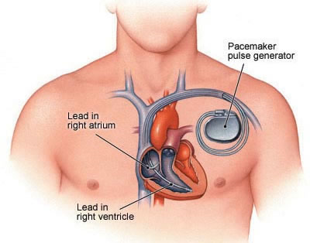
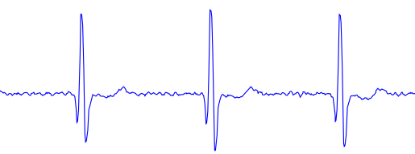
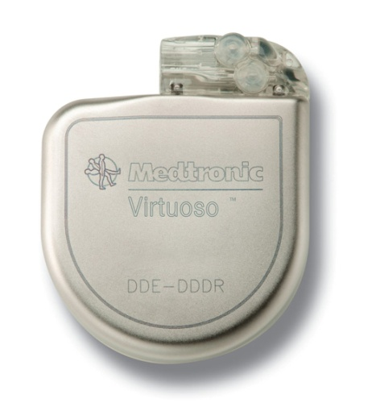
Safety-critical CPS
pacing stimulus
Medical device software:
Need guarantees of correctness and predictable performance
Current practice: low-level code
Can higher-level programming abstractions help?
Prior work: Pacemaker verification using timed/hybrid automata
This talk: High-level specification of arrhythmia detection
Notes:
Implemenations are plenty... choose one that has typical features

Slide 5
Distributed Real-Time Stream Processing
Existing systems/architectures:
Storm, Heron, Flink, Spark, Streams, …
Why popular:
High-performance stream processing
Why not satisfactory:
No specifications or guarantees of correctness
No high-level programming abstractions
Notes:
Implemenations are plenty... choose one that has typical features

Slide 6
Talk Roadmap
Quantitative Regular Expressions (QRE) [ESOP 2016]
Declarative language for specifying quantitative policies
StreamQRE: Implementation and Experimental Evaluation
Specifying Arrhythmia Detection
Interfaces for Distributed Stream Processing Systems
Notes:
Follow the wall and obstacle avoidance can be sequentially implemented

Slide 7
Quantitative Policy
data
decisions
Policy
Example network policy:
if number of packets in current VoIP session exceeds
the average over past VoIP sessions by one standard deviation,
then drop the packet
Stateful: Need to maintain state and update it with each item
Quantitative: Based on numerical aggregate metrics of past history
Notes:
Implemenations are plenty... choose one that has typical features

Slide 8
Streaming Algorithm
state s = initialize;
for each packet p {
s = update (s, p);
output d = decide (s)
}
data
decisions
Notes:
Implemenations are plenty... choose one that has typical features

Slide 9
High-level Abstractions over Data Streams ??
(source IP, dest IP, payload)
drop / forward /
alert controller
Switch
Example network policy:
if number of packets in current VoIP session exceeds the average
over past VoIP sessions by a standard deviation then drop the packet
Low-level programming:
What state to maintain? How to update it?
Desired high-level abstraction: Beyond packet sequence
Notes:
Implemenations are plenty... choose one that has typical features

Slide 10
Design Goals for Policy Language
Programming abstractions for processing data stream ??
Policy spec
Theoretical foundations
Expressiveness
Optimization
Policy compiler
data
Policy code
decisions
Efficiency critical: Key parameters
1. Time to process each packet
2. State that needs to maintained
Ideally both should be constant or logarithmic in length of data stream
Notes:
Implemenations are plenty... choose one that has typical features

Slide 11
Do We Need A New Policy Language ?
State-based Languages
Regular expressions
Temporal logics
Dataflow/synchronous languages
Application: Runtime monitoring
Quantitative extension:
Weighted automata
Relational languages
SQL + Continuous queries
Regular expressions +
time windows to select events
Industrial-strength implementations
IBM Streams Processing Language
MSR StreamInsight / CEDR
Notes:
Follow the wall and obstacle avoidance can be sequentially implemented

Slide 12
Illustrative Example: Patient Monitoring
Data items:
Begin episode
Measurement
End episode
End of day
145
145
152
141
150
146
160
138
Output every day, maximum over episodes during that day,
average measurement during the episode
Notes:
Implemenations are plenty... choose one that has typical features

Slide 13
Regular Hierarchical Structure
145
152
141
150
146
160
138
*
Episode = . *.
Episode
Day = . Episode*
Day
Regular expressions is a natural match
But need a quantitative extension !
Notes:
Implemenations are plenty... choose one that has typical features

Slide 14
Quantitative Iteration
145
152
141
150
146
f = iter(M, average)
Episode : average M value
h = iter (Episode, max)
Atomic function M maps an item, if it is a measurement, to its value
Function f maps a sequence of measurements to its average
Function Episode maps an episode to average measurement within it
Function h maps a sequence of episodes to the maximum episode value
Notes:
Implemenations are plenty... choose one that has typical features

Slide 15
Quantitative Regular Expressions Summary
Each QRE f maps a sequence of data items to a cost value
rate(f) specifies when f produces outputs
given by symbolic regular expression
Core combinators:
Atomic QRE: p(d) → f(d)
Quantitative concatenation: split(f, g, op)
Quantitative iteration: iter(f, c, op)
Choice: f else g
Output composition: op(f₁, … f_{n})
Type checking rules check compatibility of rates (decidable!)
Notes:
Follow the wall and obstacle avoidance can be sequentially implemented

Slide 16
Quantitative Iteration: iter(f, c, op)
f is a QRE with rate r, c is a constant, and op is a binary operation
matches r
matches r
matches r
matches r
f
f
f
f
c
op
op
op
op
Special case: op is set-aggregator (apply op to “set” of returned values)
max, min, sum, average, standard deviation …
Order dependent: Linear interpolation, Discounted sum
Notes:
Follow the wall and obstacle avoidance can be sequentially implemented

Slide 17
QRE Compilation
QRE
QRE compiler
state s = initialize;
for each packet p {
s = update (s, p);
output d = decide (s)
}
data
decisions
Guarantee: Data complexity: O(1) space and O(1) per item processing time
Cost model: O(1) space for data values and O(1) time for data operations
Notes:
Implemenations are plenty... choose one that has typical features

Slide 18
Expressiveness of QREs
Is expressiveness of QREs too limited?
Why not allow all streaming algorithms?
split(f, g, op)(w) = op (f(u), g(v))
if w can be split uniquely as w = u.v such that f(u) and g(v) are defined
Streaming algorithms are not closed under split:
f and g may be streamable but not split(f,g,op)
QREs are closed under split !
Notes:
Follow the wall and obstacle avoidance can be sequentially implemented

Slide 19
Expressiveness of QREs
Do we have enough operators?
Is expressiveness of QREs robust?
Streamable regular functions
parameterized by cost operations
Quantitative regular expressions
Cost register automata (CRA)
MSO-definable string to term transformations
Emerging theory
Regular languages
Regular expressions
Deterministic finite automata
Monadic second-order logic MSO
Beautiful well-understood theory
Notes:
Follow the wall and obstacle avoidance can be sequentially implemented

Slide 20
Talk Roadmap
Quantitative Regular Expressions (QRE)
StreamQRE: Implementation and Evaluation [PLDI 2017]
Can theory of QREs lead to a practical implementation?
NetQRE: Implementation for SDN controller
[SIGCOMM 2017]
Specifying Arrhythmia Detection
Interfaces for Distributed Stream Processing Systems
Notes:
Follow the wall and obstacle avoidance can be sequentially implemented

Slide 21
Can QREs lead to a practical system ?
StreamQRE Java library
Esper
by
Apache Flink
developed by
Popular and actively maintained engines with Java implementation
Rich high-level APIs for stream processing
Notes:
Follow the wall and obstacle avoidance can be sequentially implemented

Slide 22
StreamQRE: A Java Library
Base atomic operations and iterators written by user in Java
QRE combinators:
Split
Iter
Choice
Combine
Two additional combinators
Map-collect for partitioning by keys
Streaming composition: f >> g
Users
Students in Marktoberdorf summer school
CPS group at Penn
Notes:
Follow the wall and obstacle avoidance can be sequentially implemented

Slide 23
Key-based Partitioning
Suppose stream contains events for both Alice and Bob
Suppose we want to compute for each patient, whether the daily summary (max over episodes, average measurement during episode) exceeds a threshold value
QRE f maps stream of single-patient events to daily summary
Modular programming: Partition input stream into multiple streams, one for each patient identifier, and apply f to each
Challenge: How to synchronize outputs of different partitions?
Notes:
Follow the wall and obstacle avoidance can be sequentially implemented

Slide 24
Experimental Evaluation
StreamQRE
Yahoo Streaming Benchmark
web clickstream analysis
ReactiveX
throughput
(million events/sec)
Esper
Flink
NEXMark Benchmark
real-time analytics for business event streams

Slide 25
Talk Roadmap
Quantitative Regular Expressions (QRE)
StreamQRE: Implementation and Evaluation
Specifying Arrhythmia Detection [Proc. IEEE, To appear]
What good is a high-level query language for?
Interfaces for Distributed Stream Processing Systems
Notes:
Follow the wall and obstacle avoidance can be sequentially implemented

Slide 26
Specifying Arrhythmia Detection
Clinical diagnosis
→ pacing stimulus
Specification of detection policy: logical query over digitized signal
➔ Implementation: control algorithm in pacemaker
Key resource constraint: battery life, so need optimized code
Goal of case study: Methodology for estimating resource usage of alternative diagnosis policies at design time
Notes:
Implemenations are plenty... choose one that has typical features

Slide 27
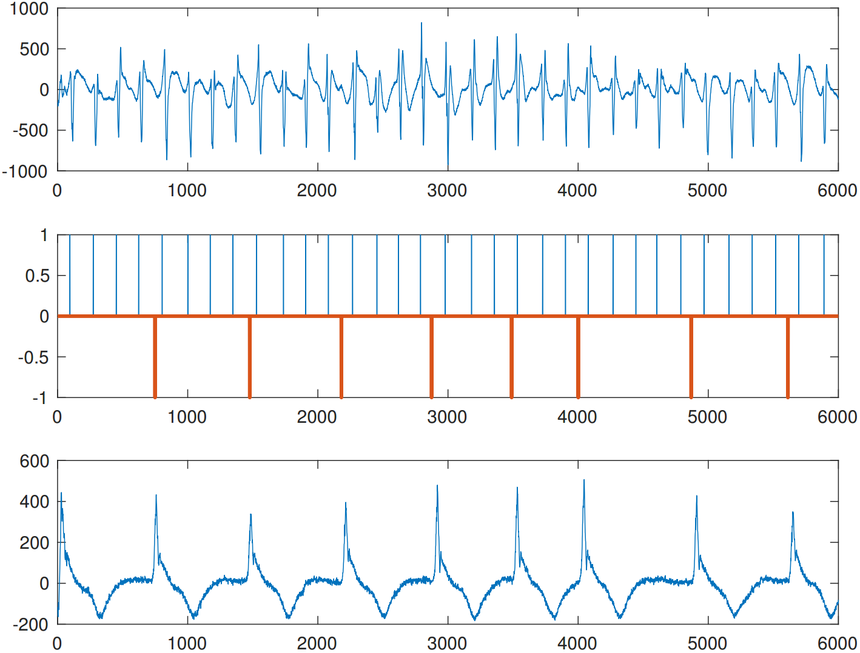
Monitoring Heart
Analog signal from Atrium
Discrete timed events capturing peaks
Discrete timed Ventricular events
Analog signal from Ventricles
Notes:
Implemenations are plenty... choose one that has typical features

Slide 28
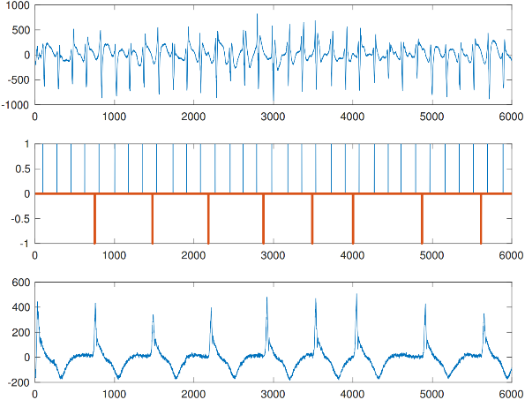
Detecting Tachycardia
Ventricular Fibrillation (VFib)
Delay between successive ventricular events too short
Atrial Fibrillation (AFib)
Delay between successive atrial events too short
Ventricular Tachycardia (VT): Fatal!
Sustained VFib events triggered by VFib events
Supraventricular Tachycardia (SVT)
Not fatal, and ideally pacemaker should not shock heart in this case
Notes:
Implemenations are plenty... choose one that has typical features

Slide 29
14 ventricular intervals
Begin Duration
End Duration
1
2
3
4
5
6
7
8
9
10
11
12
13
14
Duration: 5 seconds
(C1) 3 consecutive short intervals
(C3) sustained V-rate: for all windows of 10 consecutive V-intervals, 6 intervals are short
(C2) 8 out of 10 intervals are short
(C4) V-rate stability: low variance of interval lengths
(C7) sudden onset: the heart rhythm accelerates suddenly
(C5) V/A rate: average(V-rate) exceeds average(A-rate) by 10bpm
VT (Deliver Shock) =
C1 and C2 and
C3 and
C4 or C5 or ( not C6 ) or C7
(C6) AFib: for all windows of 10 consecutive A-intervals, 4 intervals are very short

Slide 30
Design Space Exploration with StreamQRE
Goal: How to compare alternative detection policies at design time?
Create StreamQRE expressions for each alternative
Different alternatives correspond to different parameter settings
Estimate per-item processing cost for each alternative
By structural induction on query
Need estimates of costs of basic operations (such as sum)
Estimate accuracy for each alternative on a database of labeled signals
Sensitivity: Fraction of correctly detected VTs
Specificity: Fraction of correctly detected SVTs
Notes:
Implemenations are plenty... choose one that has typical features

Slide 31
Design Space Exploration with StreamQRE
Algorithm | Description | Sensitivity | Specificity | Energy Estimation
Baseline | all discriminators as described | 100% | 92.5% | #3
NoSO | Without “sudden onset” discriminator | 100% | 93.13% | #2
Duration-1s | Duration period set to 1 second instead of 5 | 100% | 88.54% | #1
What good are StreamQRE-expression-level energy estimates?
Validation: Identical ranking of resulting implementations using jRAPL simulator for estimating energy consumption
Bottomline: Convenient rapid prototyping tool for comparing policies
Notes:
Implemenations are plenty... choose one that has typical features

Slide 32
Talk Roadmap
Motivation
Quantitative Regular Expressions (QRE)
StreamQRE: Implementation and Evaluation
Specifying Arrhythmia Detection
Interfaces for Distributed Stream Processing Systems [Ongoing]
A formal foundation for specification and verification
Notes:
Follow the wall and obstacle avoidance can be sequentially implemented

Slide 33
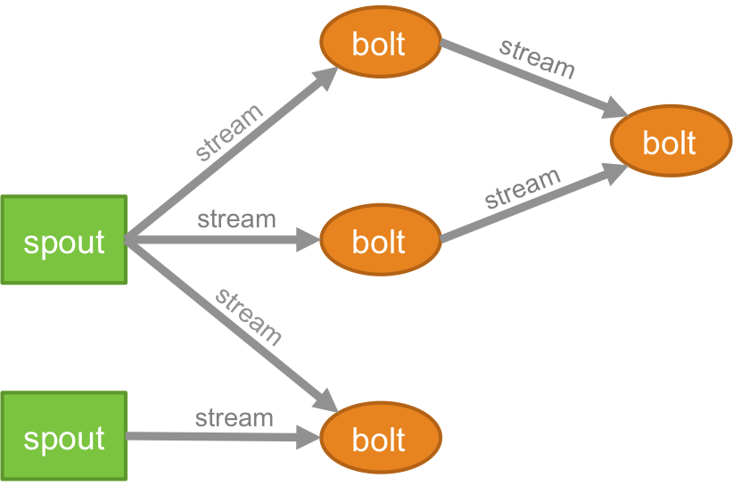
Distributed Stream Processing
Dataflow graph
Gives high performance, scalability, fault tolerance, but …
No mathematical model of behavior
No formal guarantees of correctness
Nondeterminism ➔ unpredictability

Slide 34
What’s the Spec of a Stream Processing System ?
Input data
Output data
System
What is the interface ?
Type of input
Type of output
Type of transformation performed by the system
A first step towards model-based design and analysis
Notes:
Implemenations are plenty... choose one that has typical features

Slide 35
Interface: A First Proposal
f : A* ➔ B*
Input: Sequence of items of type A
Output: Sequence of items of type B
Requirement: f should be a monotonic function
f( a₁, a₂, … a_{n} ) = All outputs produced on first n inputs cumulatively
A computation step in the streaming implementation of f
Process the next input item producing zero or more output items
Notes:
Implemenations are plenty... choose one that has typical features

Slide 36
Interface: A Second Proposal
Sequence of items of type A
Sequence of items of type C
f: A* x B* ➔ C* x D*
Sequence of items of type B
Sequence of items of type D
Allows multiple input and output channels
No ordering among items arriving on distinct channels
Deterministic as in Kahn process networks
Notes:
Implemenations are plenty... choose one that has typical features

Slide 37
Processing Relational Input ?
14
8
43
10
6
65
16
Desired spec:
Upon every , output sum of input items processed since last
Ideal type of input stream:
Items between successive are logically unordered
Input = Relation + Synchronization markers
Common in streaming database systems
CQL : Extension of SQL for streaming
Notes:
Implemenations are plenty... choose one that has typical features

Slide 38
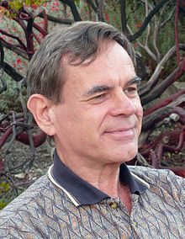
Input as a Pomset (Partially ordered multiset)
14
10
8
6
43
Pomsets generalize both sequences and relations
Pratt [1986] for modeling “true” concurrency
Notes:
Implemenations are plenty... choose one that has typical features

Slide 39
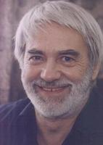
Data Trace
Pomset formalization suitable for inputs of stream processing systems
Tag alphabet Σ
Data item: ( σ, a ), where σ is a tag and a is an associated data value
Data string: Finite sequence of data items
Dependence relation D: Symmetric binary relation over Σ
Two data strings are equivalent if one can be obtained from the other
by repeatedly commuting adjacent data items with independent tags
Data trace : Equivalence class of data strings
Historical roots: Mazurkiewicz traces
Notes:
Implemenations are plenty... choose one that has typical features

Slide 40
Data Trace Examples
Σ = { , }
D = { ( , ), ( , ) }
Data trace is isomorphic to * x *
14
Σ = { , }
D = { ( , ), ( , ), ( , ) }
Data trace isomorphic to ( . Bag( ))*
10
8
6
43
Notes:
Implemenations are plenty... choose one that has typical features

Slide 41
Data Trace Transduction
Input data trace
Output data trace
System α
Formal model for specifying stream processing systems
Input type: Tags, associated data types, dependence relation
Output type: Tags, associated data types, dependence relation
Transduction α: Function from input data traces to output data traces
Given an input data trace u (items processed so far), α(u) gives outputs produced cumulatively so far
α must be monotonic: u < v implies α(u) < α(v)
< is prefix relation over data traces
Notes:
Implemenations are plenty... choose one that has typical features

Slide 42
Example Specification
14
2
22
2
8
15
43
35
43
20
Input: Modeled using 3 tags
indicates end-of-day (synchronization marker)
Data items from two customers (unordered during the day)
At the end of day, output sum of daily transactions for each customer
Output has data items with two tags, one per customer
Notes:
Implemenations are plenty... choose one that has typical features

Slide 43
Operations on Data Trace Transductions
Sequential Composition
α
β
Parallel Composition
α
β
Sufficient to construct a rich variety of common idioms:
Sliding windows, Key-based partitioning, Map reduce
Notes:
Implemenations are plenty... choose one that has typical features

Slide 44
Ongoing Work
A type discipline to ensure consistency of sequential data processing
Type refinement for data traces
When does a distributed system implement a data trace transduction?
Declarative query language to specify data trace transductions
Programming system built on top of Apache Spark
Notes:
Implemenations are plenty... choose one that has typical features

Slide 45
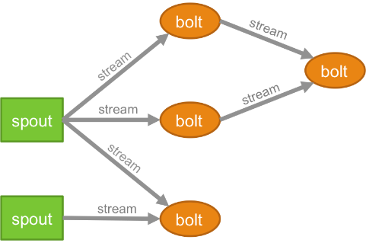
Real-time Decision Making
Talk summary
QRE: Query language over sequential data streams
StreamQRE: Java library for modular programming
Arrhythmia detection: Design space exploration
Data traces: Interfaces for specifying distributed computations
Rich opportunities for FM/PL research
Modular system design
Guarantees of correctness and performance
End-user programming
Notes:
Implemenations are plenty... choose one that has typical features

Slide 46
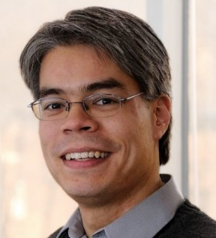
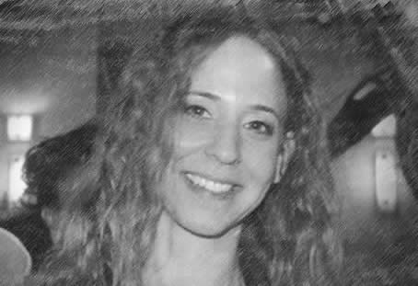
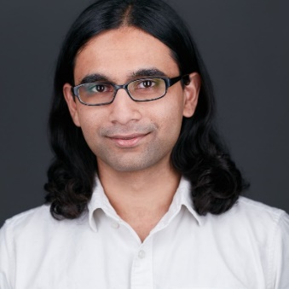
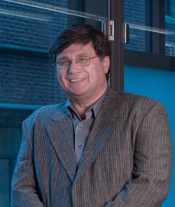
Thanks to Collaborators
Houssam Abbas
Dana Fisman
Zack Ives
Sanjeev Khanna
Rahul Mangharam
Boon Thau Loo
Kostas Mamouras
Mukund Raghothaman
Alena Rodionova
Caleb Stanford
Val Tannen
Yifei Yuan
Notes:
Implemenations are plenty... choose one that has typical features

