Slide 1
Rigorous Data Dredging Theory and Tools for Adaptive Data Analysis.
Aaron Roth
Moritz Hardt

Slide 2
From: Trustworthy-broker@trustme.com
To: aaroth@cis.upenn.edu
Date: 2/27/15
Subject: Gr8 investment tip!!!
Hi! You don’t know me, but here is a tip!
Go long on SHAK – it will go up today.

Slide 3
From: Trustworthy-broker@trustme.com
To: aaroth@cis.upenn.edu
Date: 2/28/15
Subject: Gr8 investment tip!!!
Hi again! Go short today. SHAK is going down.

Slide 4
From: Trustworthy-broker@trustme.com
To: aaroth@cis.upenn.edu
Date: 3/1/15
Subject: Gr8 investment tip!!!
Down again.

Slide 5
From: Trustworthy-broker@trustme.com
To: aaroth@cis.upenn.edu
Date: 3/2/15
Subject: Gr8 investment tip!!!
Up!

Slide 6
From: Trustworthy-broker@trustme.com
To: aaroth@cis.upenn.edu
Date: 3/3/15
Subject: Gr8 investment tip!!!
Down.

Slide 7
From: Trustworthy-broker@trustme.com
To: aaroth@cis.upenn.edu
Date: 3/4/15
Subject: Gr8 investment tip!!!
Up!

Slide 8
From: Trustworthy-broker@trustme.com
To: aaroth@cis.upenn.edu
Date: 3/5/15
Subject: Gr8 investment tip!!!
Up!

Slide 9
From: Trustworthy-broker@trustme.com
To: aaroth@cis.upenn.edu
Date: 3/6/15
Subject: Gr8 investment tip!!!
Up!

Slide 10
From: Trustworthy-broker@trustme.com
To: aaroth@cis.upenn.edu
Date: 3/7/15
Subject: Gr8 investment tip!!!
Down.

Slide 11
From: Trustworthy-broker@trustme.com
To: aaroth@cis.upenn.edu
Date: 3/8/15
Subject: Gr8 investment tip!!!
Down.

Slide 12
From: Trustworthy-broker@trustme.com
To: aaroth@cis.upenn.edu
Date: 3/8/15
Subject: Gr8 investment opportunity!!!
Hi there. I’m tired of giving out this great advice for free. Let me manage your money, and I’ll continue giving you my stock prediction tips in exchange for a small cut!
BANK ACCOUNT NUMBER PLS!!

Slide 13
Hmm…
The chance he was right 10 times in a row if he was just randomly guessing is only $\frac{1}{2^{10}}≈0.0009$.
$p<0.05.$ I can reject the null hypothesis that these predictions were luck.

Slide 14
What happened
100,000

Slide 15
What happened
50,000

Slide 16
What happened
25,000

Slide 17
After 10 days…
There remain $≈100$ people who have received perfect predictions.
The individual recipient’s error was his failure to take into account the size of the email pool.

Slide 18
Unreliable results: a crisis in data science?

Slide 19
Unreliable results: a crisis in data science?
Trouble at the Lab – The Economist

Slide 20
Most published research findings
are probably false.
– John Ioannidis
[…] three-quarters of published scientific papers in the field of machine learning are bunk because of ‘overfitting’ says Sandy Pentland
– The Economist
Irreproducible biology research costs put at $28 billion per year
– Nature News (2015)
Notes:
“If you want to believe them, then you shouldn’t believe them.”
Amgen: Of 53 landmark studies in cancer research, 6 reproduced
Bayer: Of 67 studies, 14 reproduced
28bln = 4 X NSF budget

Slide 21
Preventing overfitting
Decades old subject
Lots of tools:
holdout method, cross-validation, bootstrap
Designed for static data analysis

Slide 22
Static data analysis
Method
Data
Outcome
Can’t revise method and reuse data

Slide 23
Static vs Adaptive
Method
Method
Data
Data
Outcome
Outcome

Slide 24
Holdout method in theory
training
data
unrestricted
access
data
holdout
data
one shot
Non-reusable: Don’t use holdout in training stage!

Slide 25
Holdout method in practice
training
data
unrestricted
access
data
holdout
data
used adaptively
many times
Competitions, benchmarks, model tweaking in industry,
hyperparameter search, main experimental paradigm in ML
Notes:
Leon Bottou (ICML 2015): Main experimental paradigm; reaching its limits.

Slide 26
What about an Extra Test Set?
If you use it once, it’s expensive
If you use it repeatedly adaptively,
same issues as before
In science, benchmarks are fixed
(no extra data for MNIST, CIFAR, ImageNet)

Slide 27
Adaptivity is known by many names (not all flattering)
Data dredging, Data snooping, fishing, p-hacking, post-hoc analysis, “Garden of the Forking Paths”
Some caution strongly against it:
“Pre-registration” – specify all statistical hypotheses exactly ahead of time, before data are gathered.
(Humphreys, Sanchez, Windt 2013, Monogan 2013)

Slide 28
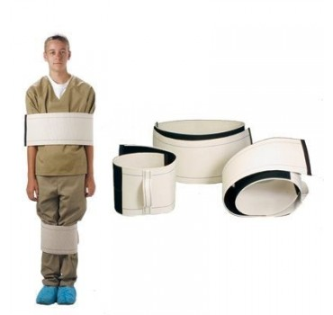
But…
We would also like to be informed by the data!
The most valuable statistical analyses often arise only after an iterative process involving the data – (Gelman, Loken 2013)
Medshop.com “HUMANE CONSTRAINT HUMANE WRAP”

Slide 29
What do we want to protect against?
Over-fitting from fixed algorithmic procedures (easiest – might hope to analyze exactly)
e.g. variable/parameter selection followed by model fitting
From: “Evaluating Machine Learning Models”. Alice Zheng, Dato.

Slide 30
What do we want to protect against?
2) “Researcher Degrees of Freedom”
Example from Gelman and Loken, “The Garden of Forking Paths”, 2013

Slide 31
What do we want to protect against?
3) Multi-researcher re-use of data sets

Slide 32
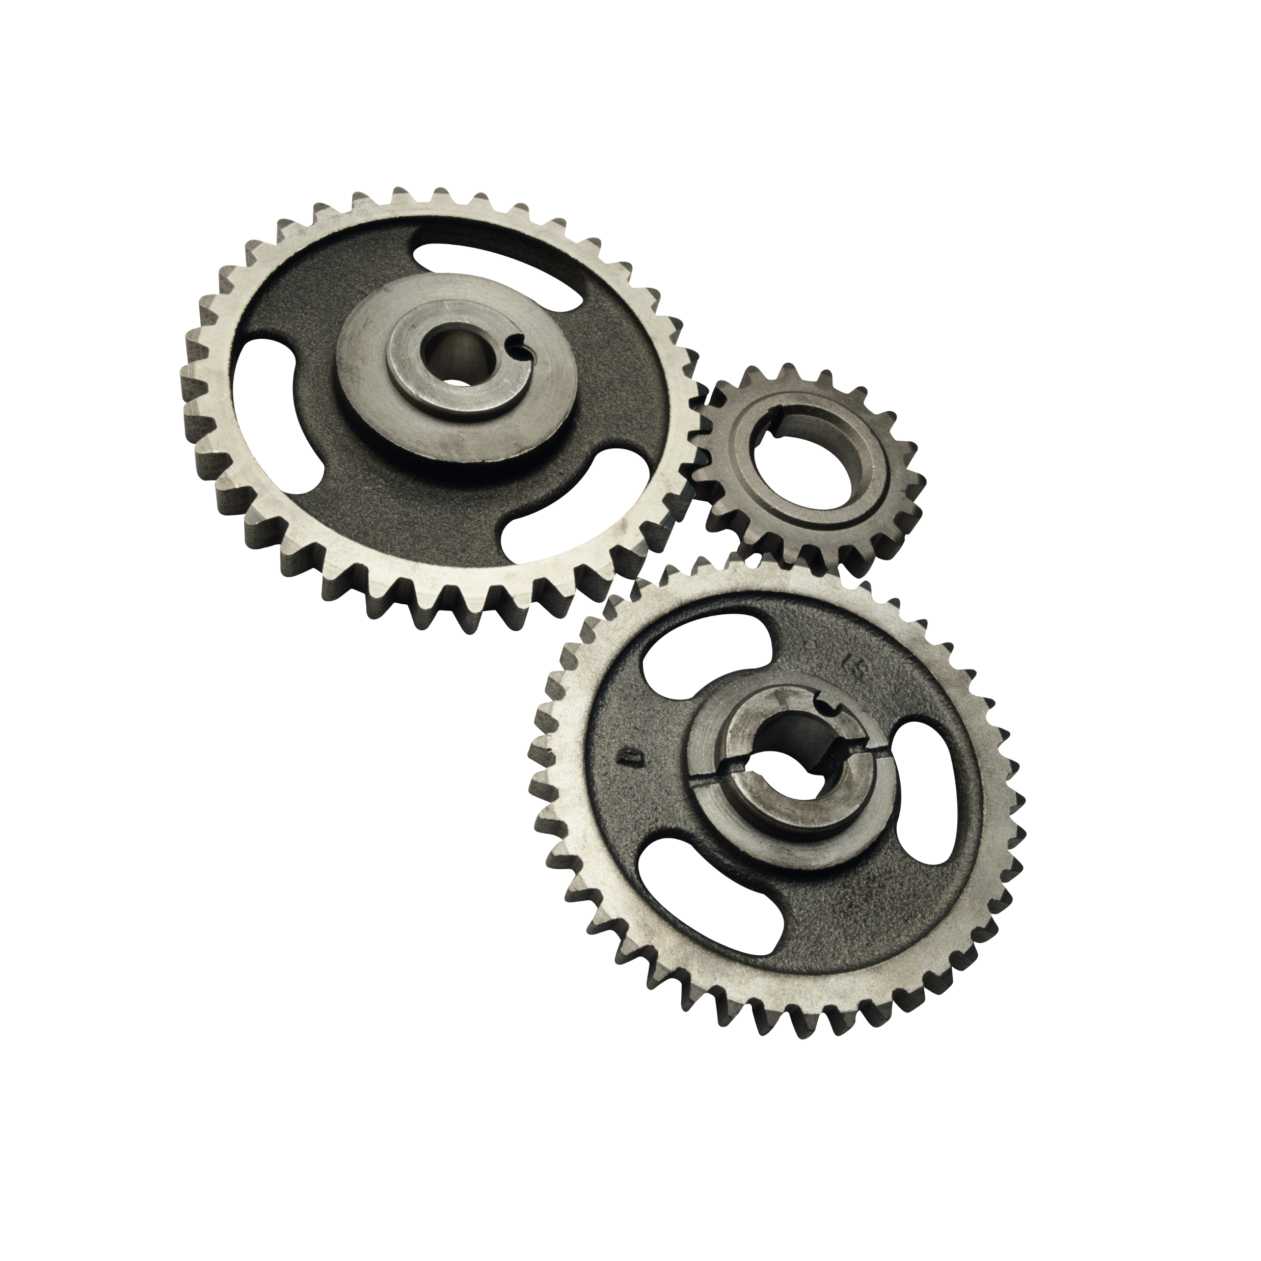
Desiderata
An information measure flexible enough to reason about many different algorithms.
Robustness to arbitrary post-processing.
Both precisely defined:
And imprecisely defined:
Graceful degradation under composition:

Slide 33
Now a growing list of such information measures
“Occam” style bit-length compressibility
Sample compression schemes
Differential Privacy
And other related information theoretic measures

Slide 34
Now a growing list of such information measures
“Occam” style bit-length compressibility
Sample compression schemes
Differential Privacy (The Rest of This Talk)
And other related information theoretic measures

Slide 35
Choosing a Formalism: Statistical Queries
A data universe $X$
A distribution $P∈ΔX$
A dataset $D⊆X$ consisting of $n$ points $x∈X$ sampled i.i.d. from $P$.
$$P$$
$$D$$

Slide 36
Choosing a Formalism: Statistical Queries
A statistical query is defined by a predicate
$φ:X→[0,1]$.
The value of a statistical query is
$$φ\left(P\right)=E_{x∼P}[φ\left(x\right)]$$
A statistical estimator is an algorithm for estimating statistical query: $A_{D}(φ)→[0,1]$

Slide 37
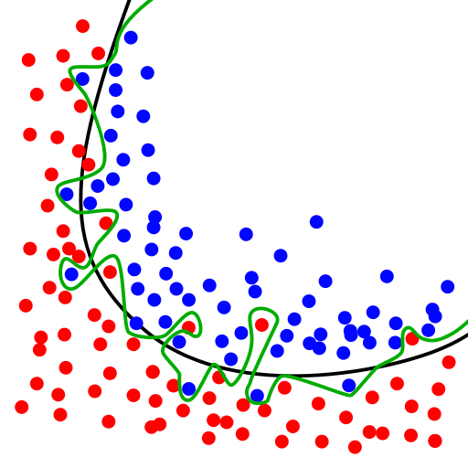
Choosing a Formalism: Statistical Queries
Loses little generality. Captures, e.g.
Means, variances, correlations, etc.
Risk of a hypothesis:
$R\left(h\right)=E_{(x,y)∼P}[L\left(h\left(x\right),y\right)]]$
Gradient of risk of a hypothesis:
$∇R\left(h\right)=E_{(x,y)∼P}[∇L\left(h\left(x\right),y\right)]]$
Almost* all of PAC learning
*Except Parity functions

Slide 38
Choosing a Formalism: Statistical Queries
$$P$$
Adaptively Chosen Queries:
$$A$$
$$φ_{1}$$
$$D$$
$$a_{1}$$

Slide 39
Choosing a Formalism: Statistical Queries
$$P$$
Adaptively Chosen Queries:
$$A$$
$$φ_{2}$$
$$D$$
$$a_{2}$$

Slide 40
Choosing a Formalism: Statistical Queries
$$P$$
Adaptively Chosen Queries:
A statistical estimator $A$ is $\left(ε,δ\right)$-accurate for sequences of $k$ adaptively chosen queries $φ_{1},…,φ_{k}$ if for all and , with probability $1−δ$:
$\max_{i}\left|A_{D}\left(φ_{i}\right)−φ_{i}\left(P\right)\right|≤ε$.
$$A$$
$$φ_{i}$$
$$φ_{k}$$
$$D$$
$$a_{k}$$
$$a_{i}$$
$$P$$

Slide 41
A Baseline
$$P$$
Non-Adaptive Queries:
The “empirical average mechanism”: $A_{D}\left(φ\right)=φ\left(D\right)≔ \frac{1}{n}\sum_{x∈D}{φ\left(x\right)}$ can answer $k$ non-adaptive queries with $(0.01,0.01)$-accuracy where:
$$k=e^{Θ(n)}$$
$$φ_{1}$$
$$A$$
$$a_{1}$$
$$D$$
$$a_{k}$$
$$φ_{k}$$

Slide 42
A Baseline
$$P$$
Non-Adaptive Queries:
The “empirical average mechanism”: $A_{D}\left(φ\right)=φ\left(D\right)≔ \frac{1}{n}\sum_{x∈D}{φ\left(x\right)}$ can answer $k$ adaptive queries with $(0.01,0.01)$-accuracy where:
$$k=O(n)$$
$$A$$
$$a_{1}$$
$$D$$
$$a_{k}$$

Slide 43
A Baseline
Overfitting with empirical means doesn’t require an adversary.
A simple “Bagging” Based Algorithm:
For $i$ from 1 to $k$:
Pick a random classifier $f_{i}:X→\{−1,1\}$.
Ask query $φ_{i}\left(x,y\right)=f_{i}\left(x\right)⋅y$.
Observe $a_{i}=\frac{1}{n}\sum_{\left(x,y\right)∈D}{φ_{i}(x,y)}$.
If $a_{i}>0$ set $s_{i}=1$ if $a_{i}>0$, $s_{i}=−1$ otherwise.
Output hypothesis $f\left(x\right)≔\text{majority}(s_{1}f_{1}\left(x\right),…,s_{k}f_{k}\left(x\right))$
Claim: With high probability, $f$ has training error
$$\frac{1}{2}−O\left(\sqrt{k/n}\right)$$

Slide 44
Is this a real concern?
Can get 1% improvement
every few hundred queries.
[Frostig-Hardt]
Bagging methods can have similar effect as
majority attack.

Slide 45
Question:
Can we do better with a different statistical estimator?

Slide 46
Differential Privacy [Dwork-McSherry-Nissim-Smith 06]
D
Bob
Xavier
Alice
Chris
Donna
Ernie
Algorithm
Pr [r]

Slide 47
A stability condition on the output distribution:
$A:X^{n}→𝒪$ is $(α,β)$-differentially private if for every pair of neighboring datasets $D,D′$, and outcome $S$:
$$\operatorname{Pr}\left[A\left(D\right)∈S\right]≤e^{α}\operatorname{Pr}\left[A\left(D^{′}\right)∈S\right]+β$$
Crucial: Stability on the distribution.
No metric on $𝒪$.

Slide 48
Distributional Stability Yields Robustness to Postprocessing
An “Information Processing” inequality:
Theorem: If $A:X^{n}→𝒪$ is $(α,β)$-differentially private, and $f:𝒪→𝒪^{′}$ is an arbitrary algorithm, then $f∘A :X^{n}→𝒪^{′}$ is $(α,β)$-differentially private.
Important:
Don’t need to understand anything about $f.$
$$f= f=$$

Slide 49
Distributional Stability Degrades Gracefully Under Composition
Compose( ;D)
For $i$ = 1 to $k$:
Let choose an $α$-DP $A_{i}$ based on $o_{1},…,o_{i−1}$.
Let $o_{i}=A_{i}(D)$
Output ($o_{1},…,o_{n}$).
Theorem*: For every , and $β^{′}$, Compose( ;D) is $\left(α^{′},β^{′}\right)$-differentially private for:
$α^{′}$=$O\left(α⋅\sqrt{k⋅\ln\left(\frac{1}{β^{′}}\right)}\right)$

Slide 50
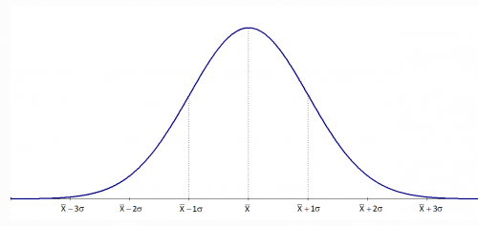
Composition and Post-processing: Modular Algorithm Design
Differential Privacy is a powerful language for stable algorithm design.
Can combine a collection of differentially private primitives modularly in arbitrary ways.
Simplest primitive: independent, Gaussian noise addition.
e.g. Output $\hat{φ}\left(D\right)≔φ\left(D\right)+N\left(0,σ^{2}\right)$
where $σ=O\left(\frac{\sqrt{ln⁡(\frac{1}{β})}}{αn}\right)$

Slide 51
A simple, private method for answering statistical queries
For $i$ = 1 to $k$:
Let choose a SQ $φ_{i}$ based on $a_{1},…,a_{i−1 }$
Output $a_{i}=φ_{i}(D)+N(0,σ^{2})$
for $σ=O\left(\frac{\sqrt{k⋅ln⁡(\frac{1}{β})}}{αn}\right)$
This is $(ε,δ)$-accurate with respect to the sample for:
$$ε=O\left(\frac{\sqrt{k⋅\log{(k)}⋅\ln\left(\frac{1}{β}\right)⋅\ln\left(\frac{1}{δ}\right)}}{αn}\right)$$

Slide 52
Who Cares About Accuracy on the Sample?
A “Transfer-Theorem”: If an algorithm is both differentially private, and accurate in sample, it is also accurate out of sample.
$$φ_{i}$$
$$P$$
$$a_{i}$$
$$P$$
$$A$$
$$φ_{i}$$
$$D$$
$$a_{i}$$

Slide 53
Who Cares About Accuracy on the Sample?
Theorem: [DFHPRR’15,BNSSSU’16]:
Let $A$ be a statistical estimator for adaptively chosen statistical queries. Let $P$ be any distribution, and let $D∼P^{n}$. If:
$A$ is $\left(ε,ε⋅δ\right)$-differentially private, and
$A$ is $(ε, ε⋅δ)$-accurate with respect to the sample $D$, then:
$A$ is ($O(ε), O(δ))$-accurate with respect to the distribution $P$.

Slide 54
Lets Prove It!
Following the Proof from [BNSSSU16]
A change in Perspective.
Main Technical Statement: If $B$ is an $\left(ε,ε⋅δ\right)$-differentially private algorithm for choosing a statistical query given a dataset, then with probability $1−δ$, for $φ_{i}=B\left(D\right):$
$\left|φ_{i}\left(D\right)−φ_{i}\left(P\right)\right|≤O\left(ε\right)$
Then:
If we also have $\left|a_{i}−φ_{i}\left(D\right)\right|≤O\left(ε\right):$
$\left|a_{i}−φ_{i}\left(P\right)\right|≤O(ε)$.

Slide 55
Lets Prove It!
A change in Perspective.
But we want $B=$ !
i.e. we want to allow queries to be generated via arbitrary processes!
Post-Processing to the Rescue:
If accesses data only via differentially private $A$,
then is also differentially private.

Slide 56
Lets Prove It!
Lemma: Suppose $B:X^{n}→SQ$ is $(α,β)$-differentially private and $D∼P^{n}$. Then:
$$\left|𝔼\left[φ\left(P\right) | φ=B\left(D\right)\right]− 𝔼\left[φ\left(D\right) | φ=B\left(D\right)\right]\right|≤e^{α}−1+β$$
Proof:
Write $D=(x_{1},…,x_{n})$
Let $x^{′}∼P$. For each $i$, let $D^{i}=(x_{1},…,x_{i−1},x^{′},x_{i+1},…x_{n})$
Note: $(D, x^{′})$ and $(D^{i},x_{i})$ are identically distributed.
$$≤2α+β$$

Slide 57
Lets Prove It!
$$𝔼\left[φ\left(D\right)\right|φ=B(D)]$$
$$=\frac{1}{n}\sum_{i=1}^{n}{𝔼\left[φ\left(x_{i}\right)\right|φ=B(D)]}$$
$$≤\frac{1}{n}\sum_{i=1}^{n}{e^{α}𝔼\left[φ\left(x_{i}\right) | φ=B\left(D^{i}\right)\right]+β}$$
$$=\frac{1}{n}\sum_{i=1}^{n}{e^{α}𝔼\left[φ\left(x^{′}\right) | φ=B\left(D\right)\right]+β}$$
$$=e^{α}𝔼[φ\left(P\right)|φ=B\left(D\right)]+β$$
$\left(α,β\right)$-DP
$$\left(D^{i},x_{i}\right),\left(D,x^{′}\right)$$
i.d.

Slide 58
Lets Prove It!
A Technical Generalization:
Lemma: Suppose $B:{\left(X^{n}\right)}^{T}→\left[T\right]×SQ$ is $(α,β)$-differentially private and $D=(D^{1},…,D^{T})∼{\left(P^{n}\right)}^{T}$. Then:
$$\left|𝔼\left[φ\left(P\right) | i,φ=B\left(D\right)\right]− 𝔼\left[φ\left(D^{i}\right) | i,φ=B\left(D\right)\right]\right|≤e^{α}−1+βT$$
$$≤2α+βT$$

Slide 59
Lets Prove It!
Input: $D∼P^{n}$
Given: 1) $A$ $\left(ε,εδ\right)$-private and $(ε,εδ)$-accurate. 2)
For $i$ = 1 to $k$:
Let choose a SQ $φ_{i}$ based on $a_{1},…,a_{i−1 }$
Output $a_{i}=A(φ;D)$
So:

Slide 60
Lets Prove It!
Thought Experiment
Input: $D^{1},…,D^{T}∼{\left(P^{n}\right)}^{T}$
Given: 1) $A$ $\left(ε,εδ\right)$-private and $(ε,εδ)$-accurate. 2)
Make $T$ independent copies: $A_{1},…A_{T}$, $…$,
For t = 1 to T:
For $i$ = 1 to $k$:
Let choose a SQ $φ_{i}^{t}$ based on $a_{1}^{t},…,a_{i−1 }^{t}$
Output $a_{i}^{t}=A_{t}(φ_{i}^{t};D^{t})$
Let ($i^{∗},t^{∗})=\arg{\max_{i,t}{|a_{i}^{t}−φ_{i}^{t}\left(P\right)|}}$. Output $(t^{∗},φ_{i^{∗}}^{t^{∗}})$.
$$1$$
$$T$$
$$t$$
Observation: This algorithm is also $\left(ε,εδ\right)$-differentially private.
Proof: Post-processing.

Slide 61
Lets Prove It!
Thought Experiment
Input: $D^{1},…,D^{T}∼{\left(P^{n}\right)}^{T}$
Given: 1) $A$ $\left(ε,εδ\right)$-private and $(ε,εδ)$-accurate. 2)
Make $T$ independent copies: $A_{1},…A_{T}$, $…$,
For t = 1 to T:
For $i$ = 1 to $k$:
Let choose a SQ $φ_{i}^{t}$ based on $a_{1}^{t},…,a_{i−1 }^{t}$
Output $a_{i}^{t}=A_{t}(φ_{i}^{t};D^{t})$
Let ($i^{∗},t^{∗})=\arg{\max_{i,t}{|a_{i}^{t}−φ_{i}^{t}\left(P\right)|}}$. Output $(t^{∗},φ_{i^{∗}}^{t^{∗}})$.
$$1$$
$$T$$
$$t$$
Hence: $𝔼\left[\left|φ_{i^{∗}}^{t^{∗}}\left(D^{t^{∗}}\right)−φ_{i^{∗}}^{t^{∗}}\left(P\right)\right|\right]≤2ε+εδT$.
Thus: $𝔼\left[\max_{i,t}\left|a_{i}^{t}−φ_{i}^{t}\left(P\right)\right|\right]≤3ε+2εδT$

Slide 62
Lets Prove It!
Thought Experiment
Input: $D^{1},…,D^{T}∼{\left(P^{n}\right)}^{T}$
Given: 1) $A$ $\left(ε,εδ\right)$-private and $(ε,εδ)$-accurate. 2)
Make $T$ independent copies: $A_{1},…A_{T}$, $…$,
For t = 1 to T:
For $i$ = 1 to $k$:
Let choose a SQ $φ_{i}^{t}$ based on $a_{1}^{t},…,a_{i−1 }^{t}$
Output $a_{i}^{t}=A_{t}(φ_{i}^{t};D^{t})$
Let ($i^{∗},t^{∗})=\arg{\max_{i,t}{|a_{i}^{t}−φ_{i}^{t}\left(P\right)|}}$. Output $(t^{∗},φ_{i^{∗}}^{t^{∗}})$.
$$1$$
$$T$$
$$t$$
Thus: $𝔼\left[\max_{i,t}\left|a_{i}^{t}−φ_{i}^{t}\left(P\right)\right|\right]≤3ε+2εδT$
But note -- $\max_{i}{|a_{i}^{t}−φ_{i}^{t}\left(P\right)|}$ are independent across $t$.

Slide 63
Lets Prove It!
Choose $T=1/δ$.
$$𝔼\left[\max_{i,t}\left|a_{i}^{t}−φ_{i}^{t}\left(P\right)\right|\right]≤3ε+2εδT≤5ε$$
Suppose $A$ is not ($10ε,δ)$-accurate. Then:
$$\operatorname{Pr}\left[\max_{i,t}\left|a_{i}^{t}−φ_{i}^{t}\left(P\right)\right|≥10ε\right]≥1 −{\left(1−δ\right)}^{T}≥1−\frac{1}{e}$$
Contradiction!

Slide 64
Applications
Using Independent Gaussian Perturbation
Theorem: There exists a simple, computationally efficient statistical estimator that can answer $k$ adaptive queries with $(0.01,0.01)$-accuracy where:
$$k=\tilde{Θ}(n^{2})$$
A quadratic improvement over the empirical average mechanism!

Slide 65
Tight for Efficient Algorithms
Theorem [HU14, SU15]:
Under a standard assumption*, no computationally efficient algorithm has error $o(1)$ on $O(n^{2})$ adaptively chosen queries.

Slide 66
Applications
Using State of the Art Differentially Private Mechanisms
Theorem: There exists a statistical estimator that can answer $k$ adaptive queries with $(0.01,0.01)$-accuracy where:
$$k=e^{Θ\left(\frac{n}{\log\left|X\right|}\right)}$$
An exponential improvement if the data universe $X$ is finite and $n≫\log{|X|}$.

Slide 67
Applications
training data
unrestricted
access
Data
Reusable
holdout
can be used
many times
adaptively
valid estimate every time you use the holdout

Slide 68
Thresholdout [DFHPRR15]
thresholdout.py:
from numpy import *
def Thresholdout(sample, holdout, q, sigma, threshold):
sample_mean = mean([q(x) for x in sample])
holdout_mean = mean([q(x) for x in holdout])
if (abs(sample_mean - holdout_mean)
< random.normal(threshold, sigma)):
# q does not overfit
return sample_mean
else:
# q overfits
return holdout_mean + random.normal(0, sigma)

Slide 69
The Guarantee
Theorem*: Thresholdout guarantees $(0.01,0.01)$-accuracy, and can be run until the number of over-fitting queries asked is:
$$Θ(n^{2})$$

Slide 70
Reusable holdout example
Data set with 2n = 20,000 rows and d = 10,000 variables. Class labels in {-1,1}
Analyst performs stepwise variable selection:
Split data into training/holdout of size n
Select “best” k variables on training data
Only use variables also good on holdout
Build linear predictor out of k variables
Find best k = 10,20,30,…

Slide 71
Reusable holdout example
thresholdout.py:
from numpy import *
def Thresholdout(sample, holdout, q):
sample_mean = mean([q(x) for x in sample])
holdout_mean = mean([q(x) for x in holdout])
sigma = 1.0/sqrt(len(sample))
threshold = 3.0*sigma
if (abs(sample_mean - holdout_mean)
< random.normal(threshold, sigma)):
# q does not overfit
return sample_mean
else:
# q overfits
return holdout_mean + random.normal(0, sigma)

Slide 72
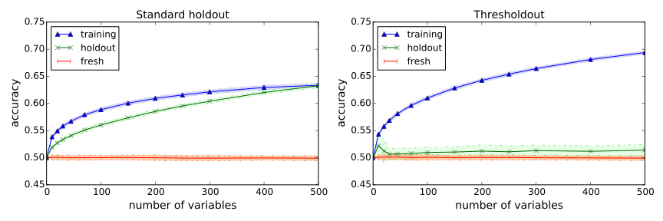
Classification after feature selection
No signal: data are random gaussians
labels are drawn independently at random from {-1,1}
Thresholdout correctly detects overfitting!

Slide 73
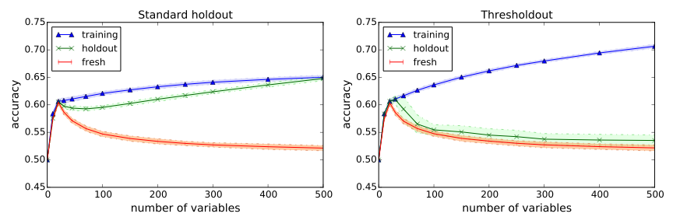
Classification after feature selection
Strong signal: 20 features are mildly correlated with target
remaining attributes are uncorrelated
Thresholdout correctly detects right model size!

Slide 74
Further Generalizations
Beyond Statistical Queries:
The same theorem holds for arbitrary low sensitivity queries. [BNSSSU16]
Beyond Numeric Valued Queries:
The same theorem holds for adaptively chosen empirical risk minimization problems [BNSSSU16]
Beyond Low Sensitivity Queries:
Differential privacy guarantees that arbitrary events that are unlikely on a freshly sampled dataset remain unlikely on your dataset [DFHPRR15b]
E.g. similar guarantees for adaptively chosen hypothesis tests, with statistically valid p-values [RRST16]

Slide 75
Parting Thoughts
The Role of Theory in Adaptive Data Analysis
Helps us understand the risks and benefits of adaptivity.
In addition to theorems and algorithms, yields rules of thumb.
“Carefully husband information derived from the holdout set”
The Threshold Principle: “Only use results derived from the holdout set when the difference between the training set is large”
The Ladder Principle [BH15]: “Only switch models when the new one improves significantly over the last one.”

Slide 76
Thanks!

Slide 77
Adaptive Data Analysis Bibliography
Differential Privacy and Low Sensitivity Statistics:
[DFHPRR15] Dwork, Feldman, Hardt, Pitassi, Reingold, Roth, “Preserving Statistical Validity in Adaptive Data Analysis”, STOC 2015.
[BNSSSU16] Bassily, Nissim, Stemmer, Smith, Steinke, Ullman, “Algorithmic Stability for Adaptive Data Analysis”, STOC 2016.
Occam Bounds and Differential Privacy Control Arbitrary Dependencies:
[DFHPRR15b] Dwork, Feldman, Hardt, Pitassi, Reingold, Roth, “Generalization in Adaptive Data Analysis and Holdout Reuse”, NIPS 2015.
[RRST16] Rogers, Roth, Smith, Thakkar, “Max Information, Differential Privacy, and Post-Selection Hypothesis Testing”, FOCS 2016.
Holdout Reuse:
[DFHPRR15c] Dwork, Feldman, Hardt, Pitassi, Reingold, Roth, “The Reusable Holdout: Preserving Validity in Adaptive Data Analysis”, Science, August 7 2015.
[BH15] Blum, Hardt, “The Ladder: A Reliable Leaderboard for Machine Learning Competitions”, ICML 2015.

Slide 78
Adaptive Data Analysis Bibliography
Sample Compression Schemes and Adaptive Learning:
[CLNRW16] Cummings, Ligett, Nissim, Roth, Wu, “Adaptive Learning with Robust Generalization Guarantees”, COLT 2016.
Mutual Information and Adaptive Data Analysis:
[Ala15] Alabdulmohsin, “Algorithmic Stability and Uniform Generalization”, NIPS 2015.
[RZ16] Russo, Zou, “Controlling Bias in Adaptive Data Analysis Using Information Theory”, AISTATS 2016.
Computational and Statistical Lower Bounds:
[HU14] Hardt, Ullman, “Preventing False Discovery in Interactive Data Analysis is Hard”, FOCS 2014.
[SU15] Steinke, Ullman, “Interactive Fingerprinting Codes and the Hardness of Preventing False Discovery”, COLT 2015.
[WLF16] Wang, Lei, Feinberg, “A Minimax Theory for Adaptive Data Analysis”, 2016.

Slide 79
Adaptive Data Analysis Bibliography
Bayesian Approaches
[Eld16] Elder, “Challenges in Bayesian Adaptive Data Analysis”, 2016.
Privacy Composition Theorems for Adaptive Data Analysis
[RRUV16] Rogers, Roth, Ullman, Vadhan, “Privacy Odometers and Filters: Pay as you Go Composition”, 2016.
Large Statistical Literature on Post Selection Inference (Tiny Sample)
[BBBZZ13] Berk, Brown, Buja, Zhang, Zhao, “Valid Post Selection Inference”, Annals of Statistics, 2013.
[Efr14] Efron, “Estimation and Accuracy After Model Selection”, JASA 2014.
[FST14] Fithian, Sun, Taylor, “Optimal Inference After Model Selection”, 2014.
[TT15] Tian, Taylor, “Selective Inference with a Randomized Response”, 2015.
[BC16] Barber, Candes, “A Knockoff Filter for High Dimensional Selective Inference”, 2016.

